Slide 1
Phil 318
Theory of Applied and Professional Ethics
Roles 1: The Legal Example

Slide 2
The standard conception of the lawyer’s role
I. What is it about lawyers?
II. The standard conception of the lawyer’s role
    1. The principle of partisanship
    2. The principle of neutrality
    3. The principle of non-accountability
    4. Summary of the standard conception
III. The Idea of Role Differentiated Obligation
Notes:
88

Slide 3
What is it about lawyers?
Standing before a headstone inscribed 'Here lies a Lawyer and an Honest Man', a man turns to his companion and says 'Look, they've buried them two to a plot'.

Slide 4
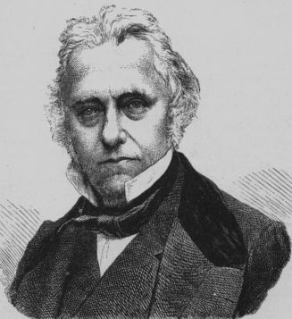
How ‘it be right that a man should, with a wig on his head and a band around his neck, do for a guinea what, without these appendages, he would think it wicked and infamous to do for an empire?’
Thomas Babbington Macaulay
'Essay on Bacon'
Notes:
80

Slide 5
Zabellav Pakel 242 F2d 452 (7th Cir. 1957)
Joseph Zabella worked for John Pakel. Zabella was better off off than his employer and from time to time loaned him money. Eventually Pakel owed Zabella $5,000.00.
The two drafted and signed a simple contract, but Pakel declared declared bankruptcy before the debt was repaid.
Some time later Zabella sued, claiming that, subsequent to the bankruptcy, Pakel had made a new promise to repay the debt. The new promise would have blocked the bankruptcy defence, but because it was not in writing Pakel was able to plead a statute of limitations to prevent legal enforcement.

Slide 6
Zabella v Pakel 242 F2d 452 (7th Cir. 1957)
The defence was successful, though the court was quite explicit that that the statute did not extinguish Pakel's moral obligation to repay Zabella.
The immorality of Pakel's reliance upon the statute was made all the all the more striking since by the time of the suit Pakel had become the well-paid Chief Executive Officer of the Chicago Savings and Loan Association, and could have repaid the money without hardship.
Though they felt obliged to allow the defense, the court made clear they thought Pakel was a scoundrel, who, being "in a position of position of some affluence ... should feel obliged to pay an honest debt honest debt to his old friend, employee, and countryman".

Slide 7
Slayer's 2 Lawyers Kept Secret of 2
More Killings
New York Times (June 20, 1974) Lake Pleasant, N.Y., June 19
  “Two lawyers for a man on trial here for murder did not disclose for six months that they had seen the bodies of two other people killed by their client because, they said, they were bound by the confidentiality of a lawyer-client relationship.
  The court-appointed attorneys said today that their client had told had told them where to find the bodies of two missing women. women. They photographed the bodies, they said, but did not report the discoveries to authorities searching for the murder victims.

Slide 8
Lake Pleasant bodies case
The lawyers also said they had kept their discovery from the father of one of one of the women, who had visited them in the hope that they could shed some shed some light on the disappearance of his 20 year-old daughter.
"The information was so privileged – I was bound by my lawyer's oath to keep to keep it confidential after I found the bodies," said Francis Belge, one of the of the two lawyers representing Robert Garrow. Mr. Garrow, a 38 year-old old mechanic for a Syracuse bakery, is accused of fatally stabbing Philip Philip Domblewski, and 18 year-old Schenectady student who was camping in camping in the Adirondacks last July.

Slide 9
The Triangle Shirtwaist Fire Case.
On March 25 1911, one hundred and forty six sweatshop sweatshop workers, most young immigrant women, died in died in the Triangle Shirtwaist Factory fire in New York York city.
Legislation required that factory doors “shall not be locked, locked, bolted or fastened during working hours”.
The owners were charged with manslaughter in the face of face of the “undisputed facts –locked doors forcing scores of women, clothes and hair ablaze, to leap from windows to their deaths.”

Slide 10
The Triangle Shirtwaist Fire Case
The final prosecution witness was a young woman, Kate Alterman, who had escaped the fire. She was called to testify that one of the victims,, burned beyond recognition, was indeed the Rose Schwartz named named in the indictment. Her evidence was heart rending.She told how told how she had turned, just before leaping from a window, to see Rose Schwartz “with both hands on the knob of the door desperately turning and pushing, but the door would not give.”
She saw Rose rise and fall twice, enveloped by flames as she wrestled with the door. As the flames approached Kate, she saw Rose on her knees, screaming and praying, turning the door handle back and forth, pulling and pushing the door, before falling to the floor, floor, completely engulfed by flames. Kate Alterman’s testimony had some of the jury in tears.

Slide 11
Max D. Steuer defended the owners. After thirty minutes of gentle preliminary cross-examination he asked Kate to tell him what she had seen. Kate did not merely ‘re-present’ the account of Rose Schwartz's death she had given in response to prosecutor’s question; she repeated it word repeated it word for word. Steuer shifted focus for a while and then asked Kate to describe what she had seen again.
Once more Kate repeated her story exactly – almost. Steuer noticed that she that she had missed a word. He asked her about the omission. She began repeating her story quietly, to herself, until she came to the missing word and then said, "Yes, I made a mistake. I left that word out.“ "But otherwise your story was correct?" asked Steuer.
Again Kate began to recite her story to herself and then replied, "Yes, otherwise my answer is correct". When Steuer asked the same question a question a third time, the prosecutor objected, but was overruled.

Slide 12
Again Kate began to recite her story to herself and then replied, "Yes, "Yes, otherwise my answer is correct". When Steuer asked the same question a third time, the prosecutor objected, but was overruled. Again Kate repeated her account verbatim. After twenty minutes addressing other matters, Steuer asked for the fourth time, “Will you please you please tell the jury what you saw and what you did after you first first observed any sign of the flames? "Again Kate repeated her story, but story, but this time omitted a different word. Steuer asked about this this omission and again Kate repeated her story quietly to herself until she until she reached the omission and said she had missed the word.
Steuer's cross-examination had completely destroyed Kate’s credibility. Her carefully prepared story made the jury suspicious of the entire prosecution case. The owners were acquitted.

Slide 13
Writing on the 75th anniversary of the fire, Daniel Kornstein described Steuer as a “court-room legend”, his cross-examination examination as “brilliant” and “one of the all-time” greats. In the In the face of overwhelming evidence of his client’s guilt, he writes, “Steuer had to bring to bear all of his considerable skills”. Kornstein concedes that he should have distinguished between “outright perjury and overly rehearsed, rehearsed, overly memorized, but essentially true testimony, but still he insists:
  “It may be that the wrong side prevailed in the Triangle Shirtwaist factory case; but it was not because Steuer did anything inappropriate. He did precisely what he should have done –and done –and what any good lawyer should have done”.

Slide 14
Spaulding v Zimmerman 116 NW 2d 704 (Minn 1962)
David Spaulding was a passenger in a vehicle driven by the defendant by John Zimmerman when they collided with another vehicle at an intersection.
Spaulding sued.
The three medical experts who examined Spaulding did not notice that, in addition to serious head and chest injuries, he had incurred a life-threatening aneurysm of the aorta, probably caused by the accident.
The physician retained by the defence lawyers – Dr Hannah – discovered and reported the injury and its seriousness to one of the defense lawyers shortly before the parties met to discuss settlement.

Slide 15
Spauldingv Zimmerman
Spaulding’s injuries were not discussed in detail.
The defense lawyers, knowing that Spaulding and his lawyers were unaware of the aneurysm, did not disclose this this injury or make representations concerning the scope of their client’s injuries.
At the settlement conference, Spaulding’s claim was settled for settled for $6,500.
Two years later, Spaudling’s aneurysm was detected at a medical examination given when he enlisted in the military reserves. He was rushed into vascular surgery.
At no point in the intervening two years had anyone from the from the defense team –the client, the lawyer, or Dr Hannah – attempted to warn Spaulding of the threat to his life.

Slide 16
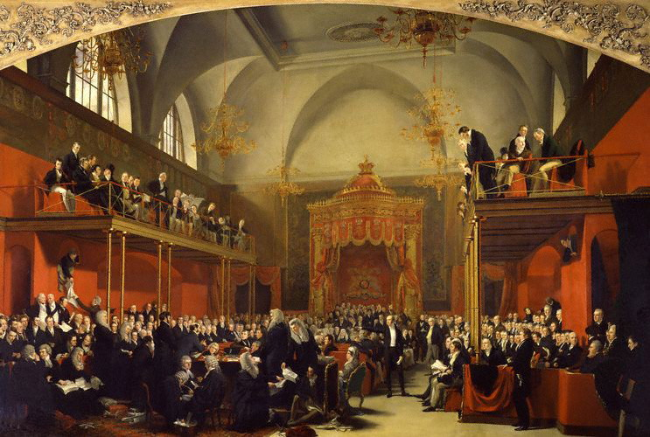
Principal of Partisanship
An advocate, in the discharge of his duty ... knows but one person in all the world, and that person is his client. To save that client by all means and expedients, and at all hazards and costs to other persons, and among them, to himself, is his first and only duty; and in performing this duty he must not regard the alarm, the torments, the destruction which he may bring others. Separating the duty of a patriot from that of an advocate, he must go on reckless of consequences, though it should be his unhappy fate to involve his country in confusion.
Lord Brougham The Trial of Queen Caroline
Notes:
86

Slide 17
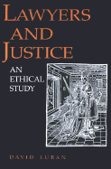
David Luban
My legal rights are everything to which I am in fact legally entitled to, not everything the law can be made to give. For obviously a good lawyer may be able to get me things to which I am not entitled.... Every lawyer knows tricks of the trade that can be used to do opponents out of their legal deserts - using delaying tactics for example, to make it too costly for an opponent without much money to prosecute a lengthy suit even though the law is on her side, or filing a nuisance claim carefully calculated to be cheaper to settle than defend.
David Luban Lawyers and Justice
Notes:
78

Slide 18
The no-holds-barred zealous advocate tries to get everything the law can give and thereby does a better job of defending the client’s legal rights than a less committed lawyer would do.
David Luban Lawyers and Justice
Notes:
84

Slide 19
Principle of neutrality
If lawyers were to substitute their own private views of what ought to be legally permissible and impermissible for those of the legislature, this would constitute a surreptitious and dangerous shift from a democracy to an oligarchy of lawyers.
Richard Wasserstrom 'Lawyers as Professionals: Some Moral Issues'
Notes:
82

Slide 20
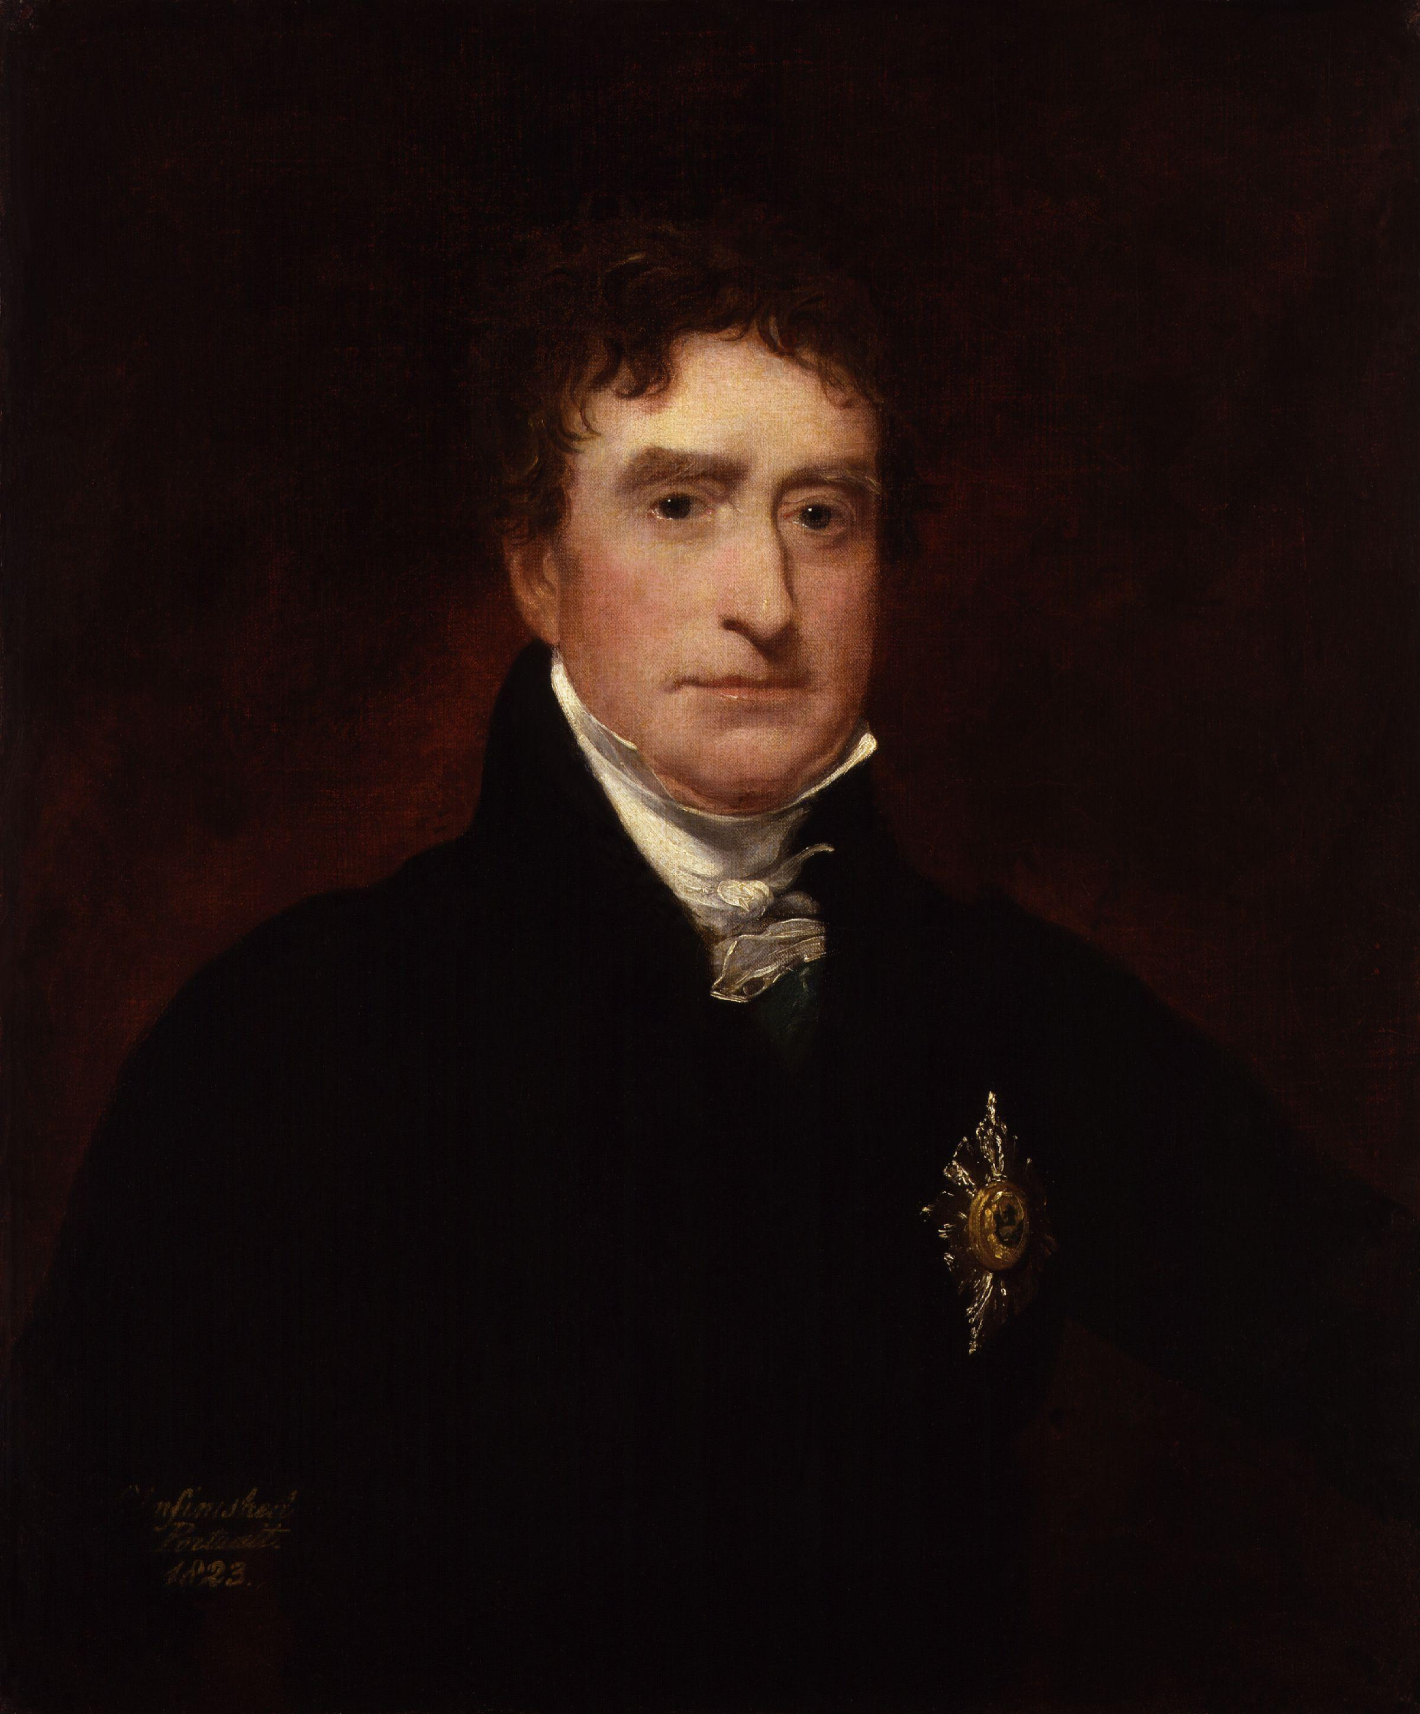
From the moment that any advocate can be permitted to say that he will or will not stand between the Crown and the subject arraigned in the court where he daily sits to practice, from that moment the liberties of England are at an end. If the advocate refuses to defend, from what he may think of the charge or the defence, he assumes the character of the judge; nay, he assumes it before the hour of judgment.
Thomas Erskine, R v Paine (1792) 22 State Trials 357,412
Notes:
63

Slide 21
The principle of nonaccountability
If counsel is bound to act for such a person, no reasonable man could think the less of any counsel because of his association with such a client, but if counsel could pick and choose, his reputation might suffer if he chose to act for such a client, and the client might have great difficulty in obtaining proper legal assistance.
Rondel v Worsley [1969] 1 AC 191, 227 (House of Lords)
Notes:
65

Slide 22
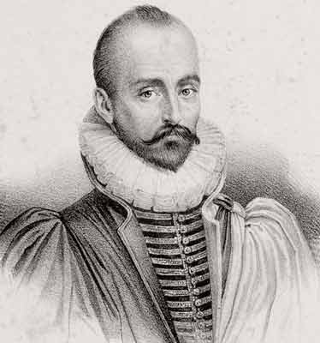
Role Differentiation
I have been able to concern myself with public affairs without moving the length of my fingernail from myself.... The Mayor [of Bordeaux] and Montaigne have always been two people, clearly separated'
Montaigne
Notes:
74

Slide 23
We are talking about the special moral code which governs a man who is acting for another. Lawyers in their practice put off more and more of our common morals the farther they go in [the] profession…
Charles P. Curtis 'The Ethics of Advocacy'
Notes:
76

Slide 24
Criticism of the standard conception
Morality and the standard conception
Roles and responsibility
Moral insensitivity
Moral insensitivity: significance outside the professional role
Moral insensitivity: Significance inside the professional role
Law's crisis of morale
Distance, Detachment, and Integrity
Notes:
67

Slide 25
The rules of discovery, initiated to enable one side to find out crucial facts from the other, are used nowadays to delay trial or to impose added expenses on the other side; conversely one might respond to an interrogatory by delivering to the discoverer tons of miscellaneous documents to run up their legal bills or to conceal a needle in a haystack. ... Similarly, rules involving conflicts of interest are now regularly used by adversaries to drive up the other side's costs by having the counsel disqualified.
David Luban Lawyers and Justice 51

Slide 26
Effective adversarial advocacy ... demands measures that are unacceptable from a moral point of view.... A firm and settled disposition to truthfulness, fairness, goodwill, and the like would thwart the lawyer’s capacity to do his tasks well. To excel as a lawyer, it would be beneficial to possess combatative character traits such as cunning.
  Andreas Esthete ‘Does a Lawyers Conscience Matter?’

Slide 27
“The lawyer's role carries no moral privileges and immunities. ... If a lawyer is permitted to puff, bluff, or threaten on certain occasions, this is not because of the [standard conception] ... but because in such circumstances, anyone would be permitted to do these things...".
  David Luban 'The Adversary System Excuse'

Slide 28
Roles and responsibility
[Role] identification is a strategy for evading one's freedom and, consequently, one's responsibility for who one is and what one does. By taking shelter in the role, the individual places the responsibility for all his acts at the door of the institutional author of the role.
  Gerald Postema ‘Moral responsibility and professional ethics’

Slide 29
Moral insensitivity outside the role
Concern for communities lawyers serve
Concern for lawyers themselves

Slide 30
Outside the role
... to become and be a professional, such as a lawyer, is to incorporate within oneself ways of behaving and ways of thinking that shape the whole person. It is especially hard, if not impossible, because of the nature of the professions, for one's professional way of thinking not to dominate one's entire adult life.
  Wasserstrom, 'Lawyers as Professionals’

Slide 31
Outside the role
[L]et me now posit this: 'dignity' has to do crucially with a butler's ability not to abandon the professional being he inhabits. Lesser butlers will abandon the professional being for the private one at the least provocation. For such persons, being a butler is like playing a pantomime role; a small push, a slight stumble, and the facade will drop off to reveal the actor underneath. The great butlers are great by virtue of their ability to inhabit their professional role and inhabit it to the utmost.... They wear their professionalism as a decent gentleman will wear his suit: he will not let ruffians or circumstances tear it off him ...."
  Kazuo Ishiguro The Remains of the Day 42-43

Slide 32
Moral insensitivity inside the role
Ways in which the standard conception may seem to reduce professional competence:
  Clients often want more than merely technical legal advice
  The jurisprudential point: positivism/natural law and all that
  The lawyer as phronemos?

Slide 33
Inside the Role
The lawyer who must detach professional judgement from his own moral judgement is deprived of the resources from which arguments regarding his client's legal rights and duties can be fashioned.
Postema, 'Moral Responsibility...' 79
Notes:
57

Slide 34
Law’s Crisis of morale
Ways in which the Standard Conception may contribute to a crisis of morale:
  by requiring them to act immorally?
  by requiring ‘moral’ schizophrenia?
  by lowering the public esteem of lawyers?
  by rendering them mere technicians, exercising no genuine wisdom

Slide 35
Distance, Detachment, and Integrity

