Slide 2
Gender roles and religion

Slide 3
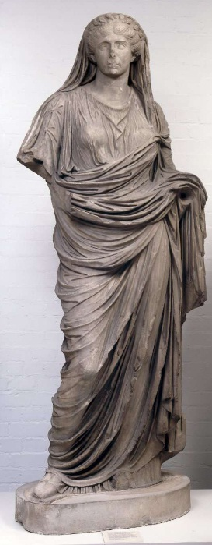
Historical perspectives
Ancient Near Eastern and Greco-Roman religions:
Priests and priestesses
Gods and goddesses
Biblical Israel
Presence of goddesses recognized (but not accepted) – texts mention Asherah (e.g. Deut. 16.21) and Queen of Heaven (see Jeremiah 7.18; 44.15-18)
No explicit mention of women priests in Hebrew Bible, but women could be prophets or sages.
Archaeological evidence of household religious cult – female involvement?

Slide 4
Religions today
Hinduism
Long tradition of female gurus, priests, and sadhu (ascetic, holy person, monk)
Goddesses in Hindu pantheon, e.g. Shakti, Durga, Lakshmi
Buddhism
Ancient tradition of ordained nuns (bhikkhunis), although this has died out (or has been forbidden) in some Theravada Buddhist countries (e.g. Burma, Thailand).
Continues to be permitted in Mahayama Buddhism (e.g. in Japan, Taiwan, China).

Slide 5
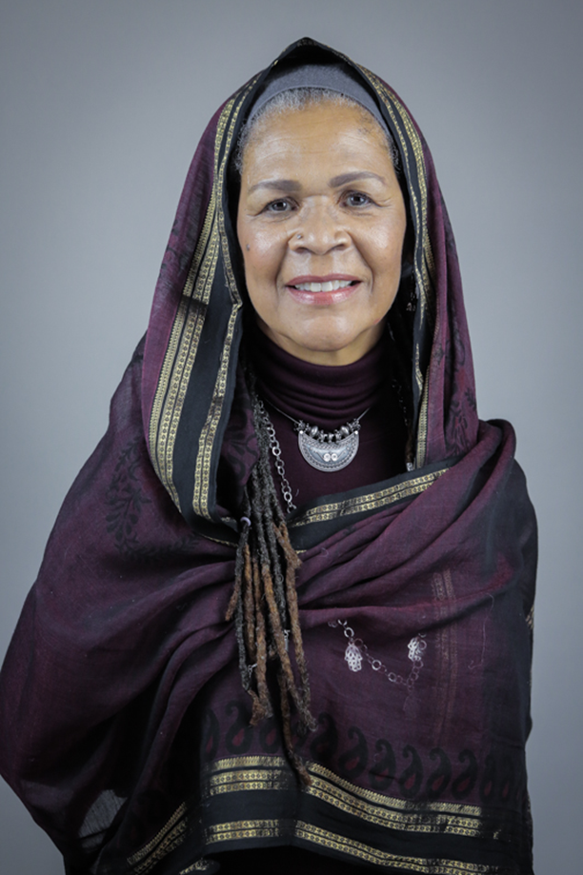
Religions today
Sikhism: women can participate in any religious function, perform any Sikh ceremony or lead the congregation in prayer.
Taoism: ordain both men and women as priests.
Shinto: both men and women can be ordained as priests.
Islam: in some Western countries, women can serve as imams (spiritual leader, authority, teacher, leads a congregation in salat, or prayer). Elsewhere, women are forbidden from serving as imams.
Judaism: Orthodox Judaism forbids female rabbis or cantors. Reform and Conservative Judaism permits them.
Amina Wadud

Slide 6
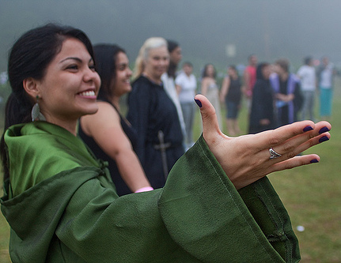
New Religious Movements
Varied relationship with cultural gender norms:
Some, but not all, NRMs imitate traditional patriarchal hierarchies.
Others deliberately subvert or ignore these hierarchies, offering women new opportunities in religious leadership/membership.
Neo-Pagan and New Age religious movements are particularly explicit in affirming women’s roles in religious life.

Slide 7
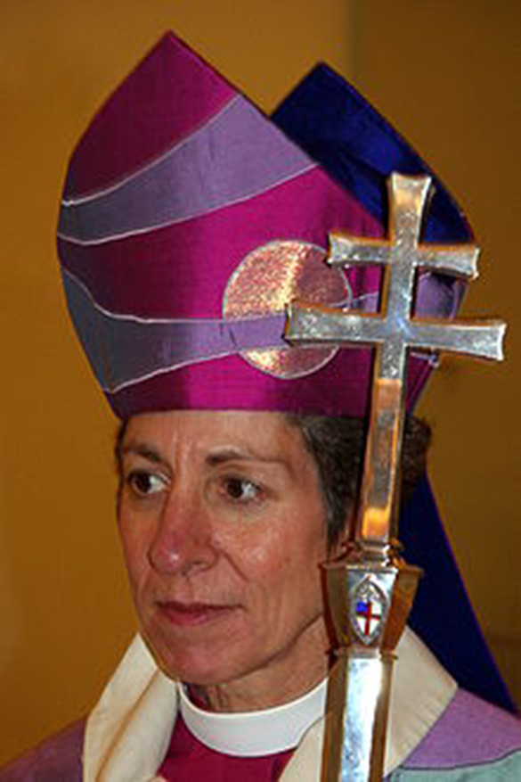
Christianity
Long and complex history of women’s ordination, and participation in religious life.
In NT, see Luke 8.1-3; John 20.17-18; Rom. 16.1-4
19th Century – first women’s ordination
Resistance to women’s ordination continues in Roman Catholic Church and some Protestant Evangelical and fundamentalist traditions.
Complementarianism: men and women are fundamentally different. Men lead, women do not.
Based on biblical texts and church traditions (e.g. 1 Tim. 2: 11-14; Eph. 5.22-33).
Katharine Jefferts Schori, first presiding bishop of the episcopal church and first female primate of the Anglican church (2006)

Slide 8
Roman Catholic Church
Pope John Paul II, Mulieris Dignitatum (1988):
Women deserving of equal human dignity but need to maintain distinct gender roles.
Women had two vocational options:
Wives and mothers
Celibate members of religious orders.
Ordinatio Sacerdotalis (1994) –reaffirmed this view on women’s ordination.
Catholic women continue to serve in non-ordained ministries within the church, as theologians, liturgists, and social activists.
Other women choose a different path…
http://romancatholicwomenpriests.org/faq.htm

Slide 9
Pink Smoke Over the Vatican
Documentary directed by Jules Hart (2011) about women ordained as priests in the Roman Catholic Church, despite their ‘invalid’ status.

Slide 10
Questions
What religious justifications are offered by the Roman Catholic Church offer for women’s exclusion from leadership and ordination?
What cultural functions do these justifcations serve? That is, what cultural impacts do women’s exclusion from ordination have?
What religious arguments are offered by the people in this video in favour of ordination?
What cultural justifications for women’s ordination are offered by some of the speakers?

Slide 11
Men’s ministries
Arose in 1970s from anxieties about ‘feminizing’ of the Church and drop in male membership.
Appealing to a particular type of ‘godly masculinity’ – often based on cultural stereotypes of masculinity (particularly sport and militarism), with some revisions around masculine sexuality.
Brotherhood (homosocial relationships)
Sexual purity (anti-pornography and casual sex)
Family and marriage
Some acknowledgement of complementarian views of gender roles.
tap into traditional heteronormative and cisnormative gender discourses.

Slide 12
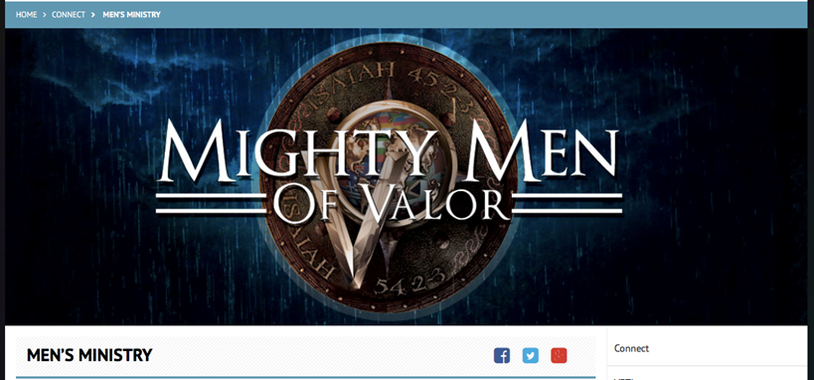

Slide 13
Promise Keepers NZ

Slide 14
Seventh Day Adventist conference

Slide 15
Some resources to check out (including links to videos we have watched)
https://www.youtube.com/watch?v=cVJYQCN_BB4
http://www.everymanministries.com/video-sermons/play/what-does-it-look-like-to-encourage-my-wife
http://mensministrycatalyst.org
https://www.youtube.com/watch?v=mzBXf7BaBAs
http://mysouthwestregion.org/event/mens-ministries-summit-weekend/
https://www.youtube.com/watch?v=gKCOVkJVhNQ
https://www.youtube.com/watch?v=Q-BTF2yYBRw

Slide 18
http://www.juliabettencourt.com

Slide 19
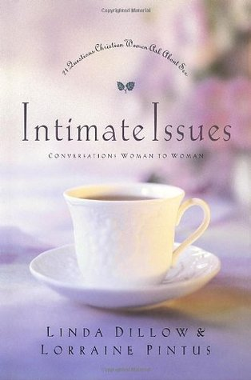

Slide 21
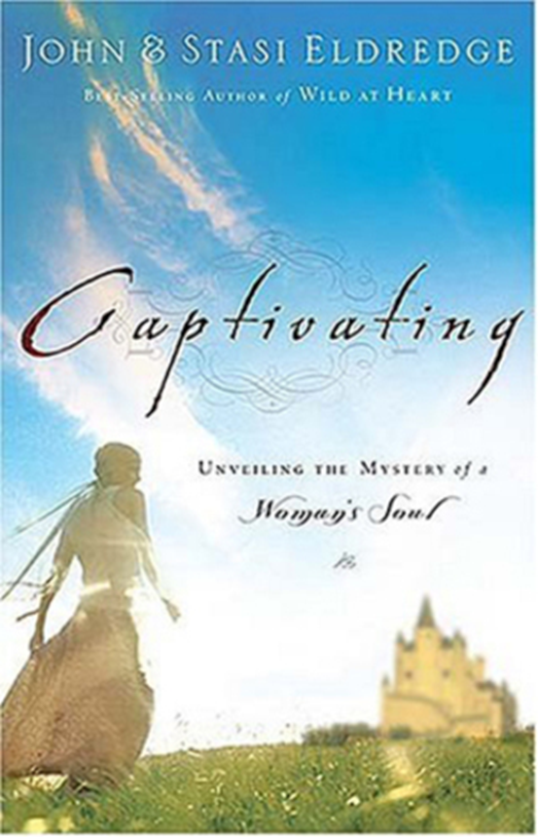

Slide 22
Seventh Day Adventist conferences for men’s and women’s ministries

Slide 23
Even breakfast ministries are gendered

