Slide 1
Gender violence and religion

Slide 2
Questions for the week
What do we mean by gender violence?
What is rape culture and how is it related to gender violence?
To what extent are religions complicit in perpetuating rape culture and gender violence?

Slide 3
What is gender violence?
Violence that arises from normative gender roles and expectations within a given society, which result in unequal power relationships between different gender groups.
Gender intersects with other identity markers (e.g. race, sexuality, age, ability, class) to create multiple sites where people are marginalized, disempowered, and vulnerable to violence.
Gender violence influences and is influenced by these power relationships – it can serve to maintain structural gender inequalities.
Subjective violence
Symbolic violence
Structural/systemic violence

Slide 4
Rape culture and gender violence
A culture in which rape and other forms of gender violence are pervasive and normalized, legitimized, denied, or trivialized due to societal attitudes about gender and sexuality.
In rape cultures, we see many, everyday sociocultural practices that excuse or tolerate gender violence.
Rape cultures perpetuate subjective, symbolic and structural violence:
Symbolic and structural gender violence serve to normalize and legitimize subjective violence.
In New Zealand, only about 10 out of 100 sexual abuse crimes are reported and 3 of those get to court. Only one of those is likely to get a conviction.

Slide 5
Rape myths
(S)he was asking for it.
It is/was the victim’s responsibility not to be raped.
Men can’t help themselves.
Women play hard to get – but ‘no’ means ‘yes’.
Rape is ‘just sex’.
Rape victims are ‘defiled’ or ‘damaged goods’.
Rapes are committed by strangers.
Women lie about being raped.
A person cannot rape their spouse.
Sex workers cannot be raped.

Slide 6
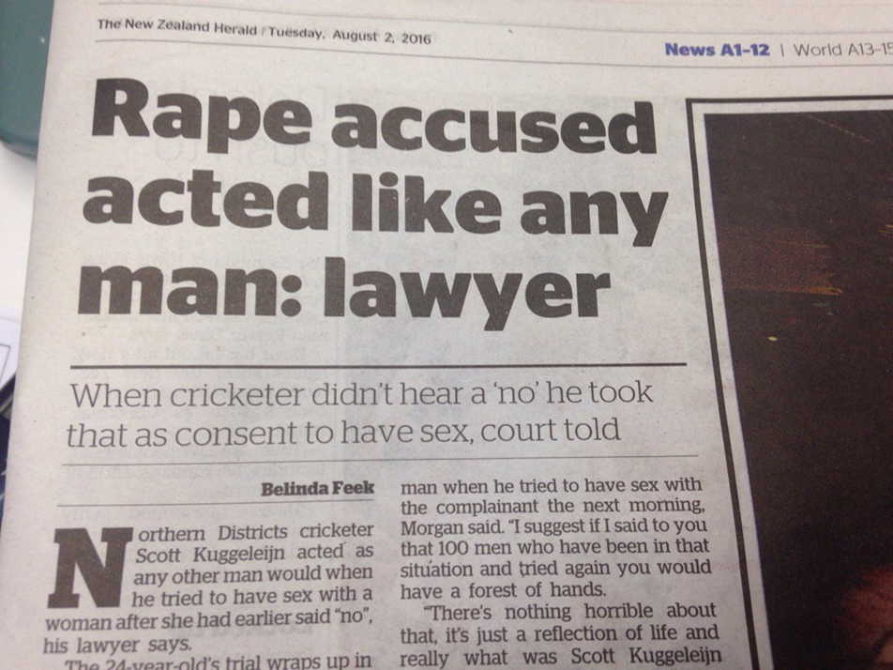
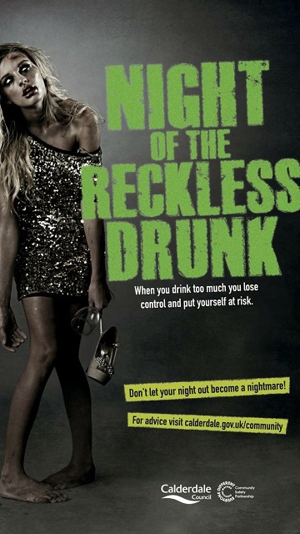
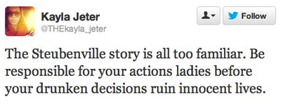

Slide 7
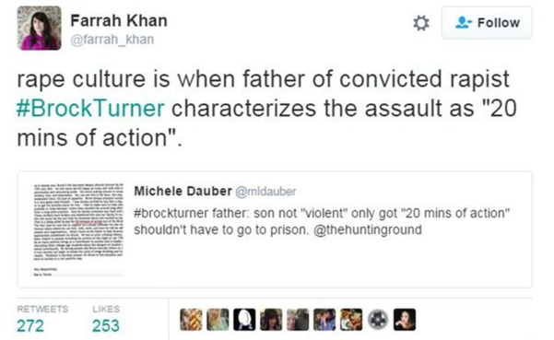

Slide 8
‘If every man stopped the first time a woman said “no,” the world would be a much less exciting place to live.’
Part of summing up speech by New Zealand judge in rape trial, 1996
‘As the gentlemen of the jury will understand, when a woman says “No,” she doesn’t always mean “no”’.
UK judge summing up to a jury in a rape trial, 1990
‘Are you sure you didn’t lead him on?’
‘You were out drinking – could you not put it down to experience?’
Responses to rape survivors from Scottish police when they reported their assaults, 2006.

Slide 9
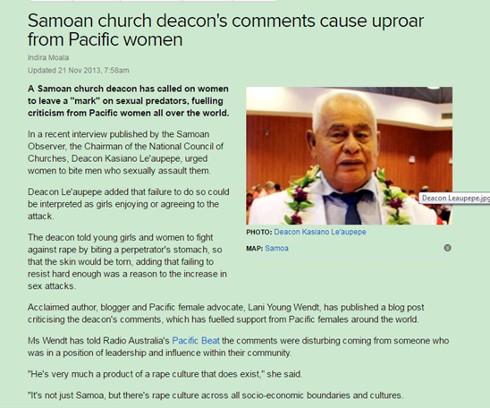
Hidden agendas

Slide 11
Rape culture, gender violence, and religion
Religion intersects with other sociocultural factors – race, gender, class, sexuality, socio-economic status, etc. – to create multiple sites of oppression and vulnerability to gender violence within rape cultures.
‘Religion and secularism can both be if not the cause, then at least the legitimation, of violence.’
Janet Jakobsen, p. 125

Slide 12
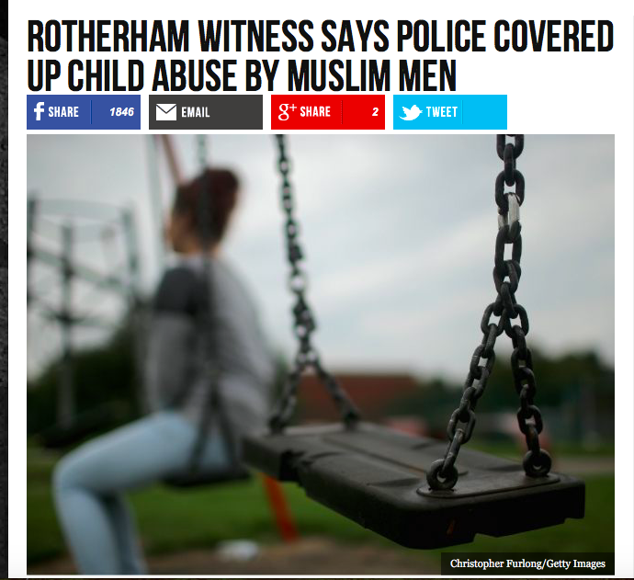
See article by Slavoj Zizek

Slide 13
Religion as roadblock and resource for helping survivors of GBV

Slide 14
Rape myths
(S)he was asking for it.
It is/was the victim’s responsibility not to be raped.
Men can’t help themselves.
Women play hard to get – but ‘no’ means ‘yes’.
Rape is ‘just sex’.
Rape victims are ‘defiled’ or ‘damaged goods’.
Rapes are committed by strangers.
Women lie about being raped.
A person cannot rape their spouse.
Sex workers cannot be raped.

Slide 15
Religious tradition – or (mis)interpretation?
Purity and modesty culture
Notions of the ‘ideal’ gender roles – masculinity and femininity.
Complementarianism = female submission and male headship.
Male ‘ownership’ of women, e.g. through marriage
Heteronormativity and stigmatization of LGBTI+ communities
Policing women’s bodies and silencing women’s voices

Slide 16
Tradition or (mis)interpretation?
Qur’an 4:34: “Men are appointed the guardians over women… so virtuous women are obedient and safeguard, with Allah’s help, matters the knowledge of which is shared by them with their husbands. Admonish those of them on whose part you apprehend disobedience, and leave them alone in their beds and chastise [beat?] them”.
Ephesians 5:22, “Wives, submit to your own husbands, as to the Lord.”
1 Corinthians 7:4 “The wife does not have authority over her own body, but the husband does.”

Slide 17
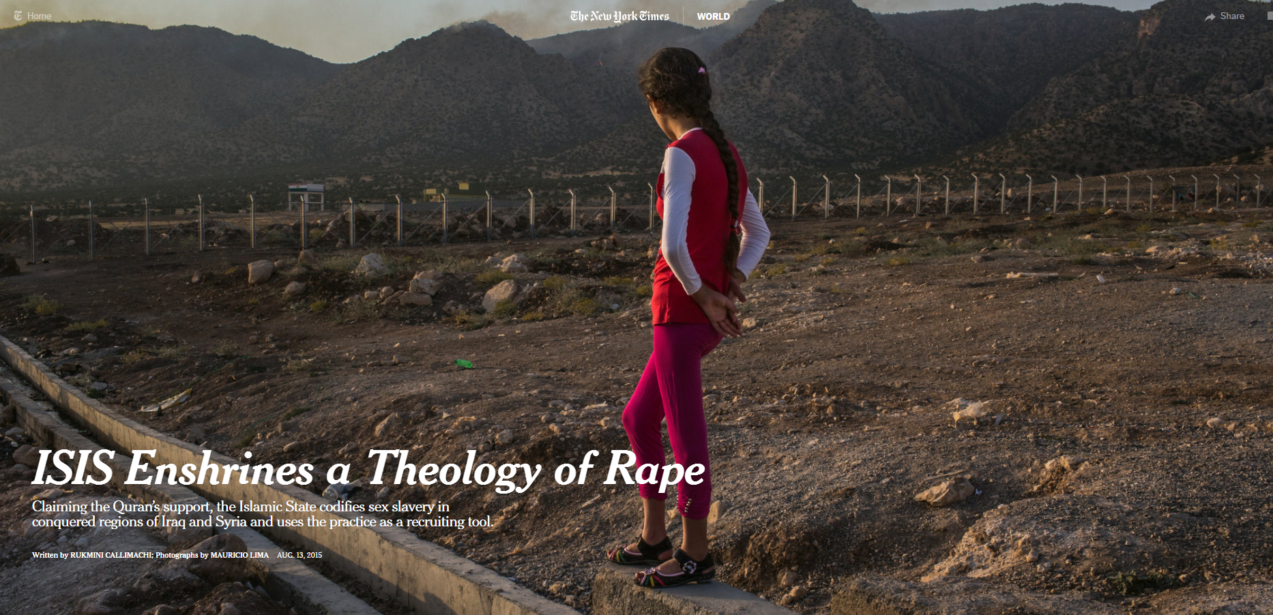

Slide 18
Questions about the article, ‘Isis enshrines a theology of rape’.
Is the rape of Yazidi women by members of ISIS ‘religious violence’ or cultural violence, or both? Do you agree with the author that this is a ‘theology of rape’?
The use of rape by ISIS – a religious tradition, or (mis)interpretation?
What rape myths do you see being drawn upon in this story?
Cultural relativism – or colonizing other cultures? How should scholars of religion respond to this story?

Slide 19
https://biblicalgenderroles.com/2015/10/03/7-ways-to-discipline-your-wife/

Slide 20
Questions about the ‘Biblical Gender Roles’ website
Is this website promoting a ‘theology of rape’? A theology of domestic abuse?
Is the author relying on religious tradition, or (mis)interpretation?
What rape myths and gender stereotypes do you see being drawn upon in this story?
Cultural relativism – or colonizing other cultures? How should scholars of religion respond to this website?

