Slide 1
Reading sacred texts queerly

Slide 2
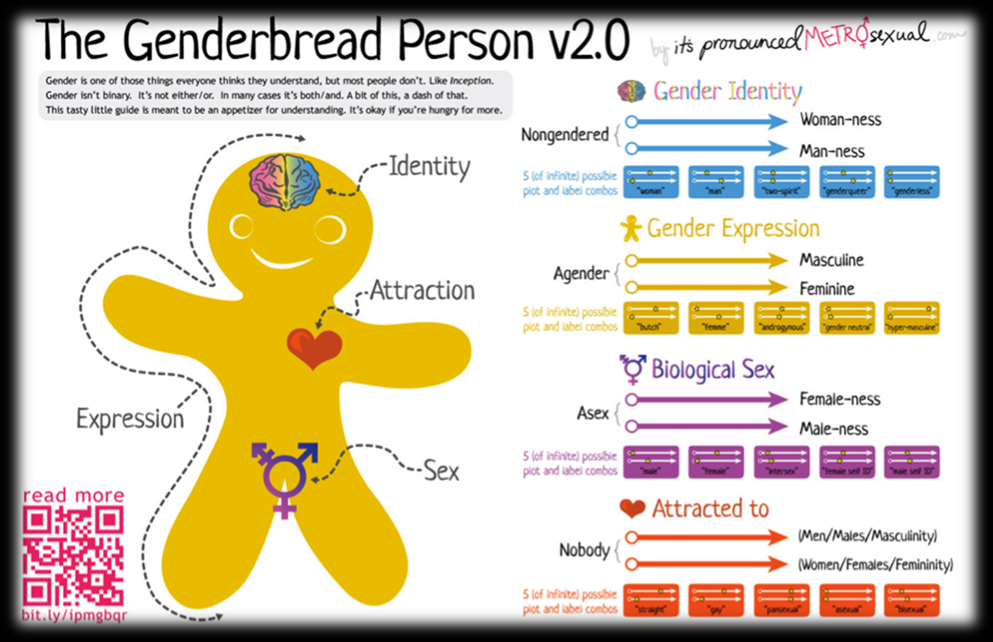
Queer theory – a reminder
Questions those binaries of gender and sexuality that sustain heteronormativity and cisnormativity.
Gender performativity
Gender and sexuality are not linked, fixed, stable or ‘natural’.

Slide 3
A note about terms
There are no universal, fixed or timeless understandings of ‘normative’ gender and sexuality.
The meanings ascribed to genders and sexualities is in constant flux across space and time.
So, when talking about ancient texts, we simply can’t assume that ancient understandings of sexuality were the same as they are today.
Plus, ancient texts such as the Bible are not cohesive or univocal. The Bible contains multiple and contradictory perspectives on gender and sexuality.
We can’t map onto ancient texts contemporary terms such as ‘homosexuality’, ‘transgender’, ‘bisexuality’… or ‘heterosexuality’.
Whose interests are being served by resisting queer readings of ancient texts?

Slide 4
Queer readings of texts
Searching for queerness that may already be present (but is often ignored) within texts.
Not just about importing a queer perspective on an explicitly ‘straight’ text.
Identifying and challenging heteronormative and cisnormative assumptions within texts and their interpretations.
Identifying taken-for-granted binaries of gender and sexuality (and other binaries) within texts and their interpretations.
Challenging the denial of queer identities in the Bible
Highlighting the way queer desires and identities are rendered invisible – eclipsed by heterosexist and cissexist reading strategies, which become the unquestioned ‘norm’. See Deryn Guest reading.

Slide 5
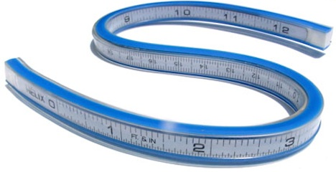
Queer readings and Lesbian rules
We need to apply a ‘hermeneutic of cis-spicion’ and a ‘hermeneutic of hetero-suspicion’.
Grace Jantzen, ‘Contours of a Queer Theology’: the ‘Lesbian rule’ – to ‘measure’ the queer bumps and curves in texts.
Thomas Bohache: ‘To queer a scripture is to render it unusual and non-normative, to shake it up and see how it might be reconfigured’ (“Matthew,” in Queer Bible Commentary, p.493).
Reading ‘with an eye towards disruption’ (Kathy Rudy, ‘Queer Theory and Feminism’)

Slide 6
Why queer scripture?
Queer readings of sacred texts don’t employ a single method or subject, but ‘take as their point of departure a critical interrogation and active contestation of the many ways in which the Bible is and has been read to support heteronormative and normalizing configurations of sexual practices and sexual identities’.
Ken Stone, ‘Introduction’, in Queer Commentary and the Hebrew Bible, 2001, p. 33; cited in Derks, p.555.

Slide 7
Teresa Hornsby and Deryn Guest, Transgender, Intersex and Biblical Interpretation, ‘Introduction’.
“If the power of heteronormativity resides in its unquestioned status of “normal” and its unchallenged place at the foundation of a sexuality that is “good” and “blessed,” the buttress of the whole façade is Bible translation and interpretation. Only in recent times (the last few decades) have scholars initiated a critique of the heterosexism that permeates all Bible reception at least since the nineteenth century. The burgeoning field of queer biblical studies has produced compelling scholarship, which seeks to show the heteronormative biases that punctuate biblical interpretation.”
“As postmodern readers of the Bible suggest, the reader makes meaning. Heteronormativity is not in the text, waiting to be discovered; the interpreter or reader brings the assumption of heteronormativity to the text and uses the text to justify heteronormativity.”

Slide 8
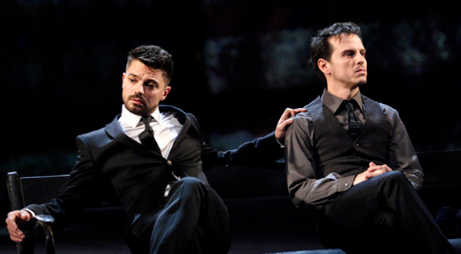
Different worlds
World in the text
World behind the text
World in front of the text
How are your own reading strategies (your world in front of the text) shaping your interpretations – and your responses to others’ interpretations?
Applying a hermeneutic of hetero-suspicion and cis-spicion.

Slide 9
David and Jonathan (1 and 2 Samuel)
And the soul of Jonathan was bound to the soul of David, and Jonathan loved him as his own soul … Then Jonathan made a covenant with David, because he loved him as his own soul.
(1 Sam. 18.1-3)
As soon as the boy had gone, David rose from beside the stone heap and prostrated himself with his face to the ground. He bowed three times, and they kissed each other, and wept with each other; David wept the more.
(1 Sam. 20.41)
Jonathan lies slain upon your high places.
I am distressed for you, my brother Jonathan; greatly beloved were you to me; your love to me was wonderful, surpassing the love of women.
(2 Sam. 1.25-6)

Slide 10
Ruth and Naomi
“Do not press me to leave you or to turn back from following you! Where you go, I will go; where you lodge, I will lodge; your people shall be my people, and your God my God. Where you die, I will die — and there will I be buried. May the Lord do this to me, and more as well, if even death parts me from you!”
Ruth 1.16-17

Slide 11
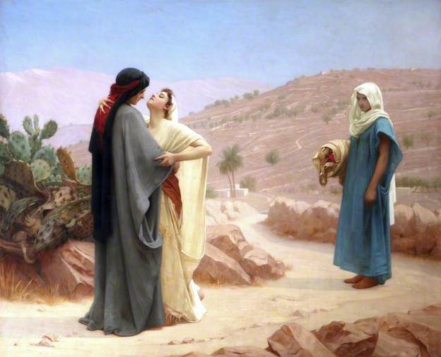
Phillip Hermogenes Calderon, Ruth and Naomi (1886)
For more details see J. Cheryl Exum, Plotted, Shot, and Painted, ch.6

Slide 12
What do you think?
What factors are shaping your own worlds in front of the text?
Your gender, sexuality, ethnicity, socio-cultural status, religious beliefs
How can you become more aware of your world in front of the text?
Approaching a text with integrity.

Slide 13
Jacob
‘When the boys grew up, Esau was a skillful hunter, a man of the field, while Jacob was a quiet man, living in tents. Isaac loved Esau, because he was fond of game; but Rebekah loved Jacob.’
(Gen. 25.27-8)
Jacob cooks and stays at home with his mother. He has to ’dress up’ to disguise himself as his (more masculine) brother (Genesis 27).

Slide 14
Judith
Both conforms to and subverts traditional gender roles ascribed to women.
A biblical character who performs some of Butler’s ‘gender trouble’.
See Deborah Sawyer, ‘Gender Strategies in Antiquity: Judith’s Performance’, Feminist Theology 10 (2001).

Slide 15
Samson and Delilah (Judges 16)
Sexualities and desires
Gender roles and gender fluidity
Think about the worlds in and in front of the text – how they influence interpretation.
Guercino, Samson and Delilah (1654)

Slide 16
Queering Delilah
Her relationship with Samson
Her sexual identity – as treacherous femme fatale, harlot.
Her gender queerness
Her ethnicity

Slide 17
Queering Samson
See Derks reading.
Hypermasculinity is a masquerade that Samson uses to hide his queerness.
He is hairy, violent, has sex with women (including prostitutes), strong, authoritative, active – adopting strong masculine traits in our gender binary.
Delilah (who herself defies traditional roles of femininity) bedazzles Samson more than any other woman he has met, making him query his own gender identity.
BDSM?
Hair cutting as a symbol of castration – does Samson offer Delilah the secret of his strength because he wants to shed his hypermasculine persona?

