Slide 1
Gender, sexuality and religion in pop culture

Slide 2
Gender, sexuality and religion in pop culture
How are these three phenomena represented in popular culture?
Do pop culture texts provide platforms for exploring contentious or controversial relationships between gender, sexuality and religion?
Focus on:
Advertising
Social media
Music – focus on Beyonce

Slide 3
Advertising
Selling a product – creating a ‘want’:
Highlights consumers’ need or inadequacy that persuades them they need this product.
Selling a lifestyle or ideology – connects to our first point:
When you buy the product, you think you’re buying the lifestyle/ideology too
Inspiring (or promising) change in the consumer
Giving information about a product
How do themes of religion, gender and sexuality create a ‘want’?

Slide 4
Religious iconography in advertising/media
Predominantly well-known Judaeo-Christian imagery
What imagery is absent? What’s a taboo too far?
Often juxtaposed with sexualized or gendered imagery:
Purely to evoke shock, irony, satire?
Saying something about contemporary understandings of the relationships between religion, gender and sexuality?
Sexual and gendered identity as a new ‘religion’?

Slide 5
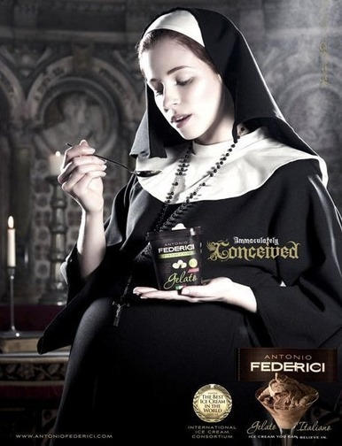

Slide 6
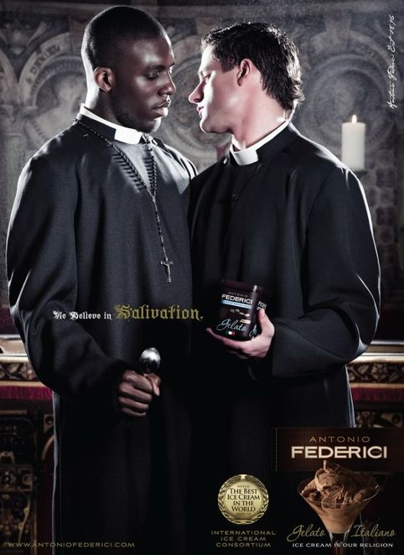

Slide 7
Angels in advertising
Symbols of ideal humanity, ‘heavenly bodies’, beauty, perfection, purity
In religious tradition, angels were typically male figures – divine messengers, companions to the gods/God in heaven
In popular culture, angels are typically female figures – idealized beauty, purity, and also sexuality.

Slide 8
Notes:
Heteronormative – men assumed to want to attract a woman
Angels – ideals, perfect, heavenly. The ad is selling a product that will make a man more attractive – the ‘ideal’ is a hypersexualized woman (an ‘angel’ – also innocent? Not sexually experienced? But sexual?) Western beauty standards

Slide 11
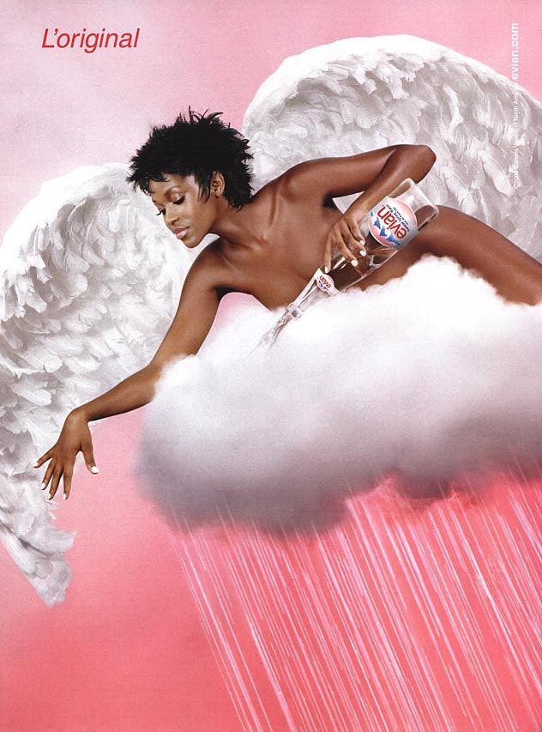

Slide 12
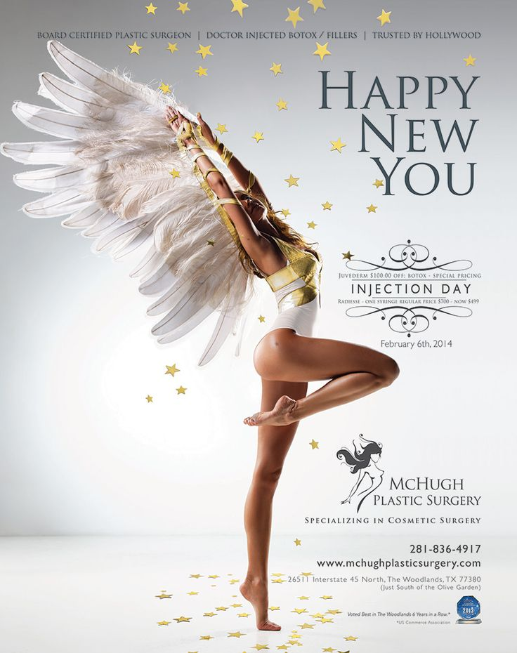

Slide 13
Masculinizing Jesus?
Notes:
Ideals of masculinity – military imagery, also vaguely homoerotic too.
Gospel Jesus was ‘queer’ in that he didn’t conform to traditional norms of masculinity – political authority, power, marriage, father, hung out with women and men.

Slide 14
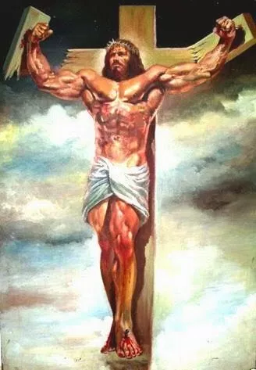

Slide 15
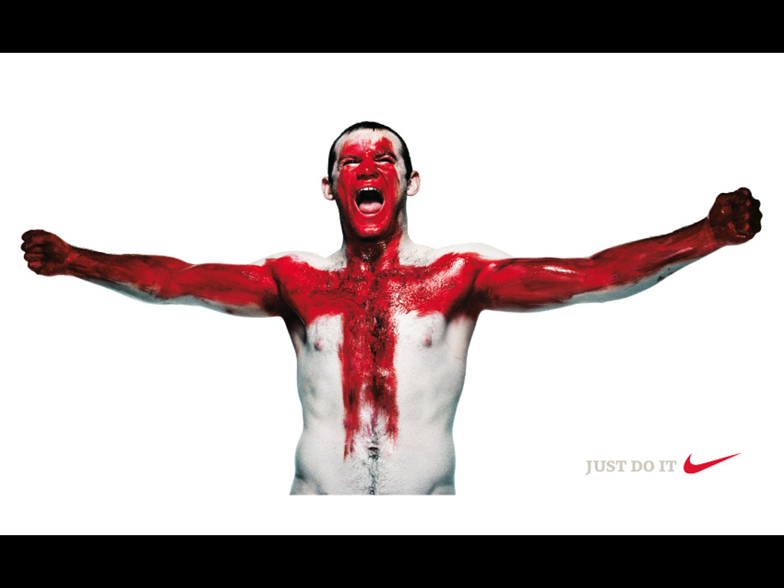

Slide 17
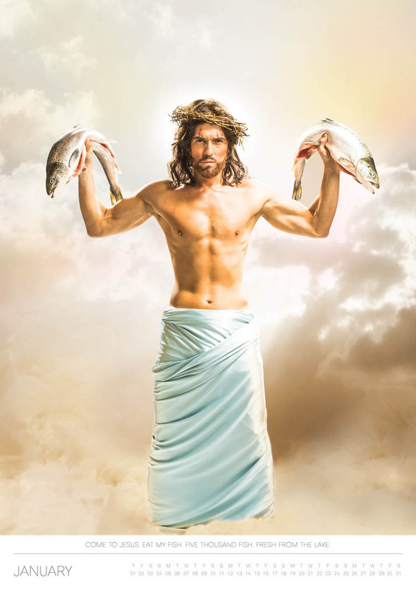

Slide 19
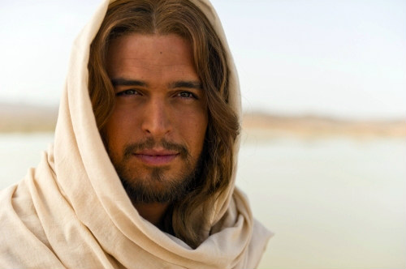
#hotjesus
Diego Morgada, Son of God (2014)

Slide 20
