Slide 1
Genesis 2-3
Creation of Adam and Eve
Adam and Eve eat forbidden fruit and are expelled from garden of Eden
Hugely popular theme in art and in later advertising.
Typically Eve is sexualized (the source of man’s temptation)

Slide 2
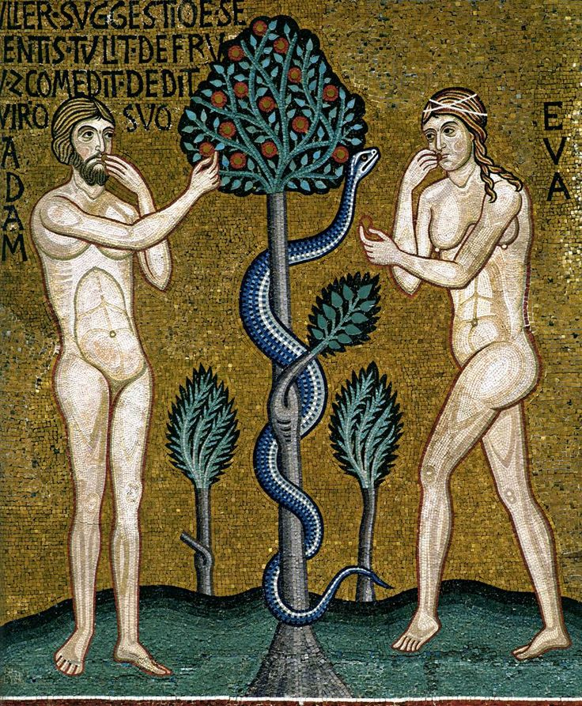
So when the woman saw that the tree was good for food, and that it was a delight to the eyes, and that the tree was to be desired to make one wise, she took of its fruit and ate, and she also gave some to her husband who was with her, and he ate (Gen. 3.6)
12th Century mosaic in Capella Palantina, Palermo

Slide 3
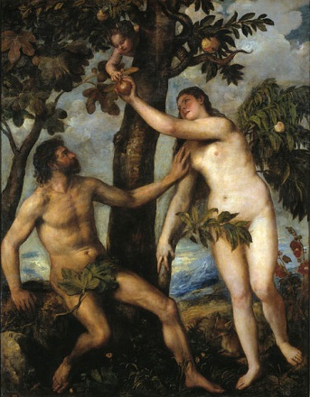
Titian, The Fall of Man (c.1550)

Slide 4
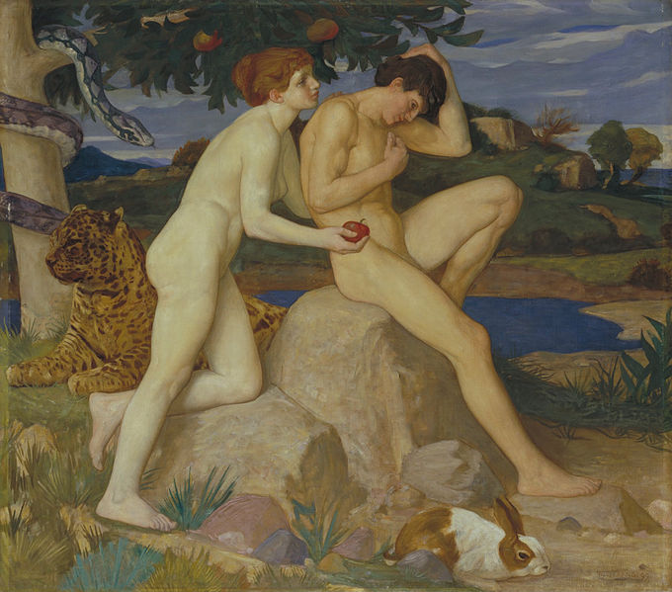
William Strang, The Temptation (1899)

Slide 5
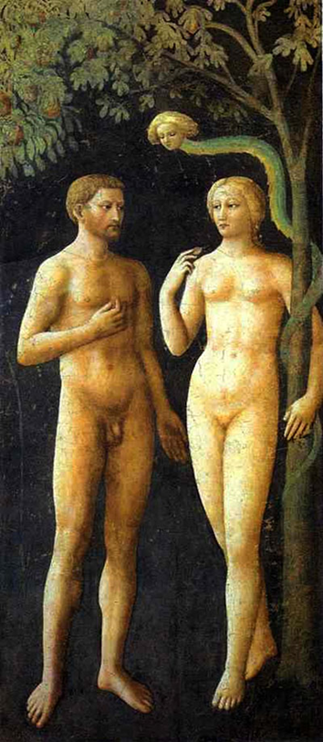
Eve and the snake – a special relationship?
Note how the snake has a female face, not unlike that of Eve herself…
Masolini, Adam, Eve and Lilith (1425)

Slide 6
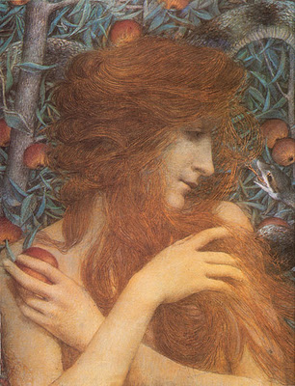
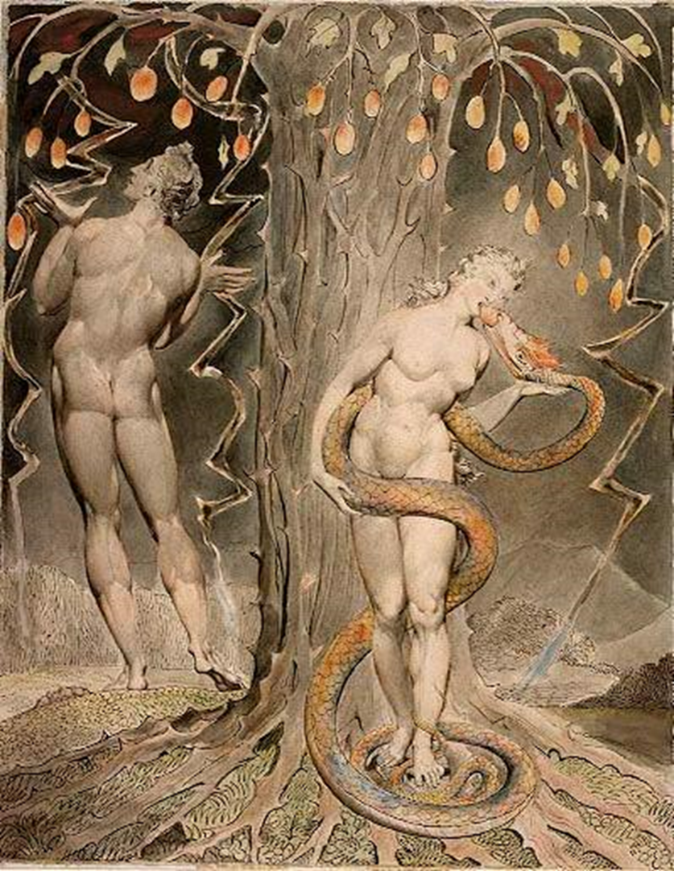
William Blake, Temptation and Fall of Eve (1808)
Lucien Levy-Dhurmer, Eve (1896)

Slide 7
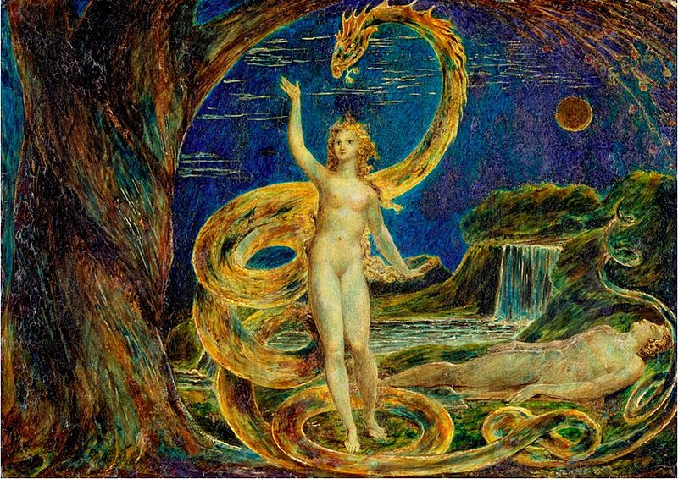
William Blake, Eve Tempted by the Serpent (c.1800)

Slide 8
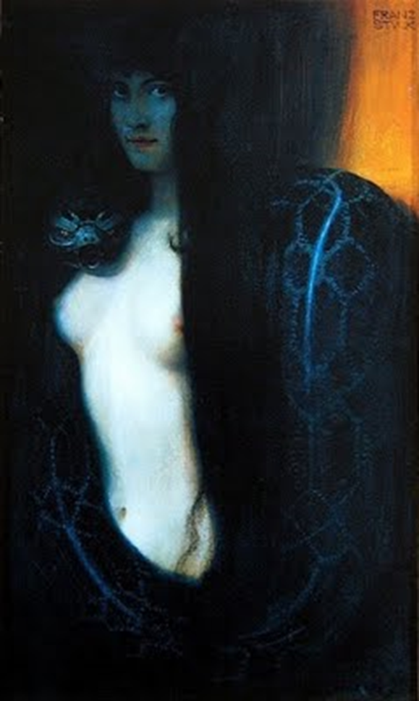
Franz von Stuck , “The Sin” (1893)

Slide 9
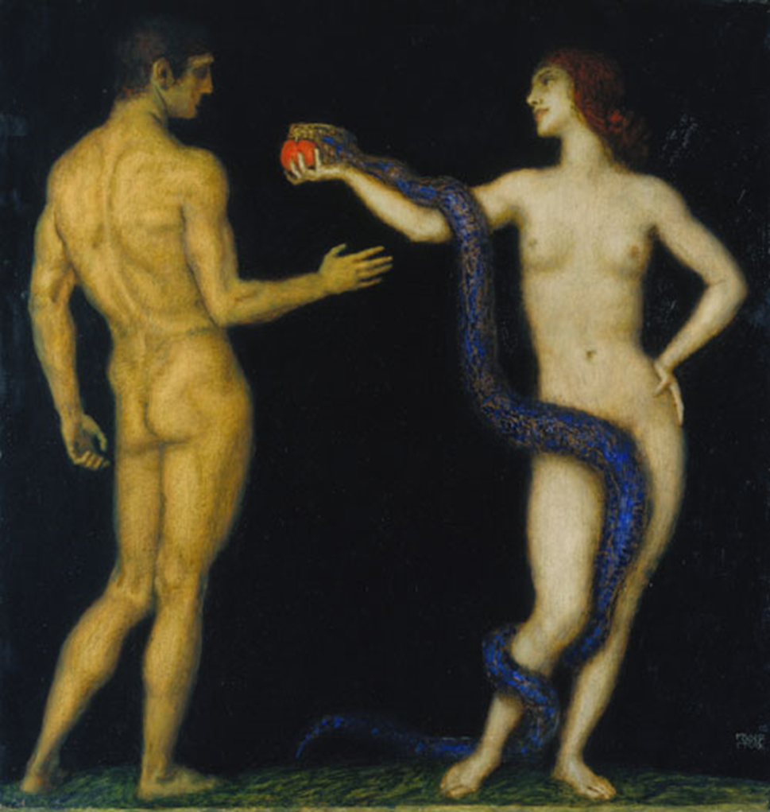
Franz von Stuck, Adam and Eve (1893)

Slide 10
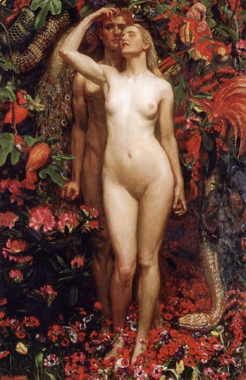
John Liston Byam Shaw, The Woman, The Man, The Serpent (1911)

Slide 11
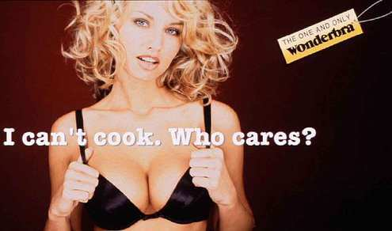
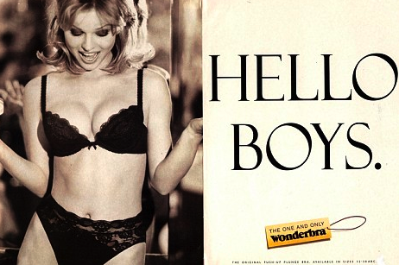
Postfeminism

Slide 12
Eve in advertising
What ideologies of gender and sexuality are being expressed in this image?
Note Adam’s ‘licensed withdrawal’ (Edwards, p. 15). What effect does this have on his involvement in this scene compared with Eve?
Billboard advertisement for Bobby's Taproom Grill and Ribs, 2008

Slide 13
Ad for POM Wonderful pomegranate juice 2010

Slide 14
Ads for Chenson bags (2010)

Slide 15
Notes:
See questions on previous slide.

Slide 16
United Colors of Benetton ad

Slide 17
TSUM (Department Store) advert 2010
Notes:
TSUM (Department Store) advert 2010
Again, what assumptions does this ad make about female sexuality? And what do you think of this post-feminist Eve? Does she echo the Genesis 3 traditions?

Slide 20
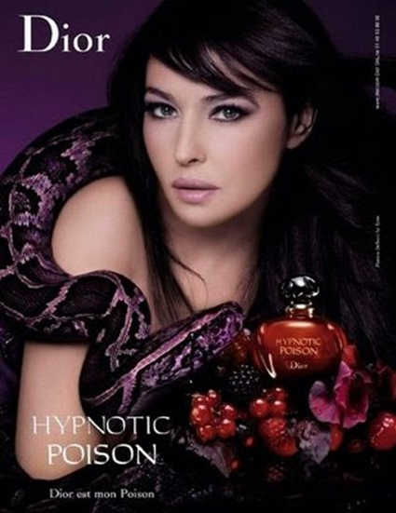

Slide 21
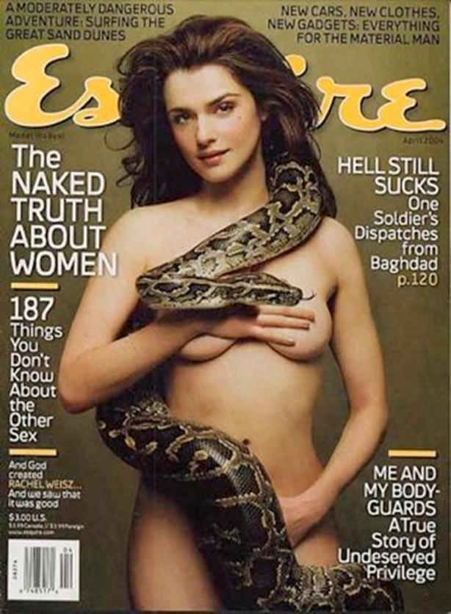
Britney Spears
Paris Hilton

Slide 25
Does it really matter?
‘The myth has projected a malignant image of the male-female relationship and of the “nature” of women that is still deeply imbedded in the modern psyche … The myth has in fact affected doctrines and laws that concern women’s status in society and it has contributed to the mind-set of those who continue to grind out biased, male-centred ethical theories … [It] undergirds destructive patterns in the fabric of our culture’.
Mary Daly, Beyond God the Father

