Slide 1
DEFINING GENDER AND SEXUALITY

Slide 2
Defining gender and sexuality
Gender is…
Sexuality is…
Queering gender and sexuality

Slide 3
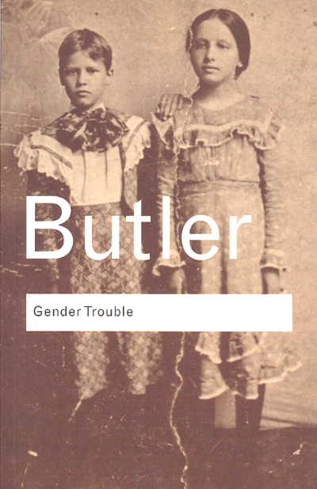
What is queer theory?
The term queer theory is credited to Teresa de Lauretis, “Queer Theory: Lesbian and Gay Sexualities,” special issue of Differences: A Journal of Feminist Cultural Studies 3 (1991).
Developed from feminist studies, gender studies and lesbian and gay studies of the 1970s and 1980s that began to question the notion of gender and sexuality as fixed entities.
Seminal work published in 1990, Judith Butler’s Gender Trouble.

Slide 4
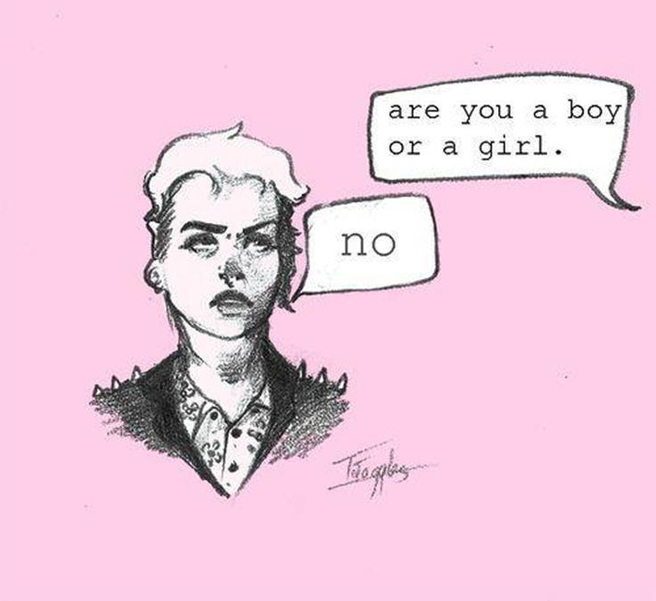
QUEER THEORY
Insists that traditional binaries of gender and sexuality are not ‘fixed’ stable categories of identity, but always shifting and changing across time and space.
Challenges heterosexuality as the standard by which all sexual identities are ‘measured’.
Also considers other social identity markers, e.g. race, class.
Binaries/categories are not ‘benign, but determine allocations of social power and authority – who has power and who is marginalized.

Slide 5
I am born with a fixed sex
My sex determines my gender
I have desire for the opposite sex
I am born with a body
I am assigned a sex and gender
I am taught to perform an identity
I may have desires

Slide 6
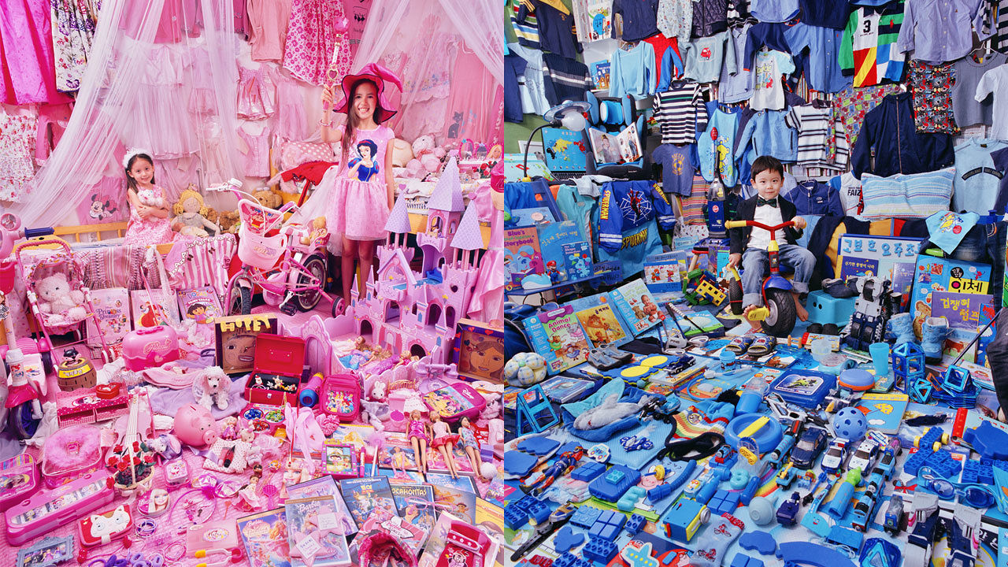

Slide 7
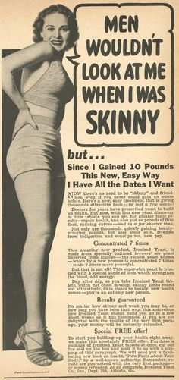
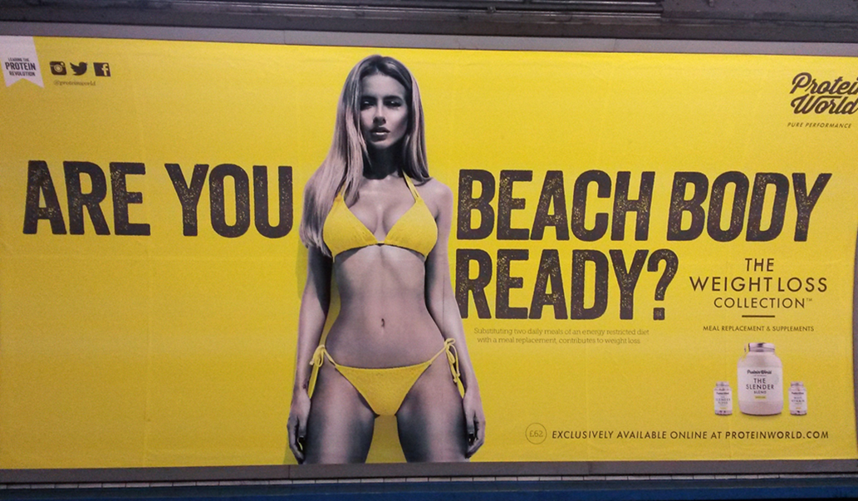
Gender norms change over time and space

Slide 8
Gender is performative

Slide 9
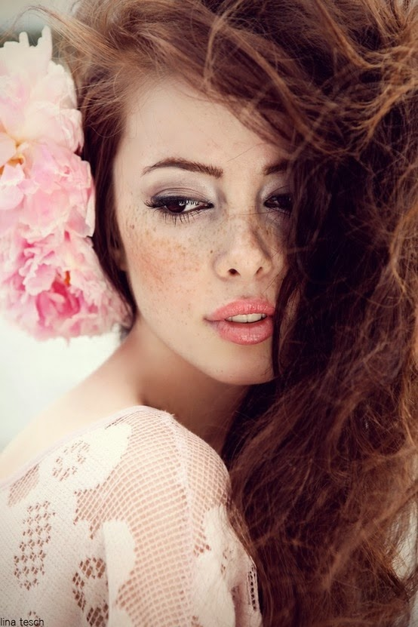
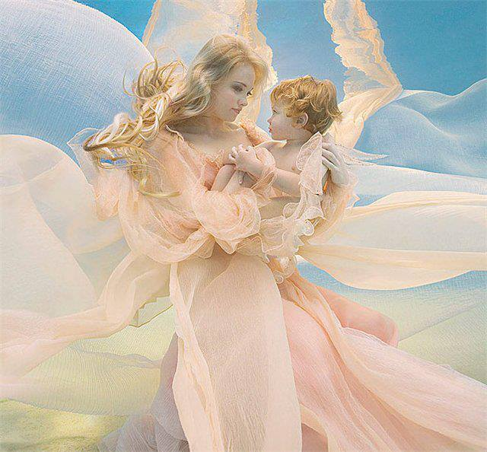

Slide 10
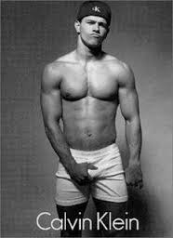
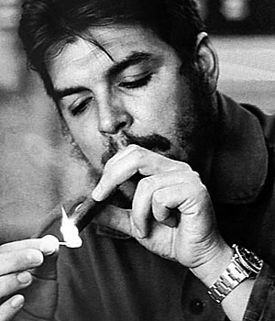
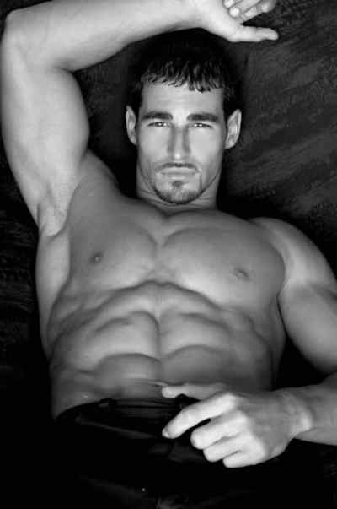
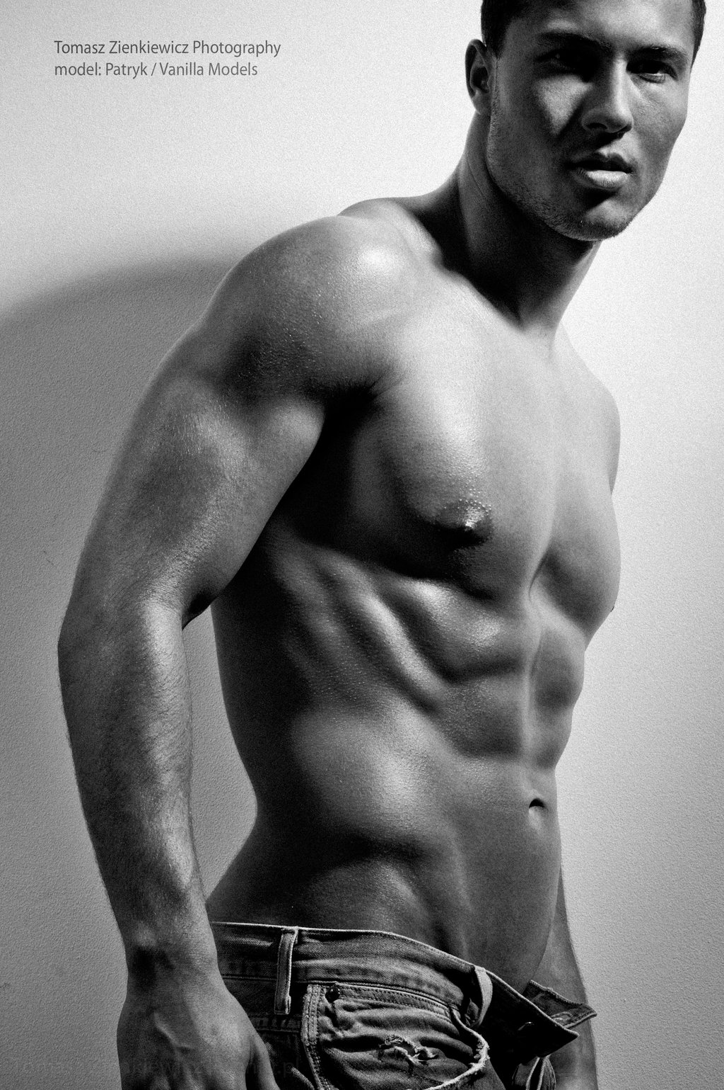

Slide 11
Defining gender in the OED
Feminine: ‘having qualities or an appearance traditionally associated with women, especially delicacy and prettiness’. E.g. ‘these flowers add a feminine touch to the table’.
Masculine: ‘having qualities or an appearance traditionally associated with men’. E.g. he is outstandingly handsome and robust, very masculine’.

Slide 12
Defining gender (from Thesaurus.com)
Masculine is…
Feminine is…
Manly
Muscular
Brave
Adult
Honourable
Powerful
Strong
Virile
Red-blooded
Male is…
Masculine, macho, potent, virile
Ladylike
Soft
Dainty
Female
Tender
Womanly
Modest
Gentle
Womanish
Effeminate
Female is…
Feminine, fertile, maternal

Slide 13
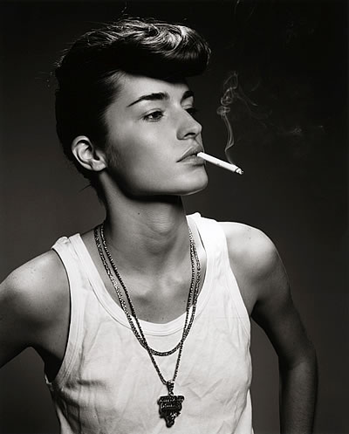
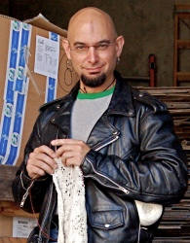
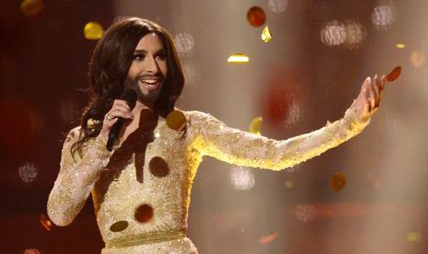
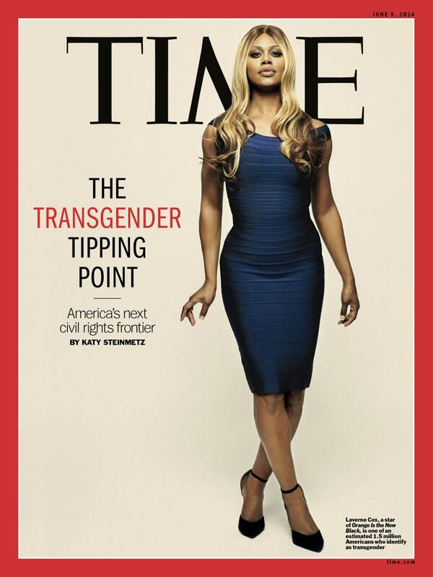
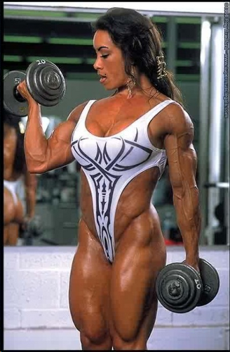
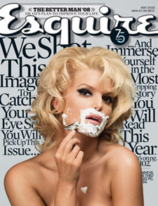
Gender trouble
Notes:
Butler – we can never stop our gender performativity entirely – we are required to do this thousands of times a day – but we can learn to subvert these performances a little, through parody or other gender performances that will challenge expectations. We can therefore call into question these binaries around gender.
Gender trouble is showing the multiplicity and fluidity of gender and sexuality – there are no binaries, or at least, these binaries can be constantly renegotiated, subverted, and shifted (and they are, constantly, throughout history)

Slide 14
Queer theory breaks the connection between sex, gender and sexuality
I am born with a fixed sex
My sex determines my gender
I have desire for the opposite sex
I am born with a body
I am assigned a sex and gender
I am taught to perform a gender
I may have desires

Slide 15
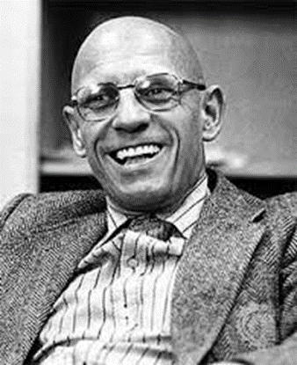
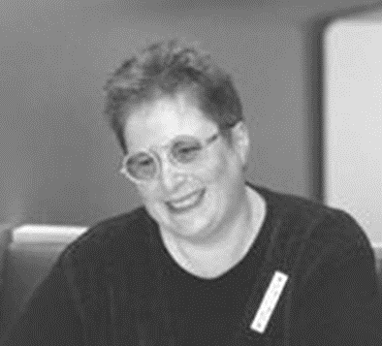
Coming out of the closet
Key thinkers in queer sexualities: Eve Sedgwick, Epistemology of the Closet (1990) and Michel Foucault, The History of Sexuality (1976)
We live according to a set of sexual ‘scripts’ – these are not fixed or natural, but socially-constructed.
Scripts and discourses change over time – Foucault refers to sexuality as a ‘historical construct’.
Our sexuality is not dependent on our sex or gender identity.

Slide 16
Heteronormativity
Coined by Michael Warner (1991)
The ‘normal’ pattern of attraction is one man and one woman who embody conventional gender roles.
Other forms of sexuality, gender and desire are treated as less ‘normal’ or natural.
Straight privilege

Slide 17
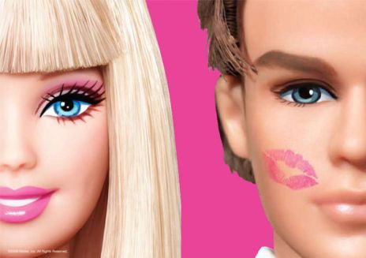
Heteronormative social forces ‘pull a cloak of virtue around themselves by manufacturing a deviant other into which a great many people can be dumped and dismissed’ (Eve Sedgwick, Epistemologies of the Closet).

Slide 18
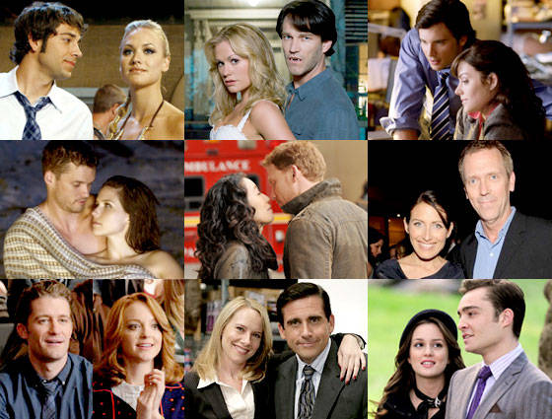
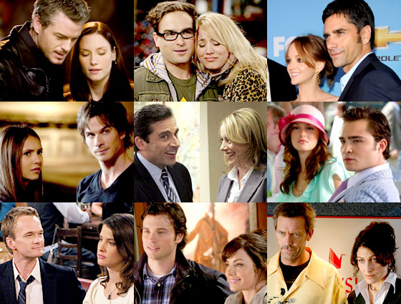
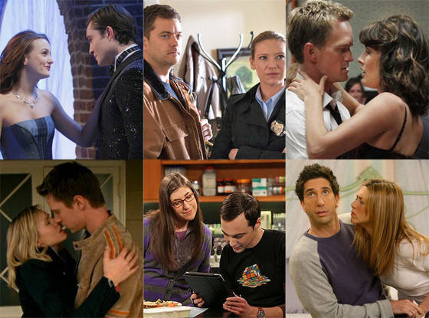
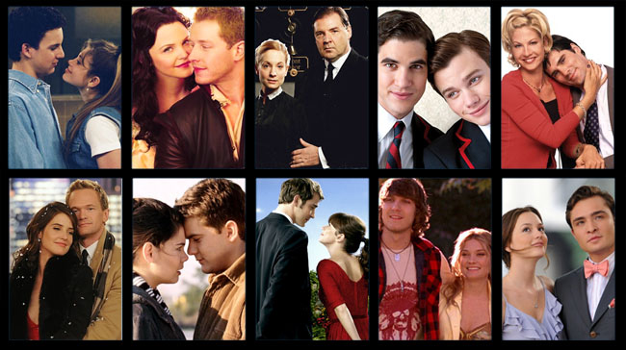

Slide 19
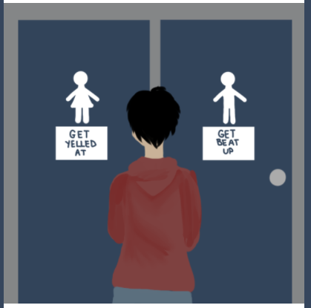
Cisnormativity
The belief that people naturally or normally continue to identify with the gender they were assigned at birth.
Marginalization of trans-identifying people as ‘abnormal’ or a threat.
“When trans people can’t access public bathrooms we can’t go to school effectively, go to work effectively, access health-care facilities — it’s about us existing in public space…It’s really about us not existing — about erasing trans people.” Laverne Cox, 2017.

Slide 20
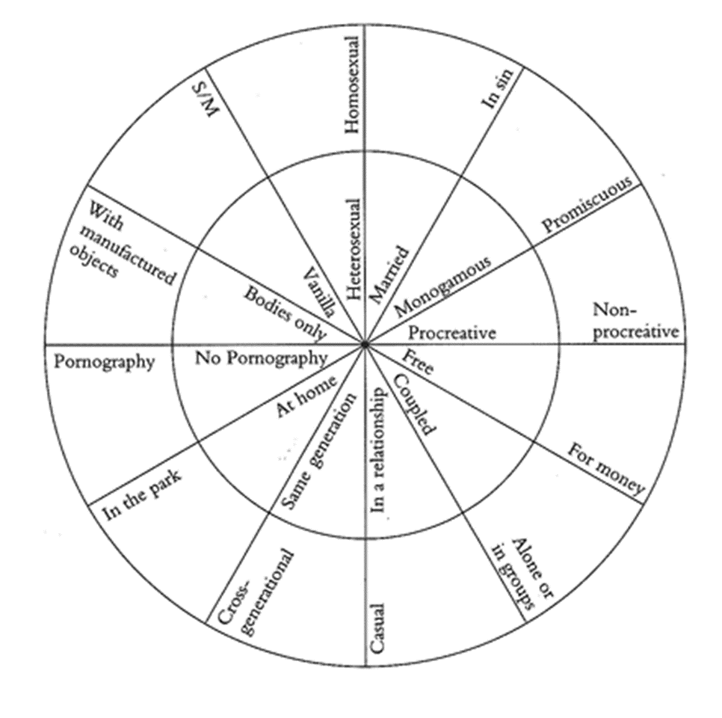
Other normativities
Gayle Rubin’s ‘charmed circle’ of sexual preferences and desires (from Thinking Sex, 1984)
Notes:
Sexuality is constantly policed in societies – it is a very private event but one that is constantly evaluated and prescribed by public bodies, institutions, laws, etc.

Slide 22
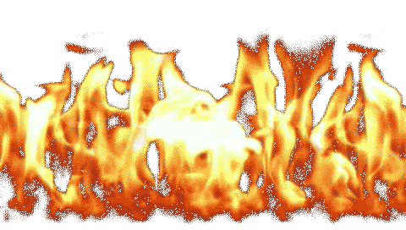
In this course
 | ATTRACTED | TO
GENDER | MEN | WOMEN
Male | gay | straight
Female | straight | gay

Slide 23
Queer theory vs. identity politics
Notes:
Criticisms of queer theory – and Butler’s gender trouble is its focus on individualism rather than collective identities.
Some postcolonial, feminist and race theorists argue though that it is expedient at times to identify with a collective, either because it is politically expedient, or it gives a person a vital element of their identity.
Also, we can’t ignore the embodied, material experiences of our multiple identities. This leads us on to intersectionality, which is another vital facet of our course’s general approach to gender and sexuality.,

Slide 24
Intersectionality
Kimberlé Crenshaw: focussing on either race or sex does not fully capture the experiences of marginalized women who are at caught at the intersection, simultaneously experiencing multiple forms of discrimination.
Criticism of second wave feminism – white, middle-class, heterosexual
‘Dominant conceptions of discrimination condition us to think about subordination as disadvantage occurring along a single categorical axis...[This] marginalizes those who are multiply-burdened and obscures claims that cannot be understood as resulting from discrete sources of discrimination’ (Crenshaw, ‘Demarginalizing’, 140)

Slide 25
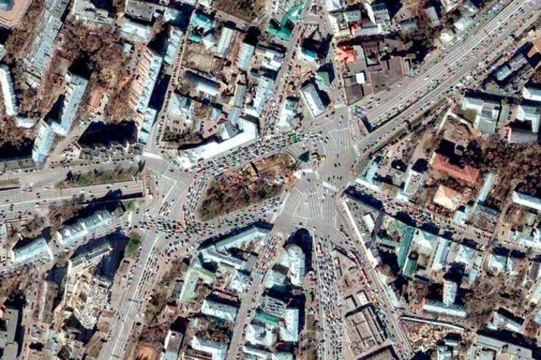
Other categories of identity : gender, ethnicity, religion, class/socio-economic status, sexuality, age, disability, nationality, etc…

Slide 26
What makes me who I am?

