Slide 1
Policing bodies 1
PURITY, PURITY CULTURE, MODESTY

Slide 2
Tradition and interpretation
Who is speaking? And who is silent?
Who is being addressed? Who is absent/excluded from the audience?
What is the context (cultural, historical, religious, etc) of the views being put forward?
What rhetoric is being used? [I.e. how are the audience being persuaded?]
What/whose interests are being protected/promoted? And whose interests are being challenged/threatened?
What are the consequences – what religious and cultural functions are being served?
Who wins, and who loses? [or ‘who has the power in this relationship?’]

Slide 3
This week:
What is ‘purity’ in religious and cultural terms?
Gendered purity:
Menstruation
Purity culture and virginity
Modesty
What are the religious and cultural functions of purity and modesty regulations?
Hermeneutic of suspicion.

Slide 4
Meanings of purity
The condition or quality of being pure; freedom from anything that debases, contaminates, pollutes, etc.
Things in their ‘correct’ place – impurity is caused by ‘matter out of place’ (Mary Douglas, Purity and Danger, 1966).
Physical chastity; virginity.
Ceremonial or ritual purity.
Freedom from guilt or evil; innocence, spiritual purity.
Adapted from dictionary.com (http://www.dictionary.com/browse/purity)

Slide 5
Religious purity regulations
Bodies and body fluids
Foods
Diseases
Spaces and places
Peoples
Other objects, including sacred texts
Ritual (im)purity
Moral (im)purity

Slide 6
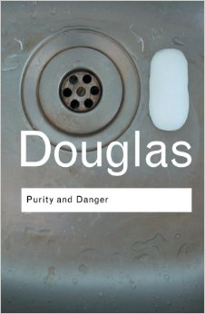
What cultural functions do purity regulations serve in religions?
A means of cohesion within a group – purity rituals ‘create unity in experience’ (Douglas).
A way to draw group boundaries and exclude the ‘Other’, particularly among close-dwelling communities.
A means of social control and validating political/social authority, hierarchies and segregation.
A symbolic means of “moral” control.

Slide 7
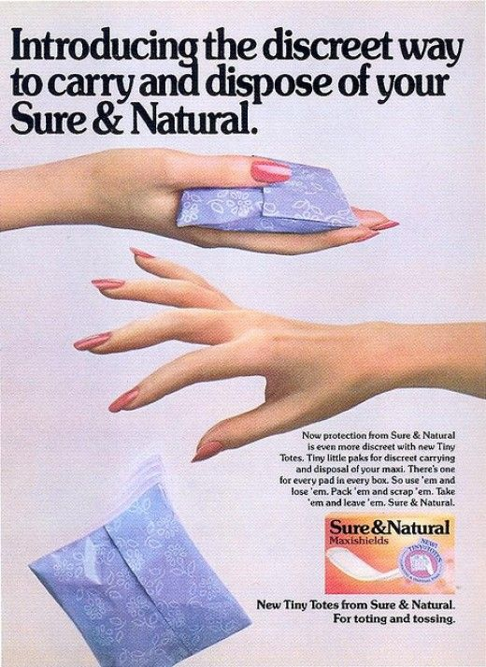
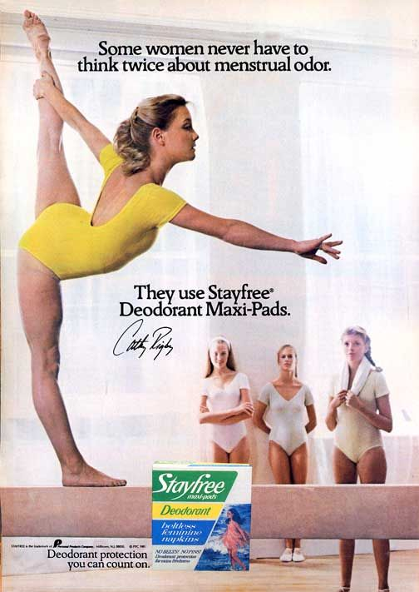
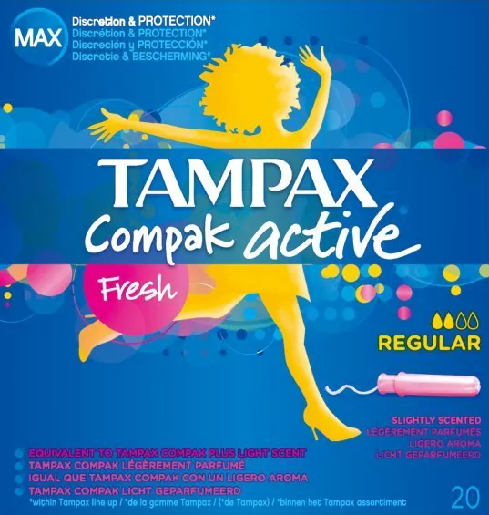
Menstrual taboos in culture

Slide 8
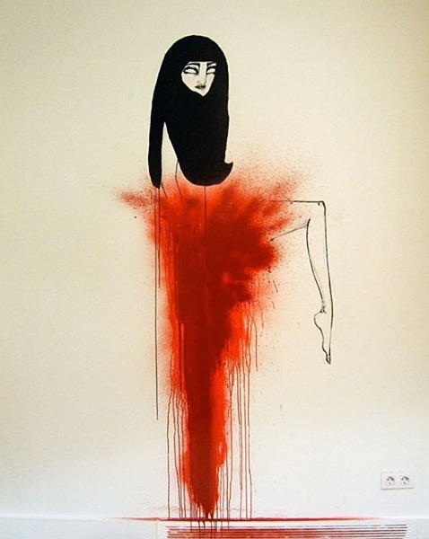
MENSTRUATION AND RELIGION
Taboo in many religious communities
a (temporary) source of ritual impurity
contagious, but not necessarily associated with ‘wrongdoing’
A form of ‘threat’ and danger - taboo
A ‘supernatural’ event
Often a source of stigma
May involve rituals of segregation and re-purification (laid down in scriptures and traditions).

Slide 9
Menstruation and religion
See reading by Guterman, Mehta, and Gibbs, ‘Menstrual Taboos among Major Religions’.
A ‘curse’
Source of danger and impurity – taboo
May harm community (especially men)
Sexual prohibitions
Social restrictions – segregation (menstruation huts), restriction to touch
Domestic restrictions – e.g. cooking, family relationships, personal hygeine
Religious restrictions
May require re-purification rituals

Slide 10
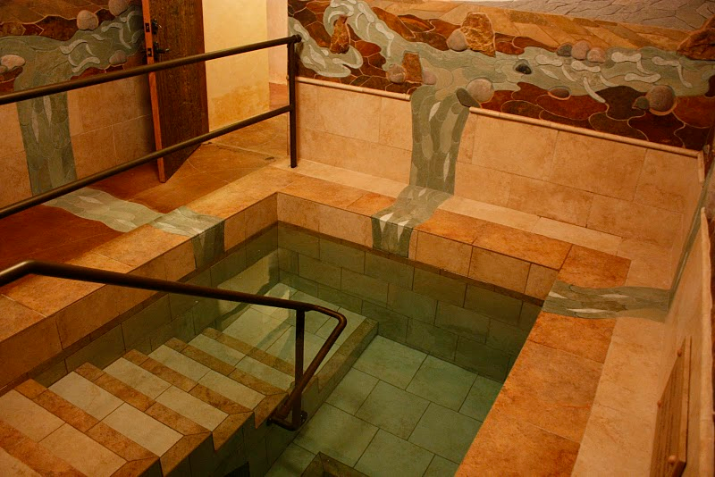
Reframing menstrual taboos
See article by Dunnavant and Roberts in your reading list, ‘Restriction and Renewal, Pollution and Power, Constraint and Community’.
Positive understandings of menstruation
Offers women sense of community
Affirms women’s reproductive/creative powers
Spiritual significance
An important rite of passage
Offers women respite from other rules and regulations governing their lives
The Mikvah

Slide 11
Questions to ask of religious discourses about menstruation
Who is speaking? And who is silent?
Who is being addressed? Who is absent/excluded from the audience?
What is the context (cultural, historical, religious, etc) of the views being put forward?
What/whose interests are being protected/promoted? And whose interests are being challenged/threatened?
What rhetoric is being used?
Who has the power in this relationship?

Slide 12
WHAT ARE THE CULTURAL FUNCTIONS OF MENSTRUAL TABOOS IN RELIGIONS?
Menstrual stigma/taboo extends beyond religious boundaries – it is a socio-cultural construct.
Policing women’s bodies, sexually and socially?
Asserting patriarchal authority? Or the authority of patriarchal religious traditions/hierarchies?
Rendering women’s reproductive health a ‘public’ or communal concern – fears over paternity?
Barring entry of women to full religious life and leadership?

Slide 13
Cultural relativism? Or is there a need to address cultural and religious menstrual stigma?

