Slide 1
Purity culture and virginity
CULTURAL AND RELIGIOUS MEANINGS

Slide 2
Menstrual taboos and religion
A source of ritual impurity
Rules of segregation, restriction, and re-purification
These rules may be interpreted and encountered positively or negatively by women

Slide 3
WHAT ARE THE CULTURAL FUNCTIONS OF MENSTRUAL TABOOS IN RELIGIONS?
Menstrual stigma/taboo extends beyond religious boundaries – it is a socio-cultural construct.
Policing women’s bodies, sexually and socially?
Asserting patriarchal authority? Or the authority of patriarchal religious traditions/hierarchies?
Rendering women’s reproductive health a ‘public’ or communal concern – fears over paternity?
Barring entry of women to full religious life and leadership?

Slide 4
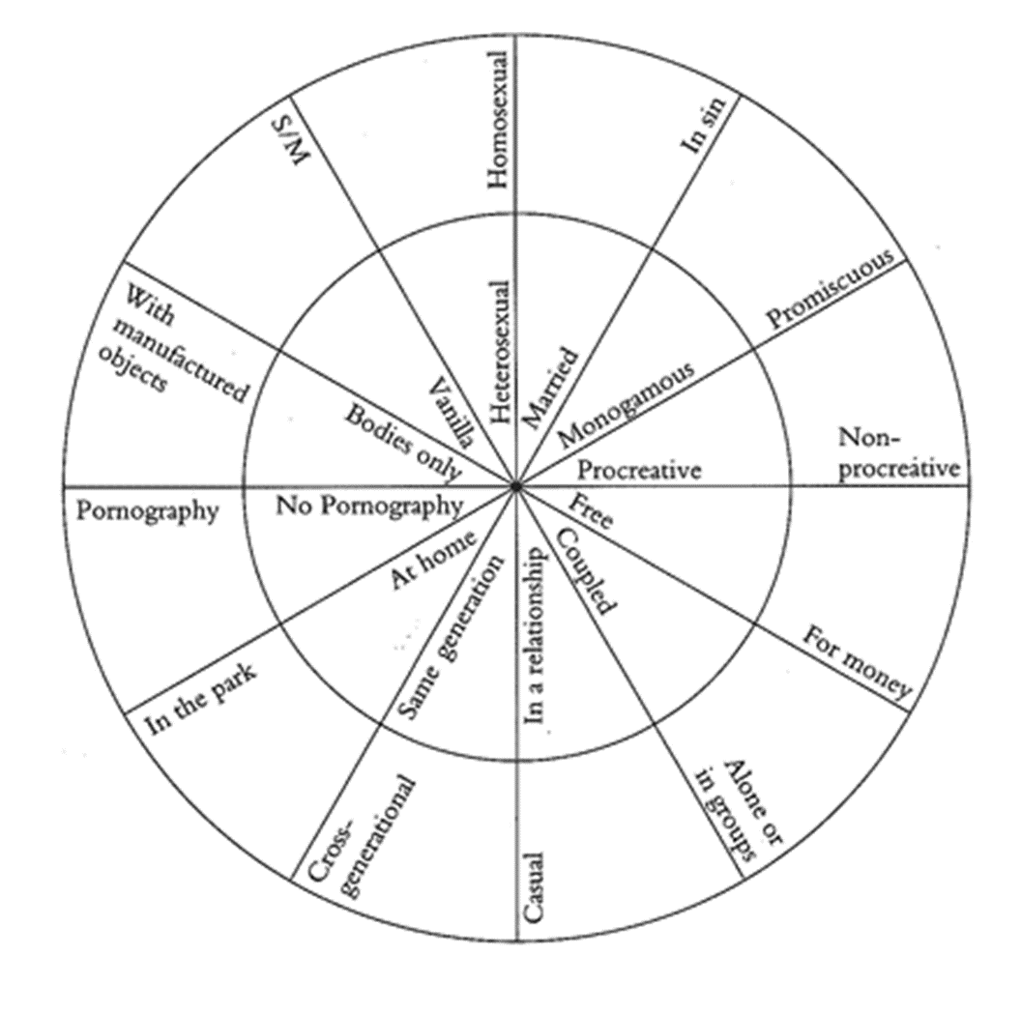
Sexual purity
Many religious traditions connect issues of purity to sexual behaviour.
‘Moral’ or ‘spiritual’ purity – an ethical value judgment is placed on certain sexual behaviours.
Gayle Rubin’s charmed circle – those outside the charmed circle may be regarded as sources of impurity within some religious traditions.
And for others, anything in the circle is ‘impure’.

Slide 5
Virginity: Definitions in Oxford English Dictionary
Abstinence or avoidance of all sexual relations; bodily chastity, as a virtue of great commendation, or as conferring especial merit or sanctity.
The state or condition of a virgin or chaste woman; chastity, as the natural or normal condition of an unmarried woman; maidenhood. Also, a condition affording presumption of chastity; spinsterhood.
Often practiced for religious reasons.

Slide 6
Purity and virginity in culture
Sexuality becomes a means of defining a person’s social ‘worth’ – particularly for women.
‘Lack’ of virginity = less ‘good’, less ‘valuable’, less ‘moral’.
The sexual double standard.
Perpetuates the myth of women as passive gatekeepers of their sexuality.
Profoundly affects many women’s lives – they can be ‘judged to death’ on the grounds of their sexual ‘purity’.
Who determines this? And who is silent?
How does it impact power and privilege?

Slide 7
Purity culture discourses feed into stereotypes about gender – recall our discussion of common cultural understandings of ‘femininity’ in week 1 – do you see similarities between ‘femininity’ and concepts of ‘virginity’ and sexual purity? Both are strongly gendered and convey some similar meanings (e.g. women as pure, passive, sexy not sexual, etc.)
Also, particular ‘types’ of women are highlighted as being ‘pure’ – typically white, western, young, ‘pretty’ (according to western standards) and heterosexual.
How might other issues – race, class, sexuality – intersect with women’s abilities to negotiate their sexuality and retain some autonomy and power in their sexual relationships? Do we judge women with less social and sexual power using the same purity lens?

Slide 8
Virginity in religious traditions
Virginity as a prized ‘commodity’ for women (or their male kin). An unmarried woman who is not a virgin is considered less ‘valuable’ (ties in with ideas of purity/impurity).
Hindu marriage ceremony focuses on Kanyadan ritual (‘gift of a virgin’) – possession of the woman’s father, passed to her husband.
Pre-marital virginity is a commandment in Jewish sacred texts. A woman’s sexuality belonged to her father, and was ‘bought’ by her husband’s family (Exodus 22.16-17).
Think of contemporary weddings – bride (dressed in white) is ‘given away’ by her father.

Slide 9
Virginity in religious traditions
Premarital sex is immoral in most Christian and Islamic teachings. Virginity and chastity are prized, particularly for women.
According to Sikh sacred texts and traditions, virginity prior to marriage is an important part of spirituality for all sexes.
Chastity and abstinence, rather than virginity, is important in Buddhist teachings – sex is a distraction from enlightenment. Chastity (or celibacy) is also idealized in some Christian texts and traditions.

Slide 10
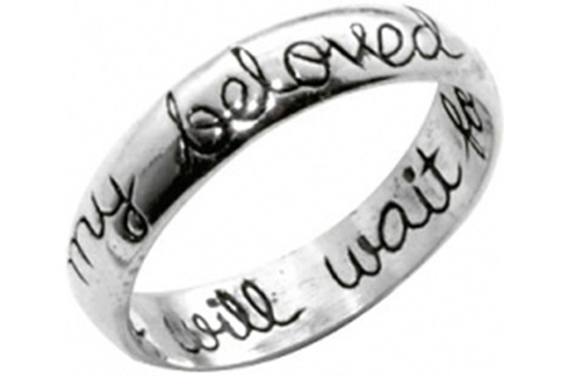
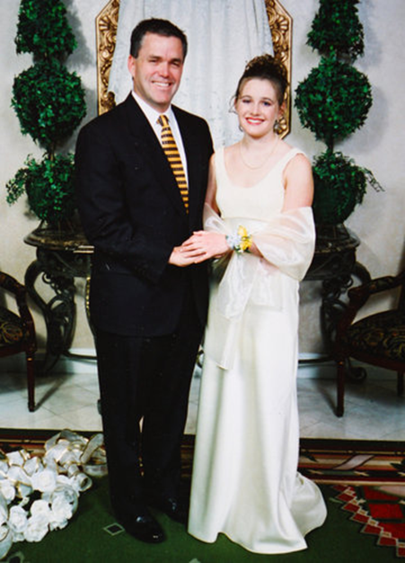
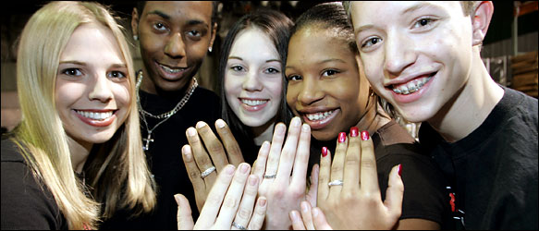
Purity culture
‘Purity Culture’ is often associated with conservative Christianity, but is also a cultural phenomenon:
Pre-marital virginity
Virginity pledges
Purity pledges, balls, rings
Modesty teachings
Abstinence-based sex education
Heteronormative

Slide 11
Cultural function of religious teachings on virginity and purity
A means of exerting patriarchal control over (predominantly) women’s bodies and sexual agency?
Validation for women’s subjection to male control?
A woman’s virginity as a commodity – a valuable source of economic exchange?
Safeguarding patrilineal inheritance, ensuring a husband’s paternity?
Granting validation to women who wish to embrace a lifestyle?

Slide 12
MODESTY CULTURE
A shame-based environment – (women’s) purity is compromised by ‘immodest’ dress and therefore shames her.
Double standards – men are ‘naturally’ sexually aggressive, while women ought to be passive and sexless.
Women may ‘tempt’ men by immodest dress, and will be held (partly) to blame for men’s sinful thoughts and actions.
Women must take responsibility for men’s ‘natural’ sexual impulses.
Consent is absent from the conversation
Strict, heteronormative gender roles

