Slide 1
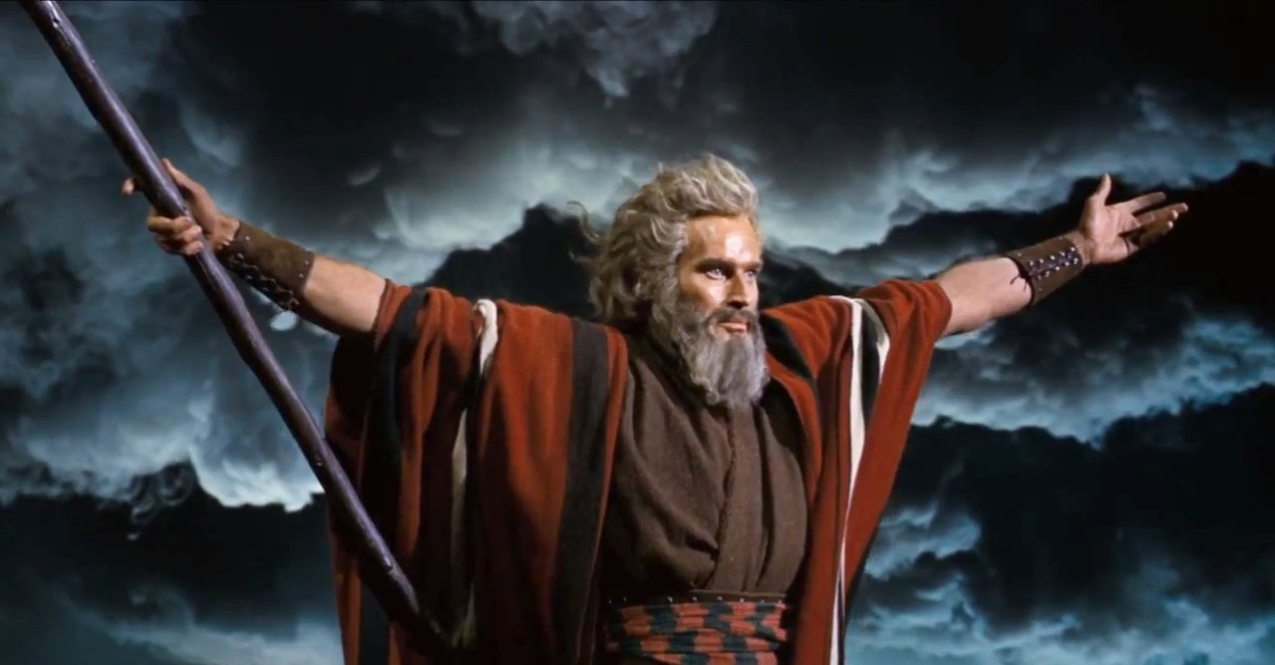
Prophecy in the Bible and Popular Culture
The Prophets

Slide 2
Mid-semester quiz
Worth 15% of total grade
Available between 20 August (from 9am) and 27 August (11pm).
30 minutes to answer 20 multi-choice questions.
Will cover material from weeks 1-5 (from readings and slides)
Completed online, via Canvas quizzes.
Practice quiz (based on last year’s) is available for you to try out on Canvas.
Tuaakana quiz workshop – details to follow

Slide 3
Learning objectives
Learn some definitions of the biblical prophets (Borg reading) and where to find them in the Bible
Identify contemporary figures in popular culture who fulfil some of the same functions as biblical prophets.
Think about writing an essay/exam question relating to the prophets.
3. Using Borg's definitions of the 'biblical prophet', identify and discuss a contemporary individual or group (real or fictional) who you think has a prophetic role within their own culture or context.

Slide 4
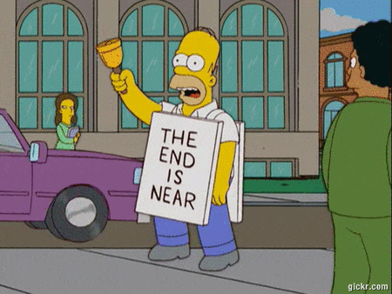
What is a prophet?

Slide 5
Tanak (Hebrew scriptures) | Old/First Testament (Christian)
Torah: Law of Moses – Genesis, Exodus, Leviticus, Numbers, Deuteronomy | Pentateuch: Law of Moses – Genesis, Exodus, Leviticus, Numbers, Deuteronomy
Nebi’im: Prophets - Joshua, Judges, 1 and 2 Samuel, 1 and 2 Kings – prophets as advisors and critics of Israel’s rulers - Isaiah, Jeremiah, Ezekiel; the Twelve (Hosea-Malachi) - named prophets who speak to power | Historical books: Joshua, Judges, 1and 2 Samuel, 1 and 2 Kings - – prophets as advisors and critics of Israel’s rulers 1 and 2 Chronicles, Ezra, Nehemiah, Esther, Ruth,
Ketubim: Writings Psalms, Job, Proverbs, Ruth, Song of Songs, Ecclesiastes, Lamentations, Esther, Daniel, Ezra, Nehemiah, I and II Chronicles | Wisdom writings: Job, Psalms, Proverbs, Ecclesiastes, Song of Songs, Prophets: Isaiah, Jeremiah, Lamentations, Ezekiel, Daniel, Hosea-Malachi - named prophets who speak to power (and for Christians, foresee the coming of Christ)
Traditions about Moses the prophet
Traditions about Moses the prophet

Slide 6
Key features of the biblical prophets
Called: They must be called by God to be a prophet – some prophets have ‘call narratives’ (e.g. Exodus 3, 1 Samuel, Isaiah 6, Jeremiah 1, Ezekiel 1-2)
Intermediary: They claim to speak on behalf of God to their audience
God’s words, not their own. Grants them more authority?
Deliver messages of protest, doom and hope
Seer (sort of): Speak to current or imminent crises – not ‘long term’ prophecies (more likely to get audience’s attention)
Agent of change: Leaders, political figures, poets, protesters
Suffering hero: Sometimes reluctant – but they are compelled by God to prophesy. Prophecy would have been an unpopular role.
Outsider: located outside the establishment, not part of it.

Slide 7
Prophets respond to:
Slavery and oppression of the Hebrew people: Moses (see Exodus 1-15)
Corrupt rulers and/or threats to Hebrew faith: e.g. Samuel, Elijah, Daniel
Imminent war: war and conquest by Assyria (8th Century BCE), Babylon and Persia (6th Century BCE) - e.g. Jeremiah, Isaiah, Hosea, Amos, Habbakkuk
Community crises: war, exile, loss of land and temple, in-group conflict (social, political, religious) - e.g. Samuel, Ezekiel, Isaiah, Joel
Social injustice: oppression of the poor by leaders and elites - e.g. Isaiah, Amos, Micah (most prophetic books mention this at least briefly)
Grief, hopelessness, despair: a voice of hope and assurance (as well as a voice of warning, threat and doom!)

Slide 8
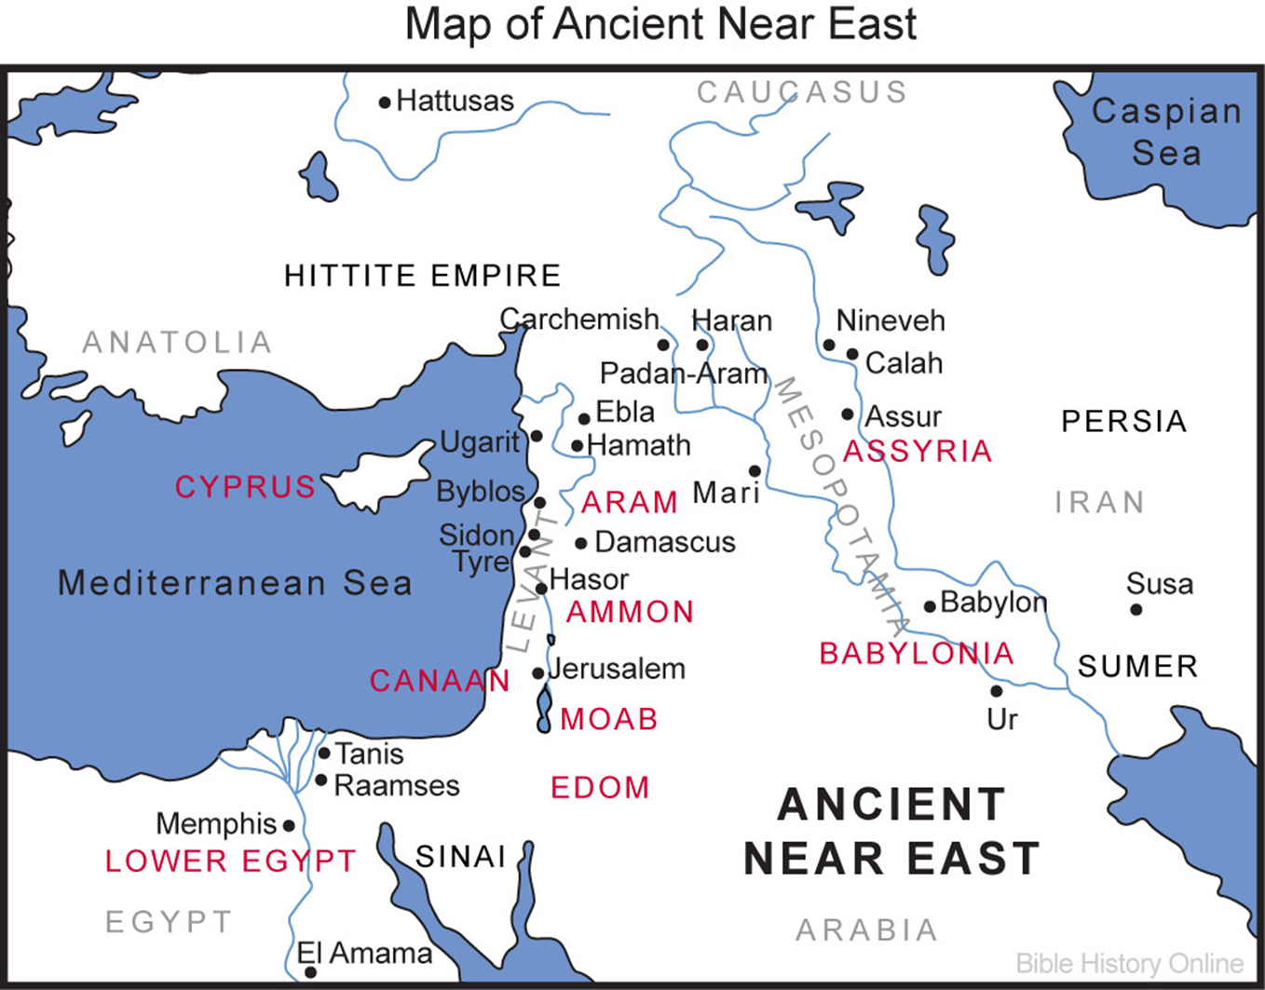

Slide 9
How did prophets convey their message?
From Terry Giles, ‘Prophets as performers’ (week 5 essential reading)
They used language that gave life and vitality, and often urgency, to their messages
Vivid metaphors and imagery – a mix of familiar and unexpected.
they wanted their audience to ‘see’ what they were saying, and to capture their attention, or even shock them
‘The prophetic performer asks the audience to imagine reality differently—to see through the prophet’s eyes.’
They may have performed actions, or used props, as well as speaking
As with any good theater, the prophetic performer does not leave his audience as he found them.’

Slide 10
Marcus Borg, The roles of the biblical prophets
(See handout on Canvas for these biblical texts)
Prophets disturb our sense of normalcy and the status quo – challenging, destabilizing dominant discourses – dare to speak the truth (even if it is unwelcome or dangerous).
Prophecy emerges from a situation of oppression by elites against the poor, vulnerable, powerless – they speak truth to power
Prophets have a passion for social justice
The prophet has a vision, a dream, that brings hope to his audience
With prophetic speech there’s corresponding prophetic action
Intimate relationship with God in their lives
Call narratives
Witness to divine words, visions, supernatural experiences.

Slide 11
Contemporary prophets?
In the absence of biblical prophets, who fulfils their role in contemporary (secular) popular culture?

Slide 12
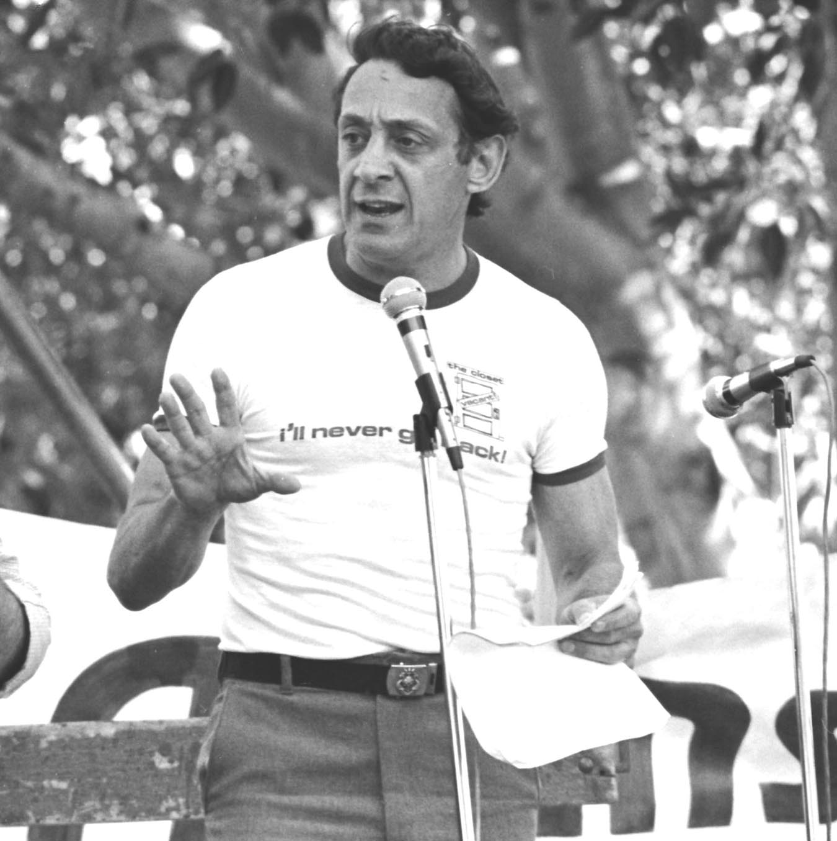
Prophets disturb our sense of normalcy
Harvey Milk (1930-78)
American politician in San Francisco who was a leading light in the gay rights movement, opposing political, social and legal discrimination against the LGBTI community.
The first openly gay person to be elected to public office in California (1977).
Left a legacy of revolutionary change in Californian politics.
Challenged the ‘normalcy’ of heteronormativity and homophobia.

Slide 13
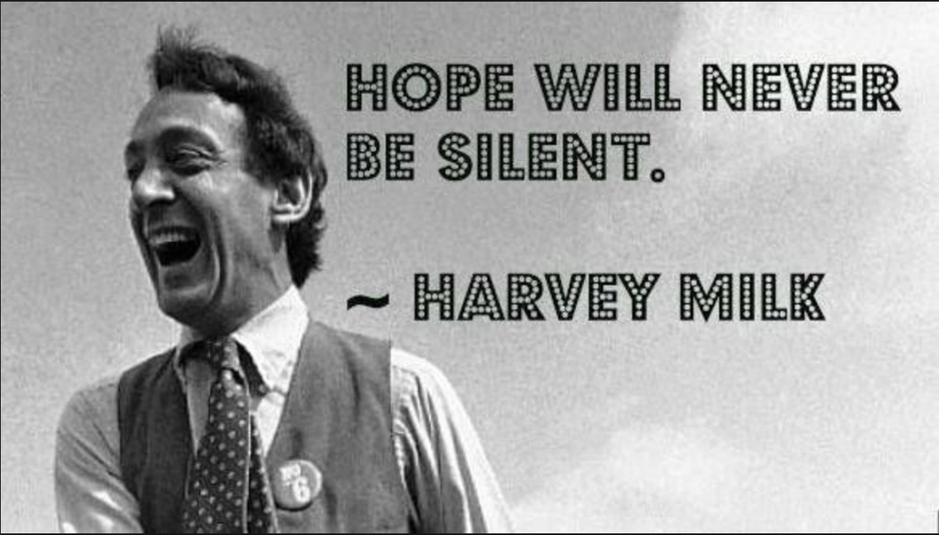
The prophet has a vision to keep hope alive
Anne Kronenberg (Milk’s campaign manager): “Whatever set Harvey apart from you or me was that he was a visionary. He imagined a righteous world inside his head and then he set about to create it for real, for all of us.”

Slide 14
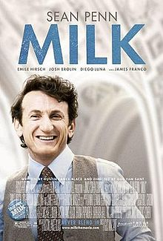
Milk
Dir. Gus Van Sant, 2008.
Starring Sean Penn
Biographical film based on life of Harvey Milk, containing some historical footage as well as recreated scenes.
http://librarysearch.auckland.ac.nz/UOA2_A:Combined_Local:uoa_alma51250585710002091

Slide 15
Harvey Milk
Using Borg’s definitions:
Disturbing a sense of normalcy – challenges the (homophobic) status quo. Dares to speak the truth.
Passion for social justice
Emerges from a situation of oppression
Uses both words and action
Has a vision, a dream, that keeps hope alive

Slide 16
Prophecy emerges from a situation of oppression: ACT UP
ACT UP (AIDS Coalition To Unleash Power) started in USA in 1987 by activist Larry Kramer
ACT UP is a ‘diverse, non-partisan group of individuals united in anger and committed to direct action to end the AIDS crisis. We advise and inform. We demonstrate. WE ARE NOT SILENT’
‘Silence = Death’ – protesting governmental and institutional lassitude in responding to AIDS crisis.
Institutional homophobia of governments and healthcare organizations
Greed of pharmaceutical companies
Stigma and homophobia of religious institutions

Slide 17
Prophets disturb our sense of normalcy: ‘Stop the church’ protest
‘Stop the Church’ – protest over Cardinal John O’Connor’s continued condemnation of homosexuality, condom use, and abortion.
Around 5000 demonstrators from ACT-UP and WHAM (Women’s Health Action Mobilization) rallied outside St Patrick’s Cathedral, NY.
Some protesters entered the church during mass, disrupting the service and staging a ‘die in’.
See ‘United in Anger’ documentary (34:15) https://www.youtube.com/watch?v=vuMTMEendus

Slide 18
ACT-UP – fulfilling the prophetic role
Disturbed society’s (and the Church’s) sense of normalcy, destabilizing dominant (homophobic, sexist and racist) discourses – dare to speak the truth.
Prophecy emerges from a situation of oppression by elites against the poor, vulnerable, powerless (AIDS affected politically disenfranchised communities the most)
Passion for social justice – justice for those stigmatized by AIDS
ACT-UP has a vision, a dream, that brings hope (the end of AIDS)
With prophetic speech there’s corresponding prophetic action – protests, ‘die-ins’, education, etc.

Slide 19
Malala Yousafzai
Pakistani teenage activist for female education and human rights advocacy in Pakistan.
Defied Taliban restrictions in her hometown and openly campaigned for girl’s education.
Victim of assassination attempt by Taliban in 2012.
Continues to advocate for girl’s education in both Pakistan and globally.

Slide 20
Malala Yousafzai
Using Borg’s definitions:
Disturbing a sense of normalcy – challenges the (Taliban’s) status quo about gender roles. Dares to speak the truth.
Passion for social justice
Emerges from a situation of oppression – she belongs to the oppressed group
Intimate relationship with God
Has a vision, a dream, that keeps hope alive

Slide 21
Kendrick Lamar
See student essay by Eddie Mataele here.
“I got a greater purpose. God put something in my heart to get across and that’s what I’m going to focus on, using my voice as an instrument and doing what needs to be done.”
Kendrick Lamar

Slide 22
Kendrick Lamar
Disturbs society’s sense of normalcy, destabilizing dominant discourses around race – dares to speak the truth through song lyrics and public statements.
His work emerges from a situation of oppression by elites against the vulnerable and powerless (particularly African Americans)
Passion for social justice
Lamar has a vision, a dream, that brings hope to his audience (lyrics of ‘Alright’ chanted by crowds during Black Lives Matter protest)
Intimate relationship with God – not essential for contemporary prophets but part of Lamar’s overarching message

Slide 23
Taika Waititi – disturbs our sense of normalcy
Challenging racism in New Zealand through his involvement in ‘Give Nothing to Racism’ campaign.
Some of his films highlight racism and other injustices engrained in New Zealand culture.
E.g. Hunt for the Wilderpeople (2016)
“The film examines the impact of the judicial system on the country’s children, particularly Māori youth, and the history of colonisation that continues to perpetuate disconnection and trauma in Te Ao Māori (the Māori world).”
Jonno Revanche and Justine Sachs
https://overland.org.au/2016/11/the-colonial-critique-of-hunt-for-the-wilderpeople/

Slide 24
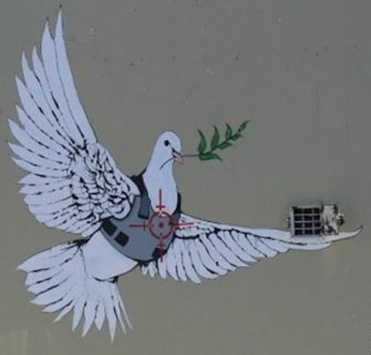
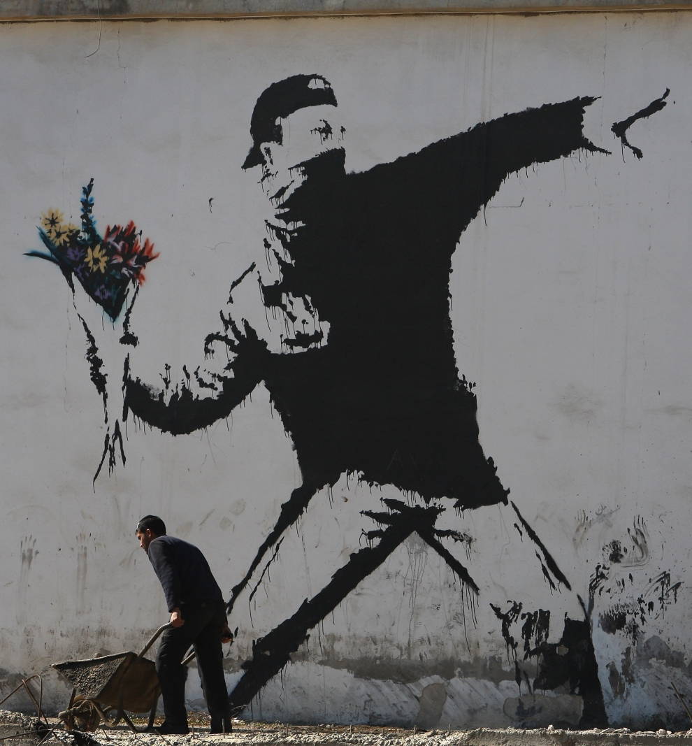
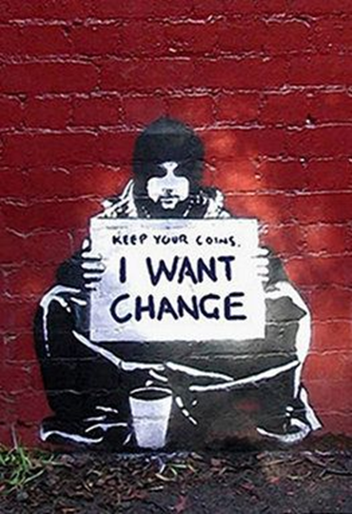
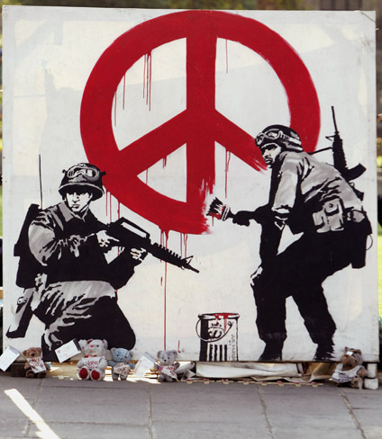
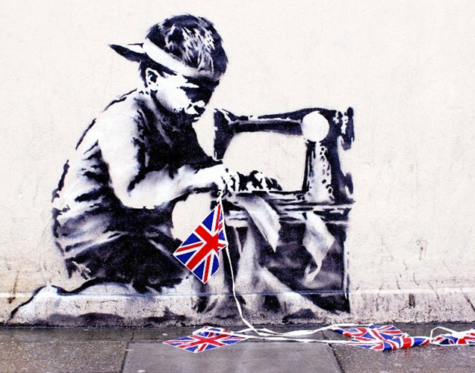
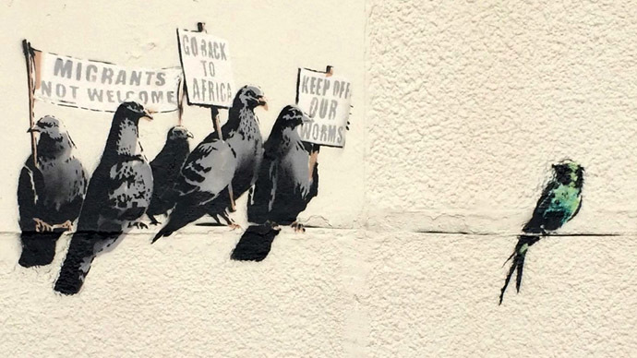
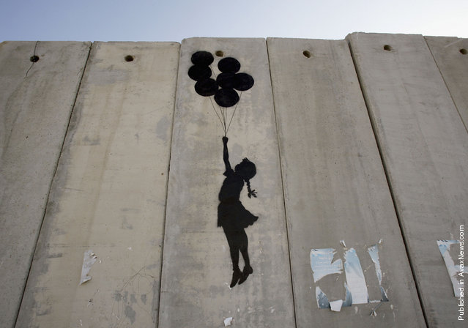
Beyond words: Banksy as prophetic artist?
World famous street artist, who uses his work to make powerful critiques about political and social injustices.

Slide 25
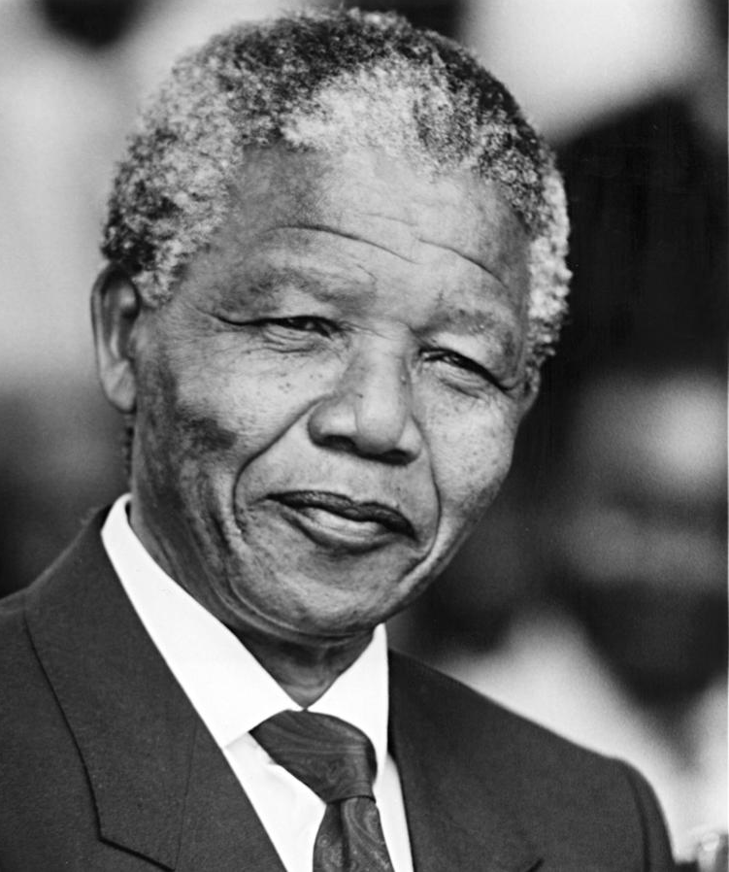
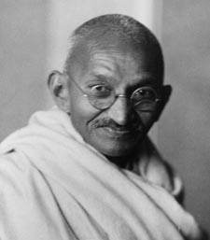
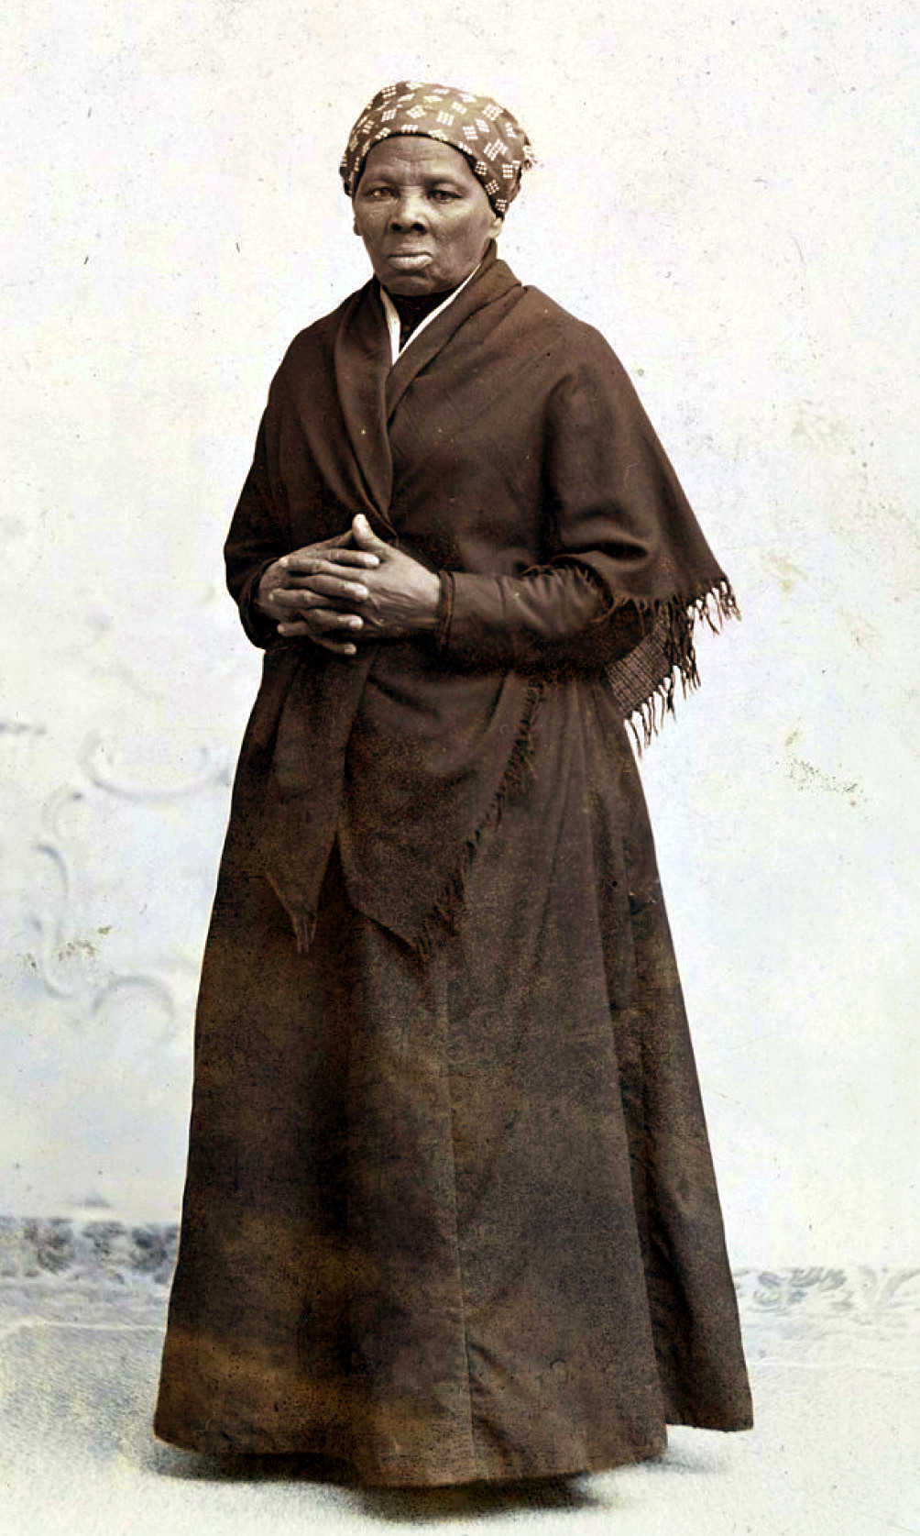
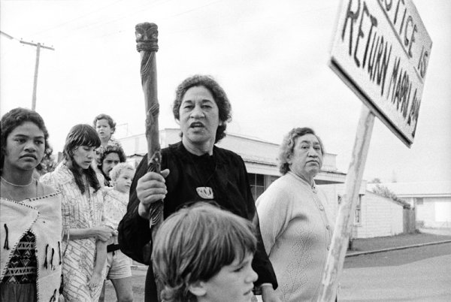
Mahatma Gandhi
Harriet Tubman
Malcolm X
Nelson Mandela
Kate Sheppard
Eva Rickard
Martin Luther King Jr

Slide 26
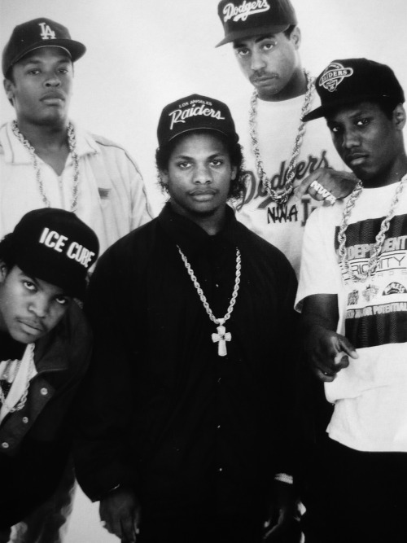
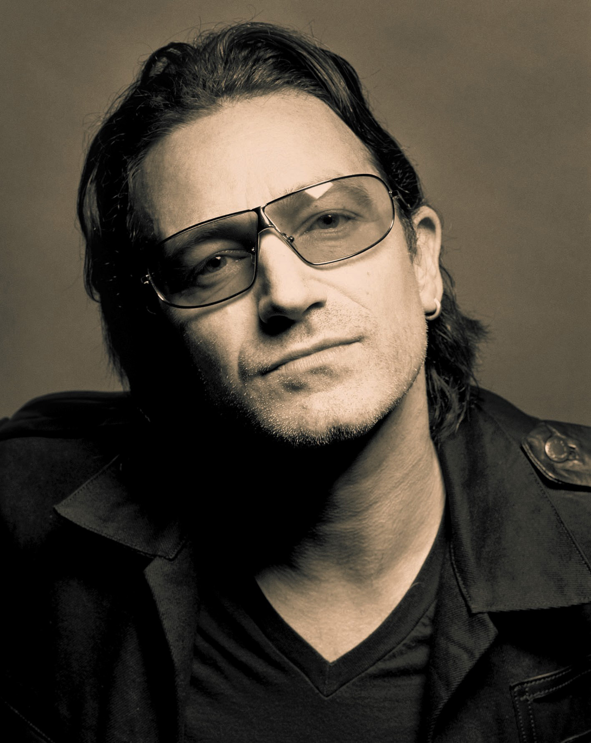
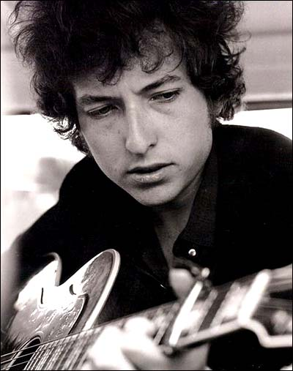
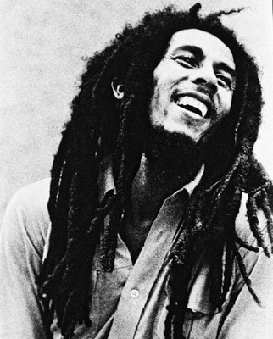
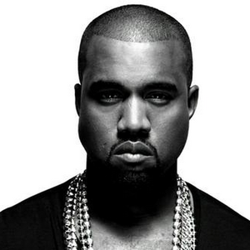
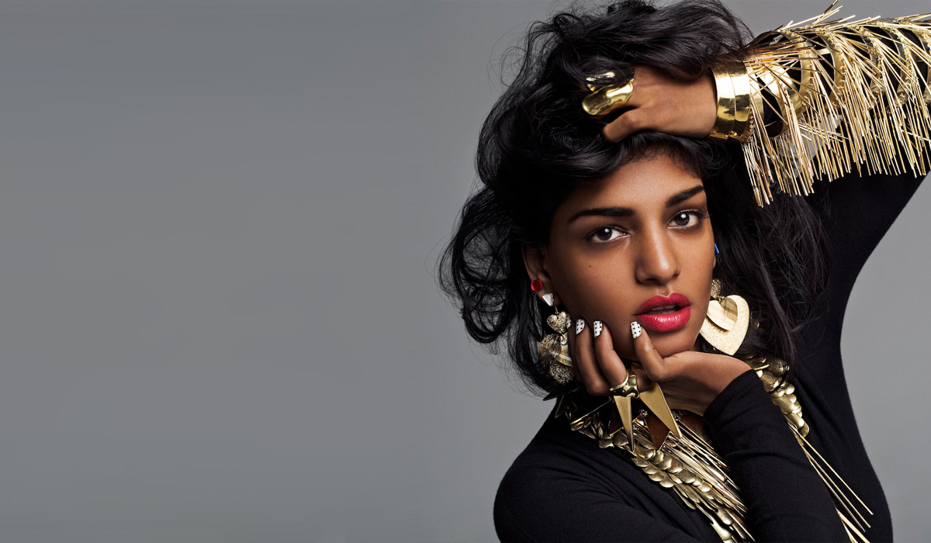
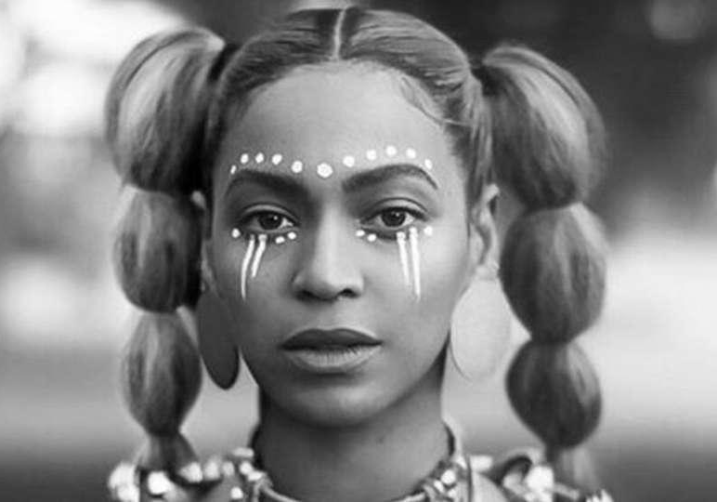
NWA
Bono
Bob Dylan
Bob Marley
Kanye West
M.I.A.
Beyoncé

Slide 27
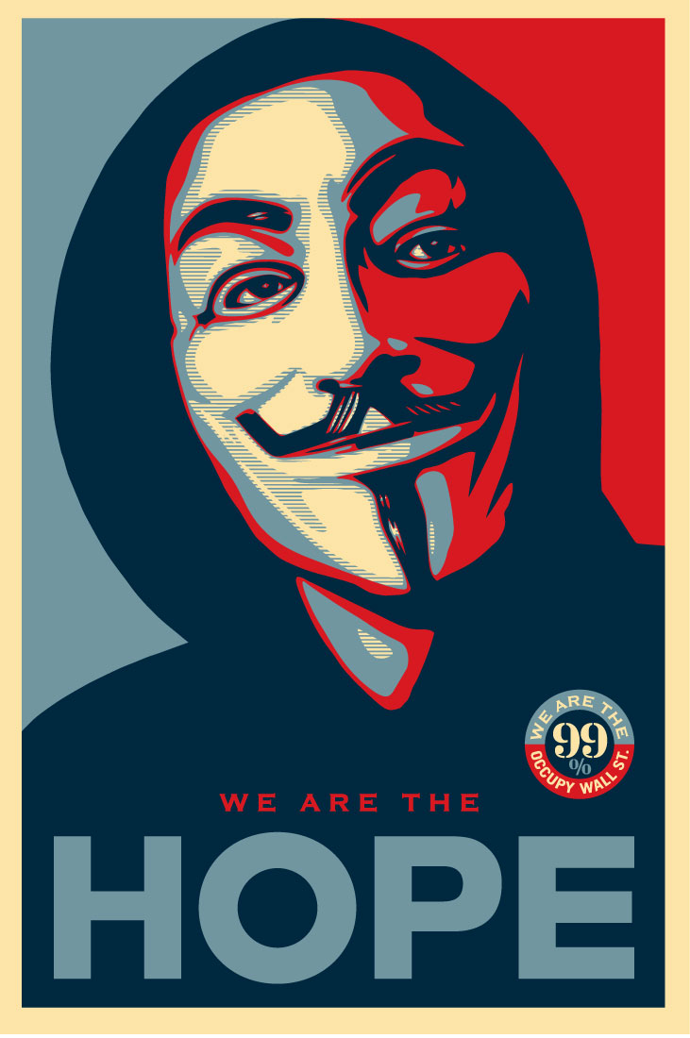
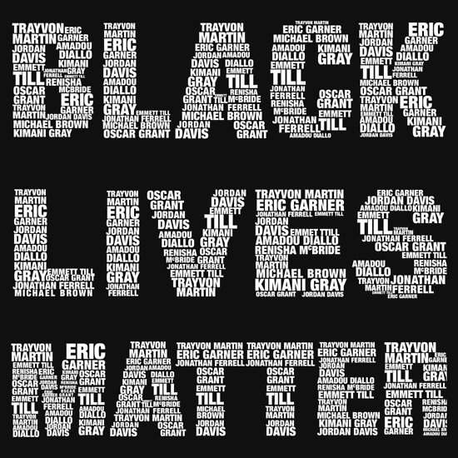
A prophetic group?

