Slide 1
O Muāgagana ma Alagaupu
19 Setema 2017

Slide 2
Fa’amoemoega/lecture objectives
Ina ia malamalama I le uiga o Muaagana ma Alagaupu ma le fa’aaogaina/ To understand the meaning of the Muagagana and Alagaupu and its use
Upu taua/Key words: Muagagana, Alagaupu

Slide 3
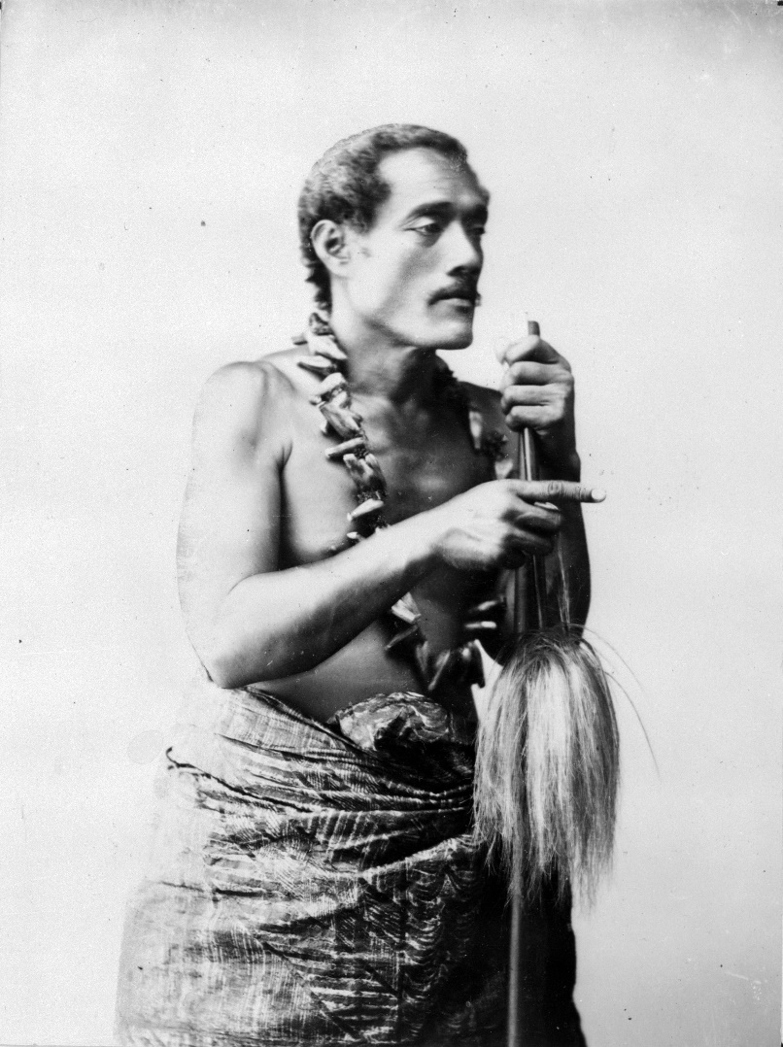
Lauga/ Art of Public speaking
Rhetorical skill or style … the study of the technique of using language effectively
The art of using speech to persuade, influence , or please;

Slide 4
Schultz E 1965 p. vii …
The most frequently used and best beloved embellishment of the language to which the orator resorts, is the muāgagana or alagā’upu.
They are proverbial expressions, taken from mythology, the history and everyday lives of the Samoan people and serve to illustrate their opinions and utterances.

Slide 5
…muāgagana & alagā’upu …
Both words are similar in meaning but differ in so far as the …

Slide 6
Muagagana
O ni upu e mafua mai i manu ma laáu, ma mea o le foafoaga e tupu i aso uma
…muāgagana (from mua, first, excellence … and gagana, language, speech) could be translated: embellishment of the language, elevated style.

Slide 7
According to the thought expressed, the ...
... muāgagana can be divided as follows: ...
1. Upu fa’aaloalo: expressions of respect and courtesy.
2. Upu fa’amaulalo: respect and courtesy in the form of self-abasement
3. Upu vivi’i: laudatory and complimentary remarks
4. Upu fiafia: expressions of joy and contentment
5. Upu alofa: expressions of love, compassion, and sympathy

Slide 8
6. Upu fa’anoanoa: expressions ...... of repentance and remorse.
7. Upu fa’aulaula: raillery, ridicule, jests.
8. Upu faifai: offensive expressions, insults
9. Upu fa’aalualu: encouragement, persuasion.
10 Upu fa’amāfanafana: comforting, consolatory expressions.
11. Upu tāofiofi: warning, exhortation, appeasement
12. Upu fa’afiti: denial, refusal

Slide 9
Schultz E (Dr) 1965 : Proverbial Expressions of the Samoans
The seven categories are : -
1. Faiva o le sami - fishing
2. Faiva o le vao - hunting
3. Galuega i totonu / fafo o le fale – Manual work inside and ouside the house
4. Taumafa, gāseseina – Food and its preparation

Slide 10
Schultz E (Dr) 1965 : Proverbial Expressions of the Samoans
5. Tā’aloga, o siva ma faigā’ai – Games, dances and feasts
6. Fēmālagaa’iga i le lau’ele’ele ma le sami – Land and Sea travel
7. Vāega ‘ese’ese e lēlaugatasiaa’i - Miscellaneous
E iai foi ma isi fa’avasegaga a Tofaeono Tanuvasa Tavale 2004, TŌFĀ MANUSINA

Slide 11
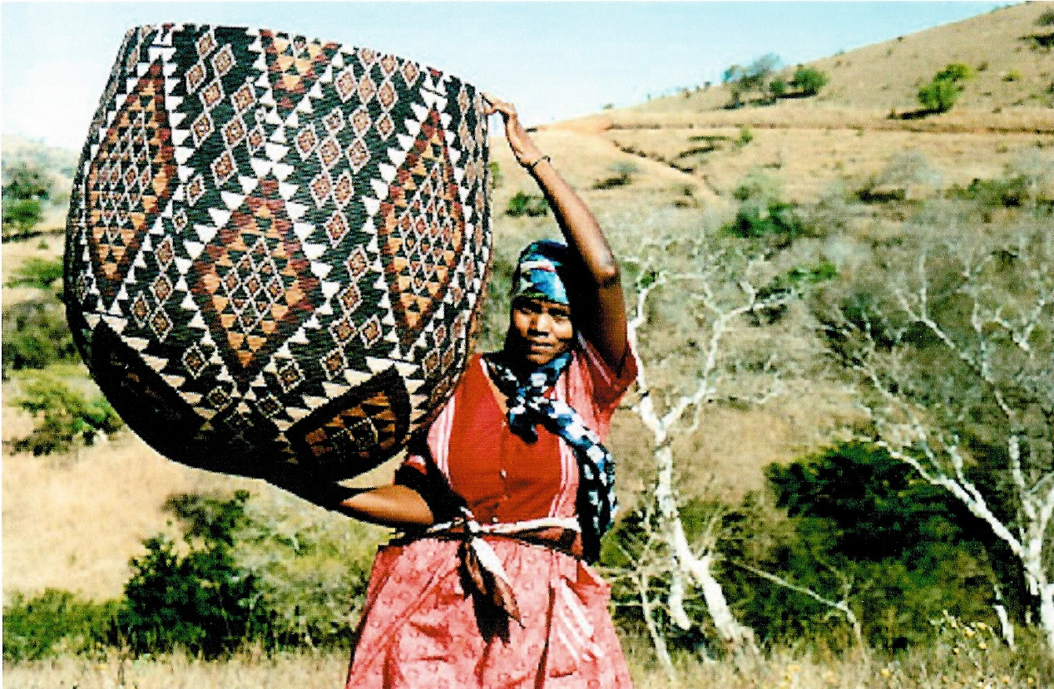
Fa átaítaíga o muagagana
Saá fa’aoti le utu o le faimea
Let the fisherman’s bamboo be completely emptied out

Slide 12
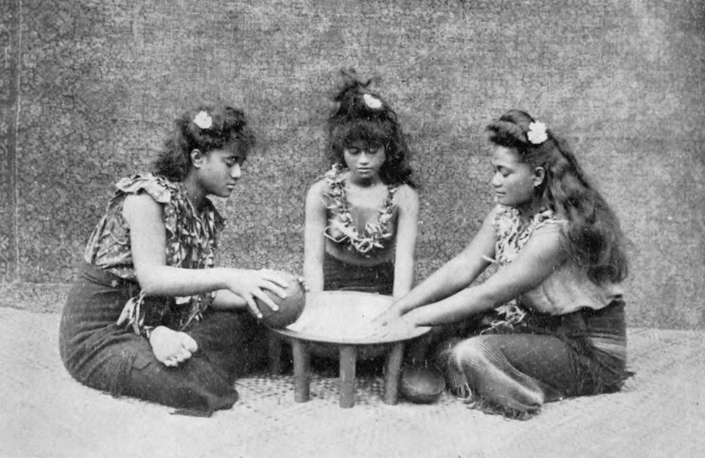
Upu fa’aalualu: In a discussion each should tell his opinion unreservedly for only then can the right decision be made

Slide 13
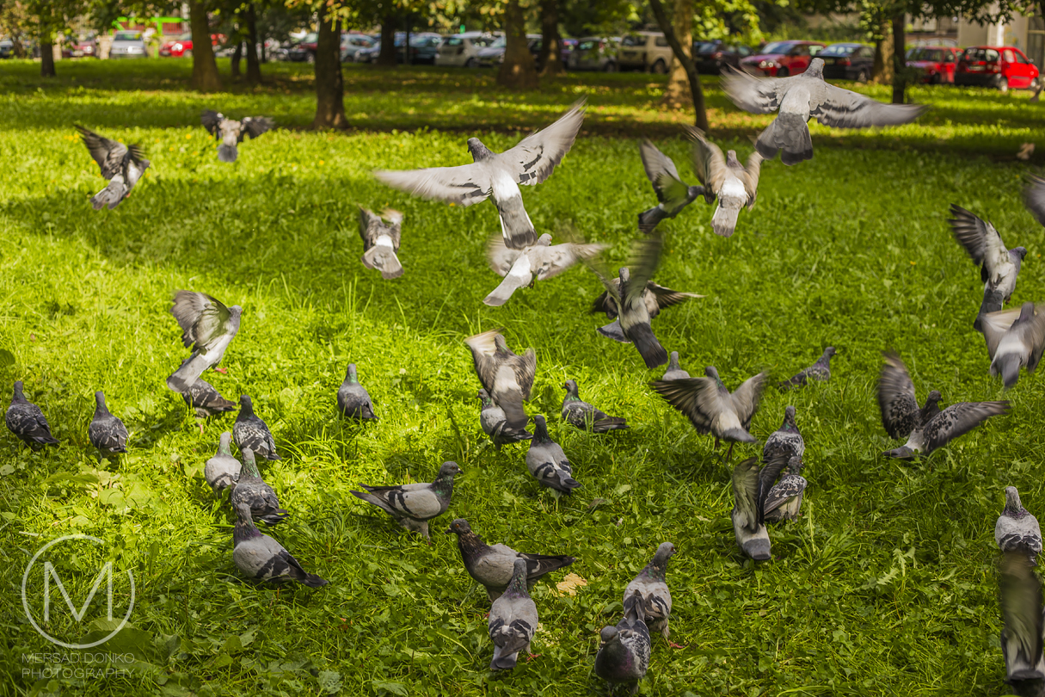
Ua fuifui fa’atasi ae vao eseese
Gathered into a flock from different parts of the forest

Slide 14
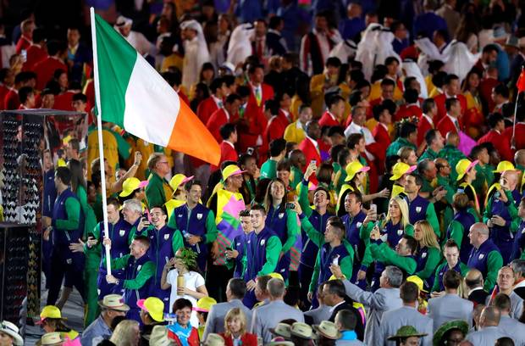
Used of an assembly whose members have come from different villages and who later on, will disperse again

Slide 15
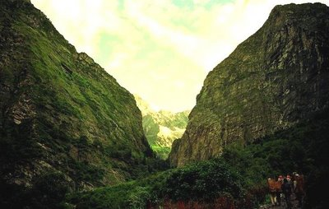
E pipi’i tia ‘ae mamao ala
The tia are close together but it is a long way from one to another

Slide 16
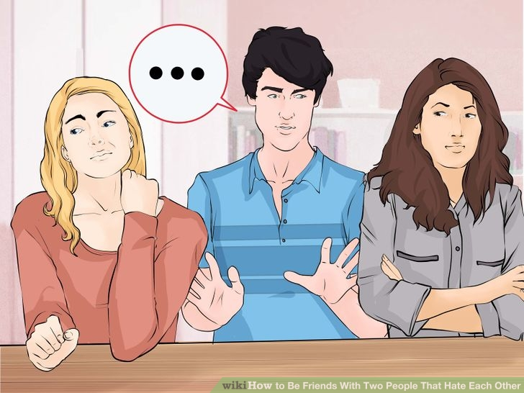
Two families or two villages may live in close proximity and yet far removed one from the other through lack of kinship

Slide 17
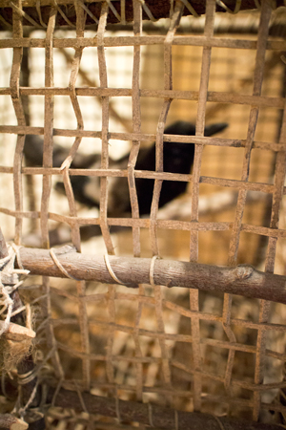
‘Ae‘ae lea manu ua ulu
‘Ae‘ae, the bird has entered the cage

Slide 18
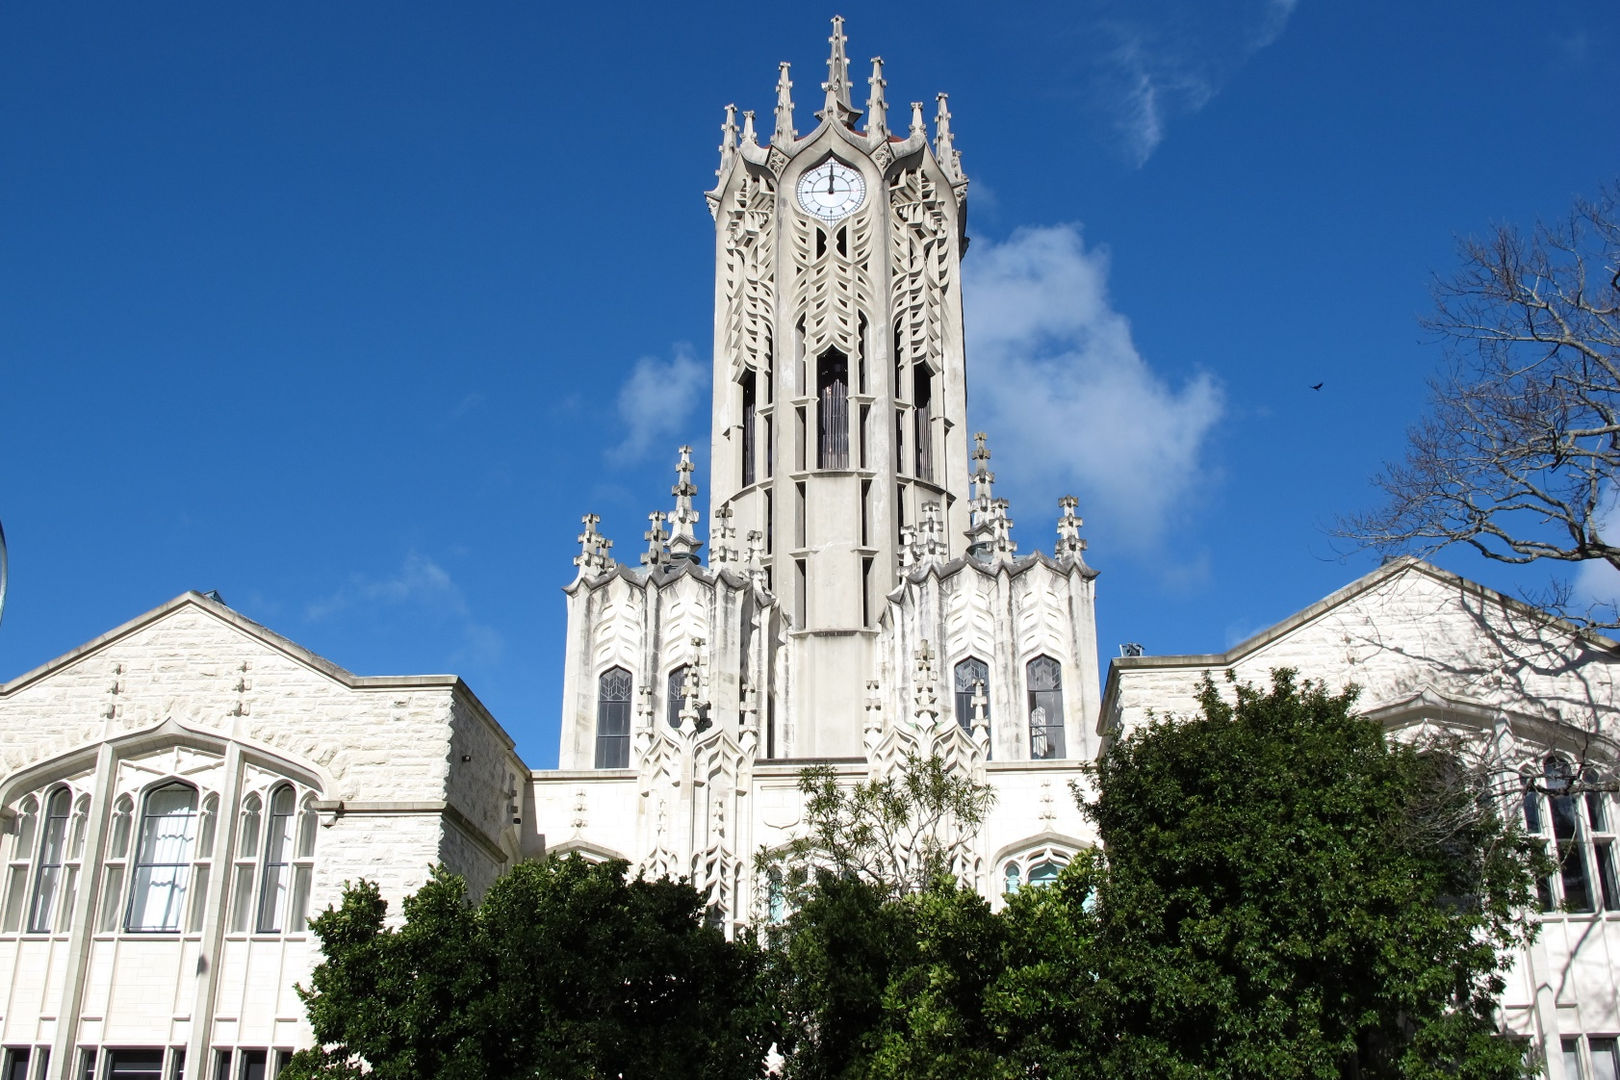
Upu faáalualu: When you see an advantage, turn it to good account. Don’t throw away a favourable opportunity

Slide 19
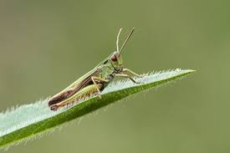
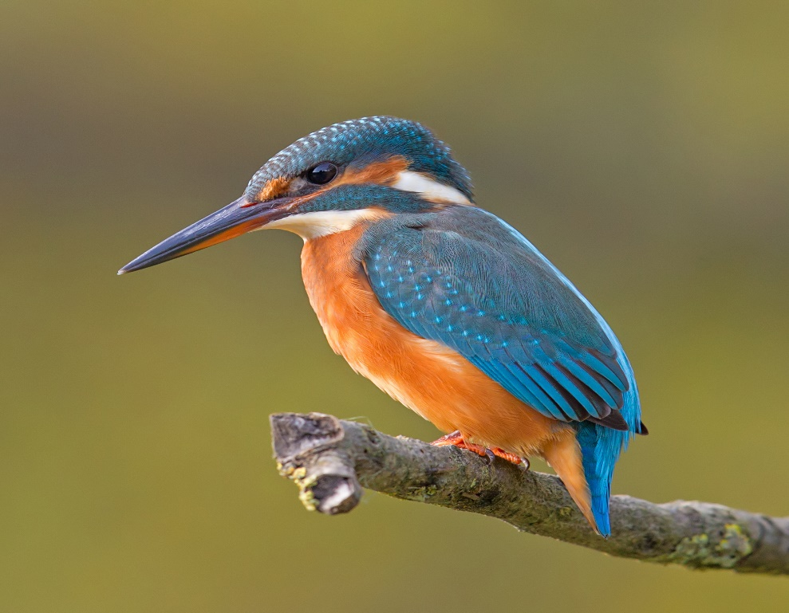
E lele le sē ae lama le ti’otala
The grasshopper flies about, but the kingfisher watches him

Slide 20
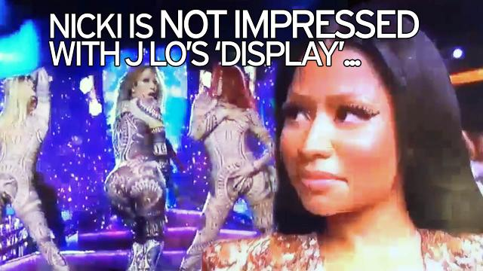

Slide 21
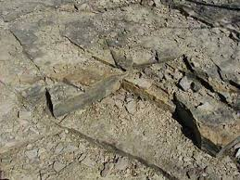
E pala le ma’a, ae le pala tala
Stones decay but words last

Slide 22
Offences are hard to forget

Slide 23
Ufiufi a manu gase
To cover up dead birds

Slide 24
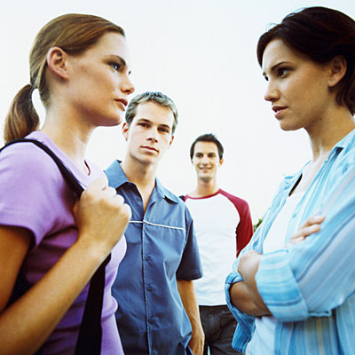
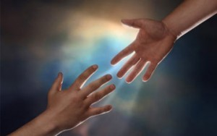
To stand up for a friend or relative, to help him bear his misfortune, to forgive and ‘cover up’ his mistakes

Slide 25
Ua sili mea le seuga
The hunting implements are hung up

Slide 26
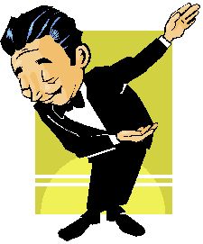
Refers to conclusion of a speech, a fono etc

Slide 27
AlagĀupu
O upu e mafua mai i tagata ma tala tu’u, o mea na tutupu i aso anamua
… alagā’upu points towards the existence of a story from which the proverb originates (o le tala e ala ai le upu)

Slide 28
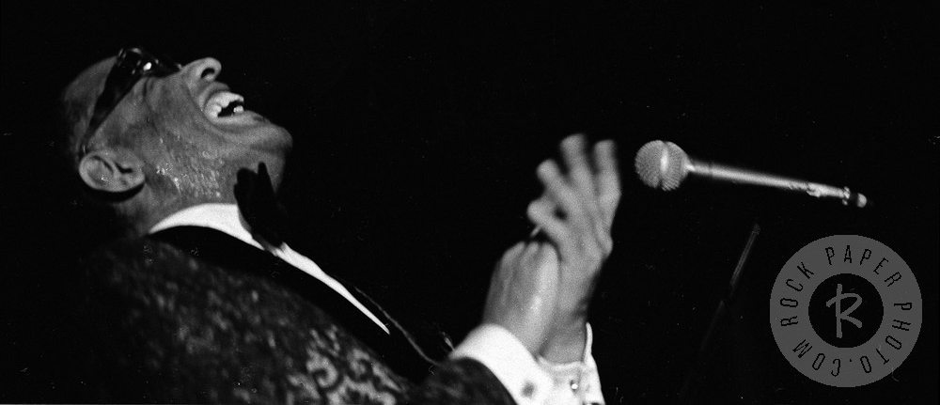
Fa’ata’ita’iga o alagĀupu
Ua patipati ta’oto le Fe’epo
Fe’epo clapped his hands lying down

Slide 29
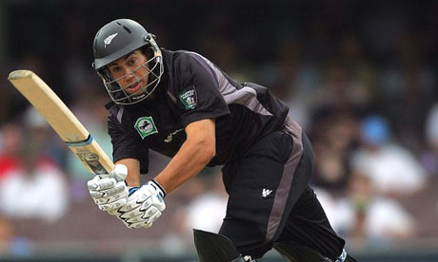
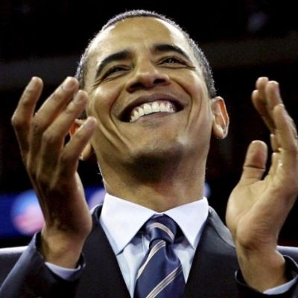
Upu fiafia: Celebrating happy occassion

Slide 30
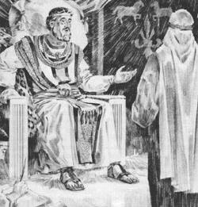
Ua ta fia Falealili fua
I want to be from Falealili

Slide 31
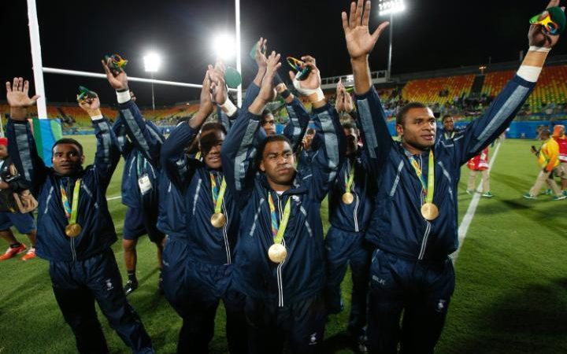
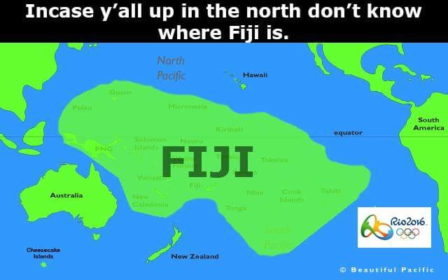
Compliment: When a job is competed so well that it inspires others to want to be like you

Slide 32
E le aóaia e Laupuā, Tamafaiga
Laupua does not teach Tamafaiga

Slide 33
Links on to past history …
In the existing Samoan literature the proverbial expressions have suffered woeful and undeserved neglect.
However, the orators use them so frequently and they shed so much light on the past history and the present opinions of the people, that their importance cannot be overrated.

Slide 34
Traditionalization process …
Systematically linking the present talk to a meaningful past, while at the same time authenticating his story (much like an art or antique dealer) by “tracing its provenience or place of origin”.
Narrator forges links of contextualization to give shape and meaning to his expression.
[Bauman 1983]

