Slide 1
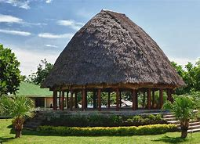
O tala tu’u a Samoa/Samoan stories
Tala: O le fale o Sina/ the house of Sina
9 Me 2018

Slide 2
Talatu’u/Samoan stories
Tala + tu’u
Story
Put/leave

Slide 3
Aisea e tĀua ai tala tu’u a samoa/Why are Samoan stories important?
1. O lo’o fa’amauina ai tala fa’asolopito a Samoa/It records the history of Samoa
2. E fai ma auala e fa’amatalaina ai tu ma aga o le atunu’u/A way to explain customas and traditions
3. Maua ai ni a’oaoga/ Serves as a reminder of timely lessons
4. Fa’amatalaina le fa’afanua o Samoa/Explains the geography of Samoa
5. Fa’amatalaina talitonuga o tagata Samoa/Explains the beliefs of Samoan people
6. Fa’amatalaina mafaufauga o tagata Samoa/Explains the mindset or worldview of Samoan people

Slide 4
Fa’amoemoe /Lecture outline
Ina ia outou malamalama i se isi foi tala taua o le atunu’u
Ia iloa le mafua’aga o nisi alaga’upu o le atunu’u
Upu taua/Keywords: Sina, Tigilau, aumoega, poula

Slide 5
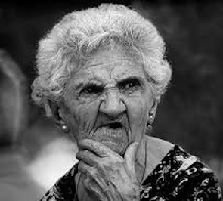
SINA
?

Slide 6
Hina
Kina
SINA
Hinemoa

Slide 7
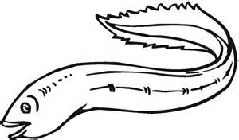

Slide 8
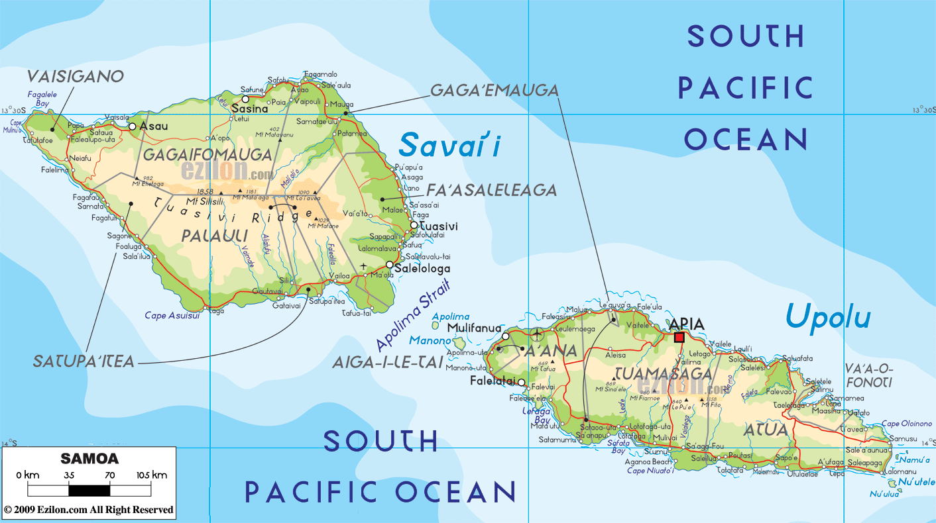

Slide 9
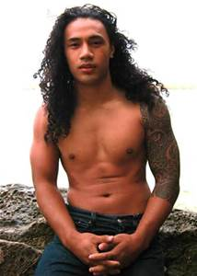
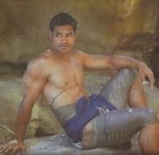
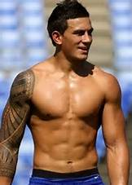
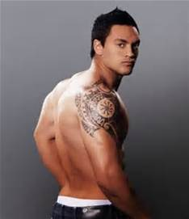

Slide 10
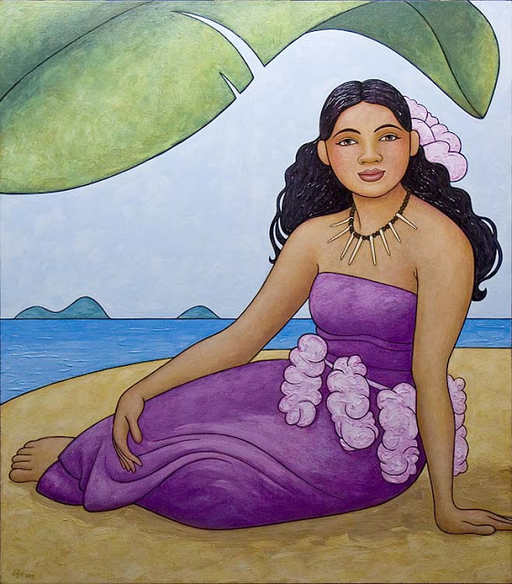
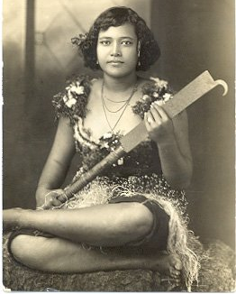
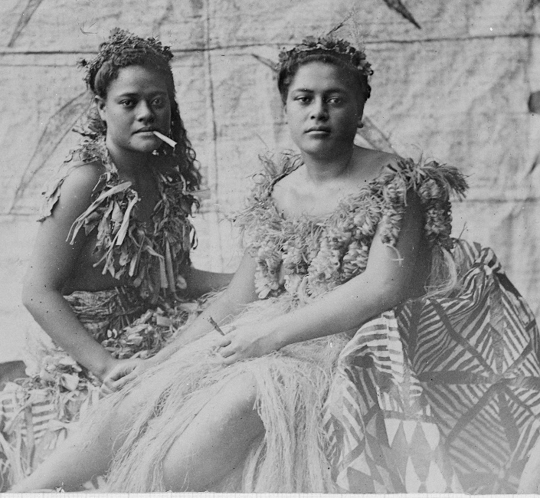

Slide 11
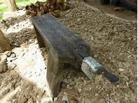
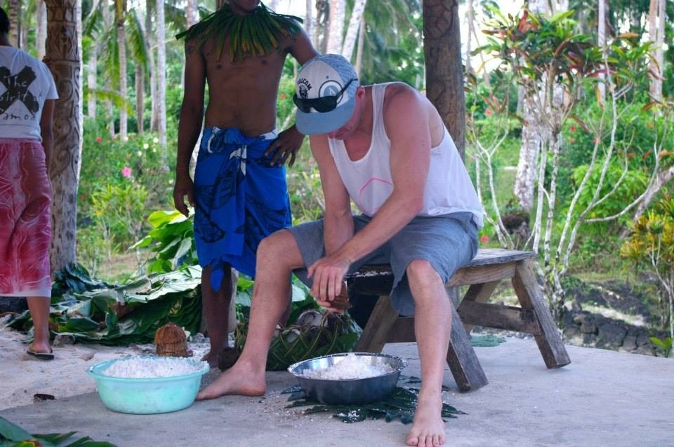

Slide 12
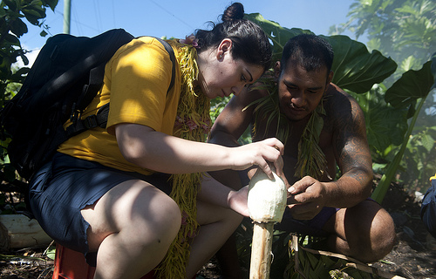
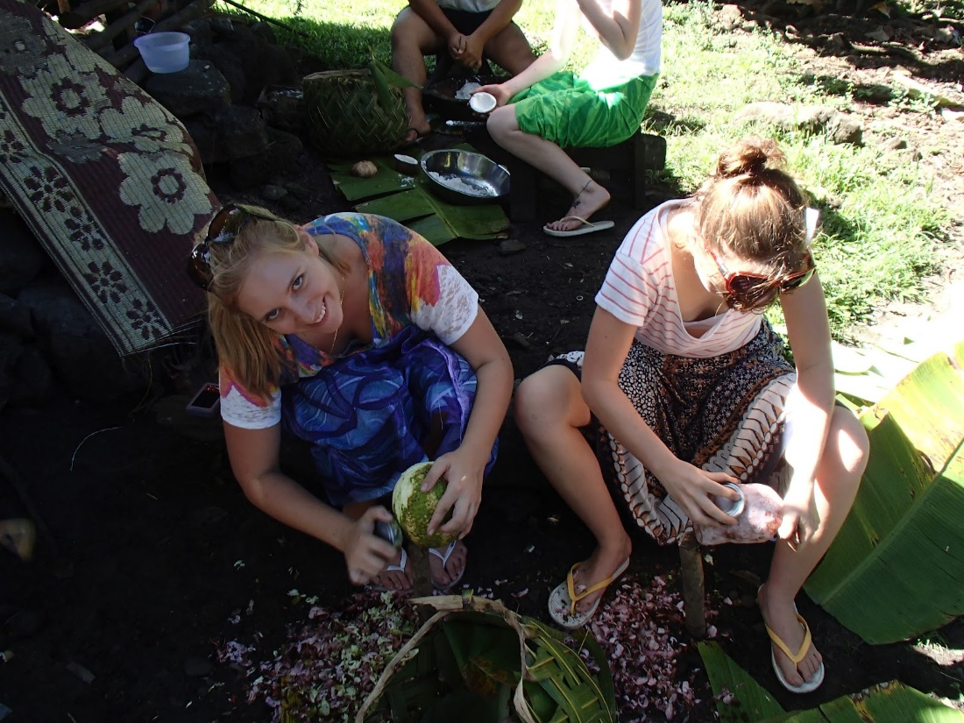

Slide 13
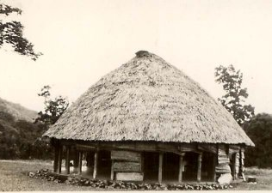

Slide 14
LEAI FAÁFETAI

Slide 15
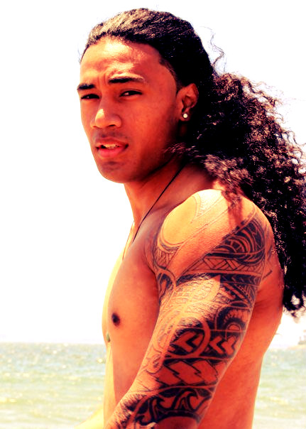
TIGILAU

Slide 16
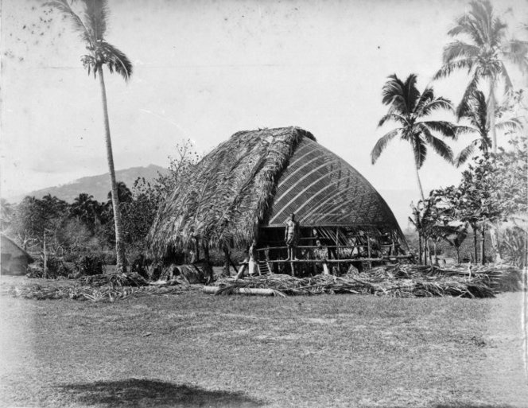

Slide 18
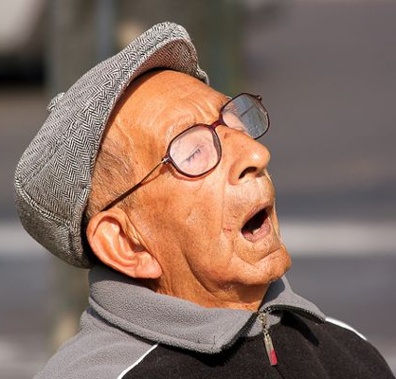
Oh what a night….

Slide 19
BRING IT ON!

Slide 20
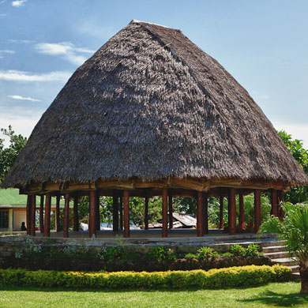
‘Ua au le ina’ilau a tama’ita’i ae leí au le ina’ilau a tane’
The ladies row of thatch is complete, but not the men

Slide 21
O A NI MEA TAUA A SAMOA NA MAUA MAI I LENEI TALA?
Le nafa o tama’ita’i i le aganu’u a Samoa
Aumoega – se tasi o tu ma aga a le atunu’u i le sa’iliga o se to’alua/ava – Sa va’aia ia Tigilau
Poula – se tu ma aga a Samoa i le taligamalo –

Slide 22
O a ni a’oa’oga na maua mai I lenei tala?
Ina ia mataala ma aua le fai mea tu’u e pei ona sa va’aia i le galuega a Sina/to always be vigilant and not procrastinate, as seen in the task of the ladies who finished their task
Humility/Loto maualalo – If the men were humble they would not have underestimated the ladies and they would have finished their row of thatch on time
Galue malosi/Tinou/Aua le fiu/Hardwork/determined/perseverance – Hardwork beats talent and strength…when ladies completed the row of thatch. While the men slept they stayed up all night to complete their task

