Slide 1
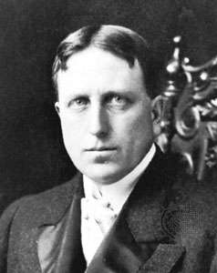
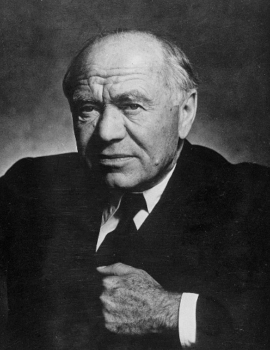
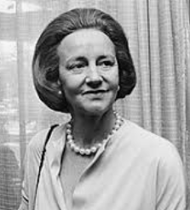
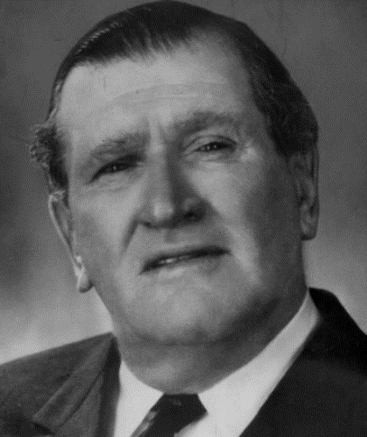
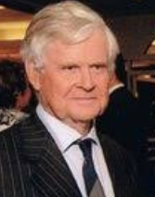
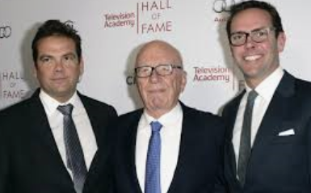
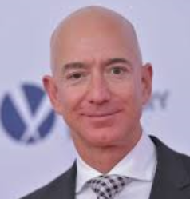
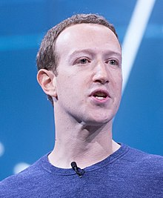
The Power of Private Interests: Media Ownership mark.boyd@auckland.ac.nz

Slide 2
Bibliography
Barry, P. 2007. The Rise and Rise of Kerry Packer Uncut, Sydney, Bantam
Economou, N. and Tanner, S. 2008. Media, Power and Politics in Australia, Sydney, Pearson
Hall, S. 2008. Tabloid Man: The Life and Times of Ezra Norton, Sydney, Fourth Estate
Hallin, D., and Mancini, P. 2004. Comparing Media Systems: Three Models of Media and Politics, New York, Cambridge University Press
Hitchens, C. 2010. Hitch-22: A Memoir, London, Atlantic Books

Slide 3
Bibliography
Myllylahti, M. (2018, December). JMAD New Zealand Media Ownership Report 2018, Auckland, AUT Research Centre for Journalism, Media and Democracy. Retrieved from: https://www.aut.ac.nz/study/study-options/communication-studies/research/journalism,-media-and-democracy-research-centre/projects/new-zealand-media-ownership-report
Page, B. 2003. The Murdoch Archipelago, London, Simon and Schuster
Tiffen, R. 1989. News and Power, Sydney, Allen and Unwin
2014. Rupert Murdoch: A Reassessment, Sydney, University of New South Wales Press
Waugh, E. 1938. Scoop, London, Chapman and Hall

Slide 4
Video
James Packer/David Gyngell
http://www.dailymail.co.uk/news/article-2626984
Alan Bond
http://www.abc.net.au/4corners/50years/decades/1990s/
Kerry Packer
http://www.youtube.com/watch?v=QB0S70UmsM0
Gina Rinehart
http://www.youtube.com/watch?v=BDAwGqlIp7E

