Slide 1
Comms 200: Writing in the Workplace
Semester 1, 2019

Slide 2
class representative?
https://www.youtube.com/watch?v=M1P40LpXdl8&feature=youtu.be

Slide 3
course outline
https://canvas.auckland.ac.nz/courses/38215

Slide 4
writing as design
design is (both noun and verb)
— an intent or strategy (plan, plot, scheme)
— a cheat, a deceit, cunning
— an implicit structure or explicit motif
— an implicit problem
— play
See Sean Sturm, ‘“About the word design” by Vilém Flusser’
https://seansturm.wordpress.com/category/design/page/1/

Slide 5
clarity of design (writing intent)
depends on
business goals and target (user/customer)
self-explanatory functions
use of space (graphics)
legibility
interactivity and real-time feedback
effective language
awareness of context
awareness of what might go wrong

Slide 6
writing as ‘text’
text = words
document = physical container
work = set of ideas (i.e. campaign)
writing, typography and design are connected
writing may be phonetic or ideographic/pictographic/logographic (or a mixture)
DiMarco, chap. 1, pp. 1-7

Slide 7
words are images
Lets have a look at Times New Roman
Let’s have a look at Ariel
Let have a look at Calibri
Let’s have a look at Franklin Gothic Heavy
See Helvetica, dir. Gary Hustwitt (2007)
https://www.youtube.com/watch?v=9g3Ogtgleyg

Slide 9
semiotics
icon = represents the physical shape of something
symbol = an abstract image of something
index = points to something
= infographic
note: seme is a unit of meaning

Slide 10
logographics
consider
lay out/pattern
negative space
shapes
colour
typography
What does the design make you feel, think, want?

Slide 13
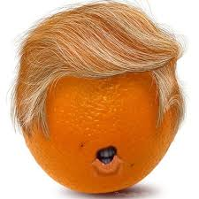
why are you writing?
educate
entertain
persuade
inform/mis-inform
complain/politicise/protest
subvert

Slide 14
writing for who(m)?
what/which audience (assessing the reader’s needs, knowledge and interest)
– speaker/writer relation is a matter of complicity, establishing rapport
Matt Abrahams https://www.youtube.com/watch?v=A1siJ0AnI3A&t=82s
5 factors to consider:
– education (what does the audience know, want to know, care about?)
– status (writer’s authority vis-a-vis your reader)
– attitude (the readers’ state of mind)
– demographics (gender, class, occupation, location/nationality)
– psychographics (‘lifestyle values, leisure activities social self-image’)
Marsen, pp. 5-7.
Marsen, pp.

Slide 15
The work of design – what’s the story?
https://thespinoff.co.nz/
https://www.nzherald.co.nz/
https://www.baristacats.co.nz/about-us
https://www.benjerry.co.nz/flavours/made-of-something-more
https://www.fonterra.com/
What do you see (design elements)?
What is the site’s language, and its effect?
What is the site’s audience (and how is it identified)?
How does the site make you feel (intensity, affect and appeal)?
What is this organisation’s purpose/value?

Slide 16
design to document (technical writing)
project (task at hand)
– advertising or promotional campaign
– identifying or solving a problem
– developing or evaluating strategic plan
brief = terms of reference (instruction to perform a task, why/where/when/for whom, and what form it should take)
– scene (scope and framework of project, stakeholders, occasion)
– content (issues, questions, materials, sources, funding, deadlines)
– treatment (plan of action, steps, timeline, division of tasks, presentation)
Marsen, pp. 9-11.

Slide 17
rhetorical situation (context)
context (time, place and occasion)
audience (relation to reader)
– internal and external (co-worker, colleagues, clients, customers public)
– knowledge basis, preconceptions, expectations
– primary, secondary and intermediate readers
genre/text-type (consider format or document design)
medium /media – appropriate to purpose, audience and genre
(Marsen, pp. 2-3)

Slide 18
text-work
purpose/intent
audience
work context/organisation
genre (text-type)
visual organisation (graphic elements and constellation)
style (diction, tone/pitch, affect)
narrative (work story)
– who are the actors and agents, and what is the action, of this story?
response
– what happens, is happening, due to this document?

Slide 20
writing does work
work is a writing operation/writing is a work operation
= means of work organisation
writing as a ‘set of instructions’ https://www.youtube.com/watch?v=jMs3CfyW1Qw
– inscribes values, people, function, strategy
work as a narrative (a story, with actors, objects, incidents and accidents)
– consider instances of mis-communication and work deviance
What organising work does writing do? What work operation does writing expose?
Y

Slide 21
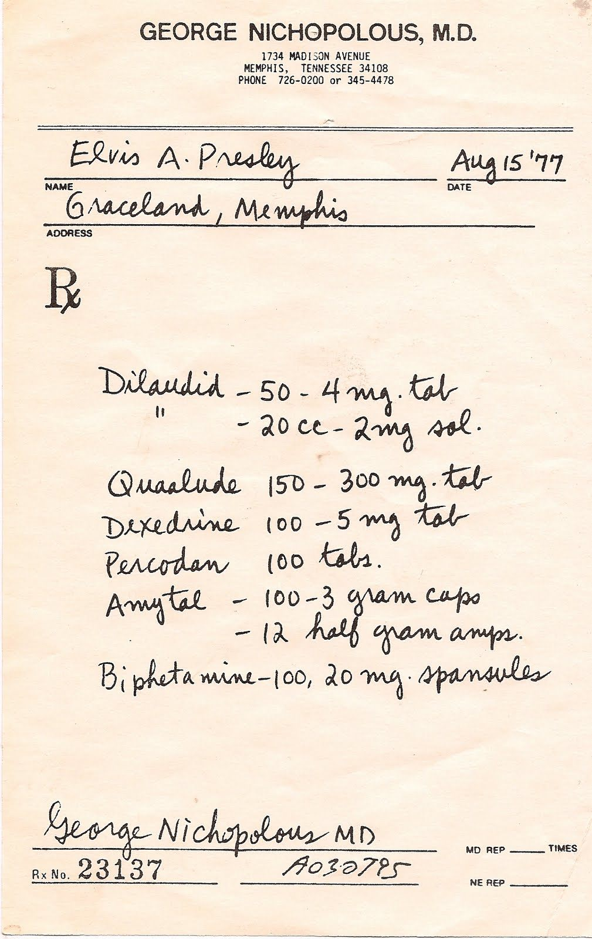
workplace domains
community organisations
professions (law, medicine, engineering)
NGOs
creative industries and Arts agencies
government institutions and agencies
educational institutions (private and public)
business
(self-owned, cooperative, corporate)
hospitality, leisure, tourism
other
What kind of writing can be found in these domains?
This Photo by Unknown Author is licensed under CC BY-NC-SA

