Slide 1
COMMS 200: Writing in the Workplace
Dr Evija Trofimova
evija.trofimova@auckland.ac.nz
Centre for Learning and Research in Higher Education (CLeaR)

Slide 2
So many of them!

Slide 3
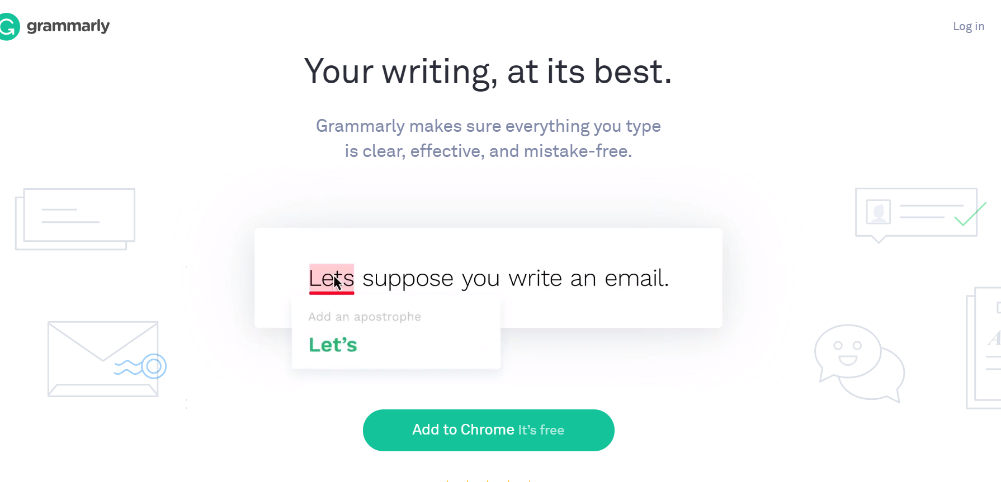

Slide 4
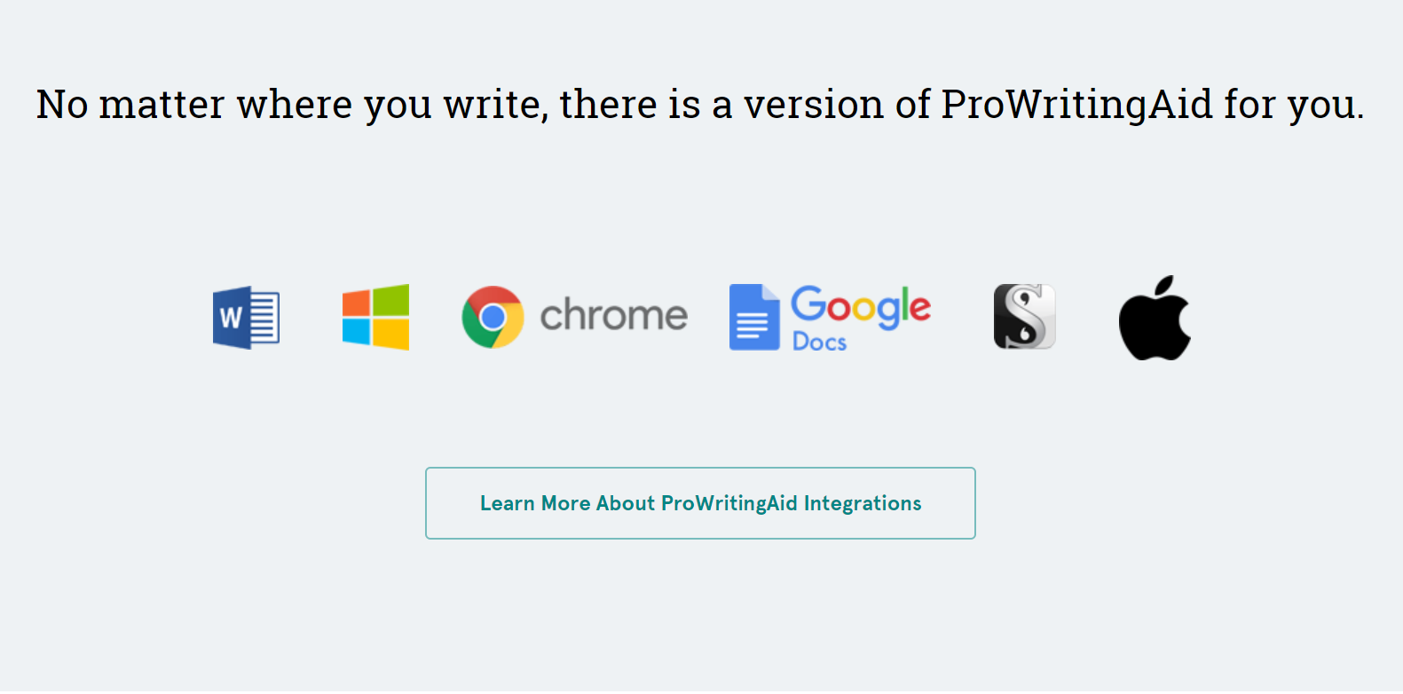

Slide 5
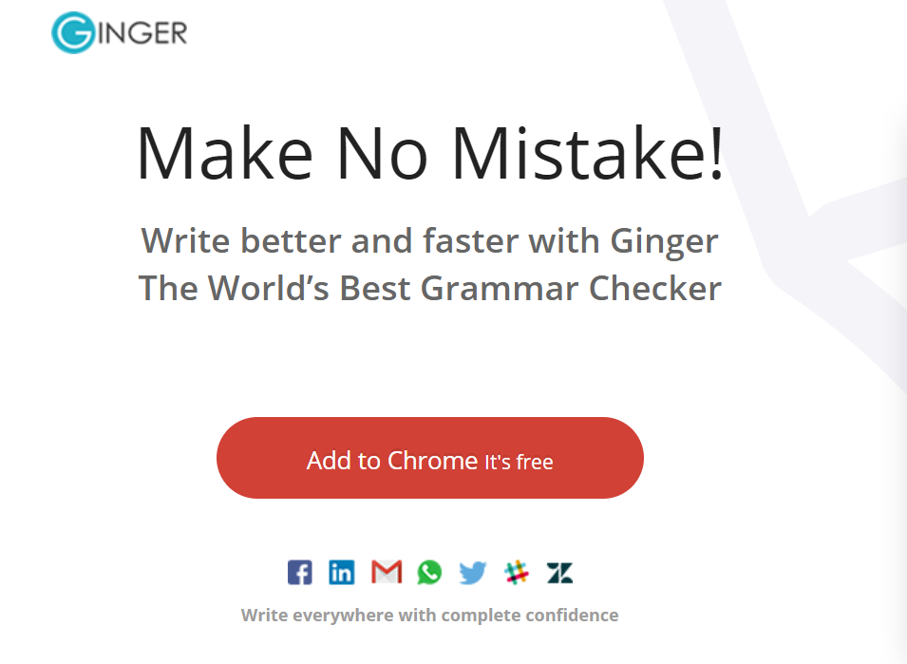

Slide 6
The dangers of relying on corrective tools
MSGC corrections are often too prescriptive, absolutist, dated, inaccurate, unclear or simply “mystifying” (Alex Vernon; Tim McGee and Patricia Ericsson; Anne Curzan)
“Our brains seem to become less vigilant when we know a grammatical safety net will catch us.” (Joe Pinsker)
Relying on a piece of software to “fix” our writing makes us complacent and “turns us from [language] actors into observers” (Nicholas Carr)

Slide 7
When choosing a digital tool for writing, consider...
its suitability for purpose (a style-checking tool will not correct your grammar)
its capacities and limitations (what are its ‘blind spots’?)
its accuracy (don’t take its claims at face value – test it)
authority (where does it get its language ‘rules’ from?)
hidden ideology (what kind of writing does it endorse? In whose interests does it work?)
ethical issues (how does the tool/website make money? Is my private data kept safe with it?)
etc.

Slide 8
Pros for writing with tools?
Possible caveats?
fast
efficient (by own standards)
can become pedagogical tools
[any more?]
not being able to judge on tool’s judgement
being mislead (‘false positives’ / ‘false negatives’)
not being aware of its limitations
never learning anything
...

Slide 9
Digital writing tools matter. They:
are ubiquitous (increasingly embedded in all writing platforms)
have assumed authority (we unquestioningly put trust into them)
are imperfect and limited (in what and how they are able to see and correct)
can be helpful (in ensuring your writing adheres to the rules of grammar, syntax, style, tone and genre) when used cautiously
can teach you more about your own writing through your self-reflection (so that you become more aware of your strengths, weaknesses and quirks as a writer)

Slide 10
Ask important questions:
What is YOUR writing like?
What does the tool think your writing is like?
What does the tool tell you about your writing?
What does the tool NOT see?
What kinds of rules does the tool follow?
What kind of writing does it envisage?
How has following the tool’s suggestions changed your writing?
How has it improved?
What strengths, if any, has your writing lost as a result?
What happened, if you let the tool do your writing for you?
Etc.

Slide 11
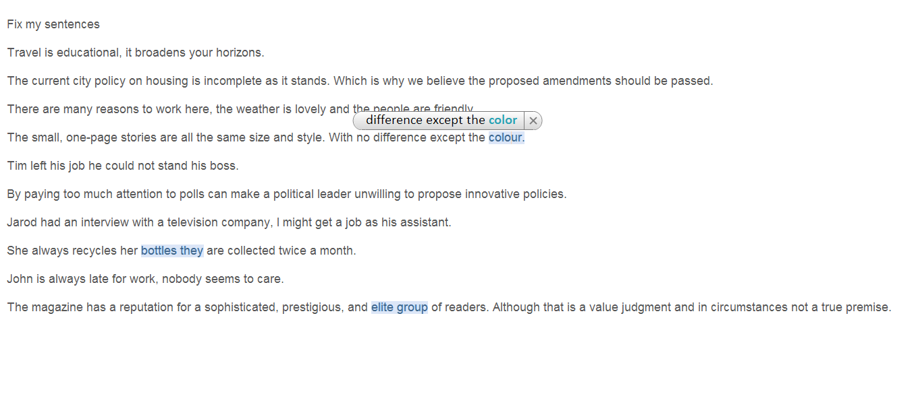
Ginger spelling & grammar checker

Slide 12
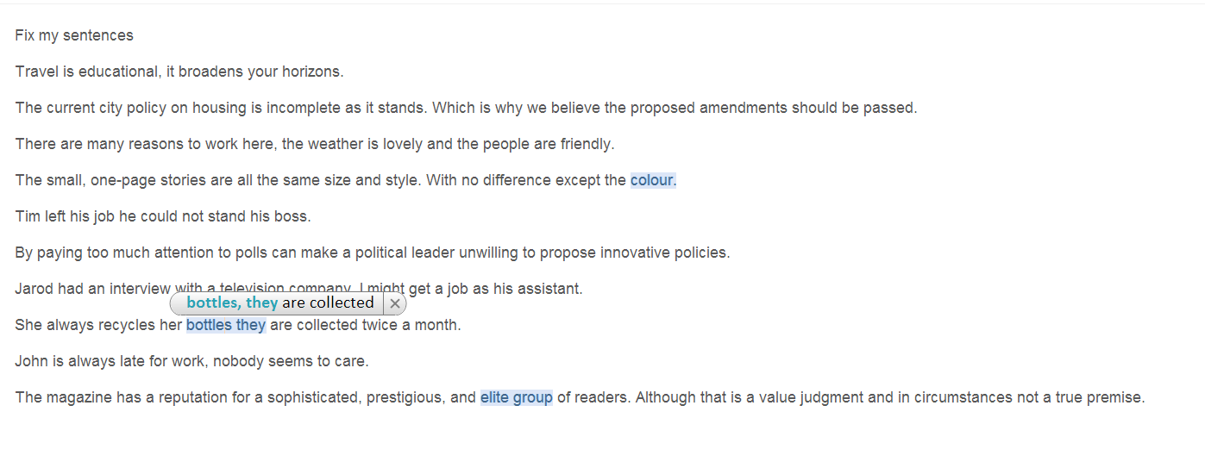
Ginger spelling & grammar checker

Slide 13
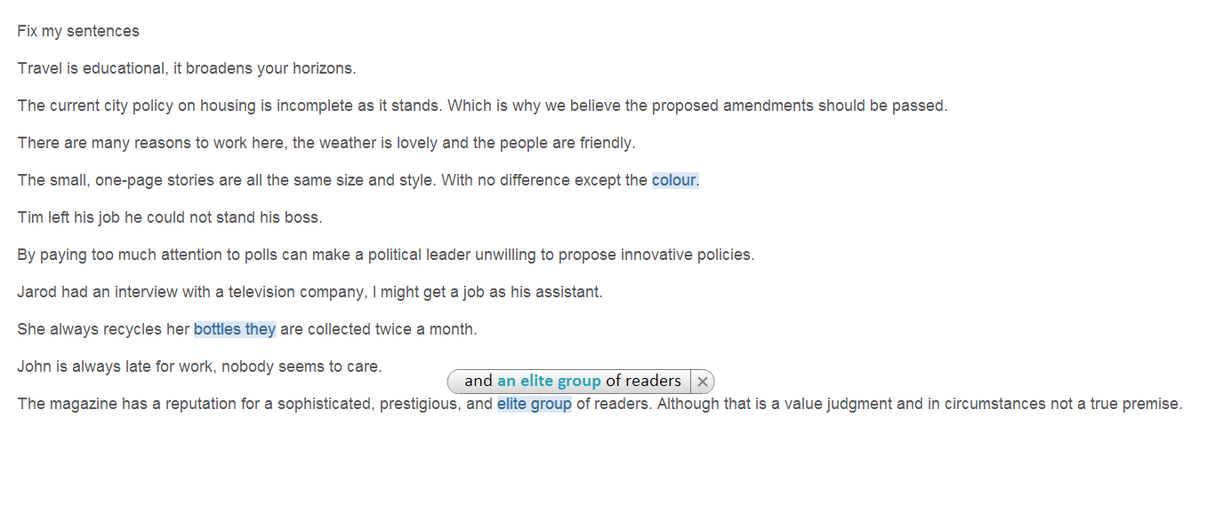
Ginger spelling & grammar checker

Slide 14
Ginger spelling & grammar checker

