Slide 1
Punctuation – Punc Rocks!
Dr Evija Trofimova
evija.trofimova@auckland.ac.nz
Centre for Learning & Research in Higher Education (CLeaR)

Slide 2
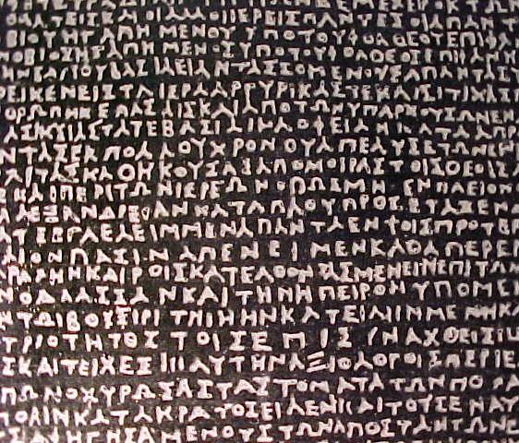
Life without punctuation
scriptio continua
Close-up of the
Rosetta Stone

Slide 3
Punctuation marks: Why use them?
to clarify meaning:
“woman without her man is nothing”
vs
“woman without her man is nothing”
to mark the boundaries of sentences
to indicate tone and intonation (!?, ...)
to set the rhythm for sentences (...)
to distinguish between a question, a statement, a command…
Punctuation marks enliven the text.

Slide 4
Preliminary self-audit
2 minutes — quickly do as many as you can
Put the exercise away
Take to tutorial next week

Slide 5
What is a sentence?
Sentence = a “unit of meaning” (usually expresses a complete idea)
Typically has a subject (doer) and a predicate (action done); together form a full sentence.
Can express a statement (.), question (?), command/exclamation (!), request, or suggestion.

Slide 6
What is a full sentence?
A subject (a noun/nominal group)
+
a predicate (a finite verb/verbal group)
I ran. You were sleeping. She coughed. A tree fell. They will vanish.
In contemporary English, the word order is fixed:
subject + predicate [+ object]
I kicked [the ball]. You ate [all my chocolate]. He said hi [to me].

Slide 7
Let’s build a full sentence!

Slide 8
Noun-verb agreement*
Subjects and predicates in sentences must agree with one another
(if S = singular → P must be singular too):
The student passes the exam. The students pass the exam.
Pick the correct verb form!
The group of boys and girls was/were? supervised by the teacher.
John or Mary is/are? suitable.
Either John or Mary has/have? been elected to the Council.
She is one of the many singers who has/have? played in this competition.
Each of the little girls was/were? given a red balloon.

Slide 9
Phrases & clauses
= the building blocks of sentences
A clause: a group of related words
with a subject (S) + a predicate (P)
A phrase: a group of related words
without a subject (S) + a predicate (P)

Slide 10
Independent & dependent clauses
Compound sentences contain two or more clauses connected by conjunctions.
independent clauses (i.e., they can exist on their own; connected by conjunctions and, but, yet, or... Think of FANBOYS!)
The sun was shining and the birds were singing.
dependent clauses (do NOT make sense on their own; connected by which, if...)
Damage from the storms, which have hit England recently, is enormous.
If the rain continues, it will cause even more flooding.

Slide 11
Sentence types:
compound
I like George Clooney, and he likes me too.*
simple
I like George Clooney.
Sentences
compound-complex
Even though our relationship is complicated, I like George Clooney very much, and he likes
me too.*
complex
I like George Clooney, even though
our imaginary relationship is quite complicated.
* in my imagination

Slide 12
Tragic attempts at sentences: sentence fragment (SF)
No worries. Raining!
When all data had been considered.
Given that the subjects were interviewed separately.
Tomorrow?
I’ve travelled to many countries. For instance, France, Norway and Brazil.
Even though I told him to leave my cat alone.

Slide 13
Make the world a better place by fixing this sentence fragment (SF):
Because the mother’s responsibilities are to cook, to
clean and to raise the children.

Slide 14
Tragic attempts at sentences: run-on sentences (ROS)
Look having nuclear my uncle was a great professor and scientist and engineer Dr John Trump at MIT good genes very good genes OK very smart the Wharton School of Finance very good very smart you know if you’re a conservative Republican if I were a liberal if like OK if I ran as a liberal Democrat they would say I'm one of the smartest people anywhere in the world it’s true but when you're a conservative Republican they try oh do they do a number that’s why I always start off Went to Wharton was a good student went there went there did this built a fortune you know I have to give my like credentials all the time because we’re a little disadvantaged but you look at the nuclear deal the thing that really bothers me it would have been so easy and it’s not as important as these lives are nuclear is powerful my uncle explained that to me many many years ago the power and that was 35 years ago he would explain the power of what's going to happen and he was right who would have thought but when you look at what's going on with the four prisoners now it used to be three now it’s four but when it was three and even now I would have said it's all in the messenger fellas and it is fellas because you know they don't they haven’t figured that the women are smarter right now than the men so you know it’s gonna take them about another 150 years but the Persians are great negotiators the Iranians are great negotiators so and they they just killed they just killed us.

Slide 15
Or can be as simple as...
X We interviewed two hundred students we conducted each interview for thirty minutes the experiment took over one hundred and fifty hours.
X I am hungry I’m leaving now.
X Student learning works best with a focus on experience this is something I know from my own experience.

Slide 16
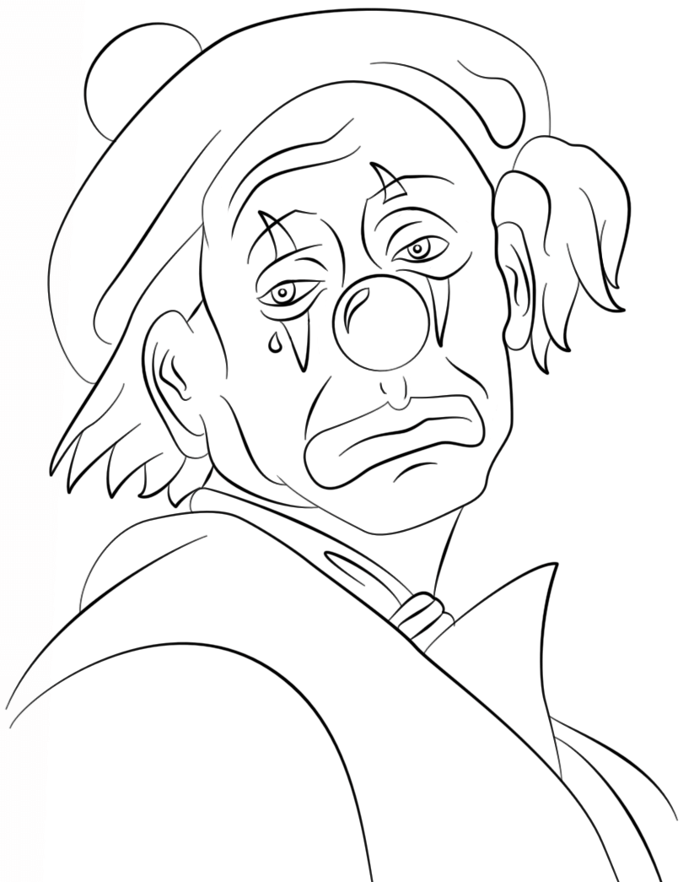
Help fix this sentence!
The clown terrified the children he also had a bad stench.
Notes:
Either way, we can agree that clowns can be terrifying, and not only to children.

Slide 17
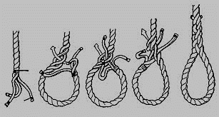
Tragic attempts at sentences: comma splice (CS)
X This book has fast action, the characters are extremely plausible, the finish is pleasingly unexpected, I would recommend it to any one.
X We read all the material, we processed all the data.
X Howard Hughes was a billionaire, he was also a recluse.
X The clown terrified the children, he also had a bad stench.

