Slide 1
Writing for the web
Jonathan Burgess | @jonatBASS

Slide 2
Hail the maintainers
Innovation is overvalued, maintenance often matters more. Hail the maintainers, Andrew Russell and Lee Vinsel.
Infrastructure

Slide 3
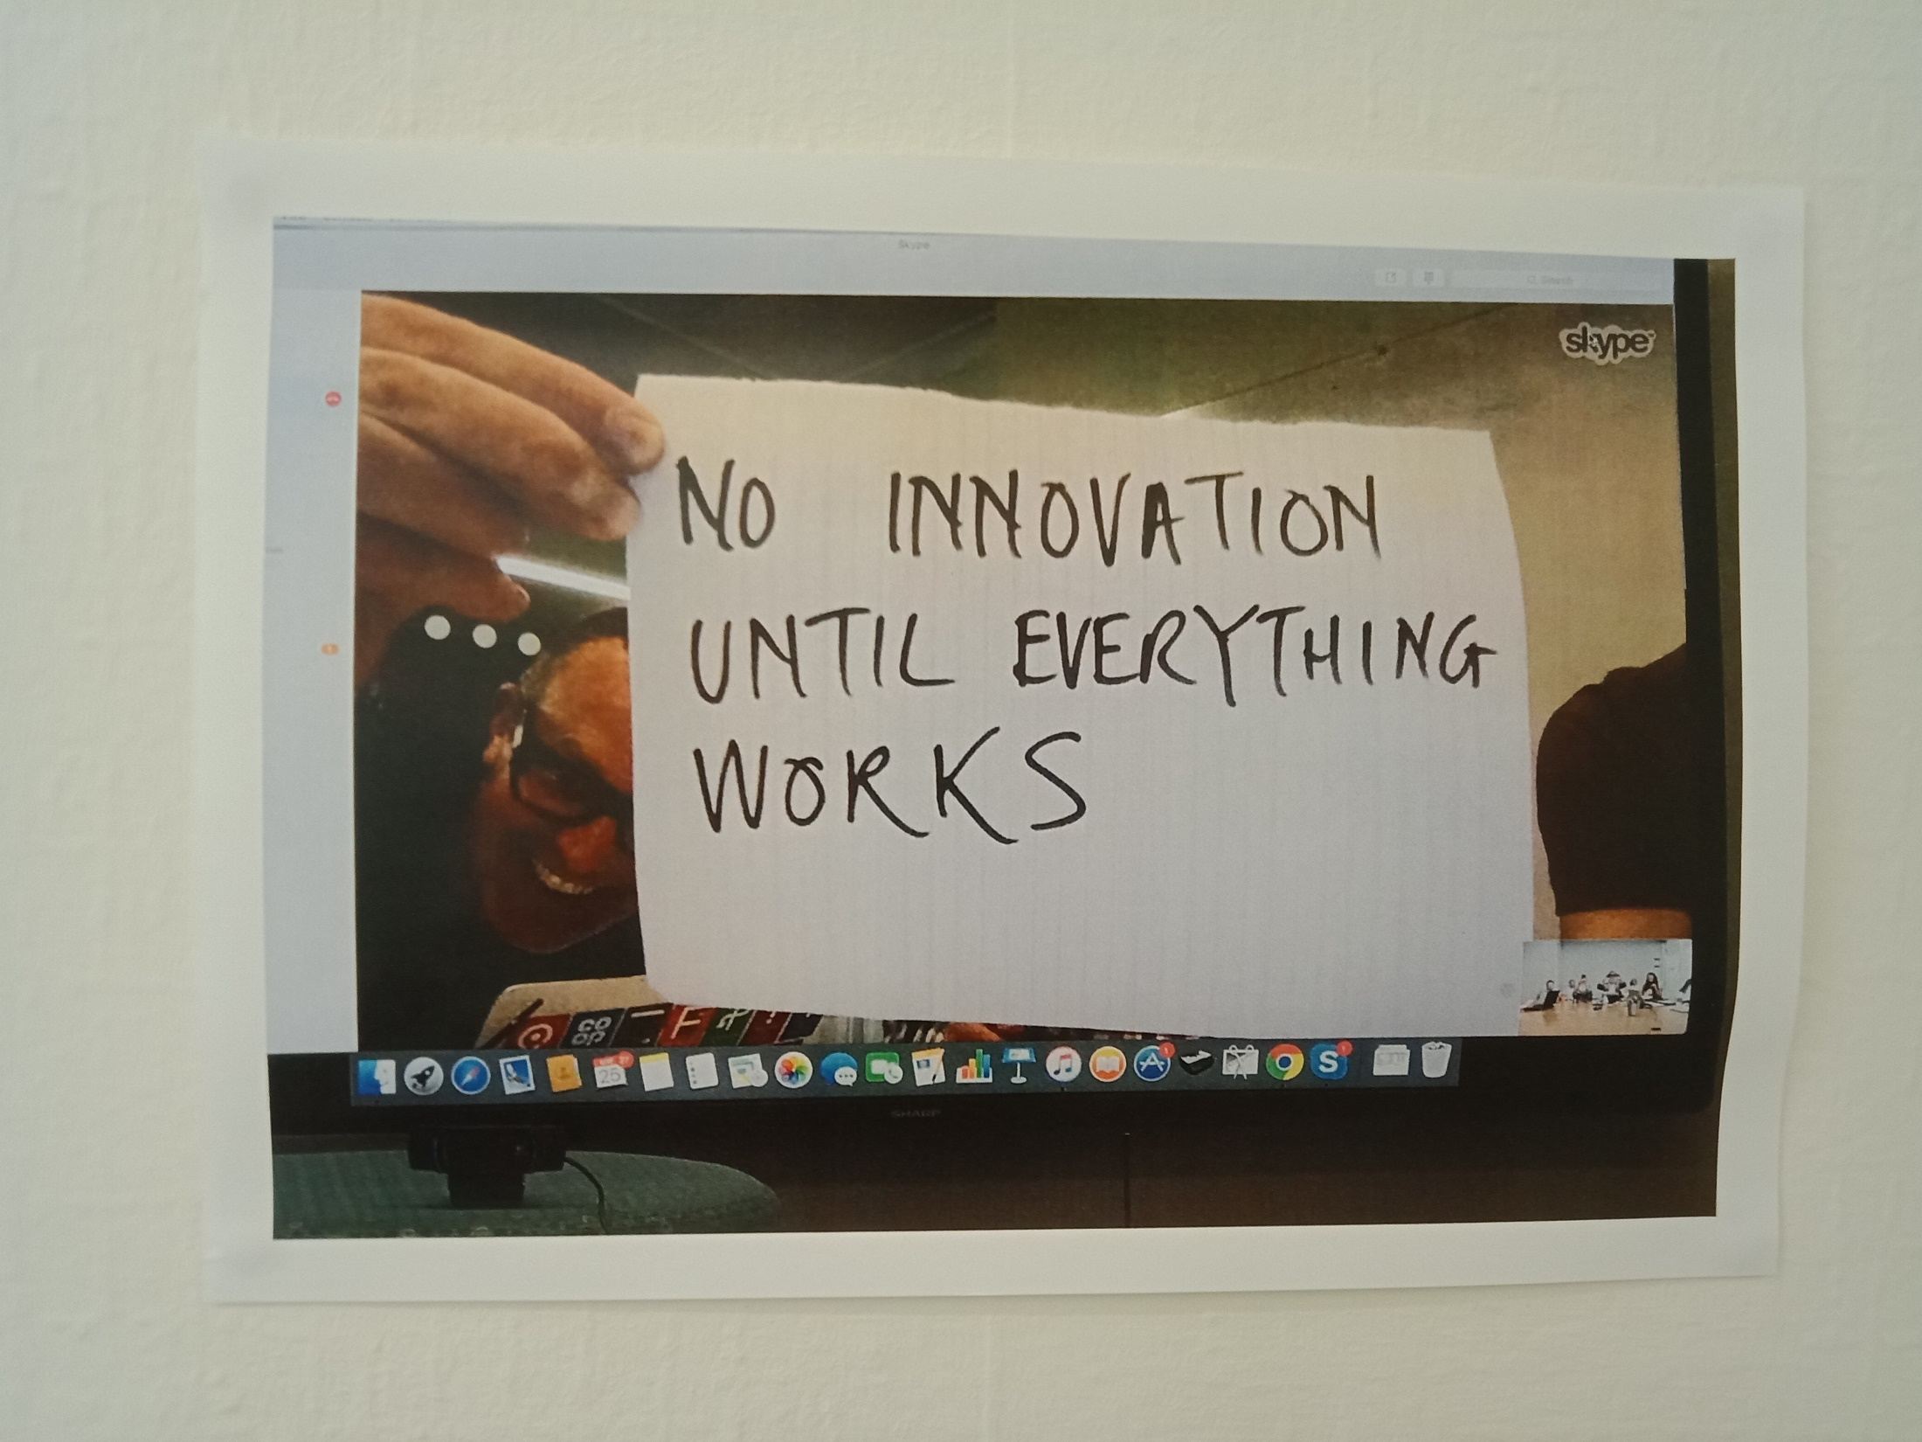

Slide 4
Content Strategy for the Web, Kristina Halvorson
Text is everywhere. Today, most of the content on the web is text. We search for it in articles, blog posts, product descriptions, reviews, and more. We depend on it to tell us which video we’re about to watch, or where to click in order to complete our purchase. We create it ourselves using social media channels, blogs, wikis, and more. Text instructs, guides, informs, confirms, communicates, connects.
Text is different. Video, audio, and images have established, familiar production processes that have been around for decades. Yes, when we deliver these assets online, they require a different kind of preparation from when we deliver them elsewhere. But typically, once these assets are online, we don’t worry about them again until it’s time to move them or remove them. They don’t require the same care and feeding as text.
Text is messy as hell. As anyone who’s ever dealt with web content knows, text is a moving target with multiple owners and stakeholders. It’s the most complex kind of content to produce, and it’s the easiest to lose control of.

Slide 5
Writing style
Simple sentence structure
Active voice
Plain English
Audience, personas
Microcopy: Meaningful, practical
Speaking directly to an individual

Slide 6
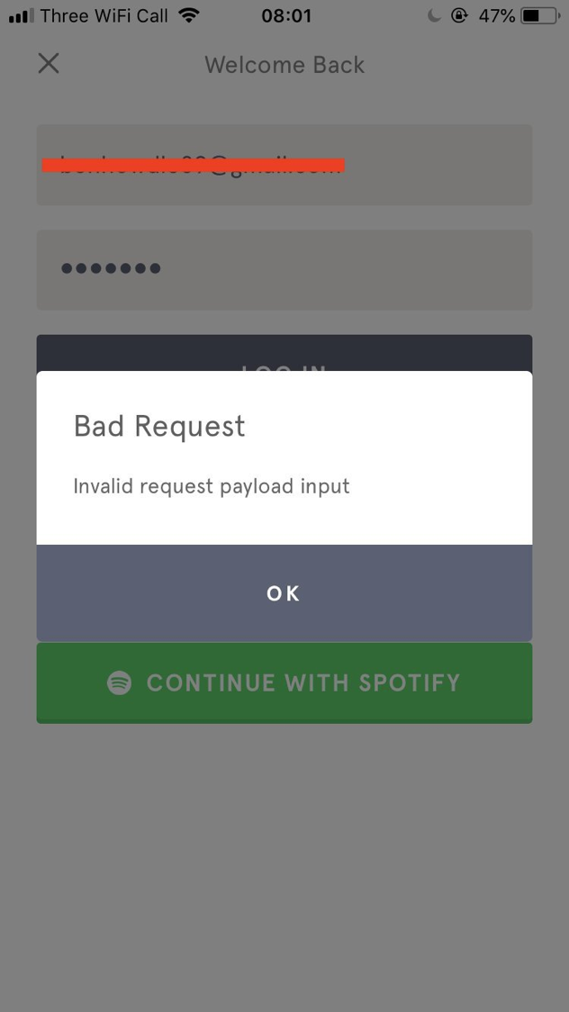

Slide 7
Active and passive
The subject performs the action, or the subject receives the action.
Marilyn mailed the letter.
The letter was mailed by Marilyn.
The man ate five hamburgers.
Five hamburgers were eaten by the man.
Researchers showed that high stress can cause heart attacks.
It was demonstrated that heart attacks can be caused by high stress.

Slide 8
Plain English
Layman’s terms
Clear and unambiguous language, without the use of technical or difficult words
“Omit needless words” – Strunk and White, Elements of Style
“The first step towards clarity is writing simply” – Psychological Bulletin
“Direct, declarative sentences with simple common words are usually best” – APA publication manual

Slide 9
Cases of Erudite Vernacular Utilized Irrespective of Necessity: Problems with Using Long Words Needlessly
Daniel Oppenheimer, Applied Cognitive Psychology
2006 Ig Nobel Prize winner
Article

Slide 10
Undergraduate writing habits
110 Stanford undergraduates were surveyed about writing habits
Have you ever changed the words in an academic essay to make the essay sound more valid or intelligent by using complicated language? 86.4% said yes
When you write an essay, do you turn to the thesaurus to choose words that are more complex to give the impression that the content is more valid or intelligent? Nearly two-thirds answered yes

Slide 11
Fluency
Simple writing is easier to process
“Fluency leads to higher judgements of truth, confidence, frequency, fame, and even liking”
“The effects of fluency are strongest… when the amount of experienced fluency is surprising”

Slide 12
The thesaurus test
Sample graduate admission essays were made more complex by substituting some words with their longest applicable thesaurus entries
Participants then rated how difficult each passage was to understand, and the intelligence of the author
“Contrary to prevailing wisdom, increasing the complexity of a text does not cause an essay’s author to seem more intelligent.”
“In fact, the opposite appears to be true.”

Slide 13
The translation test
Two English translations of Descartes’ Meditations of similar length but differing complexity were found
Participants rated how difficult each passage was to understand, and the intelligence of the author
“Simple translation won out, with participants rating the author as more intelligent.”

Slide 14
The simplification test
Dissertation abstracts from Stanford’s sociology department were simplified with words of nine letters or more replaced
Participants then rated how difficult each passage was to understand, and the intelligence of the author
“Participants judged the simplified dissertations to come from smarter authors”

Slide 15
The Public Speaks: An Empirical Study of Legal Communication
Christopher R. Trudeau
Article

Slide 16
Which passage would you prefer to read in a legal document?
“Discovery may proceed prior to the judge’s consideration of the motion.”
“Discovery may begin before the judge considers the motion.”

Slide 17
Which passage would you prefer to read in a legal document?
“I am herewith returning the stipulation to dismiss your case; the same being duly executed by me.”
“I have signed and enclosed the stipulation to dismiss your case.”

Slide 18
Results
Across all 11 examples, respondents chose the simpler version 88% of the time
The public prefers clear, understandable communication

Slide 19
Conclusions
Plain English saves time and money
Surprisingly, the higher the respondent’s education level, the less patience they had for complex language
Even those with law degrees preferred the Plain English versions

Slide 20
George Orwell on writing
Never use a metaphor, simile or other figure of speech which you are used to seeing in print.
Never use a long word where a short one will do.
If it is possible to cut a word out, always cut it out.
Never use the passive where you can use the active.
Never use a foreign phrase, a scientific word or a jargon word if you can think of an everyday English equivalent.
Break any of these rules sooner than say anything barbarous.
‘Politics and the English Language’, 1946.

Slide 21
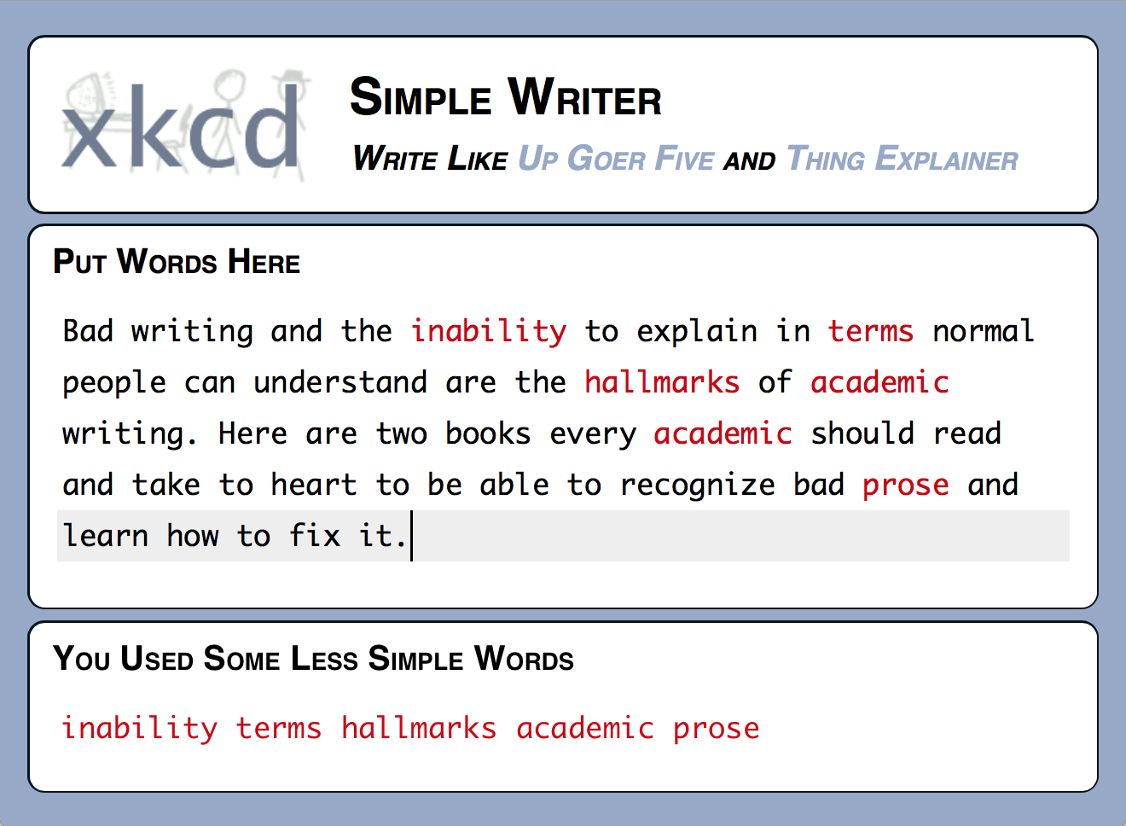
xkcd.com/simplewriter

Slide 22
Writing structure
Headings, chunking, scrolling, bullet points. Binky. ACCTG 151G.
Metadata
Heat mapping, F-shaped reading pattern for content
Mediums, platforms, devices. Arts.
Links include information-bearing words

Slide 23
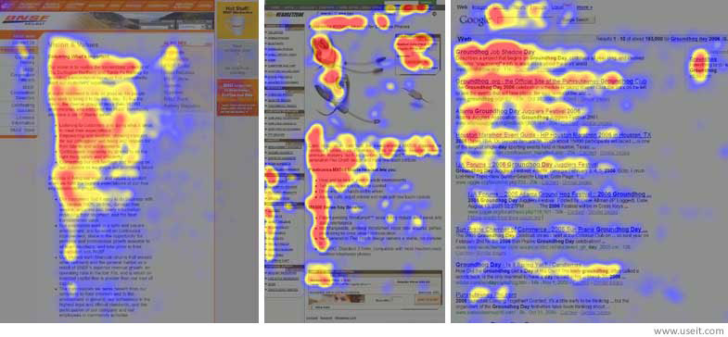

Slide 24
Analytics
Terms: Bounce rate, pageviews, exit page, time on page, session, session duration, users
Google Analytics

Slide 25
Accessibilty
One in five users has some sort of impairment: blindness and low vision, deafness and hearing loss, learning disabilities, cognitive limitations, limited movement, speech disabilities, photosensitivity
Screen readers: Headings, structure, alt text
Visual: Contrast
Navigation: Keyboard
W3C Web Content Accessibility Guidelines (WCAG)
NZ Government Web Accessibility Standard
Target sued for $6 million in 2008

Slide 26
Why Target was sued
A lack of alternative (alt) text on the site
Online purchases could not be completed without the use of a mouse
Image maps to show store locations were inaccessible
Many headings important to navigating the site were missing

Slide 27
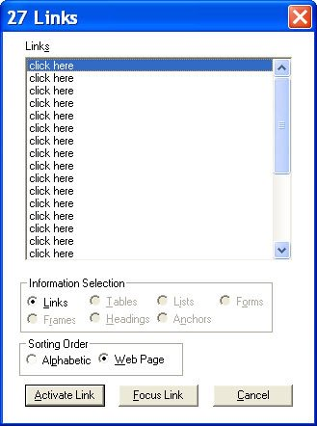

Slide 28
Search Engine Optimisation (SEO)
“the most misunderstood topic online” – Copyblogger
BackRub (1996) / Google (1997)
Back links / Authority
Keywords

Slide 29
Algorithms
PageRank
“the likelihood that a given page will be reached by a web user who randomly surfs the web, and follows links from one page to another”
~200 factors
85% off the page itself

Slide 30
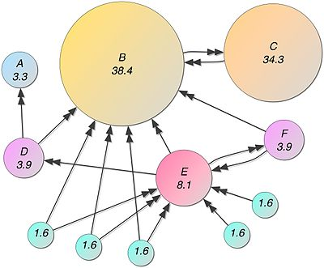
https://en.wikipedia.org/wiki/PageRank

Slide 31
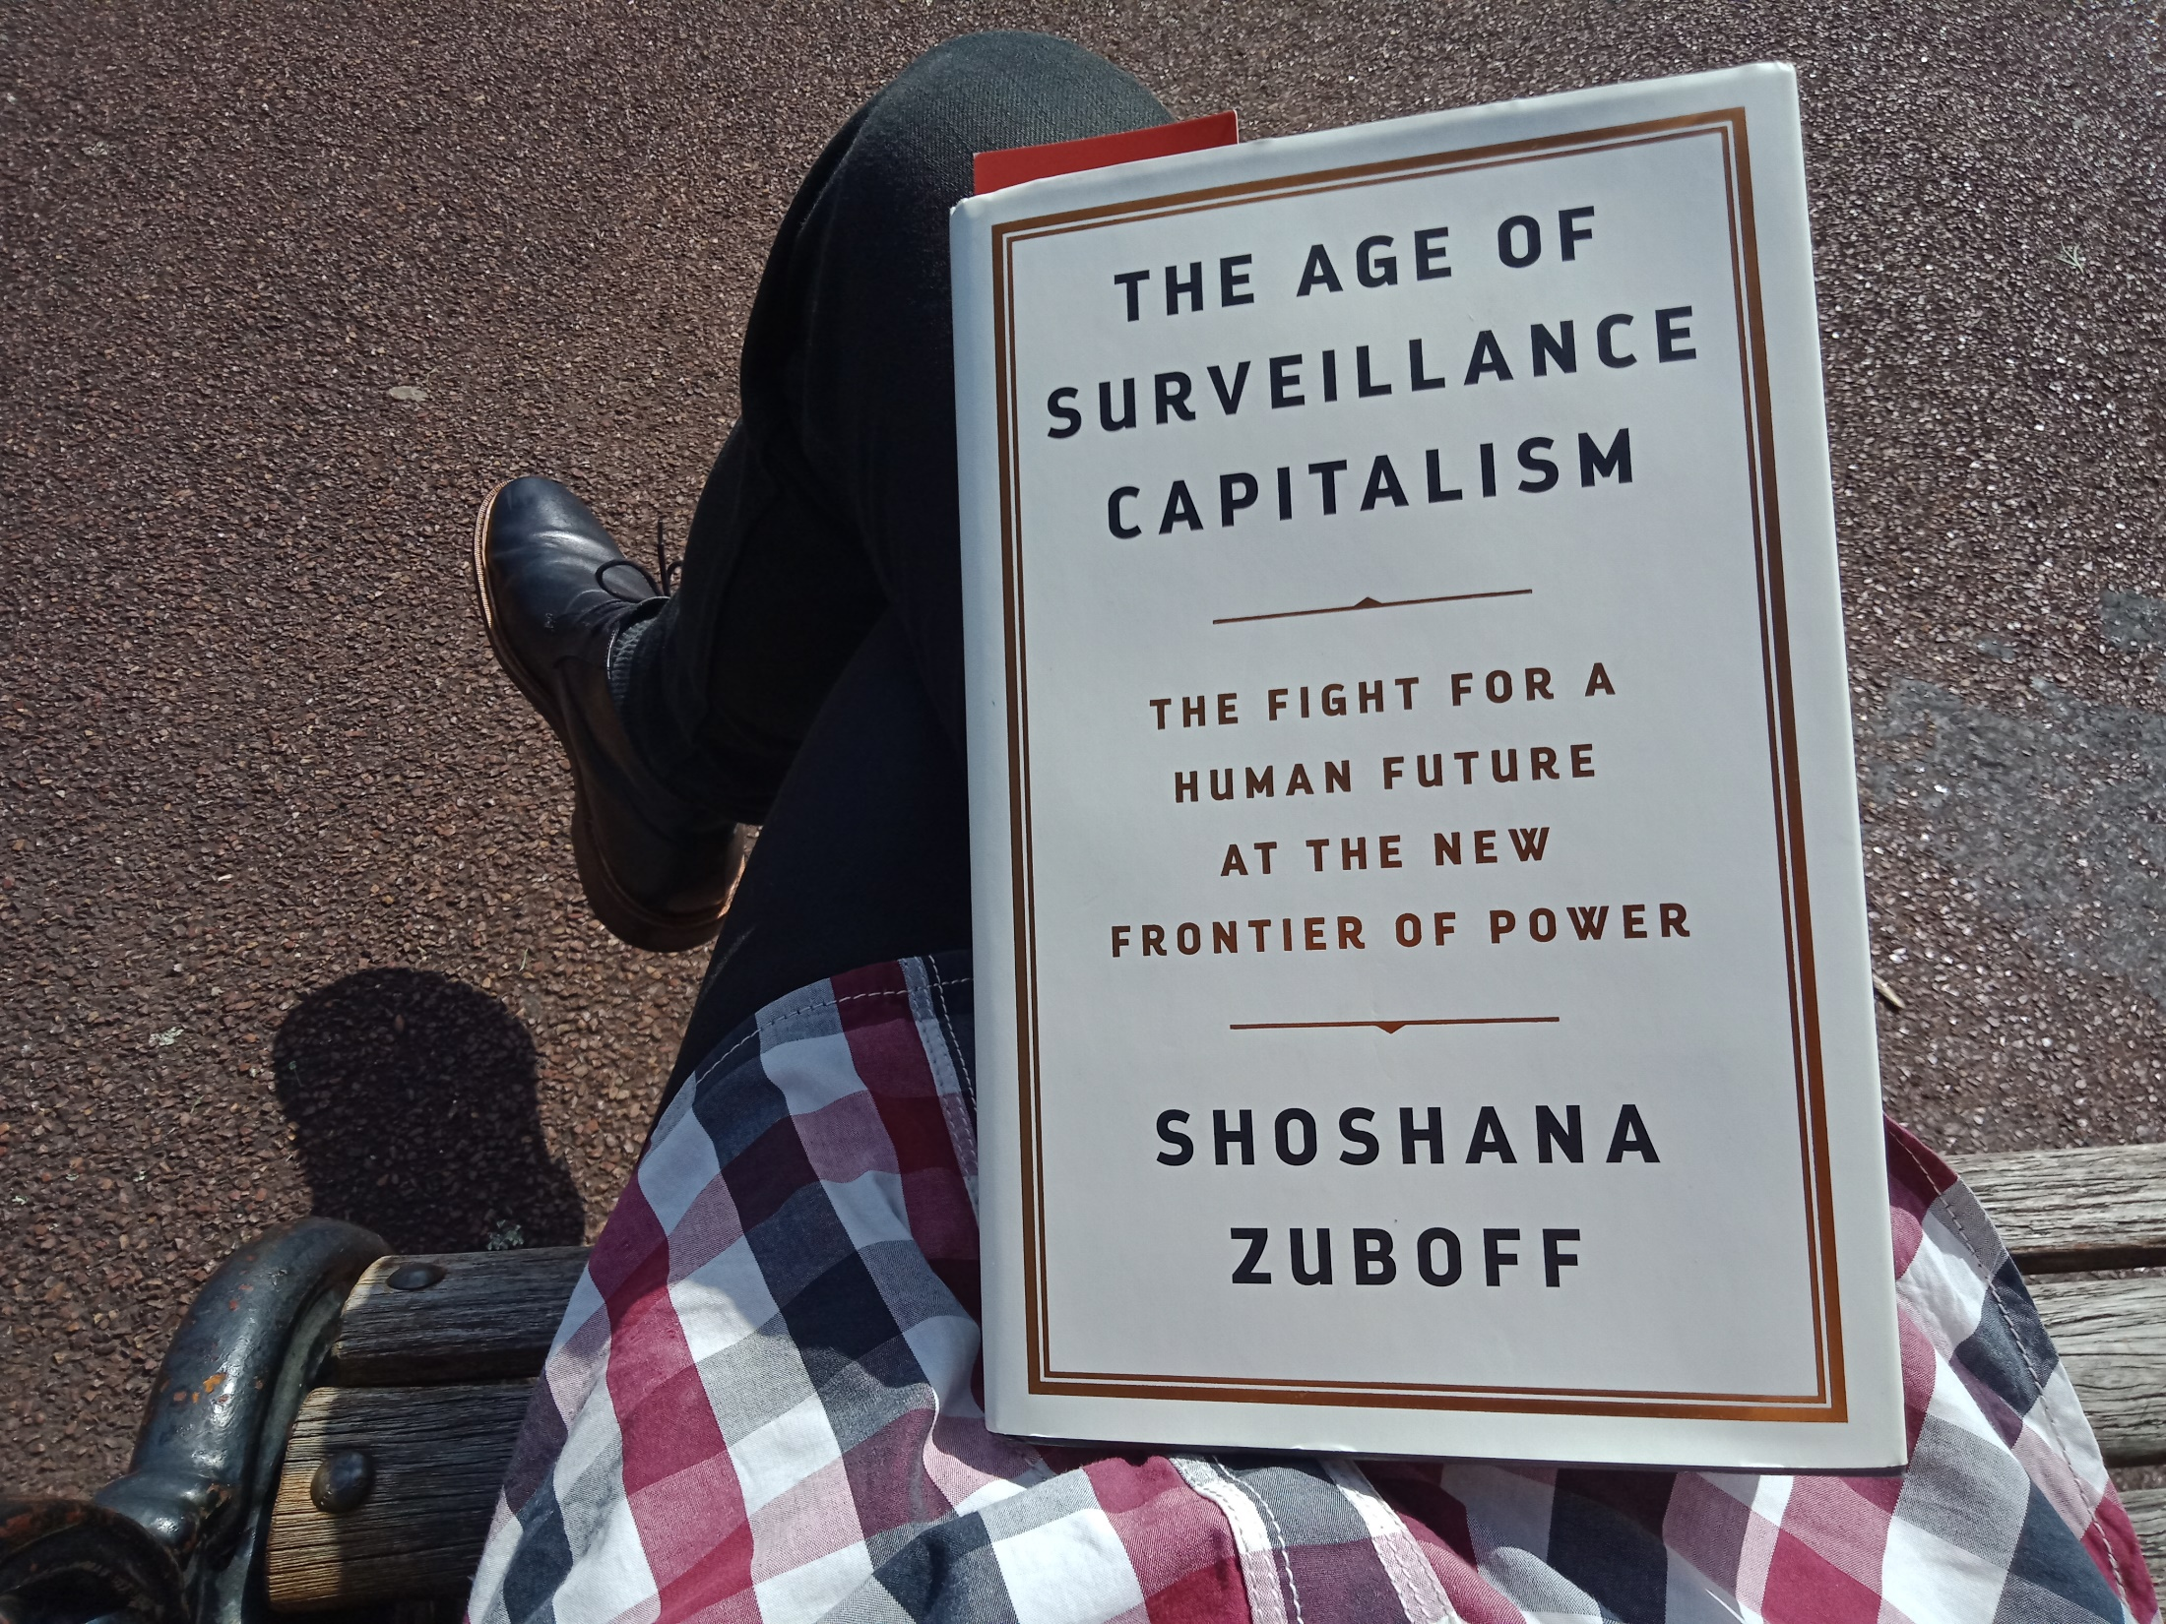

Slide 32
Content strategy
Content Strategy for the Web, Kristina Halvorson
User-centric, mobile-first, accessible
Substance, structure, workflow, governance
Business objectives, user needs
Life cycle: Creation, maintenance, deletion
“Most of the content we find online is simply in the way.”
gov.uk

Slide 33
No frequently asked questions
“One of the laziest and least useful forms of navigation that grows like a weed on the web is Frequently Asked Questions.” – Gerry McGovern
“FAQs are a way to show you've thought about what your users should know but haven't thought about your users.” – Sarah Richards
“If a question is frequently asked, it means you need that content on your site. Structure that content clearly so you won’t need another page repeating the same information in a different way.” – Sarah Richards

Slide 34
Methodology
Agile development: Iterative, incremental
User research, stakeholder research, business research
People, relationships
Auditing

Slide 35
User story
As a <persona>
I want to <do something>
So that <goal>

Slide 36
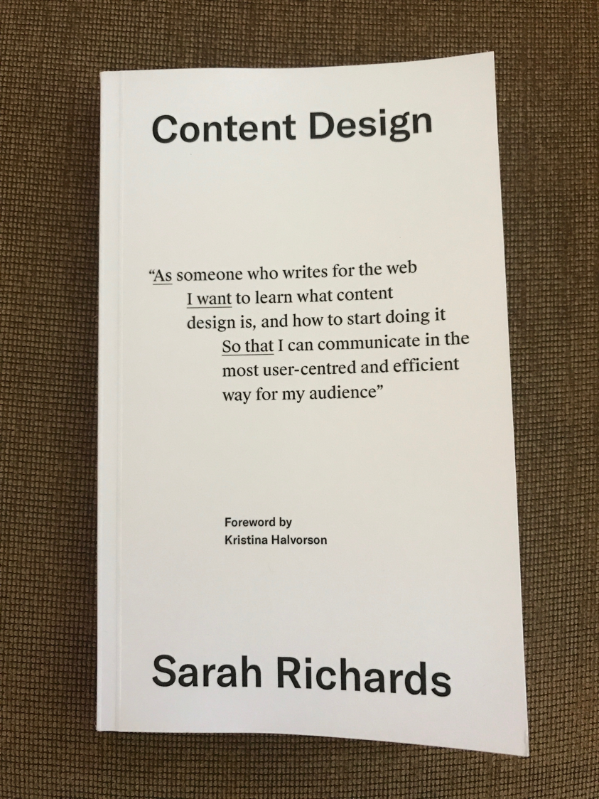

Slide 37
Content Design, Sarah Richards
"Sometimes what a user wants gets forgotten in a lot of pages saying what the business or organisation wants to say.” p.5.
"The more you publish, the more you expect your audience to read, and the more you'll have to update and maintain. You're creating more work for everyone.” p.127.

Slide 38
Experience
Get some

