Slide 1
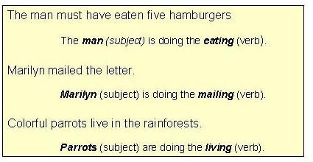
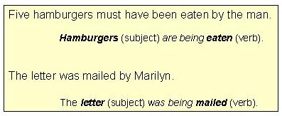
ACTIVE / PASSIVE VOICE (Towson University, https://webapps.towson.edu/ows/activepass.htm)
Active voice
In most English sentences the subject performs the action denoted by
the verb.
These examples show that the subject is doing the verb's action.
Because the subject does or "acts upon" the verb in such sentences,
they are said to be in the active voice.
Passive voice
One can change the normal word order of many active sentences (those with a direct object) so that the subject is no longer active, but is, instead, being acted upon by the verb - or passive.
Because the subject is being "acted upon" (or is passive), such sentences are said to be in the passive voice.
NOTE: Colorful parrots live in the rainforests cannot be changed to passive voice because the sentence does not have a direct object.

Slide 2
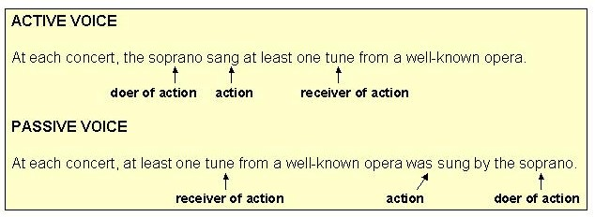
It is generally preferable to use the ACTIVE voice. As the examples below illustrate, a sentence in active voice flows more smoothly and is easier to understand than the same sentence in passive voice.
The passive voice may be a better choice, however, when
The doer of the action is unknown, unwanted, or unneeded, e.g.
the writer wishes to emphasize the action of the sentence rather than the doer of the action, e.g.
or the writer wishes to use passive voice for sentence variety.

