Slide 1
Comms 200 Week 8: Creativity and critical thinking

Slide 2
what is creativity?
https://www.youtube.com/watch?v=C9MF96wY4Fw
Brain day, 2013 ‒Your creative brain
University of Auckland
What are the bases (premises) of the claims being made?

Slide 3
‘The art of creativity’
Taika Waititi, ‘The Art of Creativity’, Tedx Doha (2010)
https://www.youtube.com/watch?v=pL71KhNmnls

Slide 4
design process
1. Identify audience, problem, and communication goals. Create a client creative brief during this stage.
2. Research the audience and media to gather data that can be used in messaging. Execute design research methods during this stage.
3. Target the emotional center of the audience by establishing words, themes, and style to elicit a response. This is the thrust of concept development. Execute design research methods during this stage. Create a GACMIST design brief during this stage [goal, audience, concept, message, image, style, theme] and use this step to establish concepts and keywords that will drive the execution.
4. Conceptualize brainstorm on paper developing sketches, storyboards, outlines, flowcharts, and rough layouts to establish layout, composition, and functionality.
5. Create mockups, proofs, prototypes, and treatments that exhibit the design solution.
6. Revise work to filter content and force the design team to justify design decisions critically to enhance the final product.
7. Evaluate against the goals of the project outlined in the creative brief and measure the success of the piece to inform future projects.
(DiMarco, 84).

Slide 5
divergent thinking/disassociation
brainstorm
mind map
concentric circles
Help to build, and make cohere, the concept, message, image, style and theme (narrative) of your product or service

Slide 6
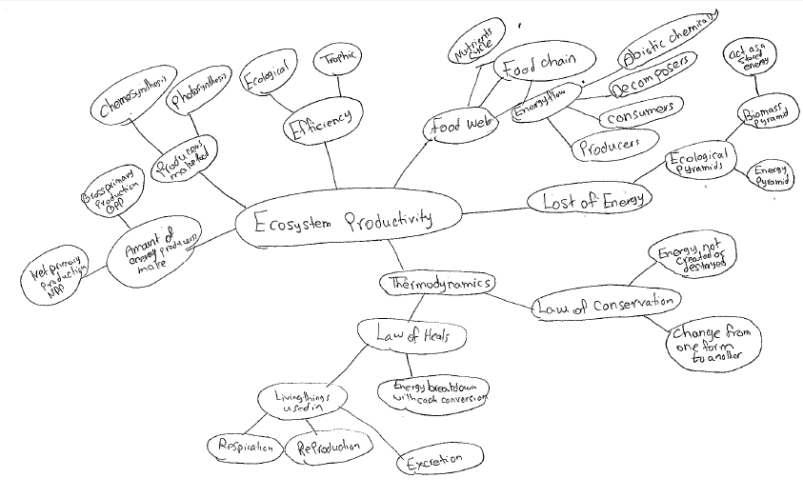
mind map

Slide 7
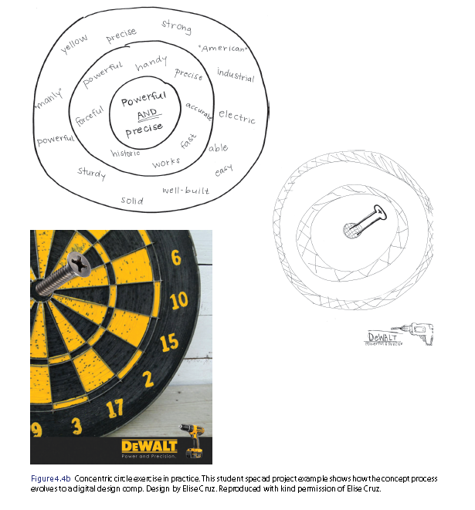
concentric circles (diMarco, 93)

Slide 8
sketching (DiMarco, 98)

Slide 9
design ethnography
1. Get in
2. Observe and record using the diary method and field notes
3. Interview people in the environment
4. Analyse data to reveal themes and patterns
5. Generate personas
6. Generate scenarios based on data
‒ persona (looks at person)
‒ scenario (looks at place, purpose and point of view)
(DiMarco, 95-97)

Slide 10
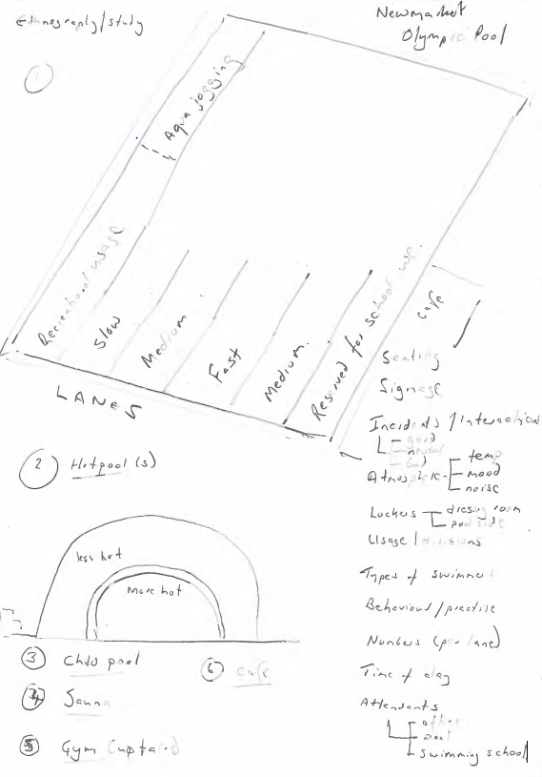
swimming pool sketch

Slide 11
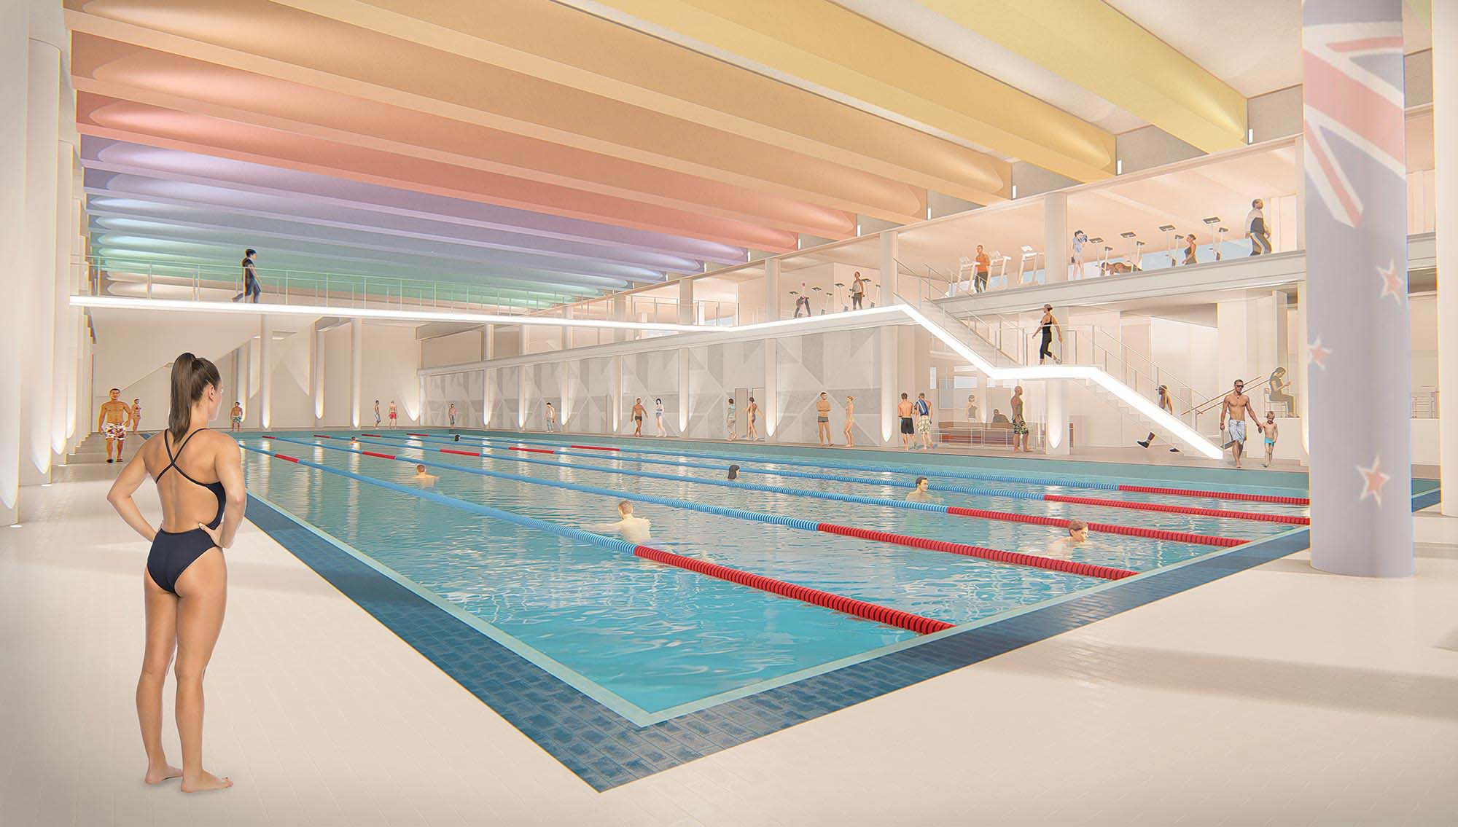

Slide 12
the existence of culture
‘culture’ is learned, shared, common sense, commonplace
‘own’ culture
what is my own ‘culture’, including worldview, habitus, disposition (in what behaviour, social practices, forms of life, is ‘it’ embedded)?
other cultures
how do other people evidently differ in their ‘culture’, including worldview, habitus, disposition, practices?
flexibility
how do I acknowledge, in my own behaviour, other values and personal and professional modes (i.e. what behaviours do I assume, or expect)?

Slide 13
who is included/excluded?
according to
ethnicity
gender and sexual orientation
class
region
religion
language (including dialect and vernacular)
type or character (cultural stereotype)
age
ability/disability

Slide 14
criticism #1 ‒ critical thinking?
(1) an opinion (expression = like/dislike)
(2) a judgement (an opinion that has evident grounds in fact and/or reason)
(3) reflexivity/awareness
‒ a sense of people, place, history and value
‒ a sense that what you are doing or saying is offensive, inadequate or lacking and will harm others

Slide 15
criticism #2 ‒ crisis (shared root = krinein)
krisis — ‘turning point in a disease, that change which indicates recovery or death’. Literally ‘judgement, result of a trial, selection’
kritikos — ‘able to make judgements’
krinein — ‘to separate, to decide, judge’
krei (root) —to ‘sieve’ thus ‘distinguish, discriminate’

Slide 16
criticism #3 ‒ emergency
(1) an emergency = imperilled people, flora and fauna, places and planet
(2) sense of urgency (Fr. l’urgence) = accelerated life (dromological), threatens depth, presence and intimacy of lifeworlds (Paul Virilio)
(3) declaration of emergency = a state of exception (Giorgio Agamben), authorising use of exceptional powers
(4) emergence of new ways of thinking and being

Slide 17
Pepsi (2017)
https://www.youtube.com/watch?v=uwvAgDCOdU4

