Slide 1
PHIL 103: Freedom, Rights and Justice
Dr. Matheson Russell
Semester 2, 2019

Slide 2
Dr. Matheson Russell, Senior Lecturer in Philosophy
m.russell@auckland.ac.nz
Office hour: 1pm-2pm Mondays, Room 435, Humanities Building (206)

Slide 3
Lecture outline:
1. More course information
2. What is philosophy?
3. What is political philosophy?
4. Overview of the course (recap)

Slide 4
More course information
Accessibility
Lecture recordings
Policy on laptops & phones
Class representatives

Slide 5
Research collated by Andrew Mills
Andrew Mills
Otterbein University
amills@otterbein.edu

Slide 6
Laptops and Phones
Lots of research shows that using laptops, tablets, & phones in class is bad for you & others
You don’t learn as much
You don’t remember as much
You take bad notes
You perform worse on tests
You distract others & they perform worse on tests
Let’s look at the research
Notes:
There’s an article by Nicholas Carr at wsj.com but I can’t access it. Here is a link to his blog where he lists the studies he cites in that article. There is an article (likely others, too) that presents some contrary data. It’s here. According to that research, banning laptops does not improve student performance.

Slide 7
Cell phones in class: Bad for you
...even if you are good at emotional regulation!
Participants were randomly assigned to one of four experimental conditions: cell phone usage allowed, cell phone possession allowed but without usage, cell phones removed, and a no‐instruction control group. All participants watched a 20‐minute lecture and were sent text messages to mimic classroom distractions. Afterward, participants took a multiple‐choice test and filled out questionnaires assessing their level of obsessiveness, nomophobia, and mindfulness. Participants who had their cell phone taken away performed best on the test with no other differences. None of the emotional‐ regulation measures moderated the results.
Lee, S., Kim, M. W., McDonough, I. M., Mendoza, J. S., and Kim, M. S. (2017) The Effects of Cell Phone Use and Emotion‐regulation Style on College Students' Learning. Appl. Cognit. Psychol., 31: 360–366. doi: 10.1002/acp.3323.
Notes:
Original article here.

Slide 8
Computers in class=bad test grades
...Average final exam scores among students assigned to classrooms that allowed computers were 18 percent of a standard deviation lower than exam scores of students in classrooms that prohibited computers. Through the use of two separate treatment arms, we uncover evidence that this negative effect occurs in classrooms where laptops and tablets are permitted without restriction and in classrooms where students are only permitted to use tablets that must remain flat on the desk surface.
Payne Carter, Susan, Kyle Greenberg, and Michael Walker, “The Impact of Computer Usage on Academic Performance: Evidence from a Randomized Trial at the United States Military Academy.” School Effectiveness and Inequality Initiative Working Paper 2016.02 (2016)
Notes:
Link to article here

Slide 9
Multitasking: Bad
We found that participants who multitasked on a laptop during a lecture scored lower on a test compared to those who did not multitask, and participants who were in direct view of a multitasking peer scored lower on a test compared to those who were not. The results demonstrate that multitasking on a laptop poses a significant distraction to both users and fellow students and can be detrimental to comprehension of lecture content.
Sana, Faria, Tina Weston, and Nicholas J. Cepeda. “Laptop multitasking hinders classroom learning for both users and nearby peers.” Computers & Education, 62 (2013): 24-31
Notes:
Article linked here

Slide 10
Laptops=Multitasking & Distracting
...students who used laptops in class spent considerable time multitasking and that the laptop use posed a significant distraction to both users and fellow students. Most importantly, the level of laptop use was negatively related to several measures of student learning, including self-reported understanding of course material and overall course performance.
Fried, Carrie B. “In-class laptop use and its effects on student learning.” Computers & Education, 50 (3), 2008: 906-914.

Slide 11
“Divided Attention” = Less Retention
Dividing attention between an electronic device and the classroom lecture did not reduce comprehension of the lecture, as measured by within-class quiz questions. Instead, divided attention reduced long-term retention of the classroom lecture, which impaired subsequent unit exam and final exam performance. Students self-reported whether they had used an electronic device in each class. Exam performance was significantly worse than the no-device control condition both for students who did and did not use electronic devices during that class.
Arnold L. Glass & Mengxue Kang (2018) Dividing attention in the classroom reduces exam performance, Educational Psychology, DOI: 10.1080/01443410.2018.1489046
Notes:
Original article here.

Slide 12
Laptops=Multitasking & Distracting
Our results showed that nonacademic Internet use was common among students who brought laptops to class and was inversely related to class performance. This relationship was upheld after we accounted for motivation, interest, and intelligence. Class-related Internet use was not associated with a benefit to classroom performance.
Ravizza, Susan M., Uitvlugt, Mitchell G., and Fenn, Kimberly M. “Logged In and Zoned Out: How Laptop Internet Use Relates to Classroom Learning” Psychological Science, 28 (2), 2016: 171-180
Notes:
https://doi.org/10.1177/0956797616677314

Slide 13
Even class-related use doesn’t help
Our results showed that nonacademic Internet use was common among students who brought laptops to class and was inversely related to class performance. This relationship was upheld after we accounted for motivation, interest, and intelligence. Class-related Internet use was not associated with a benefit to classroom performance.
Ravizza, Susan M., Uitvlugt, Mitchell G., and Fenn, Kimberly M. “Logged In and Zoned Out: How Laptop Internet Use Relates to Classroom Learning” Psychological Science, 28 (2), 2016: 171-180
Notes:
https://doi.org/10.1177/0956797616677314

Slide 14
Laptops=Multitasking a lot
We find that students engage in substantial multitasking behavior with their laptops and have non course-related software open and active about 42% of the time. There is a statistically significant inverse relationship between the ratio of distractive versus productive multitasking behavior during lectures and academic performance. We also observe that students under state the frequency of email and instant messaging (IM) use in the classroom when self-reporting on their laptop usage.
Kraushaar, James M. and David C. Novak. “Examining the Affects of Student Multitasking With Laptops During the Lecture.” Journal of Information Systems Education 21 (2), 2010: 241-251
Notes:
Article link here

Slide 15
Paper and Pencil is Better
Four digitally-based multi-tasking activities (texting using a cell-phone, emailing, MSN messaging and Facebook™) were compared to 3 control groups (paper-and-pencil note-taking, word-processing note-taking and a natural use of technology condition) over three consecutive lectures. Comparisons indicated that participants in the Facebook™ and MSN conditions performed more poorly than those in the paper-and-pencil use control…. participants who did not use any technologies in the lectures outperformed students who used some form of technology. ...attempting to attend to lectures and engage digital technologies for off-task activities can have a detrimental impact on learning.
Wood, Eileen, et. al. “Examining the impact of off-task multi-tasking with technology on real-time classroom learning.” Computers & Education 58 (2012): 365-374.
Notes:
Abstract and link to article here

Slide 16
It’s about how you take notes
...even when laptops are used solely to take notes, they may still be impairing learning because their use results in shallower processing. In three studies, we found that students who took notes on laptops performed worse on conceptual questions than students who took notes longhand. We show that whereas taking more notes can be beneficial, laptop note takers’ tendency to transcribe lectures verbatim rather than processing information and reframing it in their own words is detrimental to learning.
Mueller, Pam A. and Daniel M. Oppenheimer. “The Pen Is Mightier Than the Keyboard: Advantages of Longhand Over Laptop Note Taking.” Psychological Science 25 (6), 2014: 1159-1168
Notes:
Article link here

Slide 17
Use laptops and remember less
Two groups of students heard the same exact lecture and tested immediately following the lecture. One group of students was allowed to use their laptops to engage in browsing, search, and/or social computing behaviors during the lecture. Students in the second condition were asked to keep their laptops closed for the duration of the lecture. Students in the open laptop condition suffered decrements on traditional measures of memory for lecture content. A second experiment replicated the results of the first.
Hembrooke, Helene and Geri Gay. “The Laptop and the Lecture: The Effects of Multitasking in Learning Environments.” Journal of Computing in Higher Education 15 (1), 2003: 46-64.
Notes:
Article link is here

Slide 18
Try it… you might like it!
...many students make the decision to give up their laptop after experiencing attending a class without one, noting they would not have been willing to go through such an experience by their own decision. However, once they experience not using a laptop in the law school classroom environment, they often change their method of taking notes and report improved learning and classroom experiences.
McCreary, Jana R. “The Laptop-Free Zone.” Valparaiso University Law Review 43 (2009): 1-87.
Notes:
Abstract and link to full article here

Slide 19
How you read might matter
We prefer to read on screens, but it might not be the best medium.
[Students have] a clear preference for digital texts, and students typically predicted better comprehension when reading digitally..... While there were no differences across mediums when students identified the main idea of the text, students recalled key points linked to the main idea and other relevant information better when engaged with print.
Singer, Lauren M. & Patricia A. Alexander, “Reading Across Mediums: Effects of Reading Digital and Print Texts on Comprehension and Calibration” The Journal of Experimental Education 85 (1) 2017
Notes:
Link to abstract and article here. More here

Slide 21
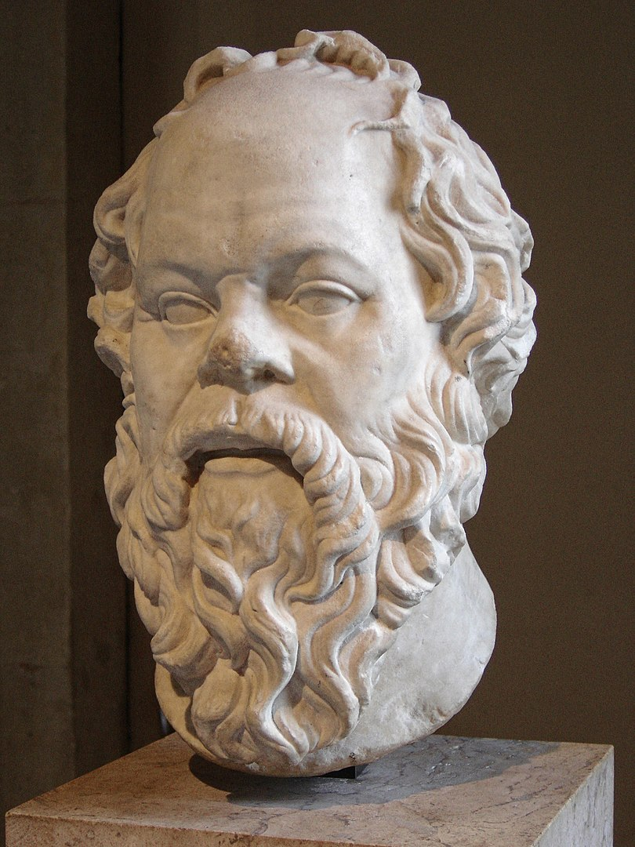
What is philosophy?
Socrates (470-399 BCE)

Slide 22
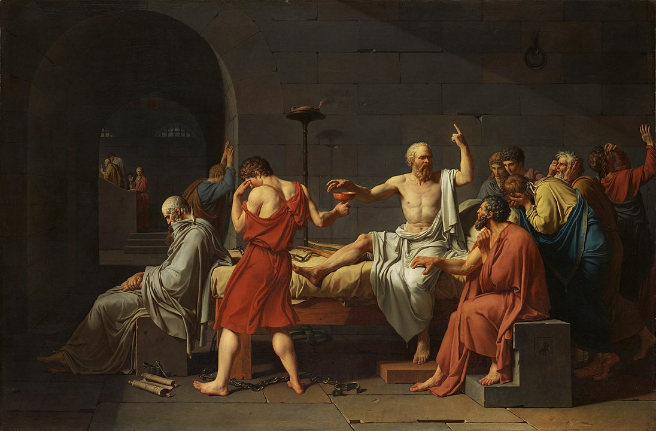
What is philosophy?
The Death of Socrates by Jacques-Louis David (1787)

Slide 23
What is philosophy?
Epistemology
Metaphysics
Philosophy of religion
Logic
Critical thinking
Philosophy of science
Ethics
Bioethics
Applied ethics
Political philosophy
Philosophy of law
Philosophy of gender, race
and sexuality
The true
The good
The beautiful
Aesthetics
Philosophical anthropology:
Philosophy of mind
Philosophy of action
Philosophy of language

Slide 24
What is political philosophy?
Elizabeth Anderson, Private Government: How Employers Rule Our Lives (and Why We Don’t Talk about It). Princeton University Press, 2017.

Slide 25
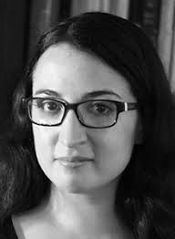
What is political philosophy?
Kate Manne, Down Girl: The Logic of Misogyny. Oxford University Press, 2018.

Slide 26
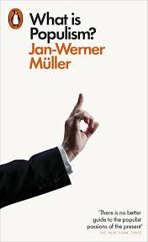
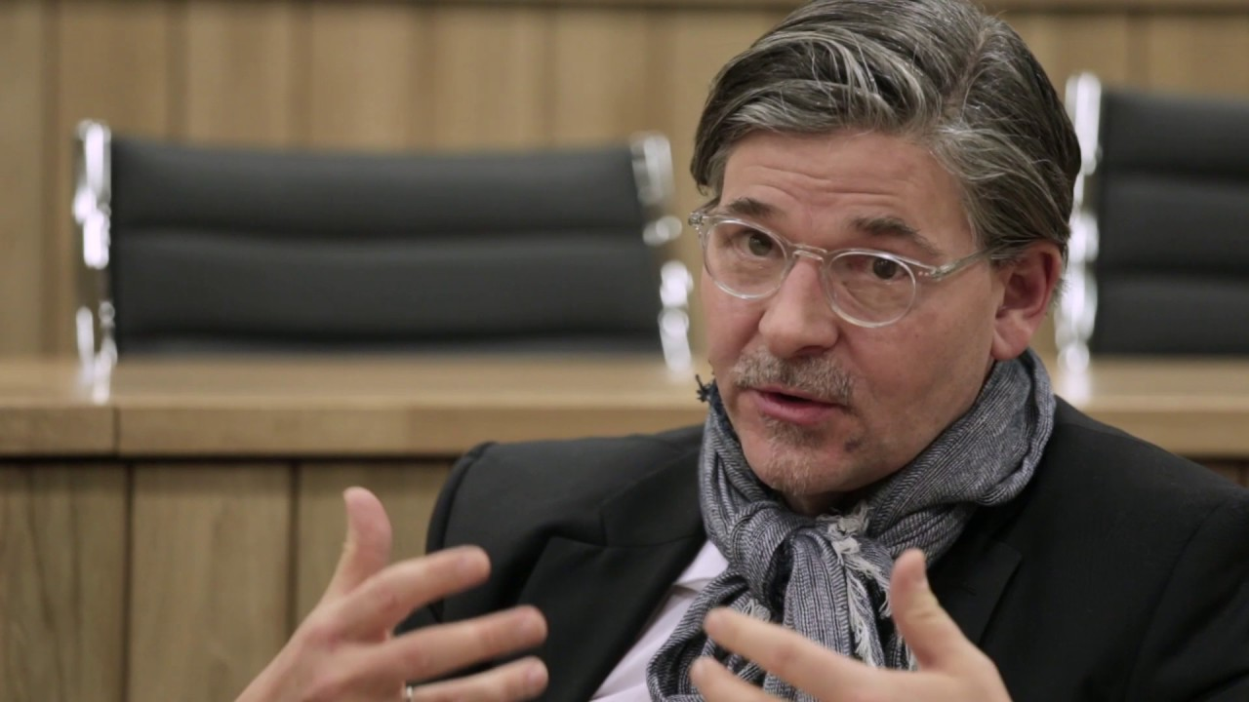
What is political philosophy?
Jan-Werner Müller, What is Populism? Penguin, 2017.

Slide 27
What is political philosophy?
Charles W. Mills, Black Rights / White Wrongs: The Critique of Racial Liberalism. Oxford University Press, 2017.

Slide 28
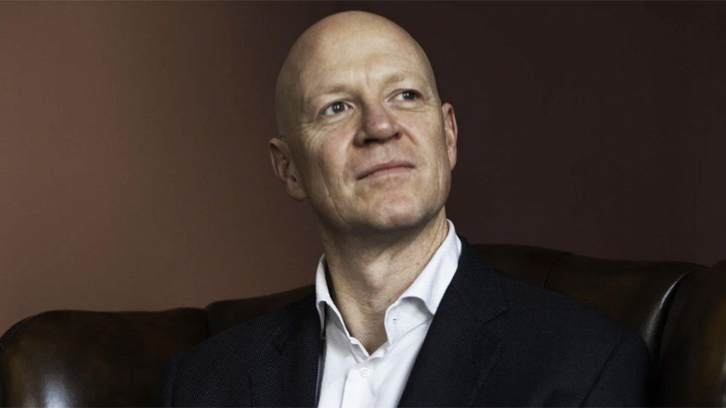
What is political philosophy?
Leif Wenar, Blood Oil: Tyrants, Violence, and the Rules that Run the World. Oxford University Press, 2017.

Slide 29
What is political philosophy?
A normative discipline
Fundamental concepts
A toolkit of methods
Remember: we’re all political philosophers

Slide 30
Overview of the course
Weeks 2-3: What would happen without government?
Weeks 4-5: Should you obey political authorities?
Weeks 5-6: Who should rule?
Weeks 7-8: When is state power over individuals legitimate?
Weeks 9-10: What are rights and what are they good for?
Weeks 11-12: What does justice require?

