Slide 1
PHIL 103: Freedom, Rights and Justice
Dr. Matheson Russell
Semester 2, 2019

Slide 2
Lecture 3: The state of nature and the reason for the state
Outline:
1. The basic question
2. Hobbes’s method: a thought experiment
3. What is the state of nature?
4. What would life be like in the state of nature?
5. Why would we fall into extreme conflict?
6. The argument for instituting a sovereign with irresistible power
7. The logic of pacification
8. The argument for absolute government

Slide 3
1. The basic question
Political authority: the right to set the rules for society and subject citizens to penalties if they disobey the rules.

Slide 4
1. The basic question
Political authority: the right to set the rules for society and subject citizens to penalties if they disobey the rules.
What justification can there be, if any, for the fact that the state can set rules and enforce them using coercive power?

Slide 5
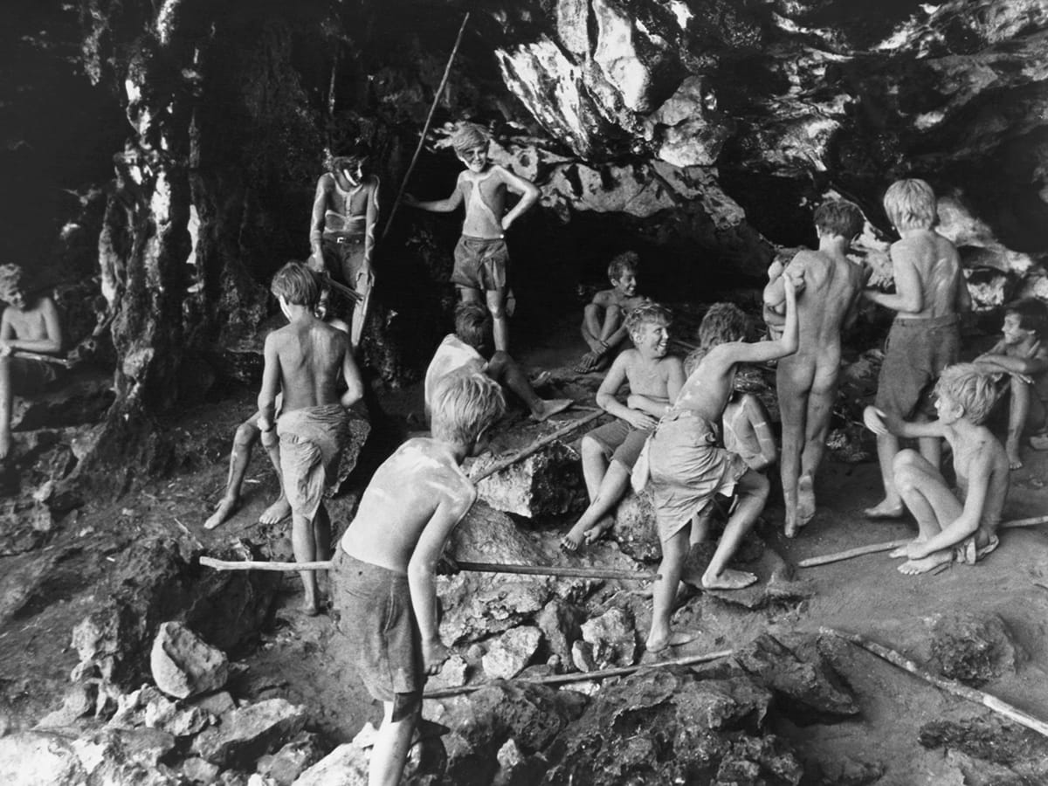
2. Hobbes’s method: a thought experiment

Slide 6
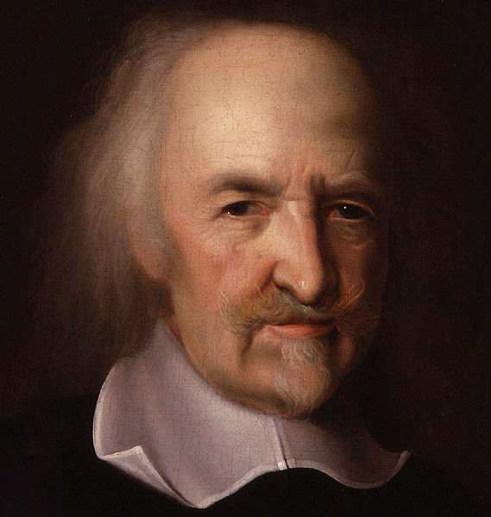
3. What is the state of nature?
Thomas Hobbes (1588-1651)
(Portrait by John Michael Wright)

Slide 7
3. What is the state of nature?
The state of nature is a situation in which:
there is no individual or institution recognized to have the authority to arbitrate disputes or to make rules and enforce them.

Slide 8
4. What would life be like in the state of nature?
“Hereby it is manifest that during the time men live without a common Power to keep them all in awe, they are in that condition which is called War; and such a war as is of every man against every man. [...] In such condition there is no place for Industry, because the fruit thereof is uncertain: and consequently no Culture of the Earth; no Navigation, nor use of the commodities that may be imported by Sea; no commodious Building; no Instruments of moving and removing such things as require much force; no Knowledge of the face of the Earth; no account of Time; no Arts; no Letters; no Society; and which is worst of all, continual Fear, and danger of violent death; And the life of man solitary, poor, nasty, brutish, and short.”
—Thomas Hobbes, Leviathan (1641), chapter XIII.

Slide 9
5. Why would we fall into extreme conflict?
1. Scarcity breeds competition
2. Equality means vulnerability
3. Vulnerability breeds fear
Responses:
Option 1. Pre-emptive attack
Option 2. Establish a reputation for strength

Slide 10
6. The argument for instituting a sovereign with irresistible power
All people (rationally) have a desire for peace.
But in the state of nature it is not in the power of any individual to establish peace.
We are roughly of equal strength.
Even if an individual or group had the might to impose its will on all, it would not be seen to be impartial.

Slide 11
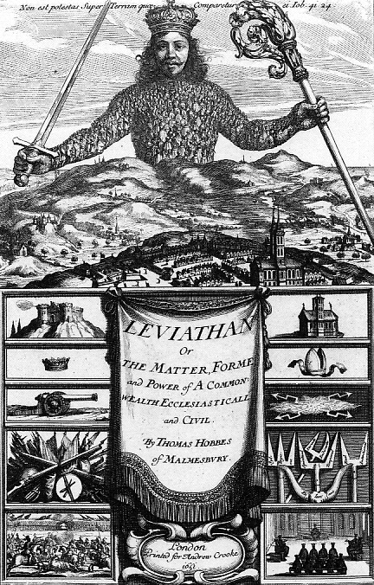
6. The argument for instituting a sovereign with irresistible power
The only way to lift us out of a state of war is:
to establish a sovereign power, an authority recognized to have the right to judge disputes and powerful enough to impose penalties for lawbreaking, even against resistance.
“a common Power to keep them all in awe”

Slide 12
7. The logic of pacification
Bystander (= sovereign)
LAW
predation
Aggressor Victim
retaliation

Slide 13
7. The logic of pacification
Bystander (= sovereign)
LAW
predation
Aggressor Victim
retaliation
CIVIL CONTRACT or
SOCIAL CONTRACT

Slide 14
8. The argument for absolute government
Absolute government = powers of government undivided, unlimited, indisputable
Absolute government is necessary to fulfill the purpose of maintaining peace. Why?
1. There can be no confusion about who has the right to settle disputes and make laws.
2. If each person could set themselves up as judge over the sovereign, there would be the risk of factional disputes.
3. Public opinion is diverse and divided.
Hence: A sovereign power with the ability to make singular and coherent decisions must be established to tame the clamour of conflicting opinion and to establish the unitary voice of the law.

