Slide 1
PHIL 103: Freedom, Rights and Justice
Dr. Matheson Russell
Semester 2, 2019

Slide 2
Lecture 4: The ‘state of nature’ thesis in historical perspective
Outline:
1. The ‘state of nature’ and racial imaginaries
2. What does the evidence show? Steven Pinker’s Better Angels of Our Nature
3. Critical perspectives on Pinker’s reconstruction
4. Reflections on the evidence

Slide 3
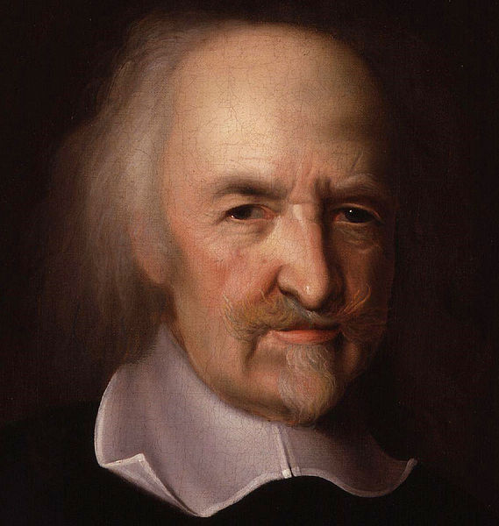
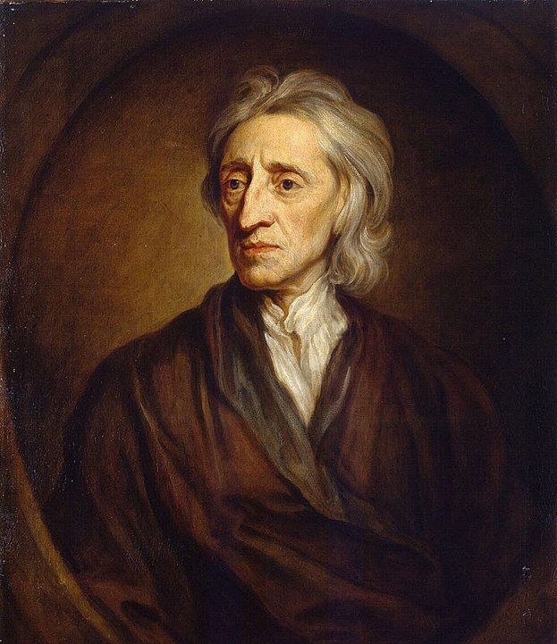
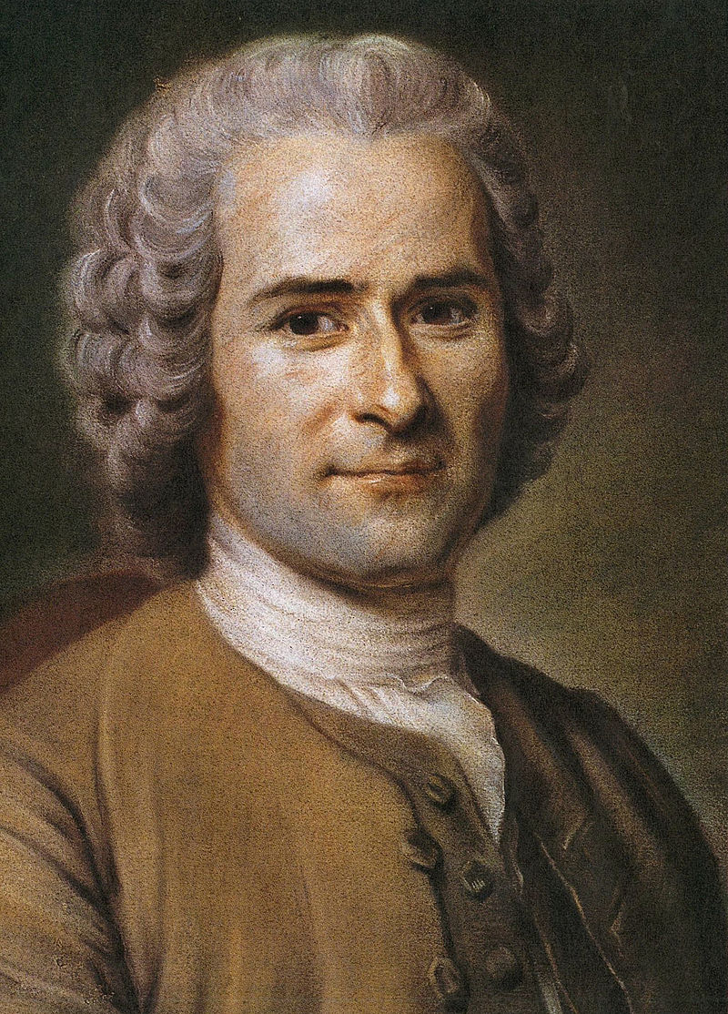
1. The ‘state of nature’ and racial imaginaries
Western political philosophy is tainted by racialized stereotypes of ‘primitive’ or ‘savage’ peoples in other parts of the world
Thomas Hobbes (1588-1679) John Locke (1632-1704) Jean-Jacques Rousseau (1712-1778)

Slide 4
1. The ‘state of nature’ and racial imaginaries
Western political philosophy is tainted by racialized stereotypes of ‘primitive’ or ‘savage’ peoples in other parts of the world
Tribal societies do not live in a state of nature
Customs, rituals, practices
Structures of political power
Forms of law
But no institutionalized means for enforcing law (police force, standing army)

Slide 5
1. The ‘state of nature’ and racial imaginaries
Western political philosophy is tainted by racialized stereotypes of ‘primitive’ or ‘savage’ peoples in other parts of the world
Tribal societies do not live in a state of nature
Images of the ‘state of nature’ have helped to justify colonial imperialism.

Slide 6
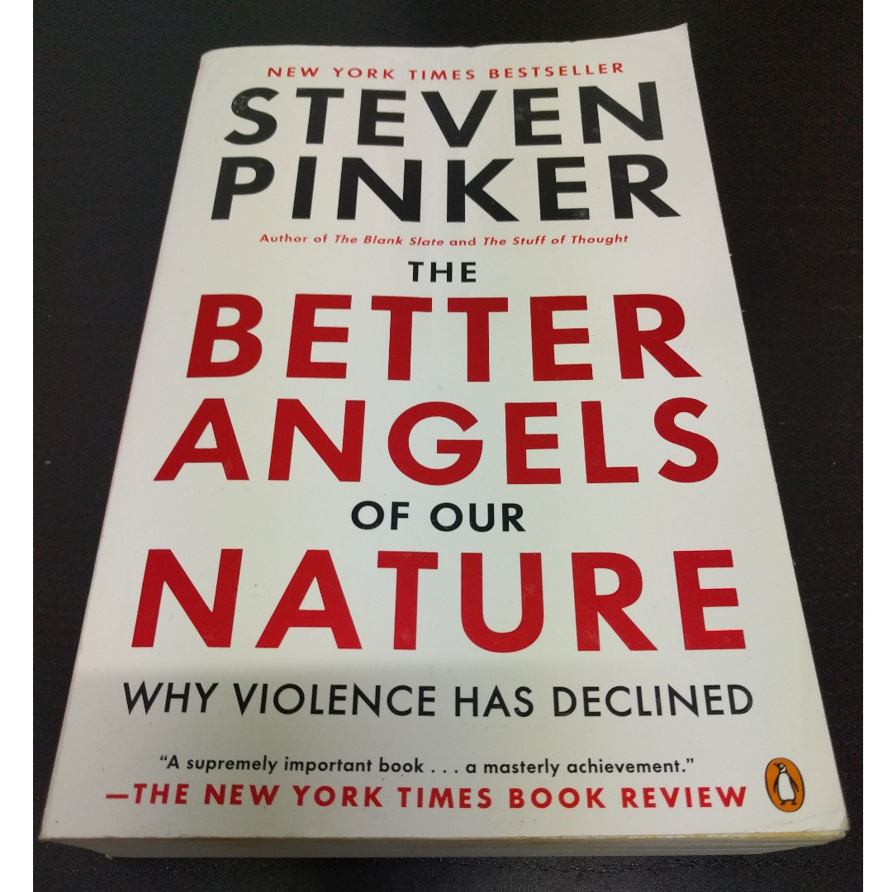
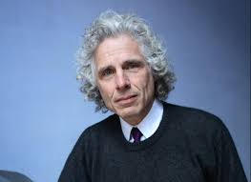
2. What does the evidence show? Steven Pinker’s Better Angels of Our Nature
Steven Pinker, The Better Angels of Our Nature: Why Violence Has Declined. Penguin, 2011.

Slide 7
2. What does the evidence show? Steven Pinker’s Better Angels of Our Nature
“The improved odds of a natural death came with another price, captured by the Roman historian Tacitus: ‘Formerly we suffered from crimes; now we suffer from laws.’ …When it came to violence, then, the first Leviathans solved one problem but created another. People were less likely to become victims of homicide or casualties of war; but they were now under the thumbs of tyrants, clerics, and kleptocrats. This gives us a more sinister sense of the word pacification: not just the bringing about of peace by the imposition of absolute control by a coercive government. Solving this second problem would have to wait another few millennia, and in much of the world it remains unsolved to this day”
—Pinker, Better Angels, 57-8.

Slide 8
3. Critical perspectives on Pinker’s reconstruction
Problems with the data:
1. Non-representative samples of ‘non-state’ societies.
2. Mis-categorisation of farming societies as hunter-gatherers / nomadic foragers.
3. In general, the evidence of interpersonal violence in pre-history is scarce, and doesn’t justify confident statements.
4. Statistics on violent deaths in modern small, non-state societies is patchy; plus it is problematic to compare death rates between very small societies and large ones.

Slide 9
3. Critical perspectives on Pinker’s reconstruction
What does the data show (positively)?:
An extremely varied picture.
Even some of the data Pinker refers to (e.g. Keeley) shows “dramatic differences in homicide rates among hunter-gatherers who tend to live in small bands and among agriculturalists in modest villages” (Lawler 2012).
Warfare is rare in hunting and gathering societies.
Why? Foragers did not need to protect land or fixed property, and could easily disperse to defuse conflict (Lee, 2014, 218).
There is evidence that warfare “ramped up considerably” in connection with the transition from foraging to settled agriculture and animal domestication in the Neolithic period”
Why? Population pressure and property, not human nature, is the root cause of conflict and violence (as Rousseau argued).

Slide 10
3. Critical perspectives on Pinker’s reconstruction
Main sources:
Richard B. Lee, “Hunter-gatherers on the best-seller list: Steven Pinker and the “Bellicose School’s” treatment of forager violence,” Journal of Aggression, Conflict and Peace Research 6(4) (2014): 216-28.
From Andrew Lawler, “The Battle Over Violence” in Science 18 May 2012: https://science.sciencemag.org/content/336/6083/829/:

Slide 11
4. Reflections on the evidence
The real problem:
Not violence and predation among non-state societies per se; hunter-gatherer societies were not prone to violence, and conflict could be easily defused.
Rather, solving the problems of conflict that was exacerbated by settled agriculture and the competition for land and resources that that brought about.
Conditions of scarcity and competition (often artificially created)
The important question then is not whether we are more peaceable than our ancestors but whether life in modern complex and pluralistic societies would be prone to violence and conflict without the rule of law.

