Slide 1
PHIL 103: Freedom, Rights and Justice
Dr. Matheson Russell
Semester 2, 2019

Slide 2
Lecture 5: Domesticating the absolutist state
Outline:
1. Recap of lectures 3 & 4
2. Do we need absolute government?
3. The idea of popular sovereignty
4. The republican tradition
5. The republican model of government

Slide 3
1. Recap of lectures 3 & 4
Why would we fall into extreme conflict in the ‘state of nature’?
1. Scarcity breeds competition
2. Equality means vulnerability
3. Vulnerability breeds fear
Responses:
Option 1. Pre-emptive attack
Option 2. Establish a reputation for strength

Slide 4
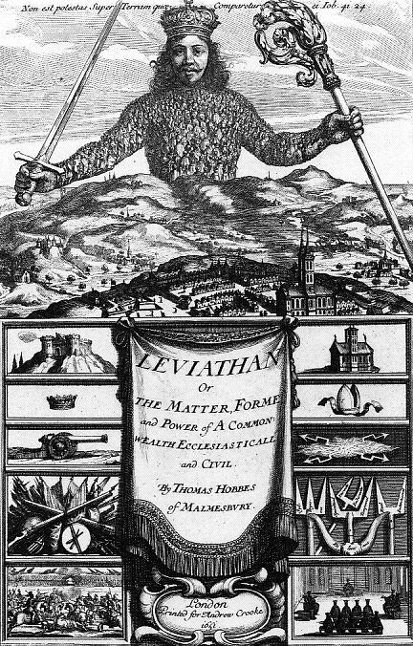
1. Recap of lectures 3 & 4
The only way to lift us out of a state of war is:
to establish a sovereign power, an authority recognized to have the right to judge disputes and powerful enough to impose penalties for lawbreaking, even against resistance.
“a common Power to keep them all in awe”

Slide 5
1. Recap of lectures 3 & 4
The logic of pacification
Bystander (= sovereign)
LAW
predation
Aggressor Victim
retaliation
CIVIL CONTRACT or
SOCIAL CONTRACT

Slide 6
1. Recap of lectures 3 & 4
The ‘state of nature’ in historical perspective
The state of nature as Hobbes describes it is neither a description of what humans are naturally like nor a description of what human societies inevitably become without institutions of political authority.
The important question then is not whether we are more peaceable than our ancestors but whether life in modern complex and pluralistic societies would be prone to violence and conflict without the rule of law.

Slide 7
2. Do we need absolute government?
Argument 1. The goal of leaving ‘the state of nature’ and entering into a ‘civil state’ is to overcome the threat of internal division and warfare. But this goal cannot be fulfilled if there is any doubt about who has final authority to make law and to judge in matters of law; there can be no question of who and what must be obeyed.
Hence:
Powers of government cannot be divided – no two branches of government can hold equal rights to legislate, adjudicate and enforce law.
Powers of government cannot be limited – no one but the sovereign decides what the law is and whether it is correctly applied;

Slide 8
2. Do we need absolute government?
Argument 2. The opinions of the public are diverse and inconsistent. To assume that ‘the public’ can and should decide matters of law is a recipe for incoherence and can only lead to the dissolution of legality itself.
Hence:
A sovereign with the ability to make singular and coherent decisions must be established to tame the clamour of conflicting opinion and to establish the unitary voice of the law.
Citizens have no right to dispute the decisions of the sovereign and no right to rebel.
The government cannot be held liable for any wrongdoing against citizens, or for any errors of judgment: “no wrong is done to a consenting party”

Slide 9
2. Do we need absolute government?
To gain the benefits of ‘the Leviathan effect’, we need an impartial third party that has the capacity to make binding decisions (e.g. laws and legal rules on whether laws are broken) and possesses effective means of coercively enforcing law (when necessary).
But, does such a system of political authority have to take on the form of an undivided and unlimited sovereign who stands as an irresistible and unquestionable power over citizens?

Slide 10
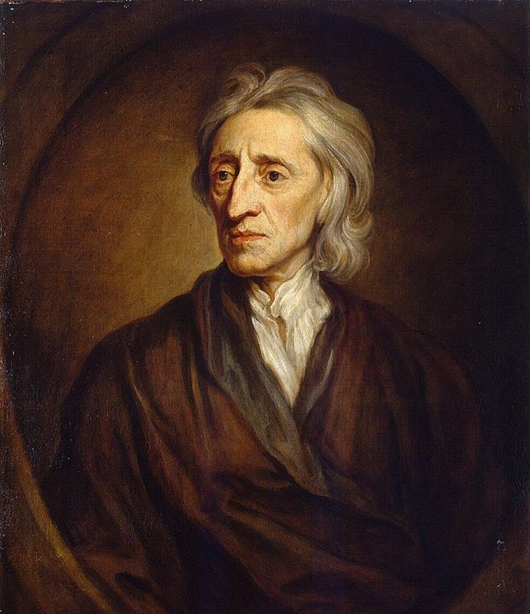
3. The idea of popular sovereignty
The authority of the sovereign is only ever ‘deputized’ to them by the people.
The people, therefore, always hold a legitimate claim to decide whether that authority has breached its trust.
The role of the people as a final court of appeal is inalienable.
John Locke (1632-1704)

Slide 11
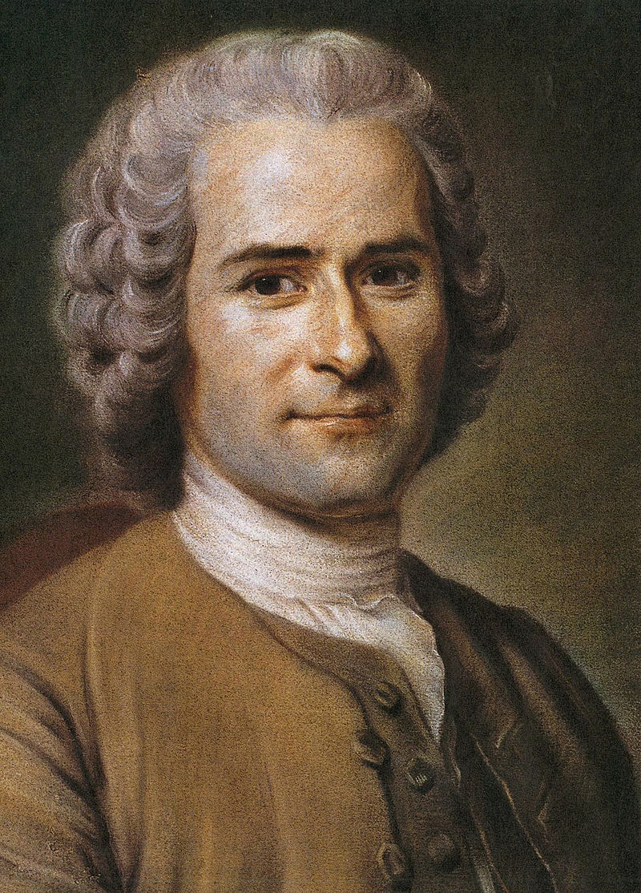
3. The idea of popular sovereignty
Rousseau denies that any transfer of sovereignty from the people to the ruler ever takes place.
Hence, no ruler can ever be said to have been given the authority to overrule the will of the people.
If laws are to be legitimate, the content of those laws must be determined by the will of the people.
Jean-Jacques Rousseau (1712-1778)

Slide 12
3. The idea of popular sovereignty
From Locke, we get the beginnings of an argument for the claim that the people should enjoy a right to remove the sovereign, e.g. through periodic elections.
From Rousseau, we get the beginnings of an argument for the claim that the legislative power of the state ought to be directed by the will of the people, e.g. through parliamentary elections.
But, there are problems with the concept of ‘popular sovereignty’

Slide 13
3. The idea of popular sovereignty
Can ‘the people’ reach consensus on any particular law or policy?
If not, what counts as the will of the people?
‘General will’ vs ‘will of all’?

Slide 14
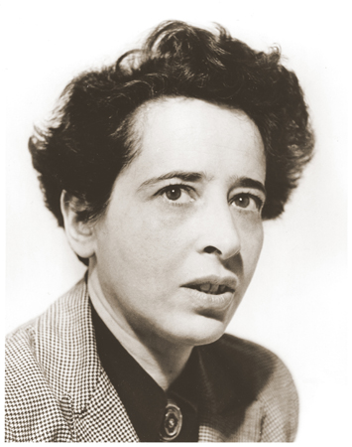
3. The idea of popular sovereignty
Against the very idea of sovereignty in politics:
“Where men wish to be sovereign, as individuals or as organized groups, they must submit to the oppression of the will, be this the individual will with which I force myself, or the ‘general will’ of an organized group. If men wish to be free, it is precisely sovereignty they must renounce.”
—Arendt, “What is Freedom”, p. 163.
Hannah Arendt (1906-1975)

Slide 15
4. The republican tradition
Republicanism is a political theory:
a conception of freedom and a theory of government;
It is not to be equated with the US Republican Party, any more than the concept of democracy is to be equated with the US Democratic Party or the concept of liberalism is to be equated with the Australian Liberal Party

Slide 16
4. The republican tradition
The basic idea:
Negatively expressed: Anti-monarchy
Positively expressed: The rule of law
James Harrington: the political community as an
“empire of laws not of men”

Slide 17
4. The republican tradition
History of the republican tradition:
Roman historians and jurists:
Polybius, Livy, Plutarch, Tacitus, and Sallust
Marcus Tullius Cicero
Revived in Renaissance Italy by Niccolò Machiavelli
The neo-Roman, republican heritage in 17th Century England:
James Harrington, Algernon Sidney, John Milton
… and in 18th Century America (‘Founding Fathers’):
Thomas Jefferson, James Madison, Thomas Paine, Benjamin Franklin, Alexander Hamilton

Slide 18
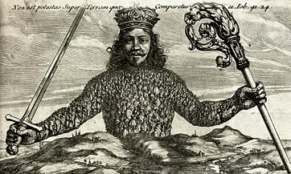
4. The republican tradition
The agenda of the republican tradition
To do away with the two threats to liberty:
1. Domination by the state (‘public imperium’)
2. Domination of citizens by each other (‘private dominium’)

Slide 19
What would a republican form of government look like?

Slide 20
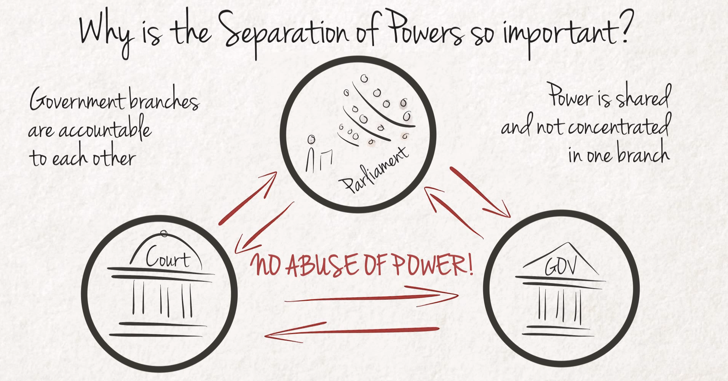
5. The republican model of government
1: Protecting citizens against domination by the state (‘public imperium’) through institutional or constitutional design

Slide 21
5. The republican model of government
1: Protecting citizens against domination by the state (‘public imperium’) through institutional or constitutional design
The traditional prescriptions for a republican constitution:
Separation of powers
Representation of different social classes (‘mixed’ constitution)
Constitutionally entrenched basic rights (‘immunities’)
Other institutional safeguards against corruption & dominance of private interests via the state: interlocking systems of accountability to legal mandates

Slide 22
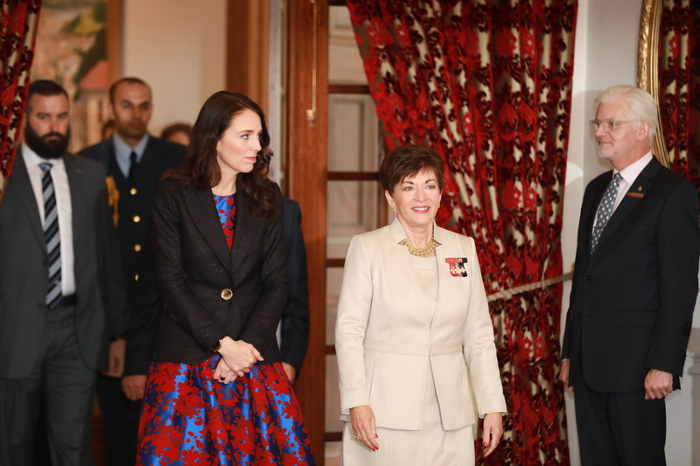
5. The republican model of government
2: The role of a culture of civic virtue, i.e. willingness to play one’s part in service of the public good.
Defending the rule of law and the republican ideal of government requires a commitment of all to each: a commitment to preferring a society of mutual relationships of non-domination rather than domination.

