Slide 1
PHIL 103: Freedom, Rights and Justice
Dr. Matheson Russell
Semester 2, 2019

Slide 2
Lecture 7: Approaches to political obligation
Outline:
1. The basic question
2. Are we necessarily defending political obligation?
3. Setting aside consequentialist defences
4. Consent approaches
5. Communitarian approaches
6. Natural duty approaches
7. Fairness approaches
8. Procedural fairness approaches

Slide 3
1. The basic question
Why should I obey the state when it tells me to do things I dislike or disapprove of?
Definitions:
“Political obligations are the moral obligations of citizens to support and comply with the requirements of their political authorities; and
the problem of political obligation is that of understanding why (or if) citizens in various kinds of states are bound by such obligations.” (John Simmons)

Slide 4
2. Are we necessarily defending political obligation?
The goal isn’t simply to work out the most plausible way to defend political obligation…
A spectrum of possible conclusions:
We are strictly bound to obey all laws Citizens have few (if any) obligations to obey laws

Slide 5
2. Are we necessarily defending political obligation?
Isn’t it dangerous to question our obligations to obey the law?
1. Questioning need not be feared if our obligations are well-founded.
2. If so, questioning will lead to a clearer understanding of why we are obligated to obey.
3. If we are obliged to obey only under certain conditions, then we will be clearer on how political authorities should be structured so as to warrant our obedience.
4. Questioning assumptions is what philosophy does.

Slide 6
3. Setting aside consequentialist defences
Should I obey the law because my disobedience would lead to the collapse of the (legitimate) state?

Slide 7
3. Setting aside consequentialist defences
Should I obey the law because my disobedience would lead to the collapse of the (legitimate) state?
Should I obey to avoid negative consequences for me?

Slide 8
4. Consent approaches
“We are obliged to obey the law because we have agreed or consented to do so.”

Slide 9
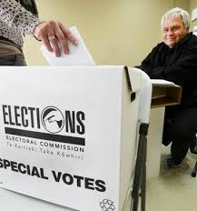
4. Consent approaches
Tacit or implicit consent?

Slide 10
5. Communitarian approaches
“We are obliged to obey the law because we have role obligations as members of the political community.”
“My claim is that a polity is, like the family, a relationship into which we are mostly born: and that the obligations which are constitutive of the relationship do not stand in need of moral justification in terms of a set of basic moral principles or some comprehensive moral theory. Furthermore, both the family and the political community figure prominently in our sense of who we are: our self-identity and our understanding of our place in the world.”
—John Horton 1992, pp. 150–51.

Slide 11
5. Communitarian approaches
Criticisms of communitarian approaches:
1. The analogy between family and state is neither persuasive nor attractive.
2. Conflates the sense of obligation with obligation itself.
3. If membership is sufficient to generate an obligation to obey, then the members of any unjust or oppressive group will have an obligation to obey the rules.

Slide 12
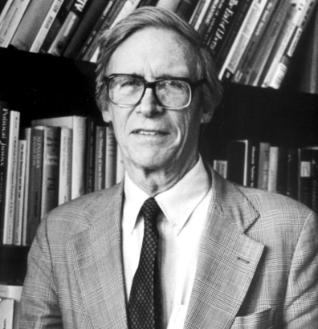
6. Natural duty approaches
“We are obliged to obey the law because we have a moral duty to do or promote justice and this implies a duty to obey and uphold laws and governments.”
John Rawls argues that everyone is subject to a ‘natural duty of justice’ – a natural moral duty “to support and comply with just institutions that exist and apply to us” and to help establish just institutions where there are none (Rawls, A Theory of Justice, 1971, 99).”

Slide 13
6. Natural duty approaches
Do we have an obligation to obey laws?
If the laws are just, then I have an obligation to follow them.
But if the laws are unjust, then I do not have an obligation to follow them.

Slide 14
6. Natural duty approaches
Critical questions for natural duty approaches:
“Political obligation is the obligation to obey each law because it is the law, and not necessarily because we think it has some independent moral justification.” (Wolff, 38)
Is a natural duty account an account of political obligation at all, i.e. an account of why we should obey political authorities and not merely to obey laws or rules that we have independent reasons to think are right or good?

Slide 15
7. Fairness approaches
“We are obliged to obey the law because it is fair that we do so.”

Slide 16
7. Fairness approaches
Do we have an obligation to obey laws?
If the laws impose fair burdens, then I have an obligation to follow them.
But if the laws do not impose fair burdens, then I do not have an obligation to follow them.

Slide 17
7. Fairness approaches
Questions for the fairness approaches:
1. Does everyone benefit from political obedience?
2. Does everyone benefit from political obedience equally?

Slide 18
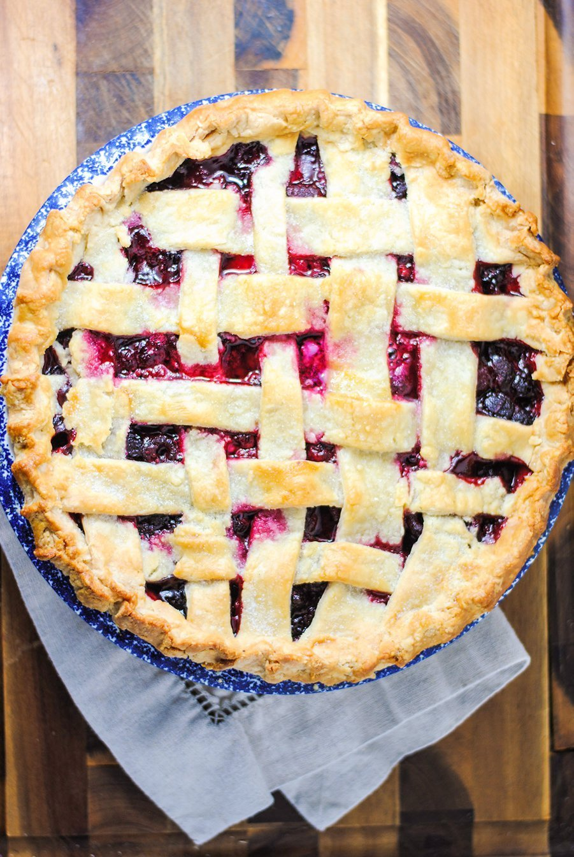
8. Procedural fairness approaches
“We are obliged to obey the law because laws have been decided by a fair (e.g. democratic) procedure.”

Slide 19
8. Procedural fairness approaches
Questions for the procedural fairness approaches:
1. What counts as a fair and just procedure for rule-making or law-making? Who decides?
2. Do we still have an obligation to obey laws that have been decided through a fair and just procedure but which we still think are substantively unjust?

