Slide 1
PHIL 103: Freedom, Rights and Justice
Dr. Matheson Russell
Semester 2, 2019

Slide 2
Lecture 9: Civil Disobedience
Outline:
1. What is civil disobedience?
2. Why civil disobedience?
3. Civil disobedience today
4. Objections to the practice and responses
5. Justifying particular acts of civil disobedience
6. Conclusion

Slide 3
1. What is civil disobedience?
Lawful protests Ordinary offences
Civil disobedience
Other forms of morally motivated breaking of the law

Slide 4
1. What is civil disobedience?
Civil disobedience
1. Morally-motivated lawbreaking
2. Targeting laws or policy decisions
3. Aimed at applying pressure to bring about change
4. Must be non-violent?
5. Must be public?
6. Must be willing to accept punishment?
7. Can also target non-governmental actions, e.g. corporations?

Slide 5
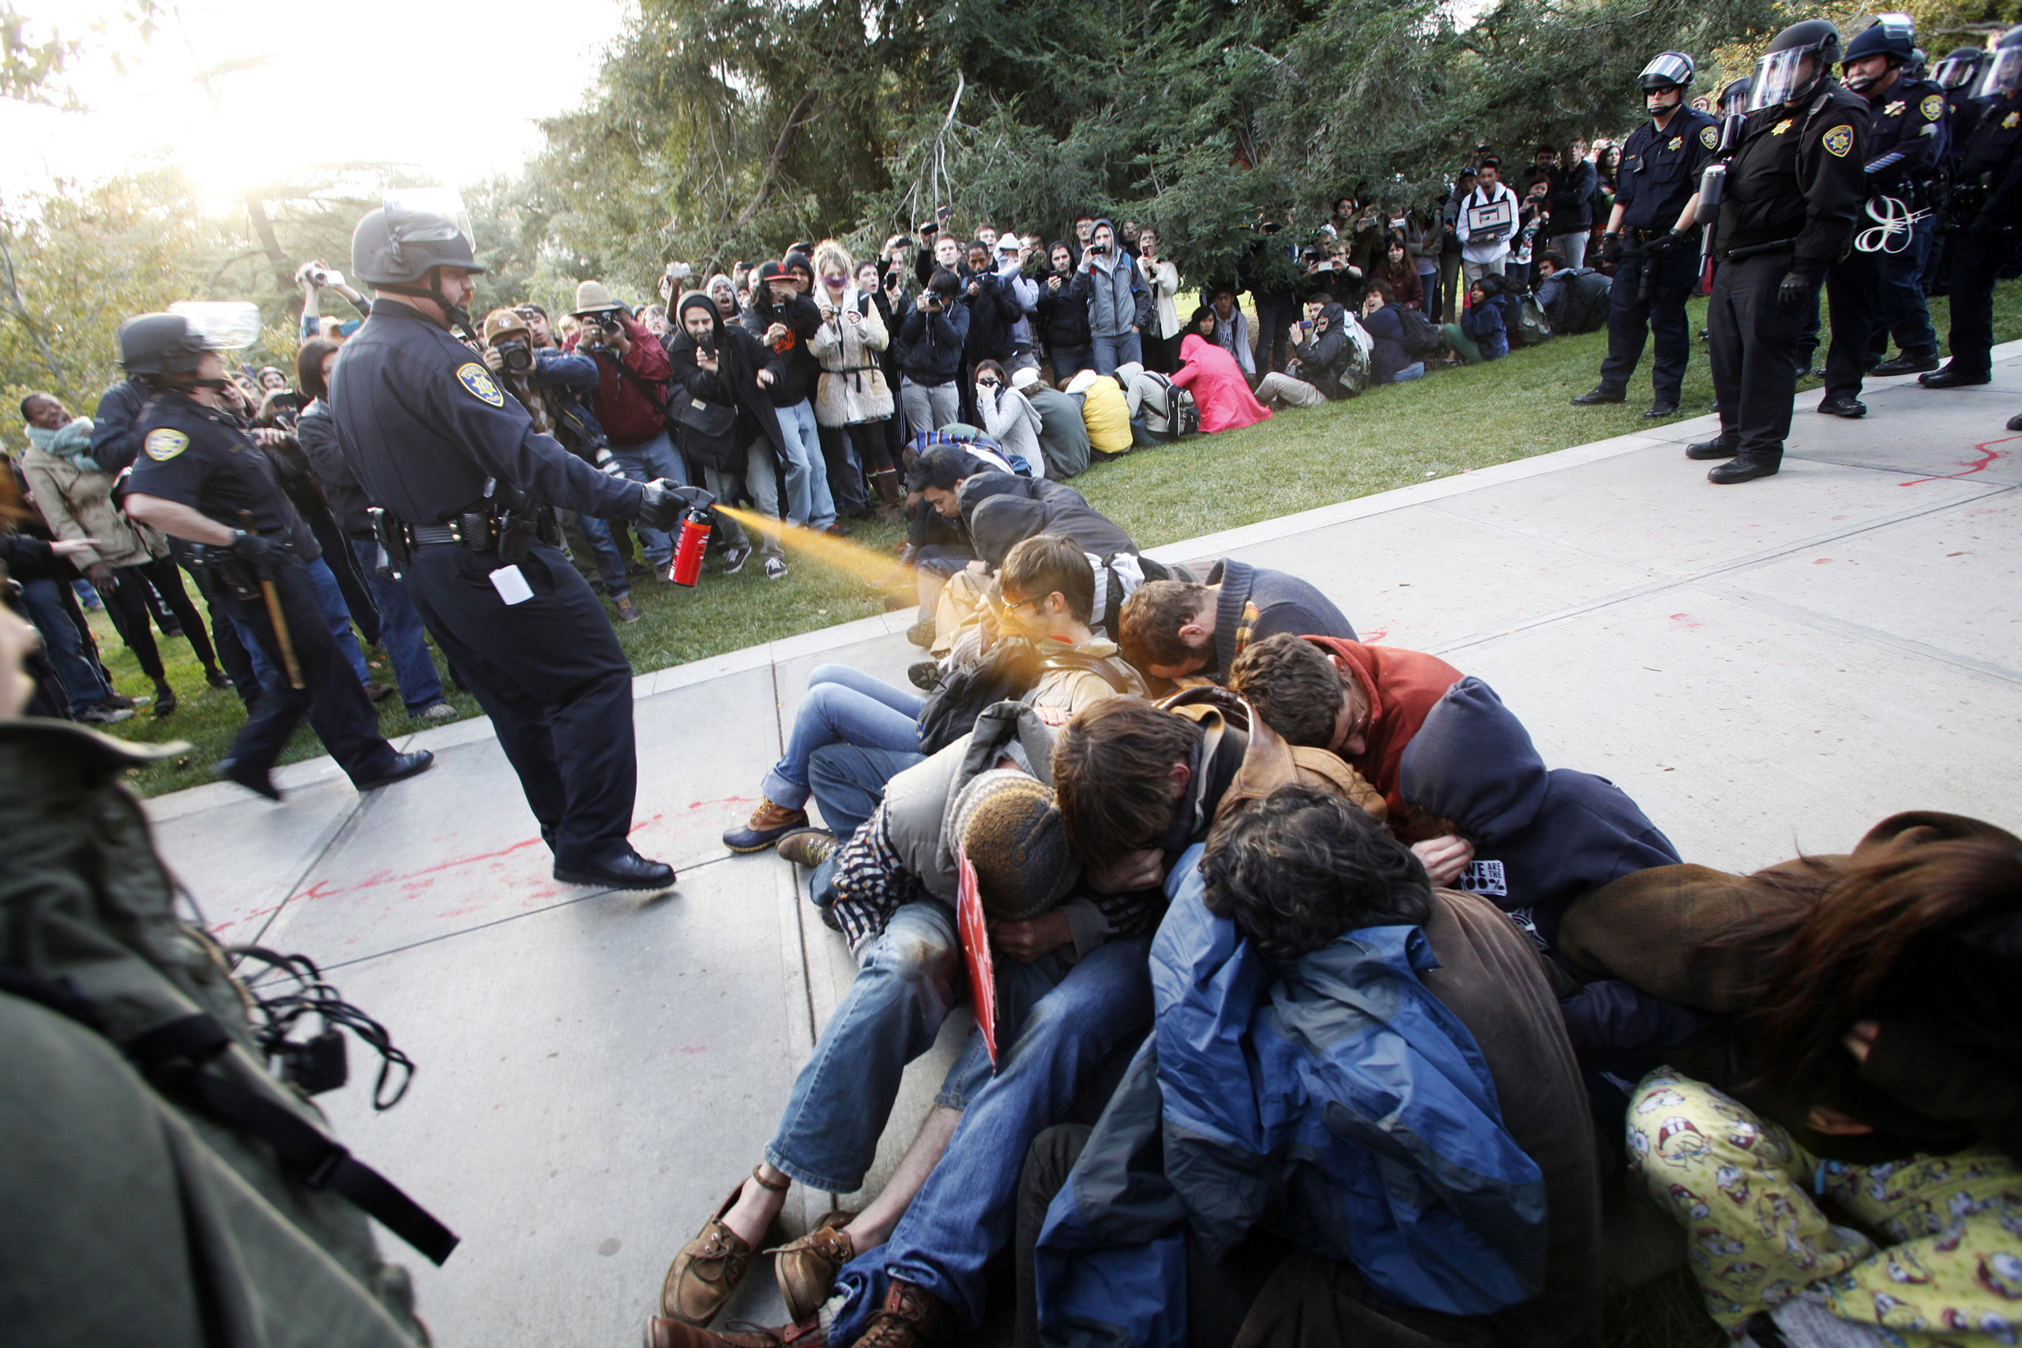
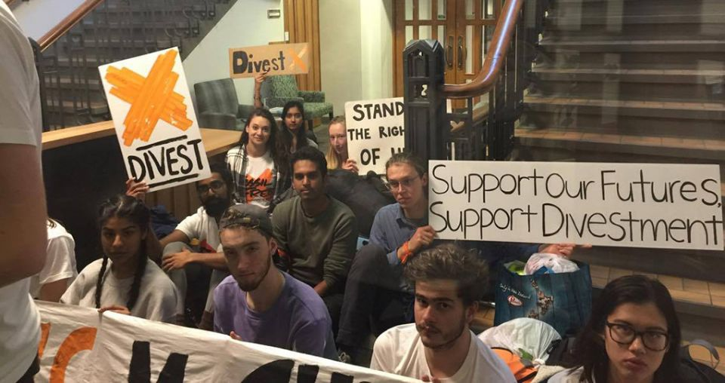
2. Why civil disobedience?
Strategic reasons for engaging in civil disobedience (as opposed to other forms of democratic action):

Slide 6
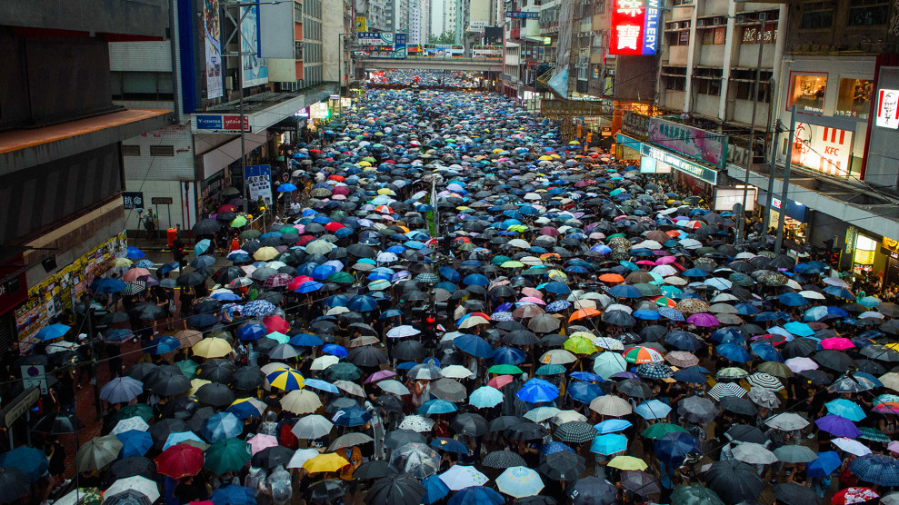
3. Civil disobedience today

Slide 7
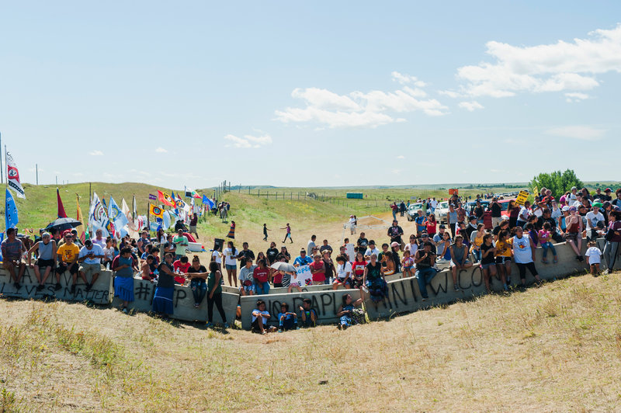
3. Civil disobedience today

Slide 8
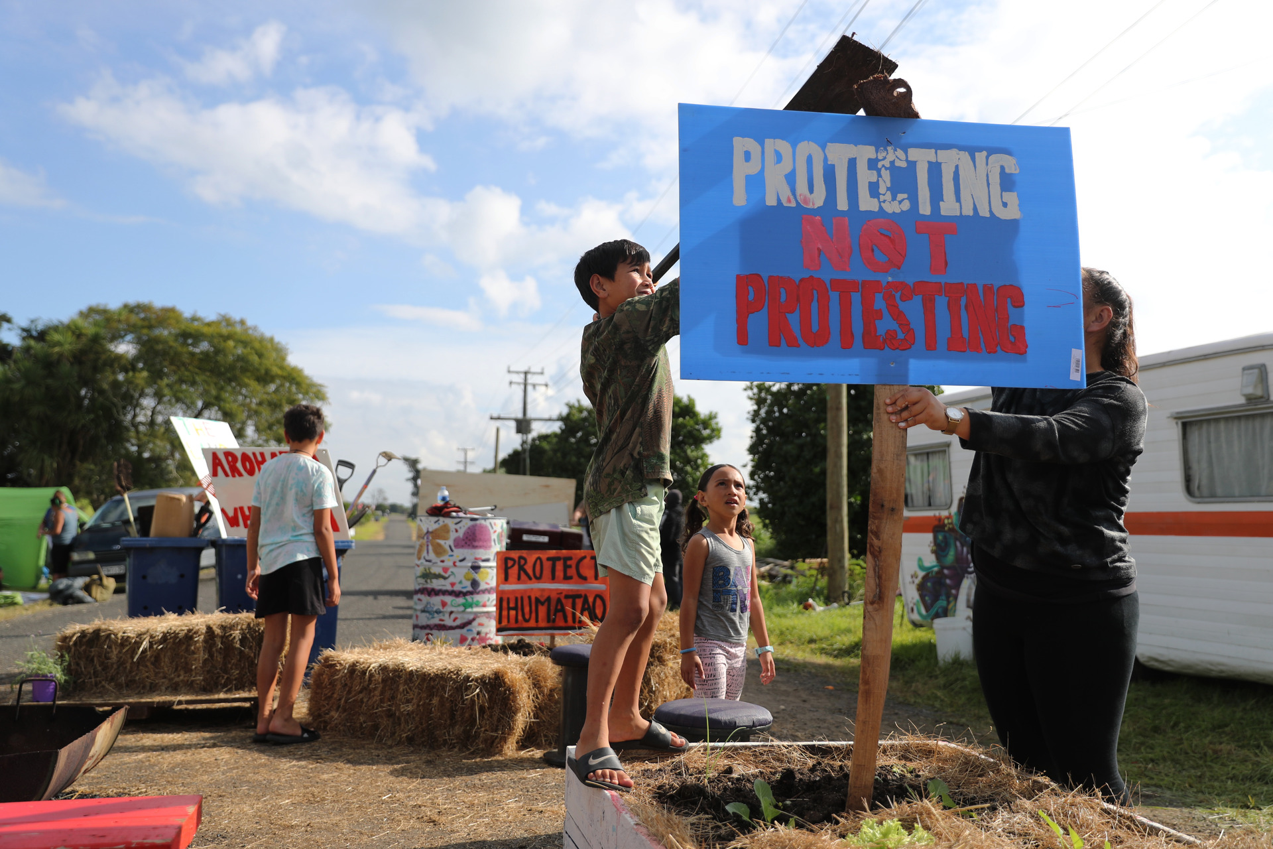
3. Civil disobedience today

Slide 9
4. Objections
Consequentialist objections
Without strict obedience, the state will collapse.
Civil disobedience is disruptive, costly, and disorderly, hence is irresponsible.
Civil disobedience can be socially divisive.
Civil disobedience can inspire further civil disobedience.
Civil disobedience can encourage disrespect for the law.

Slide 10
4. Objections
Principle-based objections
We have an obligation to obey the law (e.g. consent theories, fairness theories, natural duty theories).
The democracy objection: (i) civil disobedience is unacceptable when there are rights of free speech and lawful protest; (ii) laws passed democratically should be respected, and decisions by democratically elected officials honoured.

Slide 11
5. Justifying particular acts of disobedience
A general defence of civil disobedience doesn’t mean that any particular act of civil disobedience will be justified.
Kent Greenawalt:
For justification, nonviolence and publicness matter because they reduce the damage of violating the law.
Tactics should be proportionate to the evil against which civil disobedience is aimed;
For any particular act of civil disobedience, we need to consider both the morality of tactics and an evaluation of objectives.
Willingness to accept penalties?

