Slide 1
PHIL 103: Freedom, Rights and Justice
Dr. Matheson Russell
Semester 2, 2019

Slide 2
Lecture 10: Reasons for democracy
Outline:
1. Questioning the value of democracy
2. Democratic accountability
3. The problem of knowledge
4. Do we gain useful knowledge from polls?
5. A different approach to the epistemic value of democracy
6. The intrinsic value of democracy
7. Problems and questions

Slide 3
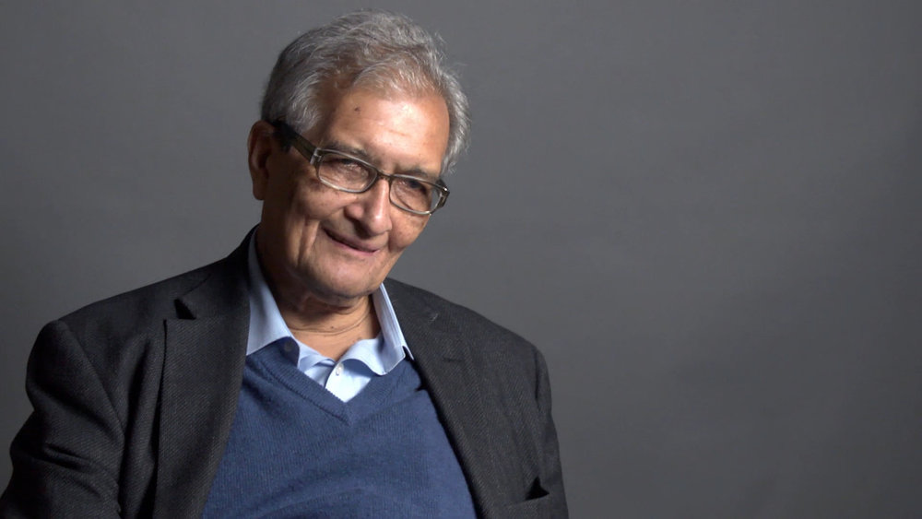
1. Questioning the value of democracy
Amartya Sen (1933 – )

Slide 4
1. Questioning the value of democracy
“The best argument against democracy is a five-minute conversation with the average voter”.
—Winston Churchill(?)

Slide 5
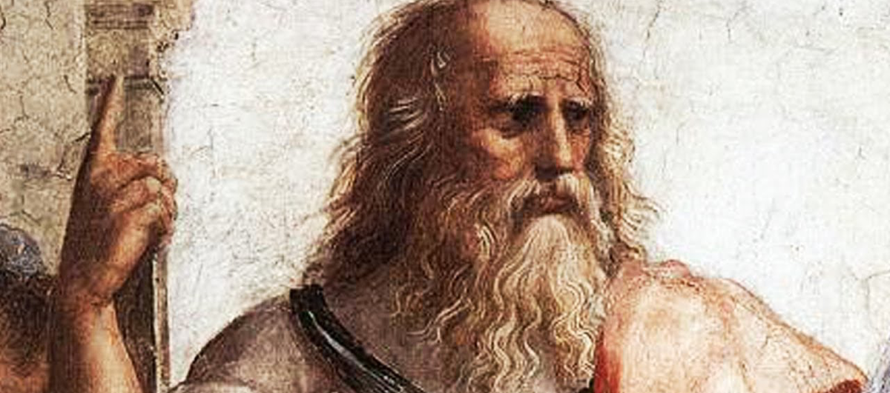
1. Questioning the value of democracy
Plato (428 BCE – 387 BCE)
Ruling is a craft. It requires skill, experience and wisdom

Slide 6
2. The value of accountability
’Republican’ mechanisms for protecting against corruption and promoting a culture of civic virtue.
‘Democratic’ mechanisms: transparency of the political process and periodic elections.

Slide 7
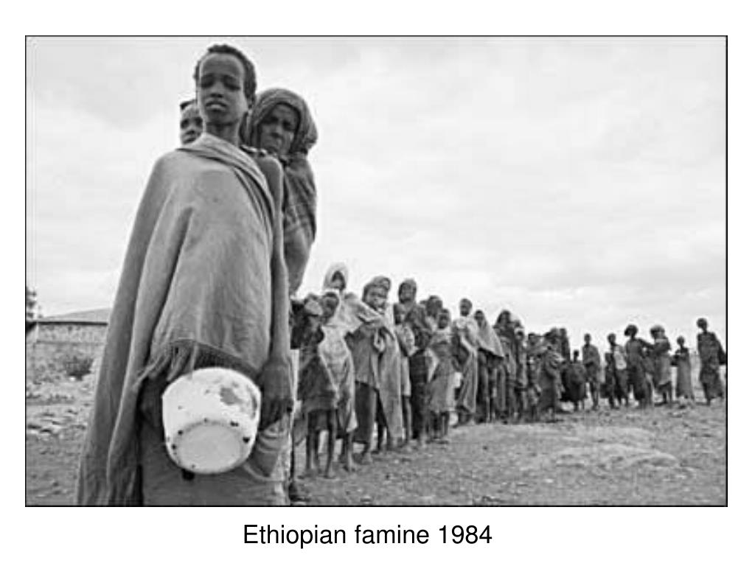
2. The value of accountability

Slide 8
3. The problem of knowledge
What are the needs or desires of the people? How do we know?
An ‘epistemic’ problem: a problem of knowledge

Slide 9
4. Do we gain useful knowledge from polls?
Reasons to be cautious:
Mixed-motivation voting makes it unclear what votes ‘express’
Preferences can be weak or changeable
Preferences can be more complex than voting procedures capture
Even clear preferences can be ‘aggregated’ in different ways

Slide 10
5. A different approach to the epistemic value of democracy
Emphasising the value of public discussion and the exchange of information.
A ‘deliberative’ model of democracy

Slide 11
6. The ‘intrinsic’ value of democracy
Realising values of freedom and equality

Slide 12
7. Problems and questions
Are we really free and equal in democracies such as ours?
Unequal access and participation
Representatives make decisions on our behalf
Is it even possible in principle to square
the ideal of freedom with political rule,
the ideal of equality with the practicalities of decision-making in large, complex societies?
Are we not subject to the ‘tyranny of the majority’?

