Slide 1
PHIL 103: Freedom, Rights and Justice
Dr. Matheson Russell
Semester 2, 2019

Slide 2
Lecture 11: The paradoxes of democracy
Outline:
1. What is democracy?
2. Populism as pseudo-democracy
3. The problem of democratic participation
4. The paradox of constitutional founding
5. The paradox of constitutional democracy

Slide 3
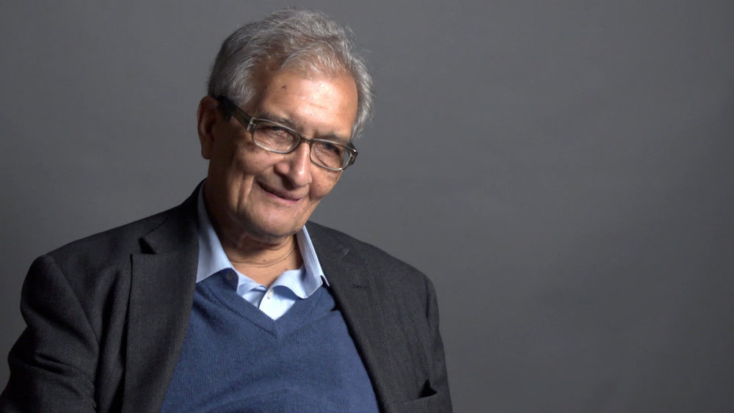
1. What is democracy?
Amartya Sen (1933 – )

Slide 4
1. What is democracy?
Rule (kratos) by the people (demos)

Slide 5
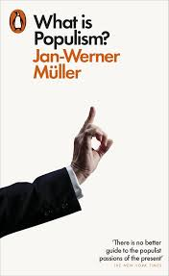
2. Populism as pseudo-democracy
A definition (Müller 2017, 19-25):
Populists represent ‘the people’ against ‘the elites’.
Anti-pluralism: A subset of the citizens are the ‘real’ people.
Exclusionary identity politics: The goal of politics is to undo moral harms done to the real people by corrupt others.

Slide 6
2. Populism as pseudo-democracy
Democracy on the populist model:
Dictatorship of the majority.
Election defeats are always illegitimate, evidence of the power of the corrupt elites and/or immoral minorities.
No legitimacy for opposition parties, free press, public dissent

Slide 7
2. Populism as pseudo-democracy
Why is this not a plausible model of democracy?
The people are never truly unified, they only appear in the ‘plural’
It undermines the three values of democracy (as articulated by Sen 1999):
The instrumental value of democracy is sacrificed to the moral goal of preserving the ascendency of the true people.
The intrinsic value of democracy is denied by populists’ denigration of classes of citizens.
The constructive value of democracy is undermined by the exclusion of the full diversity of voices from public discussion.

Slide 8
3. The problem of democratic participation
It is practically impossible for the people as a whole to govern.
The obvious solution is: delegation.
Elections as a mechanism to choose people to occupy offices of delegated authority.
Is representative democracy still genuine democracy?

Slide 9
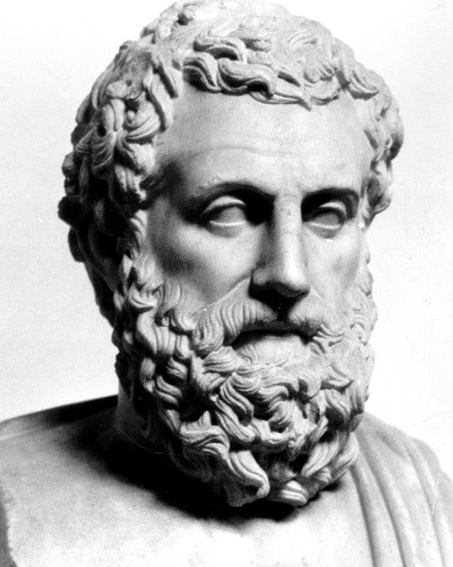
3. The problem of democratic participation
Elections = aristocracy.
Lottery = democracy!
Aristotle (384–322 BCE)

Slide 10
4. The paradox of constitutional founding
To have democratic legitimacy, constitutions need to be ratified by a democratic process.
But who institutes the procedures for democratic endorsement? These too need democratic endorsement. But this leads to an ‘infinite regress’.

Slide 11
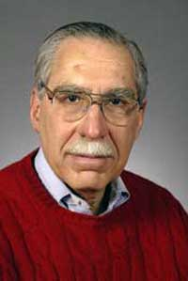
4. The paradox of constitutional founding
Frank Michelman

Slide 12
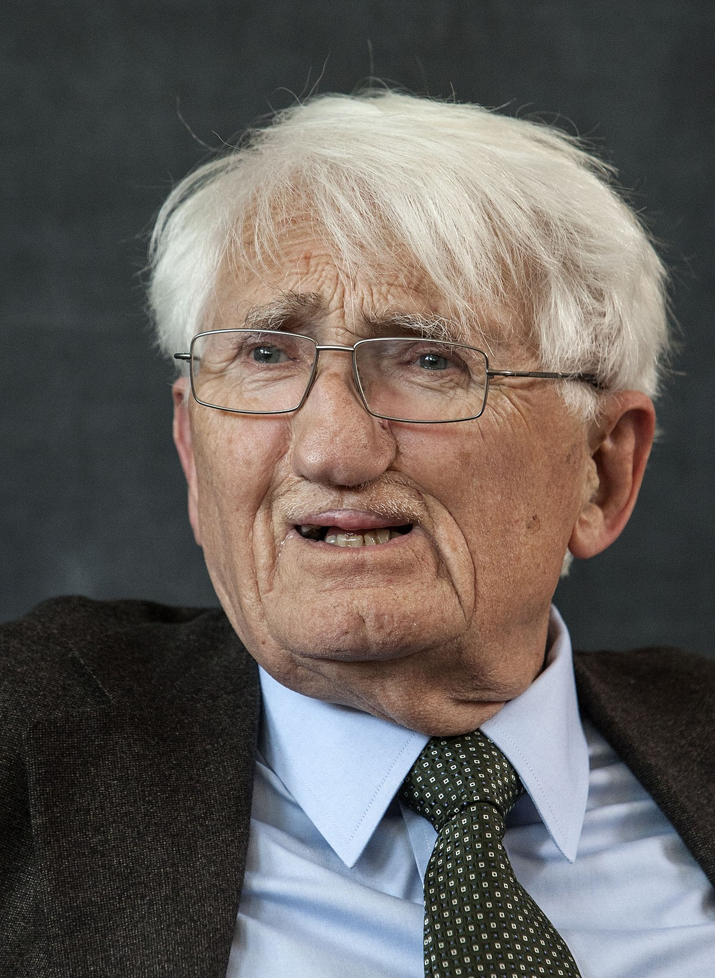
4. The paradox of constitutional founding
Frank Michelman Jürgen Habermas
We should understand constitution-making as a “project that makes the founding act into an ongoing process of constitution-making that continues across generations.”
—Habermas, ”Constitutional Democracy: A Paradoxical Union of Contradictory Principles?” (2001): 768.

Slide 13
5. The paradox of constitutional democracy
What if citizens vote to adopt a non-democratic system of government or elect non-democratic leaders?
Three views:
Laws are always legitimate so long as they emanate from the will of the people.
Laws are legitimate only if they do not violate the basic rights of citizens.
The political empowerment of the citizens (i.e. democracy) relies upon a system of rights. Hence democracy and rights are not in tension: rights are essential to guarantee democratic legitimacy.

