Slide 1
PHIL 103: Freedom, Rights and Justice
Dr. Matheson Russell
Semester 2, 2019

Slide 2
Lecture 12: The evolution of democracy
Outline:
1. Why ‘democracy’ looks the way it does today
2. Questions about the value of public discourse
3. More problems with contemporary electoral democracy
4. The revival of sortition: A People’s House?
5. Citizens’ assemblies:
What are they?
Do they work?
Some difficulties

Slide 3
1. Why democracy looks the way it does today
Absolutist state
add
Constitutional structures
Voting rights
and
and
Liberal rights
Political public sphere

Slide 4
2. Questions about the value of public discourse
Are scrutiny by the free press and public debate taking place in the mass media effective at rationally evaluating the performance of government?
Media power
Social media & ‘post-truth’ politics
Advertising & profit-seeking
Political messaging

Slide 5
3. More problems with contemporary electoral democracy
Politics as performance.
Bias towards short-termism.
Influence by the wealthy and powerful via lobbying etc.
Members of parliament not (demographically) representative of society.
Members of parliament overburdened.

Slide 6
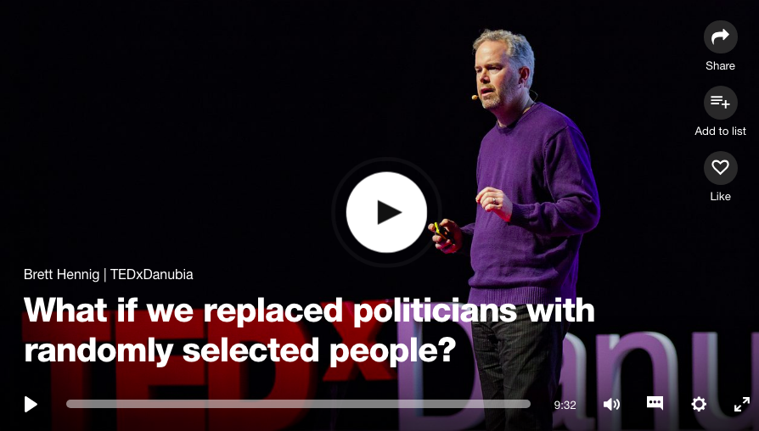
4. The revival of sortition: A people’s house?

Slide 7
4. The revival of sortition: A people’s house?
Some advantages of a ‘people’s house’:
Legislature more demographically representative of society.
Embodies a recognition of citizens as equal co-participants in the political process.
Reduces the influence of lobbyists and ’deep pockets’ on the political process.
Reduces the selection bias of the electoral system.
Some disadvantages of a ‘people’s house’:
Doesn’t solve the ‘overburdening’ of parliament.
Citizen involvement is more valuable when it is organized as a deliberative process.

Slide 8
5. Citizens’ assemblies: What are they?
Case study: Irish ‘citizens assembly’ on abortion law reform (2016)

Slide 9
5. Citizens’ assemblies: Do they work?
Public opinion vs deliberatively-generated opinion

Slide 10
5. Citizens’ assemblies: Some difficulties
Legitimacy and trust is essential.
Issues to resolve about representation.
Issues to resolve about expert input.
Issues to resolve about relationship to traditional mechanism of law-making.

Slide 11
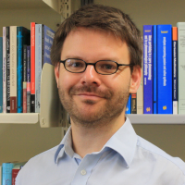
PHIL 225: Power, Critique and Emancipation
Dr. Matheson Russell, Philosophy

