Slide 1
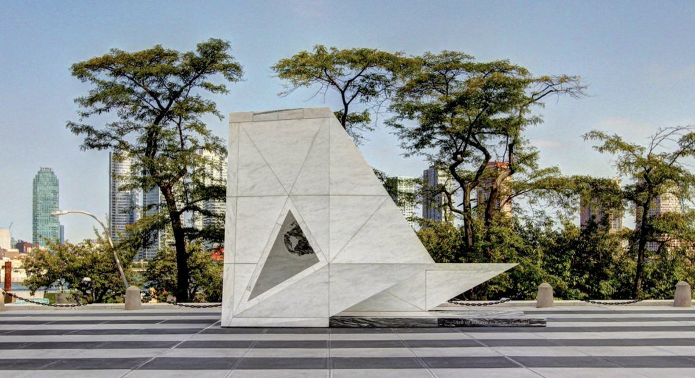
Let Freedom Reign
Freedom I

Slide 2
Overview
Freedom: Concept and Conceptions
Hegel and Haiti
Two Concepts of Liberty
Civil Liberties
Political Rights

Slide 3
Freedom: Concept and Conceptions
Varieties of freedom: different uses in language and practice.
What does freedom mean to you?
Who do you think about when you think of champions of freedom?
Which 20th century struggles purported to be freedom struggles?
Which contemporary struggles purport to be freedom struggles?
What have people(s) struggled to free themselves from?
What have people(s) struggled to become free to do?

Slide 4
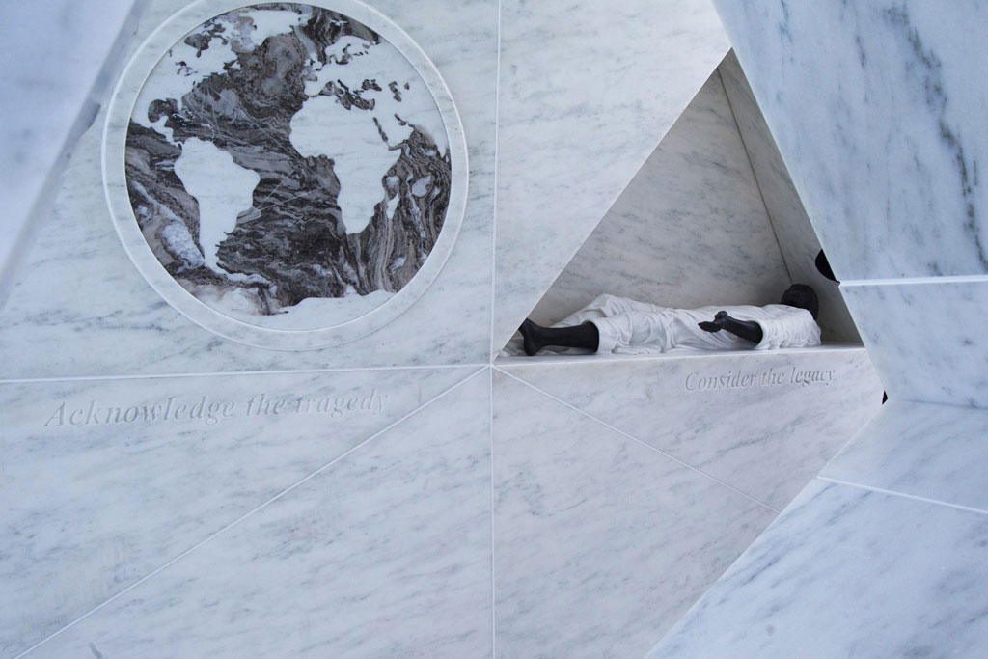

Slide 5
Two Concepts of Liberty
Negative liberty
Freedom from external constraints (de jure and de facto) on our agency.
Positive liberty
Empowerment (legal, economic, social, political, embodied) to realise our potential for rational agency.
Capabilities for functioning, rich human needs.
Economic, social, and cultural rights or “second generation rights”
Weeks 9-10 on the history, theory, and practice of rights
Classical liberalism prioritises negative liberty over positive liberty
The distinction is conceptually specious and politically contested

Slide 6
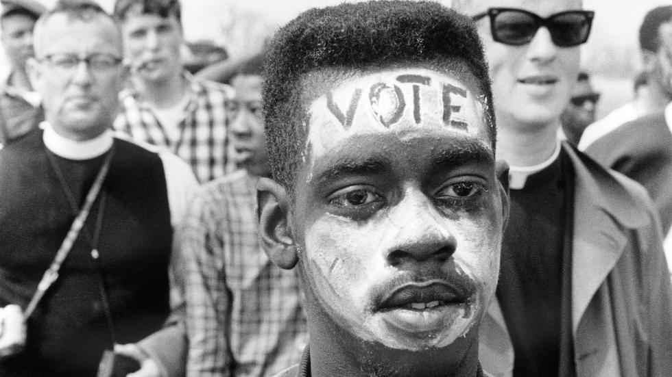
Civil Liberties
Protection of the liberty and security of the person.
Protection against torture and cruel, inhuman or degrading punishment
Protection against slavery and forced labour*
Protection from discrimination on the basis of personal characteristics.
Basic freedoms:
Privacy
Freedom of thought and conscience
Freedom of speech and expression
Freedom of movement
Freedom of religion
Freedom of the press
Freedom of assembly and association

Slide 7
Political Rights
Rights of natural justice (procedural fairness) in law, such as:
The rights of the accused: the right to a fair trial, the presumption of innocence
The right to equal treatment under the law, recognition of legal personality
The right to due process
The right to seek redress or a legal remedy
Rights of participation in civil society and politics such as:
The right to petition
The right to private property
The right to contract
The right to self-defense
The right to vote
The right to run for elected office

Slide 8
