Slide 1
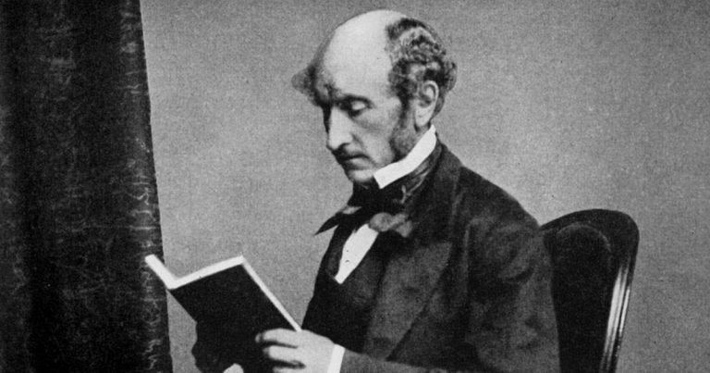
On Liberty
Freedom II

Slide 2
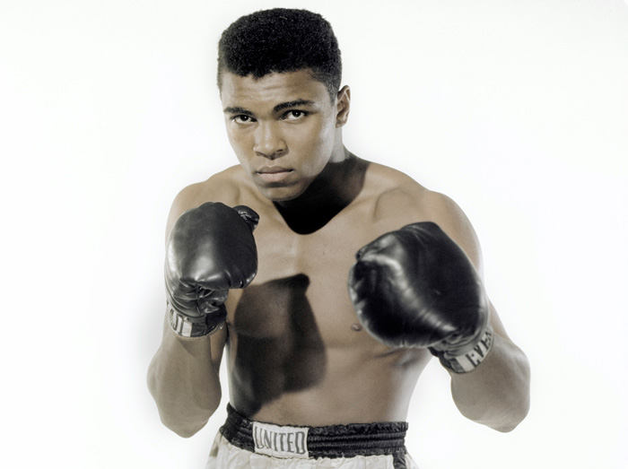
Recap of Yesterday’s Lecture
Historical examples of the use of the concept “freedom” in practice
Champions: Mandela, MLK, Rosa Parks, Wollstonecraft, Muhammad Ali.
Struggles: emancipation from slavery, black civil rights, women’s movement, Indian independence, decolonisation, anti-Apartheid.
Freedom from: systemic injustice, male domination, racism, enslavement.
Freedom to: be ourselves (identity), vote, marry, defend ourselves.
Thinking critically about Anglo-American political philosophy
Negative and positive liberty (classical liberalism = negative liberty)
Civil liberties and political rights

Slide 3
Overview
The priority of the individual over society
The political and intellectual history of liberalism, according to Mill
Public/private distinction
Liberal individualism: freedom as non-interference
The “harm principle”
The darker side of Mill’s liberal progressivism
Priorities: the right and the good
Mill’s perfectionism

Slide 4
Taming the Leviathan
Sovereign power was understood as “necessary, but also as highly dangerous; as a weapon which they would attempt to use against their subjects, no less than against external enemies.”
Early liberal revolutions aimed to set limits to sovereign power over their subjects. According to Mill, “this limitation was what they meant by liberty.”
Liberal revolution was attempted by two methods:
Recognition of political liberties or rights.
Establishment of constitutional checks and balances.
Liberal aspirations were limited to limiting sovereignty over subjects.

Slide 5
What is Mill’s Project?
Mill’s On Liberty self-consciously marks a new phase in the intellectual and political history of Western liberalism.
Philosophical inquiry into the nature and limits of the power which can be legitimately exercised by society over the individual.
Freedom as non-interference: freedom is the negative right to do what one likes without social/normative constraints – not only political domination.
This conception of freedom is the basis for the justification of negative rights that constitute the legal definition, construction, and protection of a space of unrestricted thought, speech, and action for individuals.
Negotiation of the public/private spheres: expansion of the private sphere.
“the practical question, where to place the limit.”

Slide 6
Liberal Individualism
Protection against the tyranny of majority opinion and practice.
Justified to protect the development of individuality against conformity to prevailing social norms, religious orthodoxy, etc.
Autonomous subjectivity: practical reason as the power to form and revise a private conception of the good, or a rational plan of life.
Autonomous subjectivity has as its condition of possibility that individuals have a negative right of non-interference, Mill argues.

Slide 7
“One Very Simple Principle”
The harm principle is intended to “govern absolutely” the exercise of power by society over the individual by way of compulsion and control, “whether the means used be physical force in the form of legal penalties or the moral coercion of public opinion”.
The harm principle states that “the only purpose for which power can be rightfully exercised over any member of a civilized community, against his will, is to prevent harm to others.”

Slide 8
The Justification of Restrictions on Liberty
Mill thus differentiates paternalistic and moralistic restrictions of liberty from restrictions of liberty based upon the harm principle.
Restrictions on individual liberty are paternalistic if for the agent’s own good.
Unjustified
Restrictions on individual liberty are moralistic if to ensure that the agent acts morally (upon moral obligations) or not immorally (upon moral prohibitions).
Unjustified
Restrictions on individual liberty are applications of the harm principle if to prevent harm to someone other than the agent.
Justified (maybe)
Mill claims that the harm principle is the sole legitimate justification for restricting individual liberties, iff the benefits of interference outweigh the costs (harm reduction).
Mill differentiates genuine harm and mere offense. In order for an action to to come under the harm principle, it must violate or risk violation of the core interests of others in which they have a legitimate right.

Slide 9
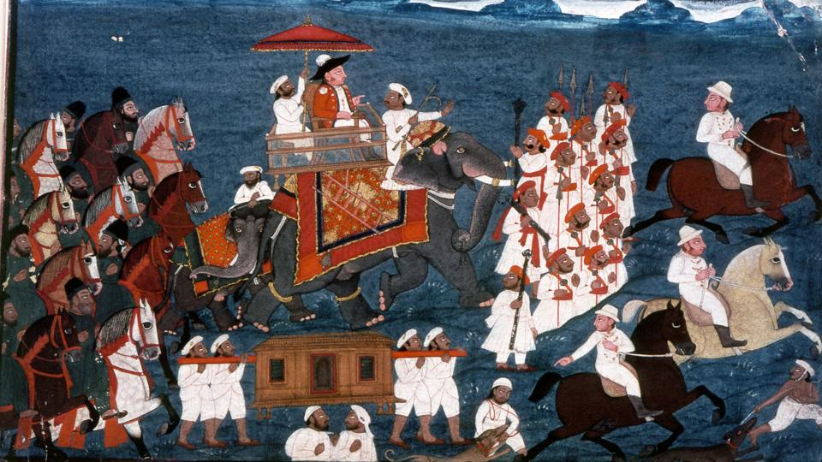
The Darker Side of Mill’s Progressivism
Recalling our pedagogical commitment to be critical of Western intellectual and political histories that construct Eurocentric, progressive narratives of human freedom.
“It is, perhaps, hardly necessary to say that this doctrine is meant to apply only to human beings in the maturity of their faculties. We are not speaking of children, or of young persons below the age which the law may fix as that of manhood or womanhood. Those who are still in a state to require being taken care of by others, must be protected against their own actions as well as against external injury.”
“For the same reason, we may leave out of consideration those backward states of society in which the race itself may be considered as in its nonage. The early difficulties in the way of spontaneous progress are so great, that there is seldom any choice of means for overcoming them; and a ruler full of the spirit of improvement is warranted in the use of any expedients that will attain an end, perhaps otherwise unattainable. Despotism is a legitimate mode of government in dealing with barbarians, provided the end be their improvement, and the means justified by actually effecting that end.”
“Liberty, as a principle, has no application to any state of things anterior to the time when mankind have become capable of being improved by free and equal discussion.”
“But as soon as mankind have attained the capacity of being guided to their own improvement by conviction or persuasion (a period long since reached in all nations with whom we need here concern ourselves), compulsion, either in the direct form or in that of pains and penalties for non-compliance, is no longer admissible as a means to their own good, and justifiable only for the security of others.” - On Liberty, 18-19

Slide 10
Mill’s Perfectionism: Liberal Progressivism
Liberal democratic state-societies are supposed to be neutral with regard to different conceptions of the good.
A basic normative premise in Mill’s argument for liberalism, however, is that the freedom to form and revise a conception of the good, and live out a rational plan of life, is a necessary (but insufficient) element of the good life for men and women as “progressive beings”.
Mill prioritises a thin theory of the good.
Our happiness consists in the higher activities that actualise our capabilities for reasoning, reflection, and creativity.

Slide 11
Priorities: the Right and the Good
Liberalism versus perfectionism (associated with republicanism)
In the liberal tradition, the measure of our institutions and policies is whether they enable the negative freedom of the individual to form and revise a private conception of the good.
The right is prior to the good.
In the perfectionist tradition, the measure of our institutions and policies is whether they enable the positive freedom of the individual to flourish in accordance with a determinate conception of the good: our final end.
The good is prior to the right.

