Slide 1
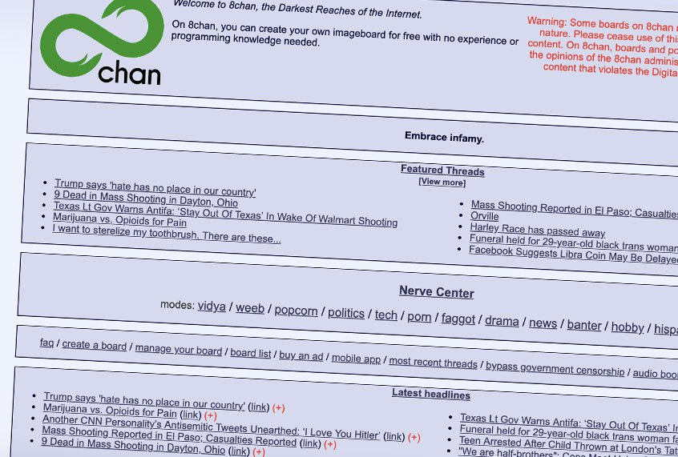
Free Speech
Freedom III

Slide 2
Overview
Is the crisis of liberalism self-correcting?
Reasoning as a social practice
Defective reasoning
Fake news
Regulating the marketplace of ideas
Mill on the limits on government intervention
Free speech and hate speech
Speaking truth to power

Slide 3
Tomorrow
Panel discussion on hate speech
Fa'anana Efeso Collins, Auckland Councillor (Manukau)
Meng Foon, Race Relations Commissioner
Jack Potaka, Pou Tikanga (Cultural Officer), Faculty of Arts

Slide 4
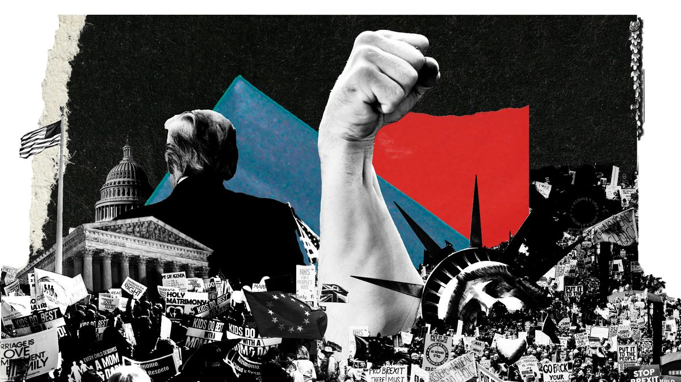
Is the Crisis of Liberalism Self-Correcting?
Christina Animashaun/Vox

Slide 5
Is the Crisis of Liberalism Self-Correcting?
Why isn’t liberalism winning the argument?
“Shouldn’t liberal democracy promote a full airing of all possibilities, even false and bizarre ones, because the truth will eventually prevail?” http://bostonreview.net/politics-philosophy-religion/jason-stanley-what-mill-got-wrong-about-freedom-of-speech
“These criticisms do not arise in a vacuum. They stem from real-world crises, most notably the 2008 Great Recession and the rise of far-right populists like Donald Trump to power. These shocks to the system show, in the eyes of liberalism’s contemporary critics, that something is profoundly wrong with the fundamental ideas that define our politics. It is a belief that “the liberal idea has become obsolete,” as Russian President Vladimir Putin recently declared.” https://www.vox.com/policy-and-politics/2019/9/9/20750160/liberalism-trump-putin-socialism-reactionary
Christina Animashaun/Vox

Slide 6
The Social Practice of Reasoning
“Wrong opinions and practices gradually yield to fact and argument: but facts and arguments, to produce any effect on the mind, must be brought before it.” - On Liberty, II, 37.
Mill’s epistemic virtue of open-mindedness to criticism of opinions and practices, and the intellectual habit of seeking out different perspectives and oppositional voices.

Slide 7
Defective Reasoning
Mill’s conception of deliberation is overly idealised:
There are imperfections or structural flaws in the “marketplace of ideas”.
Human beings are not perfectly rational agents.
Truth and falsehood coexist for long periods of time. In the meantime, the world keeps moving, and important decisions get made with imperfect information and without stable consensus.
Actual practices of public reasoning and political communication are not at all like imagined “rational”, “orderly”, “polite”, “civil” debates.

Slide 8
Defective Reasoning
Rationality is bounded because there are limits to our thinking capacity, available information, and time.
Generally, human beings aim to get a good answer, not the best one.
We fall back on heuristics and prejudices (normatively neutral).
The concept of bounded rationality emerges from the behaviouralist critique of “homoeconomicus” – of perfect economic rationality.
The concept of bounded rationality has since become generalised.

Slide 9
Defective Reasoning
Bounded rationality refers to a wide range of descriptive, normative, and prescriptive accounts of human behaviour which depart from the theoretical assumptions of perfect rationality.
A descriptive theory aims to explain or predict what judgments or decisions people in fact make and how they form them.
A prescriptive theory aims to explain or recommend what judgments or decisions people ought to make and how people ought to form them.
A normative theory aims to specify a normative standard to use in evaluating a judgment or decision and the process by which it was formed.

Slide 10
Fake News!
If human rationality is bounded, in particular due to constraints on our cognitive abilities, access to information, and the time costs of practices of reasoning, then misinformation and disinformation, which toxify the information ecosystem, further damage the prospects of reasoning and communication.
The challenge of misinformation and disinformation to democracy becomes especially pronounced when it is dressed up as real news or expert opinion, more so when the producers and suppliers of fake news are state and non-state actors engaged in information warfare.

Slide 11
Regulating the Marketplace of Ideas
Monopolistic and oligopolistic information market structures.
When there is market failure, we reasonably expect the government to intervene.
Competition is not the natural state for most markets, and has to be enforced by government through regulation in the public interest.
Liberal democratic governments typically break up monopolies, and enforce regulations to protect consumers and new entrants to market from the market dominance of oligopolistic firms.
Generally preferred to redistribution as a strategy for reducing inequalities.

Slide 12
Regulating the Marketplace of Ideas
Liberal governments typically provide for consumer protection.
A consumer protection framework comprises laws and organisations designed to ensure the rights of consumers as well as fair trade, competitive pricing, and accurate information in the marketplace.
A consumer protection framework may also provide additional protective measures for the most vulnerable in society.

Slide 13
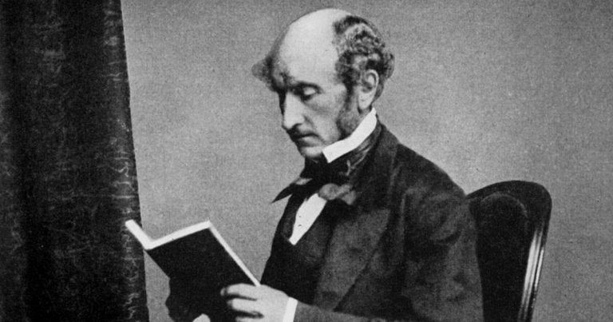
The Limits on Government Intervention in the Marketplace of Ideas

Slide 14
The Limits on Government Intervention in the Marketplace of Ideas
Mill argues that free speech can be justifiably limited.
However, the conditions under which limits on free speech can be justified are narrow. Mill gives the example of incitement (III, p.104).
Other examples include false advertising, defamation of character, blackmail, fraud, harassment, etc. where there is the clear likelihood or actuality of harms to others (violation of rights and interests) and benefits to potential victims and society as a whole in regulation.
Terrorist manifestos? Extremist content?
Mill argues that government censorship cannot be justified.

Slide 15
Against the Government Censorship of Ideas
“But the peculiar evil of silencing the expression of an opinion is, that it is robbing the human race; posterity as well as the existing generation; those who dissent from the opinion, still more than those who hold it. If the opinion is right, they are deprived of the opportunity of exchanging error for truth: if wrong, they lose, what is almost as great a benefit, the clearer perception and livelier impression of truth, produced by its collision with error.” – On Liberty, II, p.31.
Errors may contain half-truths, or at least sharpen good arguments.
Mill constructs an argument against government censorship based on the proposition that censorship implies infallibility.

Slide 16
Free Speech and Hate Speech

Slide 17
Free Speech and Hate Speech
Topic of tomorrow’s panel discussion
Recall Mill’s harm principle. Government intervention is justified if an action infringes on the legitimate rights of others, and if the benefits of intervention outweigh the costs.
Excludes offence.
We have to consider the harms to the agents whose free speech is limited by regulation, and to society as a whole.
We have to consider the harms to the agents whose legitimate rights are infringed upon.

Slide 18
Free Speech and Hate Speech
Is this utilitarian calculus the normatively correct way to resolve tensions between rights and freedoms? Or are there other ways of thinking about and codifying the balance and prioritisation of rights and freedoms?
Free speech is not more fundamental than other rights.
We need to decide how much value we place on free speech in relation to other important ideals in democratic state-societies.

Slide 19
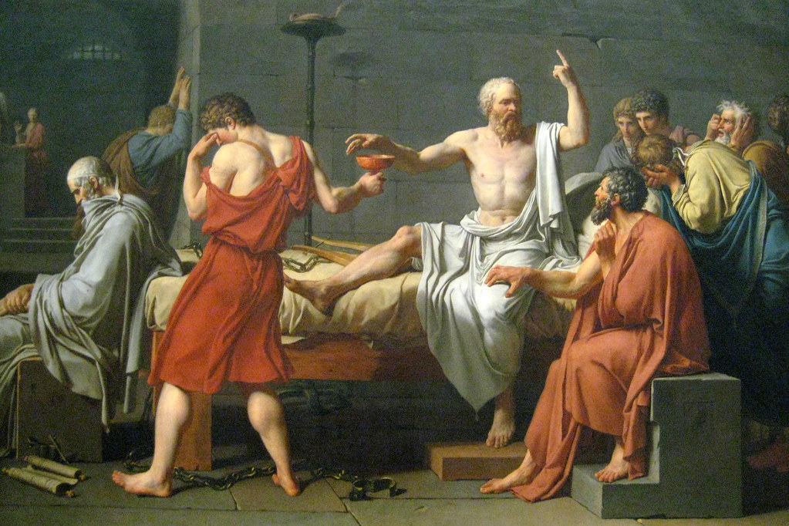
Speaking Truth to Power

Slide 20
Speaking Truth to Power
“Mankind can hardly be too often reminded that there was once a man named Socrates, between whom and the legal authorities and public opinion of his time, there took place a memorable collision. Born in an age and country abounding in individual greatness, this man has been handed down to us by those who best knew both him and the age, as the most virtuous man in it; while we know him as the head and prototype of all subsequent teachers of virtue, the source equally of the lofty inspiration of Plato and the judicious utilitarianism of Aristotle, "i maëstri di color che sanno," the two headsprings of ethical as of all other philosophy. This acknowledged master of all the eminent thinkers who have since lived – whose fame, still growing after more than two thousand years, all but outweighs the whole remainder of the names which make his native city illustrious – was put to death by his countrymen, after a judicial conviction, for impiety and immorality.” – On Liberty, II, pp.44-45.

