Slide 1
Nonsense Upon Stilts
Rights I

Slide 2
Overview
“Rights talk”
Analysing the conceptual structure of rights
Making sense of rights
Justifying rights

Slide 3
“Rights Talk”
The dominant discourse of morality in our time.
We speak of our rights as citizens of Aotearoa/New Zealand.
We speak of human rights, which we hold as “citizens of the world” or perhaps simply as human beings, members of a particular species.
We often speak of animal rights and the rights of nature.

Slide 4
Analysis of Rights
One way to understand rights is to analyse their conceptual structure.
We analyse the structure of rights in terms of agency and the modal structuring of action situations:
Permissible (not-necessarily not-φ)
Impermissible (necessarily not-φ)
Obligatory (necessarily φ)
Omissible (not-necessarily φ)
Optional (not-necessarily φ and not-necessarily not-φ)

Slide 5
Analysis of Rights
Hohfeld’s (1919) influential analysis of the four “incidents” of rights:
Claims—X has a claim that Y φ iff Y has a duty to X to φ.
Liberties—X has the liberty to φ iff X has no duty not to φ.
Powers—X has a power iff X has the ability within a set of rules to alter X’s own or Y’s Hohfeldian incidents.
Immunities—Y has immunity iff X lacks the ability within a set of rules to alter Y’s Hohfeldian incidents.
Rights usually involve a structured compound of Hohfeldian incidents.

Slide 6
Hohfeldian Analysis of Rights
Opposites | Correlatives
If X has a claim, then X lacks a no-claim | If X has a claim, then Y has a duty
If X has a liberty, then X lacks a duty | If X has a liberty, then Y has a no-claim
If X has a power, then X lacks a disability | If X has a power, then Y has a liability
If X has an immunity, then X lacks a liability | If X has an immunity, then Y has a disability

Slide 7
Making Sense of Rights

Slide 8
Making Sense of Rights
Natural rights and legal/positive rights:
Natural rights are not dependent on law, tradition, custom, or membership in a particular community (citizenship, nationality).
They are thus universal and unalienable.
Legal/positive rights are created and thus can be modified, repealed, and restrained by human laws.
Human beings have a special status, or dignity, which grounds our rights according to natural rights theorists.

Slide 9
Making Sense of Rights: Agents and Patients
Children
Animals
Rivers, forests, lakes, mountains, etc.
Adults
Severely disabled, comatose, incompetent adults
Youth
Women
The dead

Slide 10
Making Sense of Rights
“We hold these truths to be self-evident, that all men are created equal, that they are endowed by their Creator with certain unalienable Rights, that among these are Life, Liberty and the pursuit of Happiness. That to secure these rights, Governments are instituted among Men, deriving their just powers from the consent of the governed. That whenever any Form of Government becomes destructive of these ends, it is the Right of the People to alter or to abolish it, and to institute new Government, laying its foundation on such principles and organizing its powers in such form, as to them shall seem most likely to effect their Safety and Happiness. Prudence, indeed, will dictate that Governments long established should not be changed for light and transient causes; and accordingly all experience hath shewn, that mankind are more disposed to suffer, while evils are sufferable, than to right themselves by abolishing the forms to which they are accustomed. But when a long train of abuses and usurpations, pursuing invariably the same Object evinces a design to reduce them under absolute Despotism, it is their right, it is their duty, to throw off such Government, and to provide new Guards for their future security.” - Preamble to the United States Declaration of Independence

Slide 11
Making Sense of Rights
Natural rights, according to Bentham, are “simple nonsense: natural and imprescriptible rights, rhetorical nonsense, — nonsense upon stilts.”
Only positive rights, established and enforced by legitimate government, have “any determinate and intelligible meaning”.
Yet, French and American revolutionaries attempted to codify natural rights in positive law: natural rights were made sense of by declaration.
Natural rights are not only fictions, they are “anarchical fallacies” that encourage civil unrest, disobedience and resistance to laws, and revolution against governments.
Talk of natural rights is “terrorist language”.

Slide 12
Justifying Rights

Slide 13
Justifying Rights
Bentham draws a distinction between what is and what ought to be.
Two orders of justification:
Justification within a practice
Justification of a practice
Bentham’s claim is that rights can only be made sense of within the context of our practices and institutions, so there is no sense to be made of critiquing our practices and institutions by appealing to an antecedent set of natural rights.
Yet, there are rational standards of evaluation against which to judge our practices and institutions, and with which to argue for reform.

Slide 14
Justifying Rights: Status Accounts
Natural rights are grounded in our status as persons or moral agents.
One important feature of natural rights is that insofar as they are supposed to be prior to the law, they can be used to critique the law. They are revolutionary. Whether that is a good or a bad thing…
But if natural rights do not make sense, then that does not mean we do not have rights, or that the rights that we have in a given social and historical context are fixed.

Slide 15
Justifying Rights: Instrumentalist Accounts
On positivist accounts of rights, how can we argue that the rights we have are justified or unjustified? How are positive rights established, maintained, or abolished through “reason and plain sense”?
Bentham provides an instrumentalist justification for rights.
The practice of rights is a means to an end: the advantage of society.
Bentham was the pioneer of utilitarianism.
He has an important sub-argument for being specific about rights: knowing what the advantage of society consists in requires us to take into consideration specific details, which vary with time and place.

Slide 16
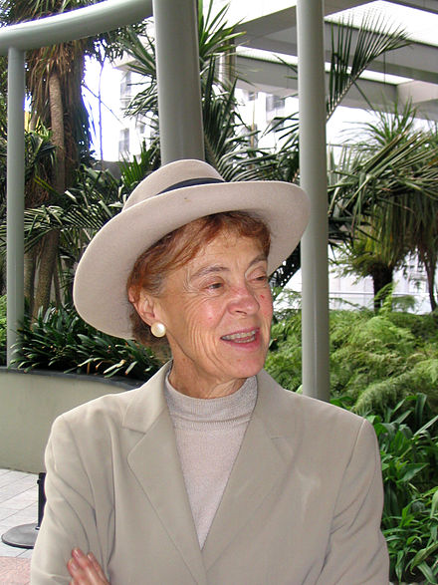
Justifying Rights: Instrumentalist Accounts
“Hume’s attack on that concept of rights enshrined in the constitutions of the American and French revolutions, and his rival account, has, I believe, been unjustly neglected. Those of us who agree with Aristotle that ethical science precedes and is continuous with political science, and who hence are inclined to reject the ‘priority of the Right’ made famous by Rawls, may find hints in Hume of the bridge we need between Aristotle's discussion of justice and post-Enlightenment thought.”
Rights are “naturally unintelligible” prior to and independent of our practices and institutions.
The rational standard of evaluation for our practices and institutions – justice, as their first virtue – is to be understood by reference to their constitutive function.

Slide 17
Justifying Rights: Perfectionism
The constitutive function of the practices and institutions that govern society is analysed in terms of the common good and the good life for human beings as rational, linguistic, social animals, in our environments.
The concept of the good is logically prior to the concept of a right.
The concept of the good is explicitly ethical and cannot be interpreted independently of a community of meaning, value, and practice.
While Hursthouse’s account shares the same instrumental structure as Bentham’s utilitarian account, it is substantively different.
Institutions can be evaluated as just or unjust against the standard of enabling or preventing members of a society living well together.
This account is non-liberal: securing liberty and property is not the standard of evaluation for our governance practices and institutions.

