Slide 1
Human Rights Discourse
Rights II

Slide 2
Overview
Origins and evolution of human rights discourse
Normative and legal force
Positivism about human rights

Slide 3
Origins and Evolution

Slide 4
Origins
World War II (1939 to 1945) and totalitarianism.
Post-WWII liberal international order building.
The United Nations Charter, October 24, 1945.
The Universal Declaration of Human Rights (UDHR), December 10, 1948.
The pre-WWII Western imperialist world order was overtly white supremacist.
Antecedents in natural rights theory.
Normative ordering: human rights as standards of modern progress.

Slide 5
Evolution: Codifying Human Rights
The UDHR has been translated into positive law through:
Treaties
Customary international law
General principles
Regional agreements
Domestic law
The UDHR has inspired over 80 international human rights treaties and declarations, numerous regional human rights conventions, domestic human rights bills, and constitutional securities, which together constitute a comprehensive legally binding system for the promotion and protection of human rights.

Slide 6
Evolution: International Bill of Rights
The International Covenant on Civil and Political Rights (ICCPR), and the International Covenant on Economic, Social and Cultural Rights (ICESCR) entered into force in 1976.
The two Covenants further elaborate the rights already enshrined in the UDHR, making them effectively legally binding on States that have ratified the Covenants.
The UDHR and the two Covenants constitute the International Bill of Human Rights.

Slide 7
Evolution: Counterhegemonic World Ordering
Over the past 70 years, international human rights treaties and instruments have become more focused and specialised regarding:
The issues addressed;
The social groups identified as requiring protection.
Recent revisionist scholarship on the intellectual and political history of the genesis of human rights has emphasised the agency of postcolonial state-societies and subaltern actors in the origins and evolution of human rights discourse.

Slide 8
Evolution: Three Generations
Three generations echo the motto of the French revolution:
Liberté (freedoms, "civil and political" or "first generation" rights)
Egalité (equality, "socio-economic" or "second generation" rights)
Fraternité (solidarity, "collective-developmental" or "third generation" rights)
Our focus next week is on the United Nations Declaration on the Rights of Indigenous Peoples and the ways in which third generation human rights discourse decolonises the practice of human rights.

Slide 9
Evolution: Three Generations
Civil-political human rights include two subtypes: norms of physical security and integrity, and norms of civil-political liberties.
Negative rights and freedoms
Socio-economic human rights include two subtypes: norms of the provision of goods meeting social needs, and norms of the provision of goods meeting economic needs.
Positive rights and freedoms
Collective-developmental human rights also include two subtypes: the self-determination of peoples and the special rights of ethnic and religious minorities.
Positive and negative moments

Slide 10
Normative and Legal Force

Slide 11
Normative and Legal Force
Although the UDHR was adopted as a mere declaration, without “binding” legal force, it is a normative standard of evaluation of State conduct.
A “common standard of achievement for all peoples and all nations”.
Human rights are, for the most part, claim-rights that impose correlative duties on other agents. The primary addressee of human rights is the State.
Some human rights (“manifesto rights”) constitute aspirations or priorities for development, and assign responsibility for their progressive realisation.

Slide 12
Normative and Legal Force
Many of the provisions of the UDHR have acquired the status of customary international law.
The States that have ratified the ICCPR and ICESCR are legally “bound” by international human rights law, but there is no final enforcement mechanism or world police force to coerce compliance.
International human rights law creates duties which States are legally bound to honour: to respect, protect, and fulfil human rights.
Respecting human rights means that States must refrain from any actions that would violate or lead to a violation of human rights.
Protecting human rights means States have a responsibility to protect individuals and groups against human rights abuses.
Fulfilling human rights means that States must take progressively enable the full enjoyment of human rights: civil and political, economic, social, and cultural, and collective-developmental.

Slide 13
Normative and Legal Force
States that ratify human rights treaties establish domestic legislation and policy measures compatible with their treaty obligations.
The domestic legal system provides the principal legal protection of international human rights law.
Regional and international level mechanisms and procedures.
Global dissensus over the justiciability of socio-economic rights.
Consequently, individuals could lodge complaints with the United Nations alleging violations by States of ICCPR, but not of ICESCR.

Slide 14
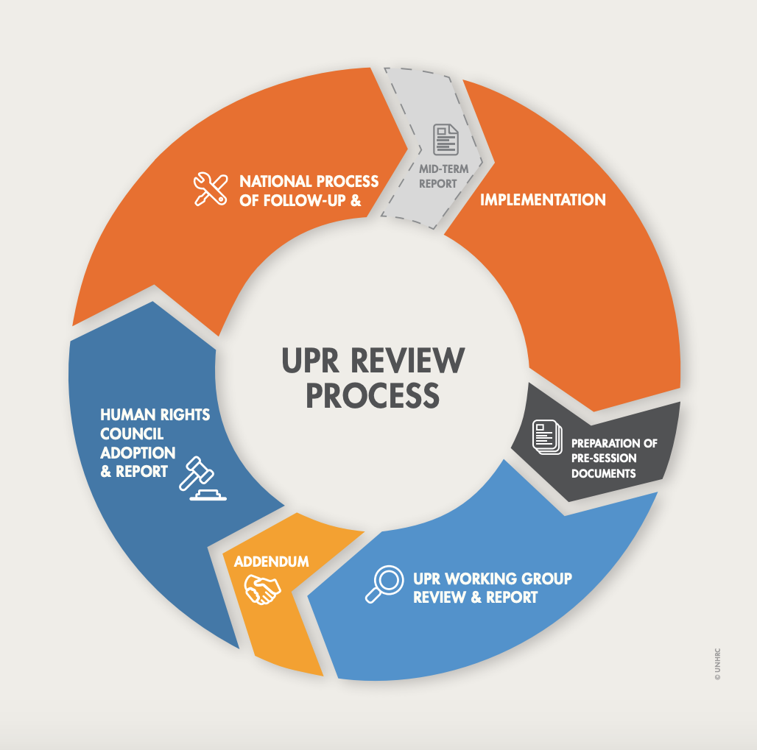
Normative and Legal Force
The function of the Office of the High Commissioner for Human Rights (OHCHR) is to protect and promote human rights.
The new Human Rights Council (HRC) includes a system of special procedures, expert advice, and a complaint procedure.
Composed of 47 Member States elected by the UN General Assembly.
Universal Periodic Review is a State-driven HRC process to monitor State compliance with human rights norms. Under this mechanism, the human rights situation of all UN Member States is reviewed every 5 years.

Slide 15
Normative and Legal Force
Some monitoring and enforcement mechanisms are linked to specialised agencies of the UN responsible for specific human rights instruments.
Many countries create domestic human rights enforcement systems, which may include a national human rights commission legislatively empowered to investigate claims and special adjudicative bodies to hear cases.
New Zealand Human Rights Commission
Monitoring and enforcement mechanisms linked to national constitutions and legislation may offer more concrete and legally enforceable remedies.

Slide 16
Positivism about Human Rights

Slide 17
Positivism about Human Rights
Are human rights nonsense upon stilts?
We boldly declare that human rights are inherent and universal, as if they have an independent existence from the discursive practice of human rights and the rules-based international order to which they are integral.
Instead of theorising human rights law as a reflection of a independently existing moral reality, a theorist might understand them “politically” as the evolving, contested norms of a historically contingent discursive practice.
Instrumentalist reasoning: human rights are about promoting and protecting core individual and collective interests – like world peace.

Slide 18
“The UN was not created to take mankind to heaven, but to save humanity from hell.” – 2nd United Nations Secretary-General Dag Hammarskjöld.

