Slide 1
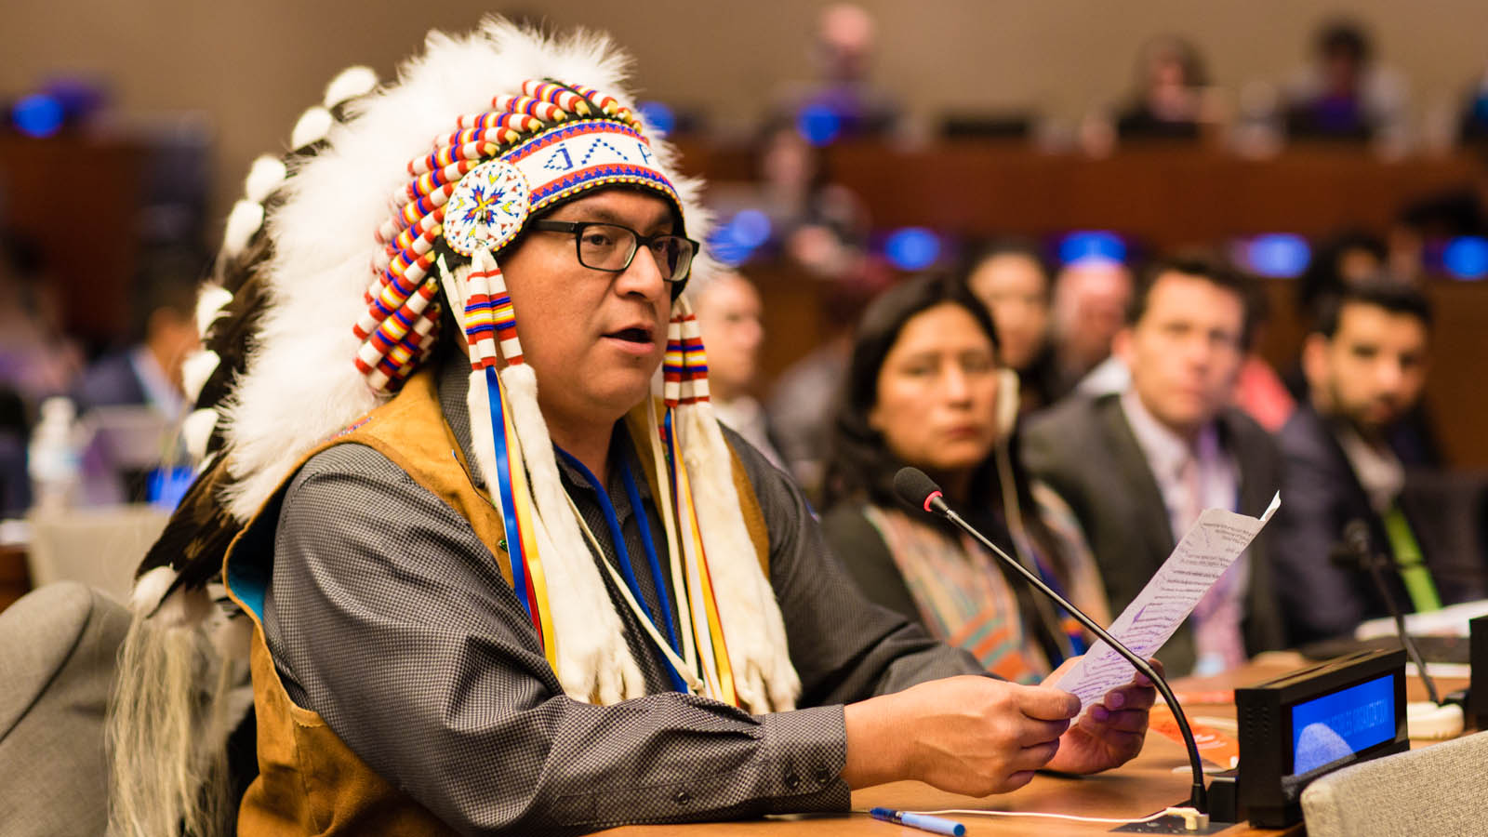
Indigenous Rights
Rights III

Slide 2
Contents
Recap of human rights discourse
Indigenous Peoples
United Nations Declaration on the Rights of Indigenous Peoples
UNDRIP in global historical context
Aotearoa/New Zealand’s treaty-based constitutional framework
UNDRIP and Te Tiriti
Tomorrow: the practicability of UNDRIP

Slide 3
Human Rights Discourse
Two approaches to the study of rights
  Analytical and ideal-theoretical
  Historical and practical
Post-WWII liberal international order building
  The pre-WWII Western imperialist world order was overtly white supremacist
  Colonialism remained a geopolitical reality after WWII
  Decolonisation struggle was planetary, framed by the Cold War
  Positive codification of human rights law – globally, regionally, and nationally
Three generations of human rights
  Liberté (freedoms, "civil and political" or "first generation" rights)
  Egalité (equality, "socio-economic" or "second generation" rights)
  Fraternité (solidarity, "collective-developmental" or "third generation" rights)

Slide 4
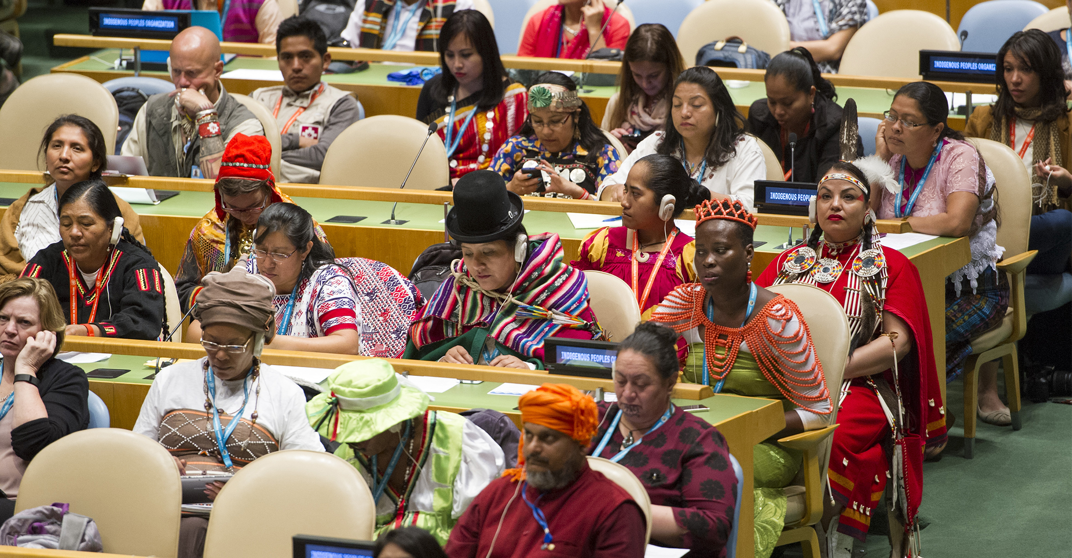
Indigenous Peoples

Slide 5
Indigenous Peoples
The practice of the international community is that no single definition of Indigenous peoples is necessary and that a combination of subjective and objective criteria may be used in identifying Indigenous peoples.
One criterion that underpins most definitions is self-identification.
If a group of people defines themselves as Indigenous, then, unless manifestly illegitimate, such designation should be respected.

Slide 6
Indigenous Peoples
Indigenous peoples are the first or earliest occupiers of lands.
~350 to 500 million people.
90% of the world’s cultural diversity.
Occupy 20% of the Earth’s land mass.
Indigenous peoples have rich and ancient cultural, religious traditions.
Indigenous worldviews typically imagine their social, political, legal, economic, environmental and spiritual systems as interdependent.
Indigenous peoples are among the world’s most oppressed groups.

Slide 7

United Nations Declaration on the Rights of Indigenous Peoples (UNDRIP)

Slide 8
United Nations Declaration on the Rights of Indigenous Peoples (UNDRIP)
UNDRIP (United Nations Declaration on the Rights of Indigenous Peoples) is a comprehensive international human rights document on the rights of Indigenous peoples. It sets out the minimum standards for the survival, dignity, wellbeing, and rights of the world’s Indigenous peoples.
Indigenous peoples, including Māori, were involved in drafting it.

Slide 9
United Nations Declaration on the Rights of Indigenous Peoples (UNDRIP)
Its 46 articles cover all areas of human rights as they apply specifically to Indigenous peoples individually and collectively. Key themes are:
  Equality and non-discrimination
  Self-determination, self-government, and self-defined development
  Participation in decisionmaking, underpinned by free, prior, informed consent
  Cultural survival and flourishing, incl. Indigenous institutions and governance
  Protection, management, and sustainable development of land, territories, natural resources, and intellectual property
  Redress for historical wrongs perpetrated or enabled by States
  Procedural justice and dispute resolution mechanisms

Slide 10
United Nations Declaration on the Rights of Indigenous Peoples (UNDRIP)
The General Assembly,
Guided by the purposes and principles of the Charter of the United Nations, and good faith in the fulfilment of the obligations assumed by States in accordance with the Charter,
Affirming that indigenous peoples are equal to all other peoples, while recognizing the right of all peoples to be different, to consider themselves different, and to be respected as such,
Affirming also that all peoples contribute to the diversity and richness of civilizations and cultures, which constitute the common heritage of humankind,

Slide 11
United Nations Declaration on the Rights of Indigenous Peoples (UNDRIP)
Affirming further that all doctrines, policies and practices based on or advocating superiority of peoples or individuals on the basis of national origin or racial, religious, ethnic or cultural differences are racist, scientifically false, legally invalid, morally condemnable and socially unjust,
Reaffirming that indigenous peoples, in the exercise of their rights, should be free from discrimination of any kind,
Concerned that indigenous peoples have suffered from historic injustices as a result of, inter alia, their colonization and dispossession of their lands, territories and resources, thus preventing them from exercising, in particular, their right to development in accordance with their own needs and interests,

Slide 12
United Nations Declaration on the Rights of Indigenous Peoples (UNDRIP)
Recognizing the urgent need to respect and promote the inherent rights of indigenous peoples which derive from their political, economic and social structures and from their cultures, spiritual traditions, histories and philosophies, especially their rights to their lands, territories and resources,
Recognizing also the urgent need to respect and promote the rights of indigenous peoples affirmed in treaties, agreements and other constructive arrangements with States,
Welcoming the fact that indigenous peoples are organizing themselves for political, economic, social and cultural enhancement and in order to bring to an end all forms of discrimination and oppression wherever they occur,

Slide 13
United Nations Declaration on the Rights of Indigenous Peoples (UNDRIP)
Convinced that control by indigenous peoples over developments affecting them and their lands, territories and resources will enable them to maintain and strengthen their institutions, cultures and traditions, and to promote their development in accordance with their aspirations and needs,
Recognizing that respect for indigenous knowledge, cultures and traditional practices contributes to sustainable and equitable development and proper management of the environment,
Emphasizing the contribution of the demilitarization of the lands and territories of indigenous peoples to peace, economic and social progress and development, understanding and friendly relations among nations and peoples of the world,

Slide 14
United Nations Declaration on the Rights of Indigenous Peoples (UNDRIP)
Recognizing in particular the right of indigenous families and communities to retain shared responsibility for the upbringing, training, education and well-being of their children, consistent with the rights of the child,
Considering that the rights affirmed in treaties, agreements and other constructive arrangements between States and indigenous peoples are, in some situations, matters of international concern, interest, responsibility and character,
Considering also that treaties, agreements and other constructive arrangements, and the relationship they represent, are the basis for a strengthened partnership between indigenous peoples and States,

Slide 15
United Nations Declaration on the Rights of Indigenous Peoples (UNDRIP)
Acknowledging that the Charter of the United Nations, the International Covenant on Economic, Social and Cultural Rights and the International Covenant on Civil and Political Rights, as well as the Vienna Declaration and Programme of Action, affirm the fundamental importance of the right to self-determination of all peoples, by virtue of which they freely determine their political status and freely pursue their economic, social and cultural development,
Bearing in mind that nothing in this Declaration may be used to deny any peoples their right to self-determination, exercised in conformity with international law,

Slide 16
United Nations Declaration on the Rights of Indigenous Peoples (UNDRIP)
Convinced that the recognition of the rights of indigenous peoples in this Declaration will enhance harmonious and cooperative relations between the State and indigenous peoples, based on principles of justice, democracy, respect for human rights, non-discrimination and good faith,
Encouraging States to comply with and effectively implement all their obligations as they apply to indigenous peoples under international instruments, in particular those related to human rights, in consultation and cooperation with the peoples concerned,
Emphasizing that the United Nations has an important and continuing role to play in promoting and protecting the rights of indigenous peoples,

Slide 17
United Nations Declaration on the Rights of Indigenous Peoples (UNDRIP)
Believing that this Declaration is a further important step forward for the recognition, promotion and protection of the rights and freedoms of indigenous peoples and in the development of relevant activities of the United Nations system in this field,
Recognizing and reaffirming that indigenous individuals are entitled without discrimination to all human rights recognized in international law, and that indigenous peoples possess collective rights which are indispensable for their existence, well-being and integral development as peoples,

Slide 18
United Nations Declaration on the Rights of Indigenous Peoples (UNDRIP)
Recognizing that the situation of indigenous peoples varies from region to region and from country to country and that the significance of national and regional particularities and various historical and cultural backgrounds should be taken into consideration,
Solemnly proclaims the following United Nations Declaration on the Rights of Indigenous Peoples as a standard of achievement to be pursued in a spirit of partnership and mutual respect

Slide 19
UNDRIP: NZHRC Summary
All human rights, including collective rights
Equality and non-discrimination
Self-determination
Autonomy or self-government
Their own institutions
A nationality
Life, liberty and security
Protection from cultural destruction or assimilation
Belong to indigenous communities or nations
Freedom from forced removal from their lands
Their culture and cultural property
Their spiritual and religious customs

Slide 20
UNDRIP: NZHRC Summary
Their languages, stories and names
Education, including in their own language
The dignity and diversity of their culture
Their own media and equal access to all other media
Protection in employment
Participation in decisions that affect them
Good faith consultation on laws and policies that affect them
Their own political, social and economic institutions and activities
Improvement of their economic and social conditions
Particular attention to the needs of elders, women, youth, children and disabled people
Development
Health, and to their traditional medicinal resources and health practices

Slide 21
UNDRIP: NZHRC Summary
Their spiritual relationship with their lands and resources
Recognition and protection of their lands and resources
Fair processes for dealing with their rights to lands and resources
Redress for lands and resources taken or damaged without consent
Environmental protection
Consultation before their lands are used for military activities
Their cultural and intellectual property
Use and develop their lands and resources, and consultation on projects that would affect these
Determine their own identity and membership
Their own institutions, laws and customs
Determine the responsibilities of individuals to their communities
Maintain and develop contacts across borders

Slide 22
UNDRIP: NZHRC Summary
Observance of their treaties with States
By States, in consultation and cooperation with indigenous peoples, through appropriate measures, including legislation
Through financial and other assistance to indigenous people
By ensuring indigenous peoples have access to fair procedures for resolving disputes with States, and to remedies for breaches of their rights
With financial and other assistance from the United Nations and other international organisations, and by establishing ways to ensure indigenous peoples’ participation in matters that affect them
Through promotion and follow up by the United Nations and States
Are minimum standards
Apply equally to males and females
Do not diminish any other rights that indigenous peoples have
Do not allow actions that are contrary to the Charter of the United Nations, or that diminish the territorial integrity of States

Slide 23
UNDRIP in Global Historical Context
UNDRIP was adopted by the United Nations General Assembly on September 13 2007.
Indigenous peoples are now “important subjects of concern” within the international program to advance human rights.
First generation human rights: individual political and civil rights.
Second generation human rights: economic, social and cultural rights.
  The individual right to culture is covered by such instruments, protecting such interests as access to education and cultural expression.
Third generation rights include collectively-held group rights.

Slide 24
UNDRIP in Global Historical Context
An emergent and evolving global regime of minimum standards and specifically concerning the rights of Indigenous peoples.
  As a Declaration of the General Assembly, it is non-binding on State parties, but its normative significance extends beyond its formal legal status.
UN bodies dedicated to Indigenous peoples include the Expert Mechanism on the Rights of Indigenous Peoples, the Special Rapporteur, and the Permanent Forum on Indigenous Issues.

Slide 25
UNDRIP in Global Historical Context
The UNDRIP was adopted by 144 of 193 countries:
  11 abstentions
  4 against
Canada, Australia, New Zealand, and the United States (CANZUS) – the Anglophone white settler colonies – originally voted against it.
  Indigenous self-determination is the last front in the decolonisation struggle.
The Fifth Labour Government warned that UNDRIP was fundamentally incompatible with New Zealand’s constitutional and legal systems.

Slide 26
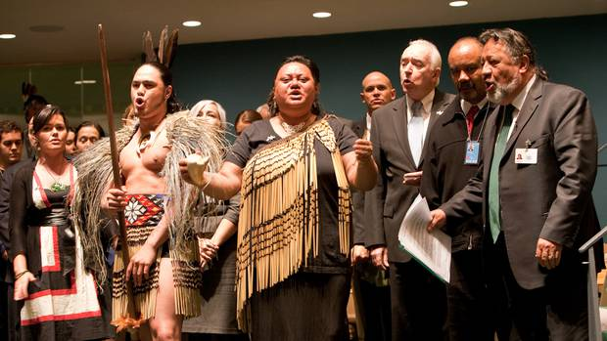
Actioning UNDRIP in Aotearoa/New Zealand

Slide 27
Actioning UNDRIP in Aotearoa/New Zealand
In 2010, the Māori Party persuaded the Fifth National Government to support the Declaration.
The statement in support of the declaration:
  acknowledges that Maori hold a special status as tangata whenua, the indigenous people of New Zealand and have an interest in all policy and legislative matters;
  affirms New Zealand's commitment to the common objectives of the declaration and the Treaty of Waitangi; and
  reaffirms the legal and constitutional frameworks that underpin New Zealand's legal system, noting that those existing frameworks define the bounds of New Zealand's engagement with the declaration.

Slide 28
Actioning UNDRIP in Aotearoa/New Zealand
Aotearoa/New Zealand, under the Sixth Labour Government, now aims to be the first country in the world with an action plan to implement UNDRIP.
A high-level UN delegation from the Expert Mechanism on the Rights of Indigenous Peoples visited Aotearoa/New Zealand to advise.
“Other countries look to what we are doing… We will be the first in the world to have a plan that can hold the Government to account on how it is making progress on indigenous rights.”
– Rt. Hon. Nanaia Mahuta

Slide 29
Actioning UNDRIP in Aotearoa/New Zealand
While there has been some progress in Aotearoa/New Zealand on the aspirations of the Declaration since 2010, no decisions were made at the time on how to develop a plan or strategy for implementation.
In March 2019, the Minister for Māori Development sought Cabinet agreement to develop an implementation plan that includes time-bound, measurable actions that show how we are making a concerted effort towards achieving the Declaration’s aspirations.
This includes actions that:
  come from the intersect between government priorities, Māori aspirations and international indigenous rights discourse
  contribute to enhancing the self-determination of Māori as the indigenous peoples of Aotearoa / New Zealand
  contribute to improving intergenerational Māori wellbeing
  demonstrate ambitious actions as opposed to business as usual
https://www.tpk.govt.nz/en/whakamahia/un-declaration-on-the-rights-of-indigenous-peoples

Slide 30
Summary
Defining Indigenous peoples.
UNDRIP was adopted by the United Nations General Assembly on September 13 2007.
UNDRIP as minimum standard – it has normative but not legal force.
46 articles cover all areas of human rights as they apply specifically to Indigenous peoples individually and collectively.
  Third generation “collective-developmental” rights.
Māori and other Indigenous peoples were involved in its construction.
Anglophone white settler colonies (CANZUS) originally opposed it.
Aotearoa/New Zealand is now focused on actioning UNDRIP.

Slide 31
Tomorrow
Explaining Aotearoa/New Zealand’s change of heart and mind
The practicability of Indigenous rights
  Possibilities of and limits on actionability
Relating UNDRIP to Te Tiriti o Waitangi

