Slide 1
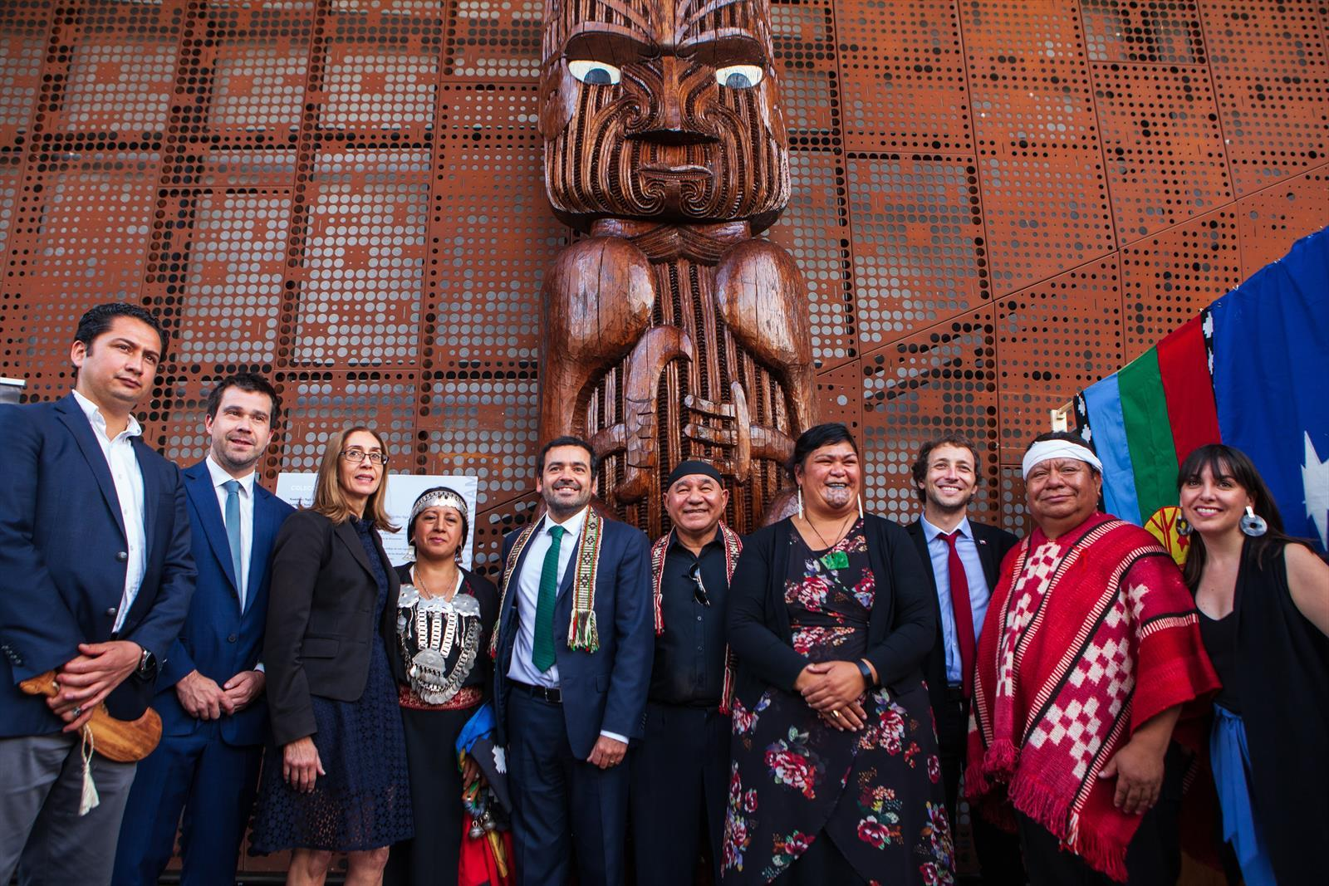
UNDRIP in Practice
Rights IV

Slide 2
Contents
Agency and Responsibility
Theorising UNDRIP: ought implies can?
UNDRIP and Te Tiriti o Waitangi
UNDRIP in practice

Slide 3
Agency and Responsibility
Indigenous rights are collective and individual claim-rights.
Third generation rights envisage complex and distributed agency.
States have the primary responsibility to respect, protect, and fulfil human rights, including Indigenous rights, through policy, legislation and regulation, and adjudication.
The United Nations Guiding Principles on Business and Human Rights specifically outline the State duty to protect human rights from abuse, including by business, based on the existing obligations of States under international law.
  The duty to protect “implies that States must take measures to prevent or end infringement upon the enjoyment of a given human right caused by third parties”.

Slide 4
Ought Implies Can?
The practical necessitation invoked by an obligation (whether or not it corresponds to a claim-right) implies practical possibility.
  “Practicability” or “feasibility”: possibilities of and limits on actionability.
Rosemary Banks, New Zealand’s Permanent Representative to the United Nations, in her address to the United Nations on 13 September 2007, explained the reasons why New Zealand could not support the Declaration in practice.
The text was clearly unable to be implemented by many States, including most of those voting in favour, New Zealand argued.

Slide 5
Ought Implies Can?
New Zealand takes international human rights and our international human rights obligations seriously. “But we are unable to support a text that includes provisions that are so fundamentally incompatible with our democratic processes, our legislation and our constitutional arrangements”.
This Declaration is explained by its supporters as being an aspirational document, intended to inspire rather than to have legal effect.
“New Zealand does not, however, accept that a State can responsibly take such a stance towards a document that purports to declare the contents of the rights of indigenous people. We take the statements in the Declaration very seriously and for that reason have felt compelled to take the position that we do.”

Slide 6
Ought Implies Can?
New Zealand had difficulties with a number of provisions of the text.
Four provisions in the Declaration in particular were claimed to be fundamentally incompatible with New Zealand’s constitutional and legal arrangements, the Treaty of Waitangi, and the principle of governing for the good of all its citizens.
These were article 26 on lands and resources, article 28 on redress, articles 19 and 32 on a so-called “right of veto” over the State.

Slide 7
Ought Implies Can?
Article 19: States shall consult and cooperate in good faith with the indigenous peoples concerned through their own representative institutions in order to obtain their free, prior and informed consent before adopting and implementing legislative or administrative measures that may affect them.

Slide 8
Ought Implies Can?
Article 26:
  Indigenous peoples have the right to the lands, territories and resources which they have traditionally owned, occupied or otherwise used or acquired.
  Indigenous peoples have the right to own, use, develop and control the lands, territories and resources that they possess by reason of traditional ownership or other traditional occupation or use, as well as those which they have otherwise acquired.
  States shall give legal recognition and protection to these lands, territories and resources. Such recognition shall be conducted with due respect to the customs, traditions and land tenure systems of the indigenous peoples concerned.

Slide 9
Ought Implies Can?
Article 28:
  Indigenous peoples have the right to redress, by means that can include restitution or, when this is not possible, just, fair and equitable compensation, for the lands, territories and resources which they have traditionally owned or otherwise occupied or used, and which have been confiscated, taken, occupied, used or damaged without their free, prior and informed consent.
  Unless otherwise freely agreed upon by the peoples concerned, compensation shall take the form of lands, territories and resources equal in quality, size and legal status or of monetary compensation or other appropriate redress.

Slide 10
Ought Implies Can?
Article 31
  Indigenous peoples have the right to maintain, control, protect and develop their cultural heritage, traditional knowledge and traditional cultural expressions, as well as the manifestations of their sciences, technologies and cultures, including human and genetic resources, seeds, medicines, knowledge of the properties of fauna and flora, oral traditions, literatures, designs, sports and traditional games and visual and performing arts. They also have the right to maintain, control, protect and develop their intellectual property over such cultural heritage, traditional knowledge, and traditional cultural expressions.
  In conjunction with indigenous peoples, States shall take effective measures to recognize and protect the exercise of these rights.

Slide 11
Ought Implies Can?
Article 32
  Indigenous peoples have the right to determine and develop priorities and strategies for the development or use of their lands or territories and other resources.
  States shall consult and cooperate in good faith with the indigenous peoples concerned through their own representative institutions in order to obtain their free and informed consent prior to the approval of any project affecting their lands or territories and other resources, particularly in connection with the development, utilization or exploitation of mineral, water or other resources.
  States shall provide effective mechanisms for just and fair redress for any such activities, and appropriate measures shall be taken to mitigate adverse environmental, economic, social, cultural or spiritual impact.

Slide 12
Ought Implies Can?
Article 26 stated that indigenous peoples had a right to own, use, develop or control lands and territories that they had traditionally owned, occupied or used.
For New Zealand, the entire country was potentially caught within the scope of the article, which appeared to require recognition of rights to lands now lawfully owned by other citizens, both indigenous and non-indigenous, and did not take into account the customs, traditions and land tenure systems of the indigenous peoples concerned.
The article, furthermore, “implied that indigenous peoples had rights that others did not have”.

Slide 13
Ought Implies Can?
“The entire country would also appear to fall within the scope of article 28 on redress and compensation”.
The text generally took no account of the fact that land might now be occupied or owned legitimately by others, or subject to numerous different or overlapping indigenous claims.
“It is impossible for the State in New Zealand to uphold a right to redress and provide compensation for value for the entire country – and indeed financial compensation has generally not been the principal objective of most indigenous groups seeking settlements in New Zealand.”

Slide 14
Ought Implies Can?
“Finally, the Declaration implies that indigenous peoples have a right of veto over a democratic legislature and national resource management, in particular Articles 19 and 32(2).”
“We strongly support the full and active engagement of indigenous peoples in democratic decision-making processes. We also have some of the most extensive consultation mechanisms in the world, where the principles of the Treaty of Waitangi, including the principle of informed consent, are enshrined in resource management law. But these Articles imply different classes of citizenship, where indigenous have a right of veto that other groups or individuals do not have.”

Slide 15
Contesting the Justification Narrative
The New Zealand Government’s position was that the Declaration is “fundamentally incompatible” with the Treaty of Waitangi.
Recall that UNDRIP affirms the status of treaties between Indigenous people and States, and helps explain how international rights standards apply and how Treaty principles can be enacted.
On the contrary, the Declaration could “be helpful in pointing us towards ways of giving effect to the Treaty, not only in settling claims for historical breaches, but also in the future life of our nation”
“Specifically, it might help us reconcile the consequences of the cession by Maori of Kawanatanga and their retention of tino Rangatiratanga” (Quentin-Baxter 1998:33).
We now accept this counterargument and have adopted UNDRIP.

Slide 16
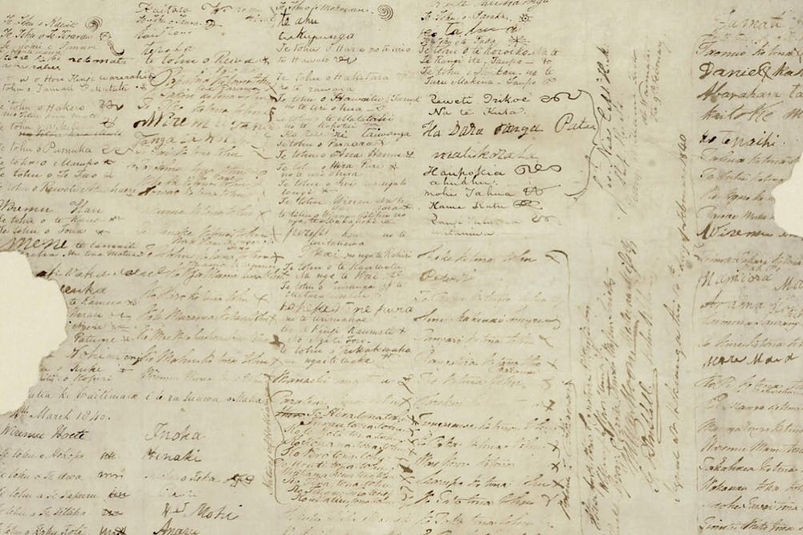
UNDRIP and Te Tiriti o Waitangi

Slide 17
UNDRIP and Te Tiriti o Waitangi
“What we did was to successfully convince the ministers that the Declaration and our constitutional and legal systems can live together, and that the key principle is about working together to restore Māori rights that were taken away in the process of being colonised.”
– Moana Jackson “A personal reflection on the drafting of the United Nations Declaration on the Rights of Indigenous Peoples.” Conversations About Indigenous Rights: The UN Declaration on the Rights of Indigenous Peoples in Aotearoa New Zealand.

Slide 18
UNDRIP and Te Tiriti o Waitangi
The New Zealand Human Rights Commission states that the Treaty and UNDRIP are “strongly aligned and mutually consistent”.
UNDRIP affirms the status of treaties between Indigenous people and States, and helps explain how international rights standards apply and how Treaty principles can be enacted.
The Declaration assists with the interpretation and application of the Treaty principles or the three P’s
  Partnership: which entails good faith cooperation and shared decision making.
  Protection: of rangatiratanga (self-determination) and taonga such as reo (language), tikanga (customs), mātauranga (knowledge), land and resources.
  Participation: of Māori in politics and society on an equal basis to others, and freedom from discrimination.

Slide 19
Aotearoa/New Zealand’s Treaty-Based Constitutional Framework
The Treaty of Waitangi is Aotearoa/New Zealand’s own unique statement of human rights. It includes both universal human rights and Indigenous rights. It belongs to, and is a source of rights for, all citizens and residents of Aotearoa/New Zealand.
Aotearoa/New Zealand has a constitution – but not a single document like the constitutions of some other countries.
Our constitution determines how we live together as a country, how the country is run and how laws are made. Our constitutional arrangements have evolved over time and will continue to do so.

Slide 20
Aotearoa/New Zealand’s Treaty-Based Constitutional Framework
The Constitution Act 1986 is now New Zealand’s principal formal statement of constitutional arrangements.
Our constitutional arrangements also include legislation such as the New Zealand Bill of Rights Act 1990, foundational documents such as the Treaty of Waitangi, and established constitutional principles including that the Government must govern according to the law.

Slide 21
Aotearoa/New Zealand’s Treaty-Based Constitutional Framework
The Treaty has two key elements:
  The first relates to Articles 1 and 3, which established the rights and responsibilities of the Crown to govern (kāwanatanga/governance) and the right of all people to live as free and equal citizens of Aotearoa/New Zealand under one law (rite tahi/equality) respectively.
  The second relates to Article 2, which affirms for Māori the right to live as Māori, with particular responsibilities (rangatiratanga/self-determination) for protecting and developing those things valued by Māori (ngā taonga katoa).
Neither of these Treaty rights is exclusive of the other.
Customary rights and responsibilities existed prior to colonisation and have survived – though not necessarily in their original form – into the present.

Slide 22
Te Tiriti o Waitangi and Other International Human Rights Standards
The complex interdisciplinary (legal, political, philosophical) work of relating UNDRIP to the Treaty-based constitutional framework of Aotearoa/New Zealand is not without precedent.
Indigenous peoples are entitled to all the rights and protections set out in the ICCPR, ICESR, CERD, and other instruments.
Other international human rights instruments relevant to Te Tiriti include International Labour Organisation (ILO) Convention 169 on Indigenous and Tribal Peoples (1991).

Slide 23
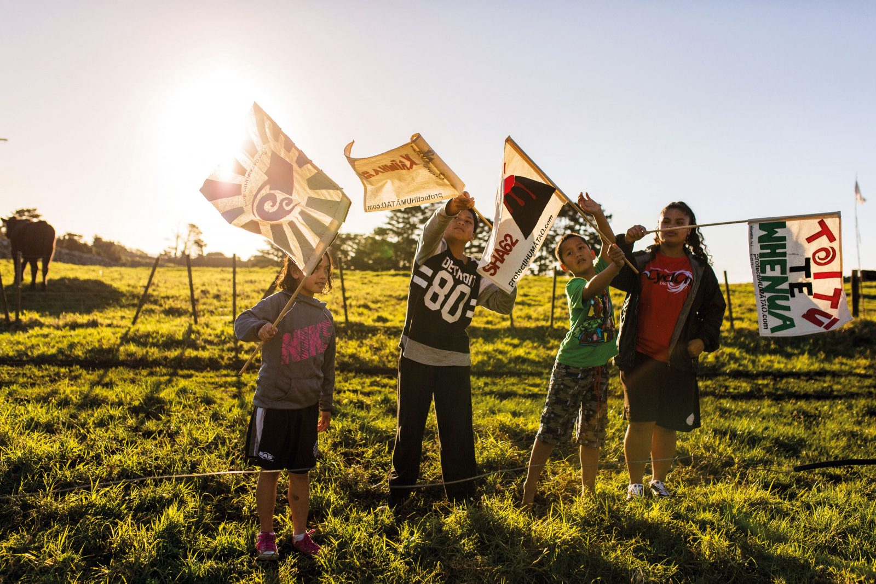
Ihumātao: UNDRIP in Practice

Slide 24
Ihumātao: UNDRIP in Practice
UNDRIP Articles 11, 17, 18, 19, 26, 27, 28.
Other relevant international human rights instruments:
  International Covenant on Civil and Political Rights (ICCPR), which was ratified by New Zealand in 1978.
  International Convention on the Elimination of All Forms of Racial Discrimination (CERD), which New Zealand has been a party to since 1972.
“Ihumātao can be a turning point for the protection of indigenous rights in Aotearoa New Zealand and that it provides a real opportunity to move the nation forward in a constructive way.“
- Paul Hunt, New Zealand’s Chief Human Rights Commissioner

Slide 25
