Slide 1
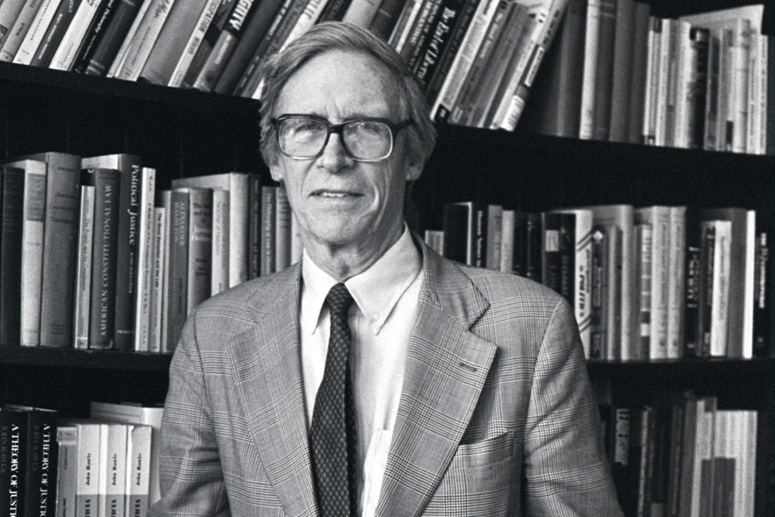
John Rawls
Justice I

Slide 2
Contents
The Rawlsian paradigm
Liberal democratic citizens’ intuitions
The basic structure of society as the primary subject of justice
The original position
Tomorrow: “Justice as fairness” and criticisms of Rawls
Next week: non-ideal theory

Slide 3
The Rawlsian Paradigm
Rawls’s revival of social contract theory exemplified by Hobbes, Locke, Rousseau, and Kant.
Rawls theorises the principles of justice that govern the basic structure as themselves as the objects of a social contract.
Rawls adapts the Kantian idea of autonomous moral agency by basing this abstract idea on the “public political culture” of actual liberal democratic societies and their intellectual and political histories.

Slide 4
Liberal Democratic Citizens’ Intuitions:
Society is an intergenerational, closed, self-sufficient, fair system of social cooperation between citizens as free and equal persons.
Contingency: the social order is not fixed or natural. It can be changed.
Political liberalism: the social order is not theocratic or aristocratic.
Social cooperation involves some idea of fair terms of cooperation, reciprocity and mutuality, which are recognised and shared by all.
Social cooperation is to the mutual rational advantage of members.

Slide 5
The Basic Structure as the Subject of Justice
A society is well ordered if it is designed to mutually advance the good of its members and is effectively regulated by publically recognised principles of justice (the ideal).
A well ordered society is one in which everyone accepts and knows everyone else accepts the same principles of justice (ideally).
A well ordered society’s main political and social institutions are believed to satisfy these principles of justice (ideally).
These comprise the basic structure of society.
Pluralism about conceptions of justice is one of the defining features of our modern circumstances of justice.

Slide 6
The Basic Structure as the Subject of Justice
The basic structure constitutes the system of social cooperation and distributes the benefits and burdens of social cooperation.
The basic structure includes:
Political,
Social,
Economic, and
Legal structures
Ranging over:
The constitution,
Legislation,
State (bureaucracy, police, courts, etc.),
Market,
Civil society,
Family, etc.

Slide 7
The Basic Structure as the Subject of Justice
The public conception of justice does not apply to:
Private associations within the basic structure
Individuals
Actions
Relationships
These are governed by private conceptions of the good, within limits.
The basic structure is the subject of justice insofar as its effects on the lives of individuals are pervasive and immediate.
Society is difficult to exit, and its rules are coercively enforced.

Slide 8
The Basic Structure as the Subject of Justice
The basic structure shapes our:
Identities
Interests
Talents
Capabilities
Characters
Ambitions
Final Ends
Prospects

Slide 9
The Original Position
How do we determine the fair terms of social cooperation?
Through a fair procedure resulting in a fair agreement.
Rawls designs a reasoning game – a thought experiment called the original position (OP).
The OP is not historical. It is hypothetical.
Parties must choose, by agreement, the principles of justice that will govern the basic structure of society from a menu from the (Western) history of moral and political philosophy.

Slide 10
The Original Position
Free and equal democratic citizens justify the basic structure of society in a particular way: they are rational and reasonable.
Citizens are “mutually disinterested” (not jealous, impartial).
Citizens are in possession of the two “moral powers”:
The first is the capacity for the sense of justice: she can understand, apply, and act from a conception of justice.
The second is the capacity to formulate, revise, and rationally pursue a conception of the good.
They are not actual people: the moral psychologies of human beings born and raised in our societies is different (e.g. altruistic, partial).

Slide 11
The Original Position
How do we control for inequalities of bargaining power, etc. to ensure that the procedure for reaching agreement is fair?
Parties to the original position reason under a “veil of ignorance”.
Parties do not know:
The race, ethnicity, gender, age, income, wealth, natural abilities, comprehensive doctrine, etc. of themselves or any of the citizens in society, or to which generation they belong.
The political system, class structure, economic system, or level of economic development of the society to which they belong.

Slide 12
The Original Position
Parties do know:
That citizens have different comprehensive doctrines and plans of life (reasonable pluralism);
That citizens have interests in more primary goods rather than less insofar as they are rational;
That the society is under conditions of moderate scarcity;
General facts and common sense about human social life and the world; general conclusions of natural and social sciences.

Slide 13
The Original Position
The original position replaces the state of nature.
For Rawls, unlike his predecessors in the social contract tradition, human beings are socialised within our practices and institutions.
The basic structure of society is justified from within the practices and institutions of liberal democracy by drawing on its latent ideals.
Positivism about rules, rights, and roles: we can only make sense of and explain our practices and institutions and, secondly, justify them, from within the liberal democratic tradition.

