Slide 1
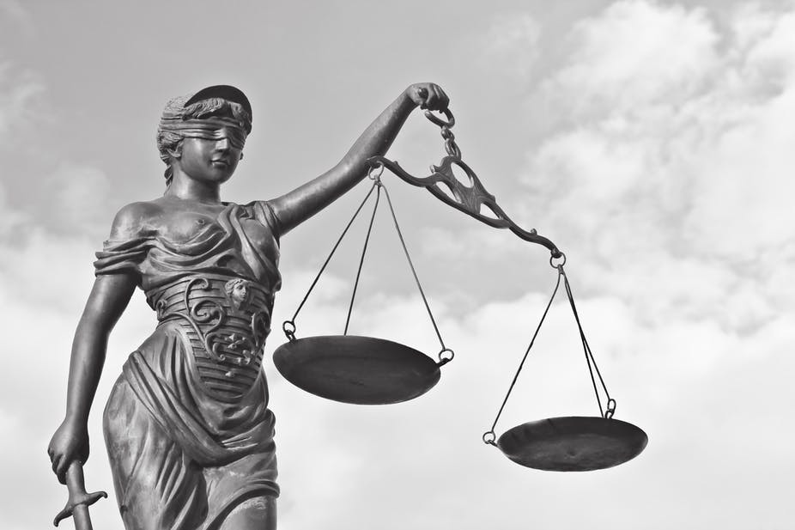
Justice as Fairness
Justice II

Slide 2
Overview
“Justice as Fairness”
Reflective equilibrium and reconciliation
Critiques of Rawls
The scope of justice
The metrics of justice
The principles of justice
The liberal idea of the person
The liberal idea of society

Slide 3
Justice as Fairness
OP representatives were to agree on the principles of justice that will govern the basic structure of society as an intergenerational, closed, self-sufficient, fair system of social cooperation between citizens as free and equal persons.
They were to choose between options on a menu drawn up from the (Western) tradition of moral and political philosophy.
Rawls argues that they would choose a liberal conception of justice.
This liberal conception he calls “justice as fairness”.

Slide 4
Justice as Fairness
We need a “metric” of justice to make comparisons.
Primary goods include:
The basic rights and liberties;
Freedom of movement;
Choice of occupation;
The powers of offices and positions of responsibility;
Income and wealth;
The social bases of self-respect.
Rational citizens are assumed to have fundamental interests in getting more of these primary goods.

Slide 5
Justice as Fairness
Each person has the same indefeasible claim to a fully adequate scheme of equal basic liberties, which scheme is compatible with the same scheme of liberties for all;
Social and economic inequalities are to satisfy two conditions:
They are to be attached to offices and positions open to all under conditions of fair equality of opportunity;
They are to be to the greatest benefit of the least-advantaged members of society (the difference principle).
The first principle is lexically prior to the second, and fair equality of opportunity is lexically prior to the difference principle if the principles come into conflict.

Slide 6
Justice as Fairness
Primary goods are to be distributed equally, unless an unequal distribution would be to everyone’s advantage.
Inequalities must be justified to the least advantaged, because they are the justificatory equals of the more advantaged.
This follows from the fundamental idea of society as a fair system of social cooperation between free and equal citizens.

Slide 7
Reflective Equilibrium and Reconciliation
Rawls is interested in theoretical stability for the right reasons.
Rawls argues that when we come to understand the basic structure of society as rationally justified, we overcome our alienation.
We are alienated because of the tension between our private identities and our public identities as citizens of modern pluralistic societies.
By inputting our intuitions as liberal democratic citizens, and assuming that our comprehensive conceptions of the good are reasonable, the result of the thought experiment, justice as fairness, attains reflective equilibrium.
Justice as fairness achieves a stable overlapping consensus among plural citizens from their different worldviews and value systems.

Slide 8
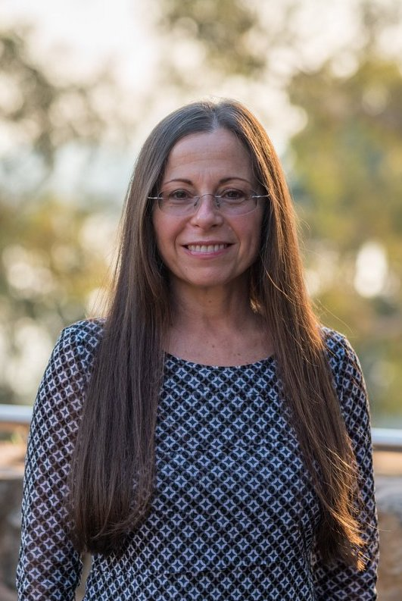
Critiques of Rawls: The Scope of Justice
Rawls limits the scope of justice to the basic structure of an intergenerational, closed, self-sufficient society.
Some cosmopolitan critics, like Gillian Brock, have argued that the scope of justice is universal.
Some cosmopolitans have argued on the Kantian grounds that freedom and equality are intrinsic to humanity.
The scope of justice is necessarily universal.
Some cosmopolitans have argued this on the Rawlsian grounds that the global order constitutes a the primary subject of justice.
The scope of justice is contingently universal.

Slide 9
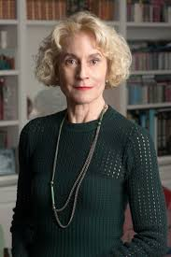
Critiques of Rawls: The Scope of Justice
Martha Nussbaum argues that Rawls excludes important classes of persons from the scope of justice as fairness.
The Rawlsian theory of justice assumes that all individuals are able to be fully contributing members of society throughout their adult lives.
Differences in need and ability.
Chronic debilitating illness, major accidents.
Patterns of dependency across normal human lives.
What about animals and non-human nature?

Slide 10
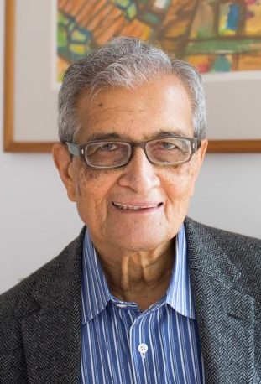
Critiques of Rawls: The Metrics of Justice
Some critics argue against Rawls’s metric of basic goods.
Rawls holds that just institutions distribute primary social goods fairly.
Amartya Sen objects we are unequally capable of transforming all-purpose resources (means) into functionings (ends).
What are individuals able to be and do with their primary goods?
The metrics of interpersonal comparisons for a theory of justice should be a measure of people’s real freedom to achieve functionings they value in accordance with their conception of the good.

Slide 11
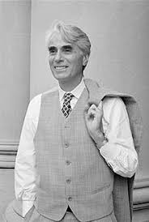
Critiques of Rawls: The Principles of Justice
Robert Nozick famously argued against Rawls’s theory of distributive justice.
The appropriate principle is entitlement, not fairness.
Nozick claims there are three sets of rules of justice:
how things not previously possessed by anyone may be acquired;
how possession may be transferred from one person to another;
what must be done to rectify injustices arising from violations of (1) and (2).
Nozick classifies theories of justice as (1) either end-result or historical, and (2) either patterned or unpatterned.
A distribution is just if is the outcome of following these three sets of procedural rules.
Radical implications for capitalism, colonialism, and slavery.
Rawls’s reply: fairness is necessary for background justice.

Slide 12
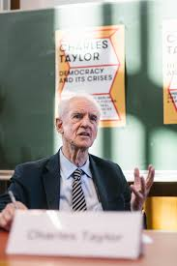
Critiques of Rawls: The Idea of the Person
“Communitarian” political philosophers such as Alasdair MacIntyre, Michael Sandel, Charles Taylor and Michael Walzer, drawing primarily upon the insights of Aristotle and Hegel, critiqued Rawls’s assumption that the point of social cooperation is to secure and distribute fairly the primary goods that individuals need to live freely.
Methodological claims about the significance of tradition and social context for practical reasoning.
Ontological claims about the constitution of the self.
Normative claims about the value of community.
Rawls’s reply: political liberalism and the public culture.

Slide 13
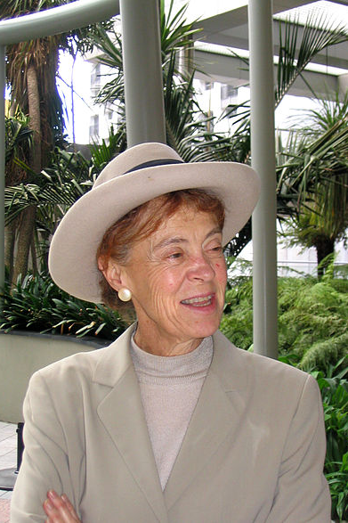
Critiques of Rawls: The Idea of Society
Rawls argues that the right is prior to the good.
Rawls argues that reasonable pluralism is one of the modern circumstances of justice.
To reach consensus on the public conception of justice, we must bracket disagreements about God and the good.
Rosalind Hursthouse argues that institutions can be evaluated as just or unjust against the standard of enabling or preventing members of a society living well together in our environments.
The human good is “thick and vague” (Nussbaum) and admits of plural forms of the good life, within the limits of human nature. Some options can be ruled out as bad.

