Slide 1
Institutional Racism
Justice III

Slide 2
Overview
Recapping the Rawlsian Paradigm
Reflective equilibrium
Challenging liberal intuitions
Society as a fair system of social cooperation
The liberal democratic conception of the person
Institutional racism
Tomorrow: “political liberalism” in settler colonial contexts
What – whose – “fundamental ideas” do we draw on?

Slide 3
Recap: The Rawlsian Paradigm
OP representatives were to agree on the principles of justice that will govern the basic structure of society as an intergenerational, closed, self-sufficient, fair system of social cooperation between citizens as free and equal persons.
They were to choose between options on a menu drawn up from the (Western) tradition of moral and political philosophy.
Rawls argues that they would choose a liberal conception of justice.
This liberal conception he calls “justice as fairness”.

Slide 4
Recap: Justice as Fairness
Each person has the same indefeasible claim to a fully adequate scheme of equal basic liberties, which scheme is compatible with the same scheme of liberties for all;
Social and economic inequalities are to satisfy two conditions:
They are to be attached to offices and positions open to all under conditions of fair equality of opportunity;
They are to be to the greatest benefit of the least-advantaged members of society (the difference principle).
The first principle is lexically prior to the second, and fair equality of opportunity is lexically prior to the difference principle if the principles come into conflict.

Slide 5
Reflective Equilibrium and Reconciliation
Develop a procedure for formulating principles of justice by drawing on the generalised intuitions of liberal democratic citizens.
Compare resulting principles with our considered judgements.
Are our considered judgments and our principles in equilibrium?
If not:
Do we give up our intuitions (and revise what we believe)?
Or do we give up the principles (and revise the procedure)?
Repeat until we attain reflective equilibrium.
Narrow versus wide reflective equilibrium.

Slide 6
The Murder of Stephen Lawrence

Slide 7
The Murder of Stephen Lawrence
22 April 1993, 18-year-old black youth, Stephen Lawrence, is stabbed to death in an unprovoked racially motivated attack by a gang of white youths as he waits at a bus stop in Eltham, South-East London, with his friend Duwayne Brooks.
The day after the murder, a letter giving the names of the suspects is left in a telephone box.
7 May-23 June 1993 - Police arrest brothers Neil and Jamie Acourt, David Norris, Gary Dobson and Luke Knight, and search their homes.
Neil Acourt and Luke Knight are identified by Duwayne Brooks, and are charged with the murder of Stephen Lawrence.
They deny the charges.

Slide 8
The Murder of Stephen Lawrence
Charges against the pair are dropped on 29 July 1993 because ID evidence from Brooks is deemed “unreliable”.
The abolition of the double jeopardy rule eventually led to the 2012 conviction of Gary Dobson and David Norris for Lawrence’s murder.
Both men receive life sentences. Dobson is jailed for a minimum of 15 years and two months, Norris for 14 years and three months.
Would lead to later investigations into Police practices and conduct.

Slide 9
The Macpherson Inquiry and Report

Slide 10
The Macpherson Inquiry and Report
July 1997: an inquiry “into the matters arising from the death of Stephen Lawrence on 22 April 1993 to date, in order particularly to identify the lessons to be learned for the investigation and prosecution of racially motivated crimes”.
Chaired by Sir William Macpherson, a retired High Court judge.
The inquiry came after years of campaigning by the Lawrence family, the collapse of the family’s private case, and the announcement of an investigation into the case by the Police Complaints Authority.

Slide 11
Pernicious and Persistent Institutional Racism
The 350-page report concluded that the police investigation into the murder had been “marred by a combination of professional incompetence, institutional racism and a failure of leadership”.
The report named, and singled out for criticism, particular agents and institutions for their responsibility.
The police, as an institution, was criticised for being racist.
The Report stressed institutional racism does not imply that policies are racist or that every officer is individually racist.

Slide 12
Conceptual Clarity
6.34. For the purposes of our Inquiry the concept of institutional racism of: The collective failure of an organisation to provide an appropriate and professional service to people because of their colour, culture, or ethnic origin. It can be seen or detected in processes, attitudes and behaviour which amount to discrimination through unwitting prejudice, ignorance, thoughtlessness and racist stereotyping which disadvantage minority ethnic people.

Slide 13
Conceptual Evolution
The concept of institutional racism was not new.
The concept had been developed over several decades by activists and academics in the US and UK who named and theorised the phenomenon that was part of black people’s average everyday experience with public and private organisations.
Generated a new critical-hermeneutical resource for making sense of the experiences of racialised oppression – to themselves, each other, and to their oppressors – and transforming the social structure.
The joint authors of the report argued that the public debate about policing and institutional racism had been transformed by the inquiry, “and that the debate thus ignited must be carried forward”.

Slide 14
Theory, Again

Slide 15
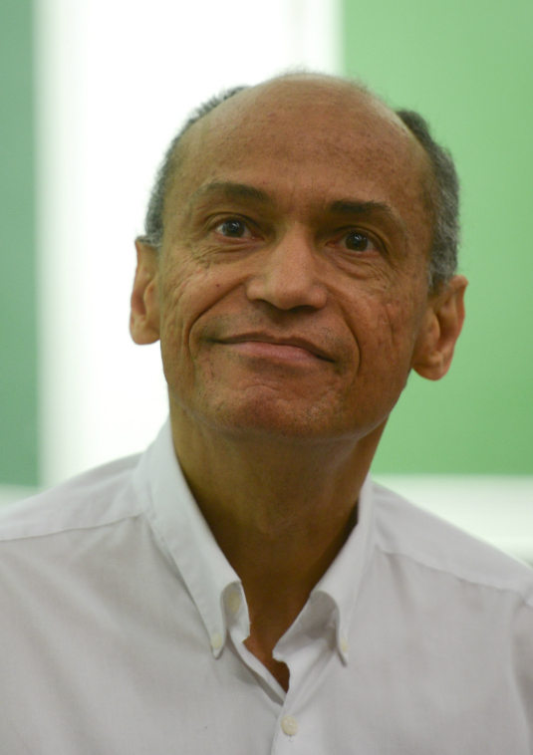
Retrieving Rawls for Racial Justice?
Justice as fairness: social institutions are to be fair to all cooperating members of society, regardless of their “morally arbitrary” features.
The shortcomings of ahistorical liberal ideal-theory for theorising structural and institutional injustice.
Problematic assumptions: closure, cooperation, freedom and equality.
White supremacy as basic structure

