Slide 1
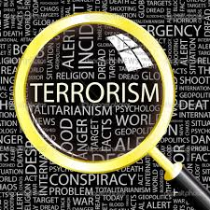
POL 346 Terrorism
Dr Fabio Scarpello
Week 1
What is terrorism?

Slide 2
Contact details
Course Coordinator:
Dr Fabio Scarpello
Lecturer in Politics and International Relations Faculty of Arts Email: fabio.scarpello@auckland.ac.nz Phone: +64 9 923 5691
Office Hours: Room: 201E 507 Tuesday 14-00 – 16-00
Teaching Assistant:
Sanjal Shastri
Sanjal Shastri PhD Candidate in Politics and International Relations Faculty of Arts Email: shsa674@aucklanduni.ac.nz
Office Hours: Room 201E-528 Friday 16-00 - 17-00

Slide 3
Objectives, expectations and teaching approach
By the end of the course students will be able to critically engage with matters-related to terrorism drawing from theories, discourses and evidence
Students are expected to prepare by reading and researching in a manner that addresses the discussion questions listed under each week
Lectures often include student-centred activities and multimedia items
Discussion hours are centred around the discussion questions. Students are expected to contribute with insights that go beyond what introduced during the lectures

Slide 4
v.laban@auckland.ac.nz
v.laban@auckland.ac.nz
v.laban@auckland.ac.nz
Nominate yourself today and get:
An important and recognised addition to your resume / Improve your leadership skill set / Ability to make
significant changes to your education / End of Year Function /
At the end of the semester, you will be eligible to receive
a class rep certificate provided you have registered with AUSA.
NB: The deadline to register your details is Friday of week two.
Responsibilities:
Elicit feedback from your classmates / Attend department and faculty meetings / Help resolve issues that may arise in your class.
For more speak to your lecturer
Application to be delivered to:
Viola Laban
Job title: Group Services Administrator
Department: Group Services
Company: The University of Auckland
Office: 201E-401
v.laban@auckland.ac.nz

Slide 5
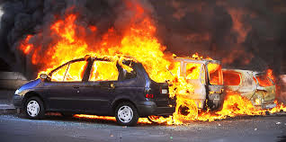
aims
Reflect on why is terrorism an essentially contested term
Critically engage with how the label terrorism is unevenly used
Identify analytical lens through which to engage with terrorism as ‘objectively’ as possible

Slide 6
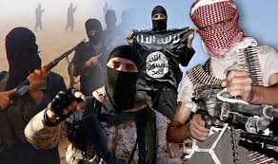
outline
Terrorism as an essentially contested term
Terrorism as a social construct
Thinking about terrorism analytically

Slide 7
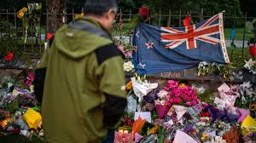
What is terrorism?
Notes:
Cold War had stabilised world order and displaced conflict into the Global South. Without that order, optimism. But, with Yugoslavia and Somalia, emerging idea was that conflict remained but had transformed.
And that with globalisation and mass circulation, need to manage poverty, environmental collapse, health etc internationally, as these do not respect state boundaries.

Slide 8
WHAT IS Terrorism?
Class exercise Write your definition of terrorism in no more than 150 words

Slide 9
What is terrorism?
The act
The perpetrators, actors
The target
The motive/ aims

Slide 10
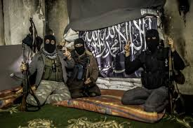
What is terrorism?
“The calculated use of violence or the threat of violence to inculcate fear, intended to coerce or intimidate governments or societies in the pursuit of goals that are generally political, religious or ideological”
(United States Department of Defense, Office of Joint Chiefs of Staff 2001/2003)
Act: Calculated political, ideological or religious violence, or the threat of it
Perpetrators: OPEN
Target: Government or society
Aim: Coerce or intimidate governments or societies

Slide 11
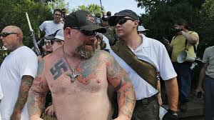
What is terrorism?
The term ‘terrorism’ means premeditated, politically motivated violence perpetrated against noncombatant targets . . . by sub-national groups or clandestine agents, usually intended to influence an audience’
(US Department of State, Office of the Coordinator for Counterterrorism 2003)
Act: Premeditated political violence
Perpetrators: individuals/groups/state-sponsored agents
Target: noncombatant/civilians
Aim: influence an audience

Slide 12
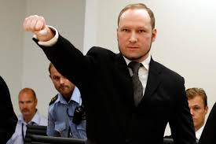
What is terrorism?
‘Terrorism is the deliberate killing of innocent people, at random, in order to spread fear through a whole population and force the hand of its political leaders’
(Walzer 2004, p. 136)
Act: Deliberate killing of civilians for political aims
Perpetrators: OPEN
Target: Innocent people (civilians)
Aim: Spread fear and influence politicians

Slide 13
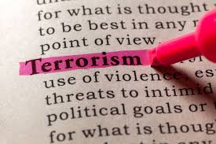
TERROSISM AS A SOCIAL CONSTRUCT

Slide 14
TERRORISM AS A SOCIAL CONSTRUCT SOCIAL CONSTRUCTs
A social construct is something that exists not in objective reality, but as a result of human interaction. It exists because humans agree that it exists*
Social constructs shape our lives. But we also shape them. If a society changes, constructs would develop and old ones may weaken. Constructs are thus fluid*
Social constructs are context specific. Different societies have different constructs; what is the "norm" here may clash with what is the "norm" in another country
Think of social class; governments; race; deviant behaviour

Slide 15
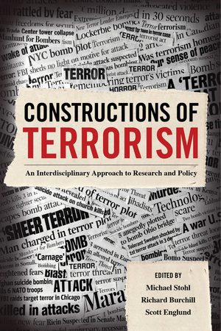
TERRORISM AS A SOCIAL CONSTRUCT
Terrorism is an objective reality and a subjective interpretation. The destruction that terrorism leaves behind is observable and quantifiable which is an objective reality, however what constitutes terrorism and who is a terrorist is a matter of subjective interpretation (Karaffa, 2015)
The saying one man’s terrorist is another man’s freedom fighter optimises the socially-constructed nature of terrorism
This is at core of the difficulties in defining the term and in the subjectivity in applying the labels ‘terrorism’ and ‘terrorists’
Definitions are the results of historical contingent trajectories, cultural and political biases. Media and law play important roles in this process

Slide 16
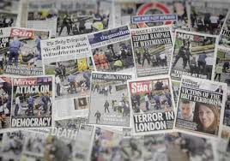
Terrorism as a social construct Media
Media plays a central role in shaping and perpetrating social constructs. Terrorism is no exception
Agenda setting decides what media covers or does not cover. It is often ideological
Terrorist attacks committed by Muslim extremists receive 357% more US press coverage than those committed by non-Muslims (Kearns et al, 2019)
Media framing can simply be described as the angle, or perspective, from which a news story is told. It is often ideological
Islamic extremists are three times more likely than far-right attackers to be described as terrorists by media worldwide* (Moore, 2019)

Slide 17
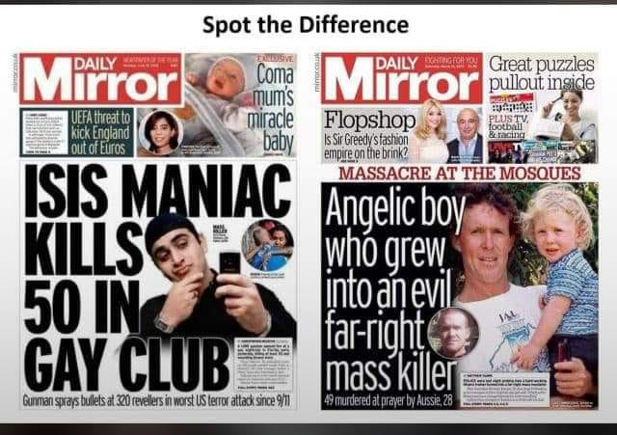
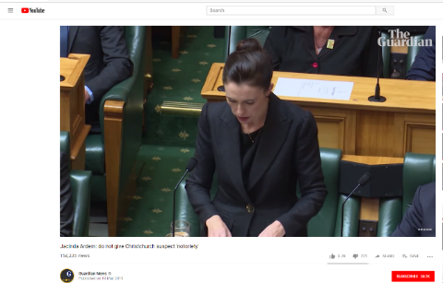
Terrorism as a social construct Media

Slide 18
Terrorism as a social construct The law
According to the US criminal code, international terrorism
(A) involve violent acts or acts dangerous to human life that are a violation of the criminal laws of the United States or of any State, or that would be a criminal violation if committed within the jurisdiction of the United States or of any State;
(B) Appear to be intended
(i) To intimidate or coerce a civilian population;
(ii) To influence the policy of a government by intimidation or coercion; or
(iii) To affect the conduct of a government by mass destruction, assassination, or kidnapping; and
(C) Occur primarily outside the territorial jurisdiction of the United States, or transcend national boundaries in terms of the means by which they are accomplished, the persons they appear intended to intimidate or coerce, or the locale in which their perpetrators operate or seek asylum

Slide 19
Terrorism as a social construct The law
According to the US criminal code, domestic terrorism
means activities that:
(A) Involve acts dangerous to human life that are a violation of the criminal laws of the United States or of any State;
(B) Appear to be intended—
(i) To intimidate or coerce a civilian population;
(ii) To influence the policy of a government by intimidation or coercion; or
(iii) To affect the conduct of a government by mass destruction, assassination, or kidnapping; and
(C) Occur primarily within the territorial jurisdiction of the United States;

Slide 20
Terrorism as a social construct The law
Class exercise The Intercept interactive quiz Who has been charged with terrorism?

Slide 21
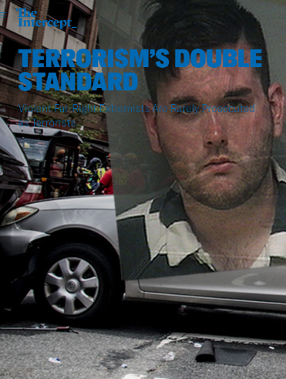
Terrorism as a social construct The law
The US Justice Department rarely charges right-wing extremists with ‘terrorism’ (Aaronson, 2019)*
No clear reasons for this. It would seem that the label ‘terrorism’ almost exclusively comes down to identity*
The label ‘terrorism’ has important repercussions*

Slide 22
Terrorism as a social construct POLITICS
“Terrorism’ has been coined to refer to protestors in Thailand, Tunisia and Libya, to the Israeli attack on a flotilla of ships attempting to break the Israeli blockade of Gaza, to the US invasion of Iraq and the Israeli invasion of Lebanon, to US drone attacks in Pakistan, to Western and NATO airstrikes against Libya, to Syrian rebels attempting to overthrow the Assad regime, and to Wikileaks founder Julian Assange who was described by US Senator Mitch McConnell as a ‘high-tech terrorist”
(Richards, 2013, p214).

Slide 23
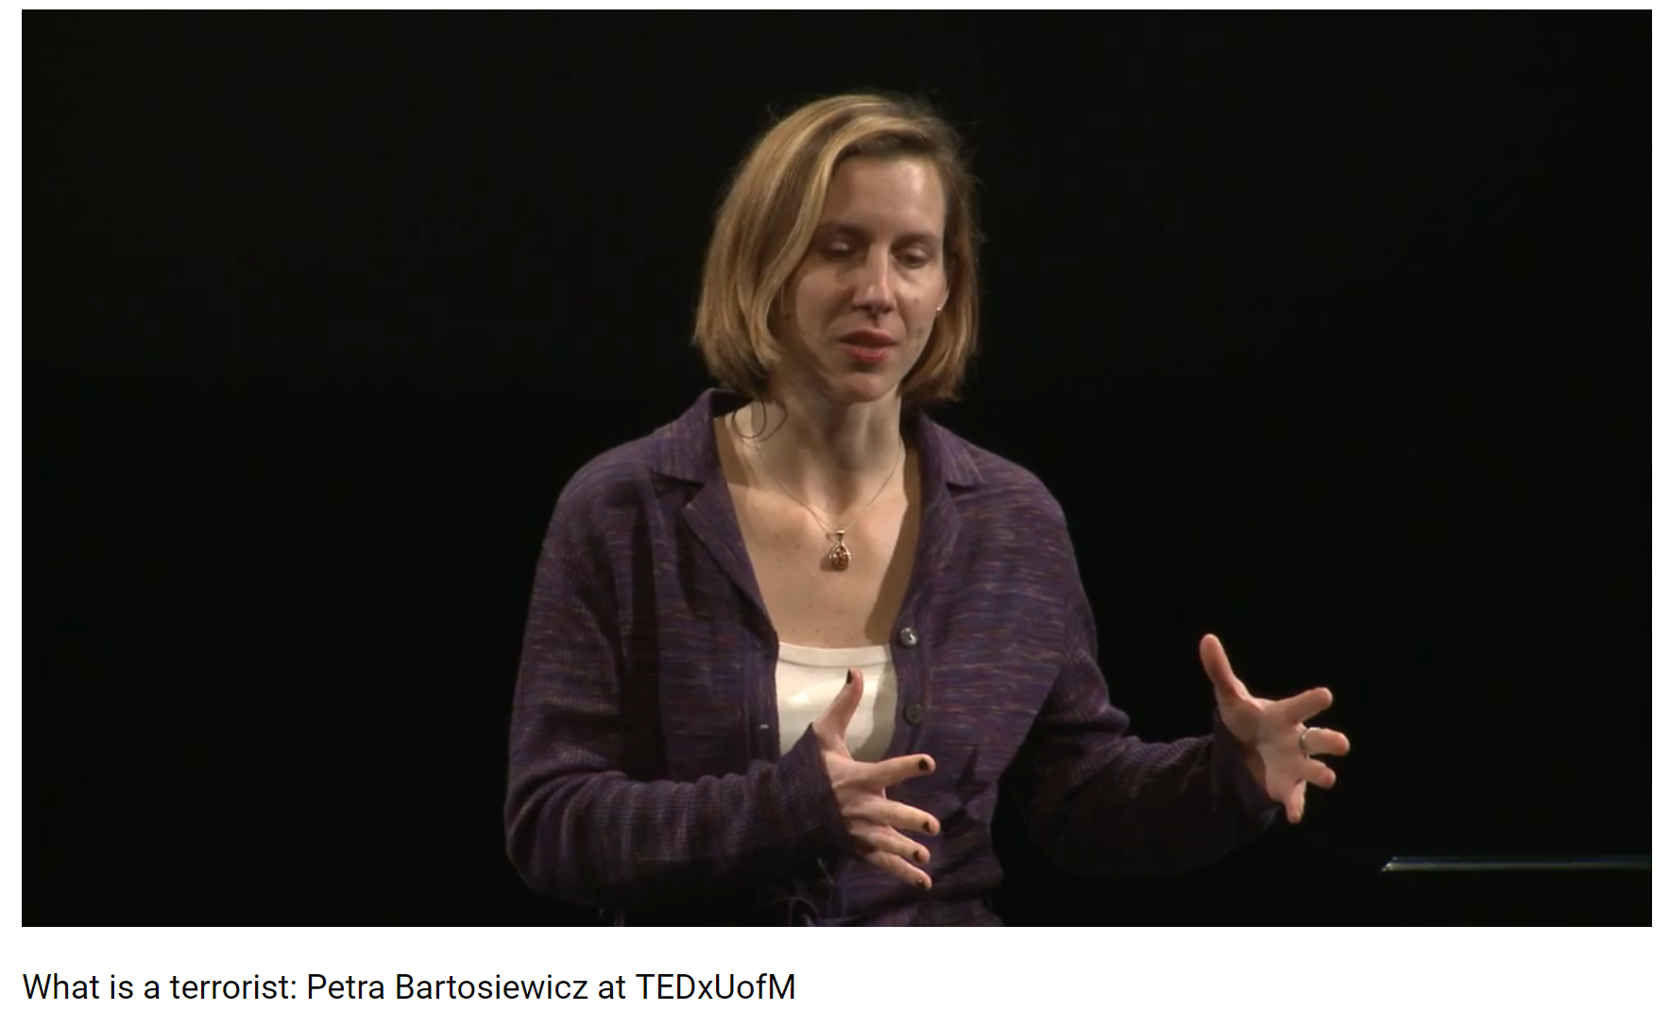
Terrorism as a social construct

Slide 24
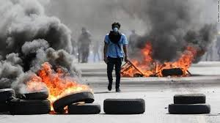
Terrorism: an analytical view
Notes:
Cold War had stabilised world order and displaced conflict into the Global South. Without that order, optimism. But, with Yugoslavia and Somalia, emerging idea was that conflict remained but had transformed.
And that with globalisation and mass circulation, need to manage poverty, environmental collapse, health etc internationally, as these do not respect state boundaries.

Slide 25
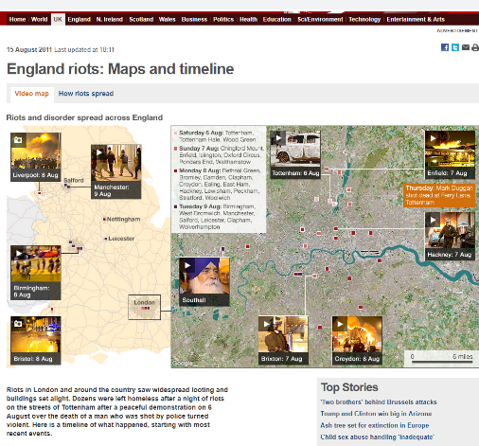
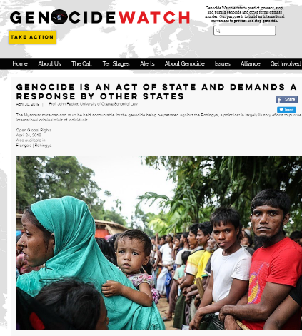
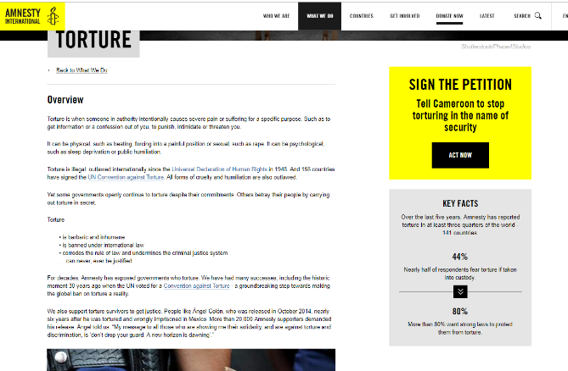
political violence
Targets Actors | State | Individuals/groups
State | War | ‘Establishment’ violence* Counter-insurgency Genocide* Lack of action
Individuals/groups | Rebellion Rioting* | Murder, assault Ethnic conflict Sectarian conflict Genocide*

Slide 26
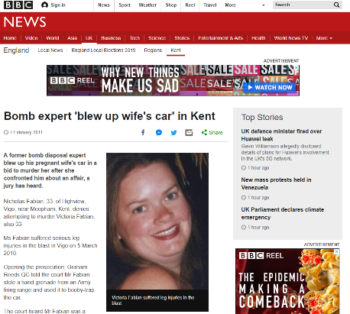
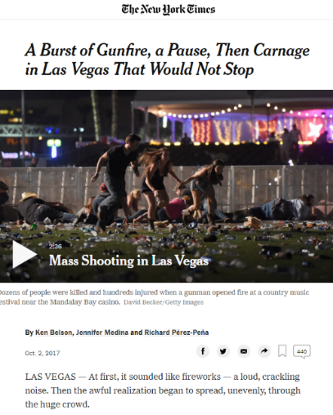
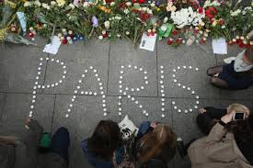
Terrorism: an analytical view key criteria
Political objective
Differentiates terrorism from ordinary violence
Does not differentiate it from other forms of political violence
Violence, or the threat of it
No act of violence is intrinsically ‘terrorism’
Does not differentiate it from other forms of political violence
Target audience beyond the victims
The need to reach a target audience is one reason why terrorist groups seek publicity
This element arguably differentiates terrorism from other forms of political violence

Slide 27
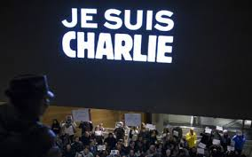
Terrorism: an analytical view implication of key criteria
Politically motivated violence can be committed by anyone: the good and the bad guys, regardless of the ‘worthiness’ of the cause
Actors and targets can be state, groups or individuals. There is not at a priori difference. The analytical focus is on the act, rather than the perpetrator or the target
Acts of terror can be committed during peace time and war time

Slide 28
What is political violence?
Targets Actors | State | Individuals/groups
State | War Terrorism | Law and order ‘Establishment’ violence Counter-insurgency Genocide Lack of action Terrorism
Individuals/groups | Rebellion Rioting Terrorism | Murder, assault Ethnic conflict Sectarian conflict Genocide Terrorism

Slide 29
Study questions
What elements do you believe are necessary to define an act of political violence as ‘terrorism’?
Why do certain acts of violence get labelled as ‘terrorism’ whilst others do not?
What factors influence the use of the term ‘terrorism’ or ‘terrorists’?

Slide 30
Key points
Terrorism is an essentially contested concept. There is no consensus in what terrorism is and who the terrorists are
Terrorism is a socially constructed term. Different meanings are associated to it in different sociopolitical contexts
Media framing plays a crucial role in enforcing and perpetrating specific understanding of terrorism
Analysts/students of terrorism need to clarify their understanding of terrorism. A good starting point is to identify the essential criteria of what constitute a terrorist act

Slide 31
References
Aaronson, Trevor. 2019. “Terrorism’s Double Standard: Violent Far-Right Extreists Are Rarely Prosecuted as Terrorists.” The Intercept, March 24, 2019. https://theintercept.com/2019/03/23/domestic-terrorism-fbi- prosecutions/.
Becker, Howard. 1963. Outsiders: Studies in the Sociology of Deviance. New York: Free Press.
Cohen, Stanley. 2011. Folk Devils and Moral Panics. London: Routledge.
Karaffa, C.A. 2015. “The Social Construction of Terrorism.” Sociology of Crime Law and Deviance 20: 67–87
Kearns, Erin M., Allison E. Betus, and Anthony F. Lemieux. 2019. “Why Do Some Terrorist Attacks Receive More Media Attention Than Others?” Justice Quarterly, January, 1–24.
Moore, Ben. 2019. “Lessons from Christchurch: How the Media Finally Acknowledged Far-Right Terrorism.” Signal, April 20, 2019. https://www.signal-ai.com/blog/lessons-from-christchurch-how-the-media-finally- acknowledged-far-right-terrorism.
Richards, Anthony. 2014. “Conceptualizing Terrorism.” Studies in Conflict & Terrorism 37 (3): 213–36. https://doi.org/10.1080/1057610X.2014.872023.

