Slide 1
POL346
Terrorism
Dr Fabio Scarpello
Week 2
What is
‘new terrorism’?

Slide 2
Position papers
Students are required to write three (3) position papers.
A position paper is a short essay that presents an arguable opinion about an issue and is aimed at convincing an audience that the opinion presented is valid. The papers will be graded together as one, and the mark counts toward 40% of students overall grade. Position papers should be of 600 words each and properly referenced. The bibliography does not tally toward the word count.
Position papers should begin with a brief introduction that provides an overview and context for the topic. Students must then state their primary argument, either for or against the proposition assigned, and follow on with supporting arguments and evidence. Alternative arguments should be explored and refuted using evidence. A brief conclusion should summarise the student’s position on the issue.
In developing their argument, students must engage with the relevant literature, refer to relevant theories and concepts and use case studies. Each position paper should refer to at least four peer-reviewed sources, and several non-peer reviewed sources.
Students must follow the APA 6: Author/Date reference style. Guidelines are available here, while tutorials are available here. The reference section must include all sources cited within the text and nothing more.
The position papers have to be submitted via Canvas.
Position papers are due by Friday 30 August midnight
’

Slide 3
Position papers
The titles of the position papers are as follow:
1. The largest majority of terrorist are mentally ill. Discuss
2. Women have only a supportive role in terrorist organisations. Discuss
3. The label ‘New Terrorism’ is useful to describe the type of terrorism we have experienced in the last decades. Discuss

Slide 4
Recap
Terrorism is an essentially contested concept
It is contested largely because of its socially constructed nature
Media framing plays a crucial role in enforcing and perpetuating specific understandings of terrorism
Analysts/students of terrorism need to clarify their understanding of terrorism

Slide 5
aims
Think critically about the ramifications of the label ‘New Terrorism’
Frame ‘terrorism’ within an historical trajectory

Slide 6
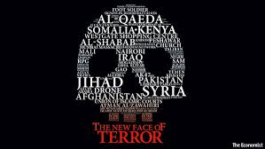
outline
Terrorism: An historical trajectory
New Terrorism: Key characteristics
New Terrorism: The debate
New Terrorism: Why it matters?

Slide 7
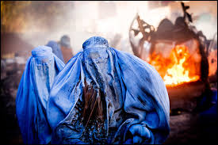
TERRORISM:
AN HISTORICAL TRAJECTORY
Notes:
Cold War had stabilised world order and displaced conflict into the Global South. Without that order, optimism. But, with Yugoslavia and Somalia, emerging idea was that conflict remained but had transformed.
And that with globalisation and mass circulation, need to manage poverty, environmental collapse, health etc internationally, as these do not respect state boundaries.

Slide 8
TERRORISM: AN HISTORICAL TRAJECTORY
Terrorism and counterterrorism:
comparing theory and practice
Professor Edwin Bakker
University of Leiden

Slide 9
TERRORISM: AN HISTORICAL TRAJECTORY
Rapoport’s Wave Theory attempts to rationalise how ‘modern’ terrorism has developed since the late 19th century
The core argument is that terrorism is not only a matter of single groups, acts. There are historically-rooted patterns, similar to waves.
A wave is: “…a cycle of activity in a given time period – a cycle characterized by expansion and contraction phases. A crucial feature is its international character; similar activities occur in several countries, driven by a common predominant energy that shapes participating groups’ characteristics and mutual relationships” (Rapoport 2002: 15)
There have been four succeeding waves: anarchism, nationalism, leftist and the religious wave
David C. Rapoport is Professor Emeritus of Political Science at the University of
California, Los Angeles, and the Founding Editor of Terrorism and Political Violence.

Slide 10
TERRORISM: AN HISTORICAL TRAJECTORY
Each wave is precipitated by international events, ‘catalysts’
Each wave reflects dominant features, and communalities (goals, targets, objectives etc.). But these are ‘dominant’ features and ‘communalities’ and there always are exceptions
Each wave has a distinct life cycle (initial, expansion and contraction phases) and lasts roughly one generation, 40 years
Waves can overlap for a period and a few groups of the previous wave may adapt and survive in the wave that follows
David C. Rapoport is Professor Emeritus of Political Science at the University of
California, Los Angeles, and the Founding Editor of Terrorism and Political Violence.

Slide 11
TERRORISM: AN HISTORICAL TRAJECTORY
Wave | Catalyst | Goals | Targets | Tactics | Other key communalities | Reason for decline
Anarchists 1870s 1910s | Slow political reforms Declining legitimacy of monarchies | Revolution Stop state abuse | Head of states | Assassinations | Dynamite Transport technology | State oppositions WWI
Nationalist 1920s 1960s | Versailles Peace Treaty Self-determination drive | Independence | Security apparatus | Guerrilla | Diaspora Freedom fighter-terrorist dichotomy | Achieved goals
Leftist 1960s 1980s | Vietnam War Cold War tensions | End capitalism | Government, especially the USA | Hijackings, Kidnapping Assassinations | Communication technology State-sponsored terrorism | End of Cold War State opposition
Religious 1979 2020s? | Iranian Revolution New Islamic Century Soviet invasion of Afghanistan | Caliphate Islamic states | USA, Europe, Israel Mass transportation Public events | Suicide bombings Bombings Vehicle as weapons | Information Technology | ?
( Source: Adapted from Walls 2017)

Slide 12
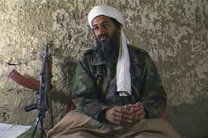
NEW terrorism: key characteristics
Notes:
Cold War had stabilised world order and displaced conflict into the Global South. Without that order, optimism. But, with Yugoslavia and Somalia, emerging idea was that conflict remained but had transformed.
And that with globalisation and mass circulation, need to manage poverty, environmental collapse, health etc internationally, as these do not respect state boundaries.

Slide 13
NEW terrorism: key characteristics
Contemporary terrorist groups are operating in an unprecedented manner and pose an entirely new type of terrorist threat
Dichotomy between ‘traditional’ and ‘new’ terrorism is the central analytical device of the ‘New Terrorism’ school*
The key characteristics of New Terrorism are
Religious and mystical motivation*
Horizontal organisational structure, transnational in nature*
Increasingly lethal and indiscriminate attacks*
Intention and potential to use WMD*

Slide 14
NEW terrorism: key characteristics
 | Traditional Terrorism | New Terrorism
Motives | Political, nationalistic ideology Clear and flexible goals as basis of political negotiations focused on geographical areas | Religious, mysticism Amorphous objectives that are absolutist and irreconcilable with political negotiations
Organisational structure | Hierarchical | Networked and increasingly transnational
Use of violence | Restrained, focus on symbolic targets | Extreme violence, keen to use WMDs

Slide 15
NEW terrorism: KEY CHARACTERISTICS?
Class survey Please, raise your hand if you think the label ‘New Terrorism’ is useful to describe the type of terrorism we have experienced in the last decades?

Slide 16
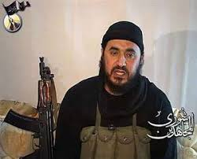
NEW TERRORISM:
THE DEBATE

Slide 17
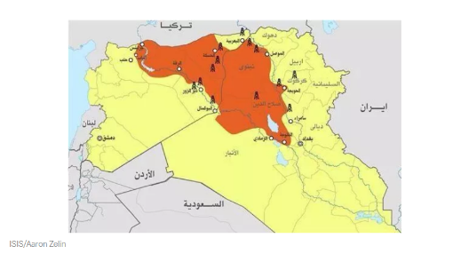
NEW Terrorism: THE DEBATE
Religious and mystical motivation
Sceptic versus proponents
Religion is a problematic label because it implies a monocausal explanation
Islam can be political
New terrorists are not purely motivated by religion: national and territorial drivers also play a role
Traditional terrorist organizations were also marked by religion
Religiously inspired terrorism is not new
Secular motivations can be as uncompromising as religious principles
‘New’ does not mean something that has never happened before. It means a new social trend, the frequency and scope of an occurrence within an historical period
The ascendency of religious terrorist groups is clear
Sceptics ignore statistical evidence for past and present secular versus religiously motivated terrorism
Sicariis, Assassins, and Thugies are three case out of a very large number of secular terrorist organizations

Slide 18
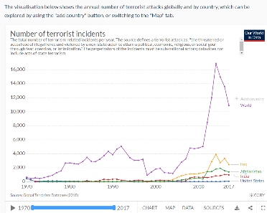
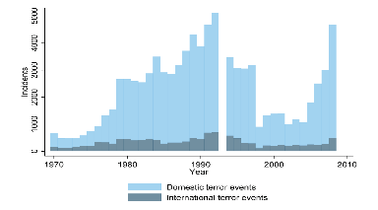
NEW Terrorism: THE DEBATE
Horizontal organisational structure, transnational in nature
Sceptic versus proponents
The network structure is not exclusive to New Terrorism. It has happen in the past
The transnational nature is also not exclusive to New Terrorism. Financing and training, among others, have often been transnational
Most terrorist acts are ‘domestic’ (Kis-Katos 2012) and most death from terrorism happen in a few countries (Our World Data). No much has changed
‘New’ explains social trends and frequency and scope of an occurrence in each historic period, rather than something that has never happened before
Terrorist groups are definitely more networked than before
This has been favoured also by the disappearance of the leftist ideological imperative and of the nationalist practical factors that shaped ‘traditional’ terrorist groups

Slide 19
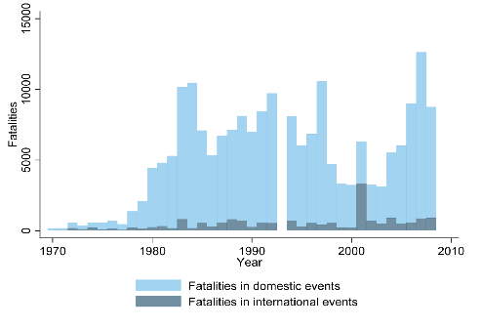
NEW Terrorism: THE DEBATE
Increasingly lethal and indiscriminate attacks
Sceptic versus proponents
The increase in lethality is not about ‘New Terrorism’ but possibly to better technology/weapons available to terrorists
The increase in lethality dates back to the 1980s (Kis-Katos 2012); it does not coincide with the ‘New Terrorism’ timeframe
There is no evidence of indiscriminate targets. Most targets still symbolic
Whether the trend started in the 1980s or in the 1990s is not so relevant: the trend is clear
Attacks by religiously-motivated lonewolves or cells in Europe or bombing in the Middle East are often indiscriminate. They do not target symbols, or politicians

Slide 20
NEW Terrorism: THE DEBATE
Intention and potential to us WMD
Sceptic versus proponents
Terrorists continue to rely, to a large extent, on conventional arms
Non-state actor incidents with chemical, biological, radiological and nuclear (CBRN) agents are actually not that new. There have been 192 cases recorded between 1945 and the late 2000s
The use of terrorists using WMD is plausible, but not strictly related to ‘New Terrorism’
Since 2001 a significant amount of information related to al-Qaeda’s activities with WMD has been published
Extremist fundamentalists and sect-based on apocalyptic mysticism are most plausible WMD perpetrators

Slide 21
NEW terrorism: KEY CHARACTERISTICS?
Class survey 2 Please, raise your hand if you have changed your mind in regards to whether the label ‘New Terrorism’ is useful to describe the type of terrorism we have experienced in the last decades

Slide 22
NEW TERRORISM: WHY IT MATTERS?

Slide 23
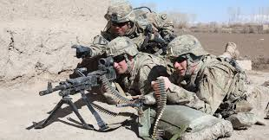
NEW terrorism: WHY IT MATTERS?
Tony Blair referred to a “new global terrorism” that “was driven not by a set of negotiable political demands, but by religious fanaticism”
And he also drew attention to ‘the risk of this new global terrorism and its interaction with states or organisations or individuals proliferating WMD” (Blair, 2004)
Definitions are powerful tool to shape how state respond to specific real or perceived threat
The concept of a ‘New Terrorism’ has grown to dominate the security agenda on both sides of the Atlantic
Is there a plausible link between the conceptualisation of New Terrorism and the controversial War on Terror?
Or with a new set of rushed restrictive governmental counter-measures without these being democratically debated, publicly discussed, independently monitored or even necessary in several countries?
George W. Bush spoke of “new realities and dangers posed by modern terrorists” that represented “a threat like no other our nation has ever faced” (Bush 2001)
He also warned of “the growing threat of terror on a catastrophic scale – terror armed with biological, chemical, or nuclear weapons” (Bush 2002)

Slide 24
NEW terrorism: KEY CHARACTERISTICS?
Class survey 3 Please, raise your hand if you have changed your mind in regards to whether the label ‘New Terrorism’ is useful to describe the type of terrorism we have experienced in the last decades

Slide 25
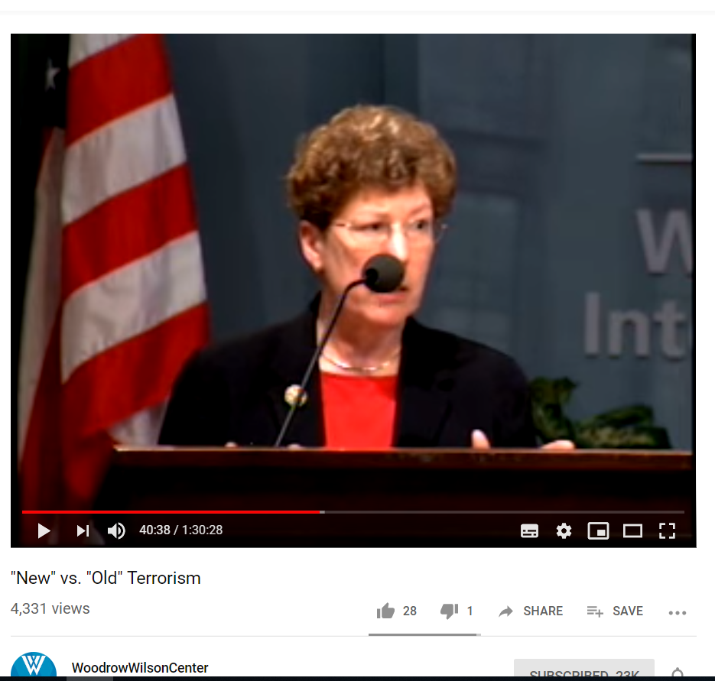
Study questions
Do you agree with the New Terrorism thesis? Why?
What does Rapoport’s Four Waves theory tell us about terrorism?
What are the policy implications of the New Terrorism thesis?

Slide 26
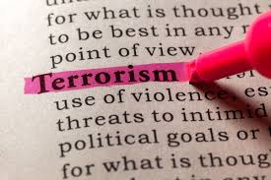
KEY points
Terrorism has a long history as a tactic employed by individuals and groups to further their political objectives
Terrorists have always innovated and exploited technical and societal advances to their advantage
Whether the type of terrorism we have experienced in the last decades is fundamentally different from before remains an open question
Labels matter, however, and we need caution to endorse, or reject, the claims of the “New Terrorism’ school

Slide 27
References
Blair, T. (2004) Speech on the Threat of Global Terrorism, 5 March. http://www.pm.gov.uk/output/Page5461.asp Cited from: Field, Antony. 2009. “The ‘New Terrorism’: Revolution or Evolution?” Political Studies Review 7 (2): 195–207.
Bush, G.W. (2001) Remarks at Signing of the Patriot Act, 26 October. http://www.whitehouse.gov/news/releases/2001/10/20011026-5.html. Cited from Field, Antony. 2009. “The ‘New Terrorism’: Revolution or Evolution?” Political Studies Review 7 (2): 195–207.
Bush, G.W. (2002) Remarks by the President on the Six-Month Anniversary of the September 11th Attacks, 11 March. http://www.whitehouse.gov/news/releases/2002/03/20020311-1.html. Cited fom Field, Antony. 2009. “The ‘New Terrorism’: Revolution or Evolution?” Political Studies Review 7 (2): 195–207.
Kis-Katos, Krisztina, Helge Liebert, and Giinther Schulze. 2012. “On the Heterogeneity of Terror.” Discussion Paper No. 6596. Bonn: Institute for the Study of Labor (IZA). https://papers.ssrn.com/sol3/papers.cfm?abstract_id=2085183.
Matusitz, Jonathan Andre. 2013. Terrorism & Communication: A Critical Introduction. Thousand Oaks, California: SAGE.
Our World Data, available at https://ourworldindata.org/terrorism
Rapoport, David C. 2002. “The Four Waves of Rebel Terror and September 11.” Anthropoetics 8 (1). http://anthropoetics.ucla.edu/ap0801/terror/.
Walls, Erin. 2017. “Waves of Modern Terrorism: Examining the Past and Predicting the Future.” Master Thesis, Washington: Georgetown University.

