Slide 1
Terrorism
Dr Fabio Scarpello
Week 3
Who joins terrorist groups?

Slide 2
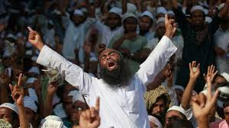
aims
Problematize ready-made analyses of terrorism root-causes
Think critically about risk factors and so-called terrorism profiling

Slide 3
outline
Root-causes of terrorism
Risk factors for terrorism

Slide 4
ROOT CAUSES OF TERRORISM
Notes:
Cold War had stabilised world order and displaced conflict into the Global South. Without that order, optimism. But, with Yugoslavia and Somalia, emerging idea was that conflict remained but had transformed.
And that with globalisation and mass circulation, need to manage poverty, environmental collapse, health etc internationally, as these do not respect state boundaries.

Slide 5
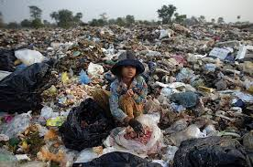
Root causes of TERRORISM
Socioeconomic factors
Demographic factors
Urbanisation factors
Political and institutional factors
Political transformation and instability
Identity and cultural factors
Global economic and political order factors
The basic concept of the root causes of terrorism is that certain conditions provide a social environment and widespread grievances that, when combined with risk factors, may favour the emergence of terrorist organizations or lead to individual joining terrorist groups

Slide 6
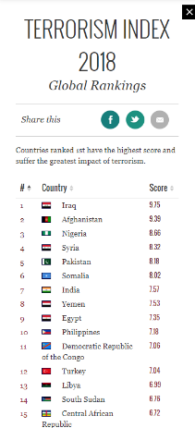
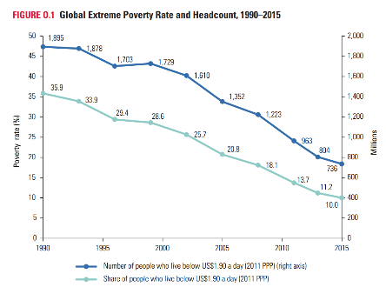
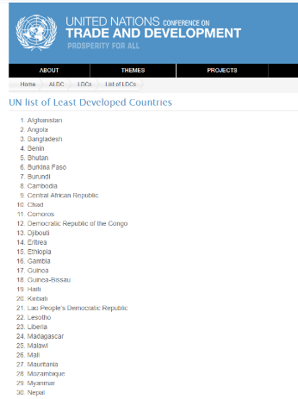
Root causes of TERRORISM Socioeconomic factor
Prominent and enduring causal explanation for terrorism. Particularly influential in policymaking since 9/11*
Key theory: “relative deprivation”
Inconclusive evidence in developed and developing countries*
Gurr uses relative deprivation to ‘‘denote the tension that develops from a discrepancy between the ‘ought’ and the ‘is’ of collective value satisfaction, that disposes men to violence.’ (Gurr 1970: 3-4)

Slide 7
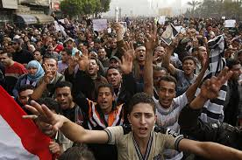
Root causes of TERRORISM Demographic factor
Uneven population shifts across different ethnic groups, rapid population growth, and especially a burgeoning of young males may increase the risk of political violence/terrorism*
Key theory: “the youth bulge”*
Inconclusive evidence*
An excess in young adult male population predictably leads to social unrest, war and terrorism, as the "third and fourth sons" that find no prestigious positions in their existing societies rationalize their impetus to compete by religion or political ideology (Heinsohn 2003, original in German)

Slide 8
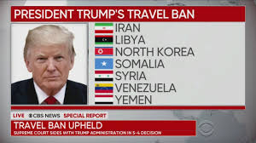
Root causes of TERRORISM Demographic factor:immigration
Popular discourse argues that immigration leads to higher terrorism risk in destination countries*
Recent studies find little evidence to support this in regards to immigrants from conflict-prone countries and no evidence in regards to Muslim immigrants (Bove and Böhmelt, 2016; Dreher et al 2017; Forrester et al, 2019)*
Rather, Western citizens appear to be committing terrorism because of their hostility to immigrants (McAlexander, 2019)*

Slide 9
Root causes of TERRORISM urbanization
Urbanization—in conjunction with unemployment and poverty—can generate a disaffected population, which enables terrorist recruitment
Cities main target for terrorist attacks
Main theories: “relative deprivation” and “youth bulge”
Conclusive evidence on cities as main targets, inconclusive regarding urbanization as root cause of terrorism

Slide 10
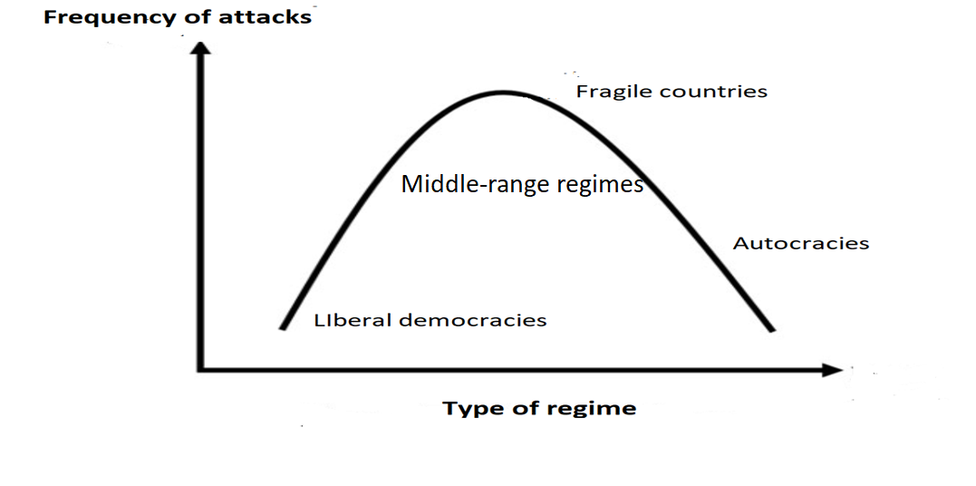
Root causes of TERRORISM POLITICAL and institutional factors*
(1980s). Democracies more prone to domestic terrorism because legal restraints on security forces, free press and electoral politics make it easier to organize terrorist groups, carry out attacks and affect politics*
(1990s). Democracy has a domestic antiterrorist effect because openness allows grievances to be peacefully and publicly redressed*
(2000s). No linear relationship between democracy and terrorism. It is an inverted U relationship

Slide 11
Root causes of TERRORISM POLITICAL TRANSFORMATION AND INSTABILITY
Political change may create political vacuums which terrorist groups may exploit
Individual may find attractive to join or support a radical organization due to few non-violent alternatives
Instable or failed states may serve as haven for international terrorist groups
Influential in policymaking. Evidence limited and contradictory*

Slide 12
Root causes of TERRORISM identity and cultural clash
Sectarian differences may lead to conflict between groups within a country or between groups organized along civilizational lines (e.g., Islamic countries versus the West)*
Influential books: The Clash of Civilizations and the Remaking of World Order (Huntington) and New and Old Wars: Organized Violence in a Global Era (Kaldor)
Influential in policy and popular discourse, but widely critiqued in academic circles*

Slide 13
Root causes of TERRORISM Global economic and political order
Terrorist may recruit from those perceiving the global order as unfair (source of terrorism)
The target of terrorism may be chosen in response to the existing global order, if perceived unjust
Traditionalist or disenfranchised segments of a society may use violence to counter foreign dominance (i.e., Western supremacy) and global modernization (i.e., Western way of life)
A globalization-terrorism nexus may exist, but its mechanics unclear and disputed. Also evidence of positive correlation*

Slide 14
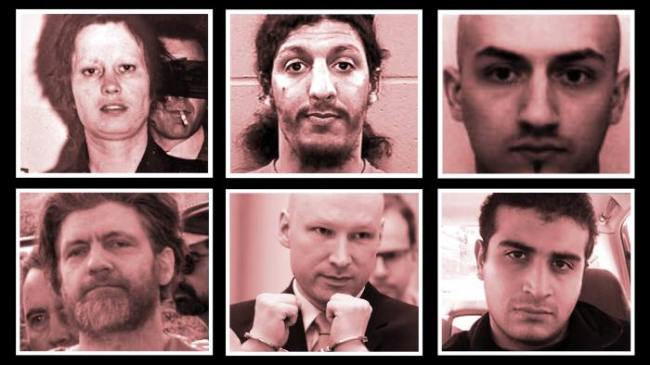
Risk factors for terrorism
Notes:
Cold War had stabilised world order and displaced conflict into the Global South. Without that order, optimism. But, with Yugoslavia and Somalia, emerging idea was that conflict remained but had transformed.
And that with globalisation and mass circulation, need to manage poverty, environmental collapse, health etc internationally, as these do not respect state boundaries.

Slide 15
Risk factors for terrorism
Studies on the risk for terrorism are based on small-scale analyses of the specific traits of individuals or small groups. These attempt to draw profiles to identify stable, predictive traits or “markers” of terrorist personalities
Psychological characteristics
Social interactions, family and peer pressure
Revenge as motivation
Anomie

Slide 16
Risk factors for terrorism Psychological characteristics
During the 1970a-1980s many scholars argued that terrorists have psychological problems—they are crazy. This has been totally rejected.
More recently, some argue that there are psychological traits and life experiences - ‘facilitating traits’ - for why people join terror groups. This is heavily critiqued too*
Most argue that outstanding psychological trait for terrorist is how ‘normal’ they are. Political aims remains key

Slide 17
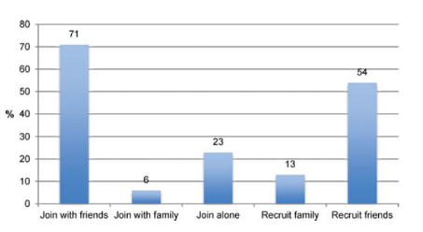
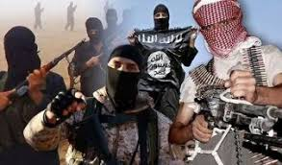
Risk factors for terrorism Social interactions, family and peer pressure
Social interactions and social ties can tell us a lot about who is likely to join terrorist groups
In particular, potential risk factors are family members or peers that have been involved in terrorism
Strong evidence support this explanation*

Slide 18
Risk factors for terrorism Revenge as a motivation
Personalised and generalised grievance as triggers of revenge terrorism
Personalised grievance directed at clear targets and triggered by the loss of family members or friends or abuse suffered by an individual
Generalised grievance directed at an entire nation/religion perceived as perpetrators of abuses suffered by groups/nations
Strong evidence regarding personalised revenge. Inconclusive evidence regarding generalised grievance. The latter often part of terror groups’ propaganda*
UN General Assembly 1985 Resolution underlined causes of terrorism to include “colonialism, racism and situations involving mass and flagrant violations of human rights and fundamental freedoms and those involving alien occupation”
(United Nations 1985)

Slide 19
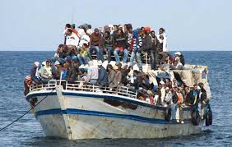
Risk factors for terrorism anomie
“An anomic individual” is displaced from a comfortable social structure into new circumstances that may be chaotic
Displacement may be due to internal or international migration, imprisonment, war and so on
Terrorist groups can provide a sense of belonging to anomic individuals
Inconclusive evidence
Émile Durkheim’s theory of anomie:
when a social system is in a state of anomie, common values and common meanings are no longer understood or accepted, and new values and meanings have not developed. Such a society produces, in many of its members, psychological states characterized by a sense of futility, lack of purpose, and emotional emptiness and despair

Slide 20
Discussion questions
Is there a reliable psychological profile for individual that join terrorist groups?
Are poverty and exclusion sufficient to cause terrorism?
How relevant is the role played by family and peers for individual that join terrorist groups? Discuss referring to data and examples.

Slide 21
KEY points
A variety of socioeconomic, political, psychological and sociological root causes and risk factors provide merely clues for understanding who joins terrorist groups. Socioeconomic and political factors important, but not determinant. Cultural/identity and psychological explanations weak. Peer pressure and personal revenge seem strong warning bells as pathways to terrorism
Generalisation are fraught with difficulties and there seem to be no single causal explanation for who joins terrorist groups

Slide 22
References
Bove, Vincenzo, and Tobias Böhmelt. 2016. “Does Immigration Induce Terrorism?” The Journal of Politics 78 (2): 572–88.
Dreher, Axel, Martin Gassebner, and Paul Schaudt. 2017. “The Effect of Migration on Terror: Made at Home or Imported From Abroad.” CESifo Working Paper. https://papers.ssrn.com/sol3/papers.cfm?abstract_id=2976273.
Forrester, Andrew, Benjamin Powell, Alex Nowrasteh, and Michelangelo Landgrave. 2019. “Do Immigrants Import Terrorism?” Cato Working Paper 56. Washington D.C.: Cato. https://www.cato.org/publications/working-paper/do-immigrants-import-terrorism.
Gurr, Ted R. 1970. Why Men Rebel. Princeton, NJ: Princeton University Press.
Huntington, Samuel P. 1996. The Clash of Civilizations and the Remaking of World Order. New York: Simon & Schuster.
Glasius, Marlies, David Lewis, and Hakan Seckinelgin. 2005. Exploring Civil Society: Political and Cultural Contexts. London [UK]: Taylor & Francis e-Library.
McAlexander, Richard J. 2019. “How Are Immigration and Terrorism Related? An Analysis of Right- and Left-Wing Terrorism in Western Europe, 1980–2004.” Journal of Global Security Studies, May, 1–17.
Sprinzak, Ehud. 1990. “Extreme Left Terrorism in a Democracy.” In Origins of Terrorism: Psychologies, Ideologies, States of Minds, edited by Walter Reich. New York: Cambridge University Press.
United Nations General Assembly, Resolution A/RES/40/61, 9 December 1985, “Measures to Prevent International Terrorism Which Endangers or Takes Innocent Human Lives or Jeopardizes Fundamental Freedoms, and Study of the Underlying Causes of Those Forms of Terrorism and Acts of Violence Which Lie in Misery, Frustration, Grievance and Despair and Which Cause Some People to Sacrifice Human Lives, Including Their Own, in an Attempt to Effect Radical Changes.” Available at www.un.org/documents/ga/res/40/a40r06/.htm
Wieviorka, Michel. 1993. The Making of Terrorism. Chicago: University of Chicago Press.

