Slide 1
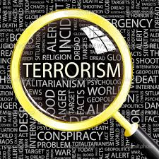
Terrorism
Dr Fabio Scarpello
Week 4
Are female terrorists ‘different’ from ‘male’ terrorists?

Slide 2
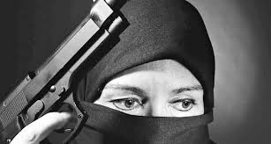
aims
Problematize how ‘gender’ affects women engagement in terrorism and/or our perception of it
Critically evaluate real or perceived differences in why and how men and women perpetrate political violence and how they are portrayed when they do so

Slide 3
outline
Gender-sensitive analysis: Some key concepts
Gender-sensitive analyses of Rapaport’s “Four Waves” of terrorism. Focus on Religious Wave
Mia Bloom: Seeing the New Faces of Terrorism

Slide 4
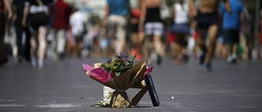
GENDERED LENS:
SOME KEY CONCEPTS

Slide 5
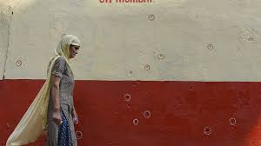
Gendered lens: some key concepts
Social construct
Gender
Intersectionality

Slide 6
Gendered lens: some key concepts SOCIAL CONSTRUCTs
A social construct is something that exists not in objective reality, but as a result of human interaction. It exists because humans agree that it exists*
Social constructs shape our lives. But we also shape them. If a society changes, constructs would develop and old ones may weaken. Constructs are thus fluid*
Social constructs are context specific. Different societies have different constructs; what is the "norm" here may clash with what is the "norm" in another country
Terrorism is a social construct

Slide 7
Gendered lens: some key concepts gender
Sex refers to the categories of male and female and their biological characteristics. Gender is the assignment of masculine and feminine characteristics to bodies in cultural contexts. Gender is a social construct
Gender is contextual and plural in a given culture, across cultures and over historical time
The construct of what being ‘male’ or ‘female’ entails in any given society affects how we view male and female engagement in terrorism*

Slide 8
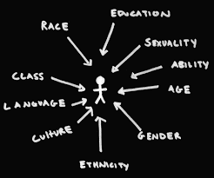
Gendered lens: some key concepts intersectionality
Gender alone is insufficient to understand how women relate to terrorism. Women of various ages, race, class, disability, and religion may relate to terrorism differently
Intersectionality refers to how one’s identities— such as race, gender, class, age, disability, and religion—interact, or “intersect”, and produce specific life experiences
Intersectionality is relevant to terrorism since one’s identities influence participation in terrorist activities

Slide 9
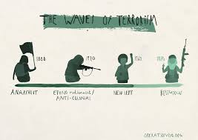
WAVES OF TERRORISM THROUGH GENDERED LENS

Slide 10
Waves of terrorism through gendered lens The anarchist wave: focus on Narodnaya Volya
Long before women acquired the right to vote in Western democracies they were active in political violence in Russia
Women played a central role in Narodnaya Volya group. Vera Zasulich crucial in gaining political traction
Ten women on the group’s executive committee (out of a total of twenty-seven). Women involved in every role, including most daring terrorist acts

Slide 11
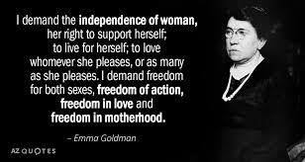
Waves of terrorism through gendered lens The anarchist wave: focus on Narodnaya Volya
Politicisation of women possibly due to women changing role in Russian society after Crimean War (1854)
Women involved were university students, i.e., educated middle-class women based in the cities. No traction in rural, older women
Russian feminist wave influential abroad too. Emma Goldman was a Russian émigré in the USA

Slide 12
Waves of terrorism through gendered lens The NATIONALIST wave: focus on FLN
Women involvement in independence movements limited
Golda Meir, key figure in Zionist movement, was an exception
FLN recruited some women to set-off bombs. They were selected for their strategic advantage of being able to ‘pass’ as Europeans*

Slide 13
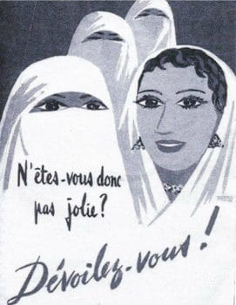
Waves of terrorism through gendered lens The NATIONALIST wave: focus on FLN
‘Gender’ was weaponised by the French and the FLN*
The end result was rising conservatism that limited expectations on women engagement in politics*
Most FLN’s women members labelled ‘patriotic motherhood’ and expected to being good wives and mothers and teach their children religious and traditional values

Slide 14
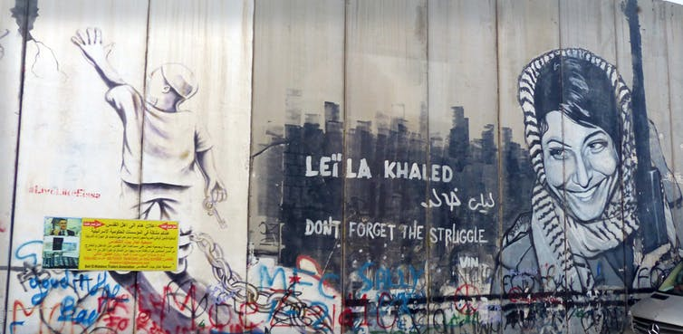
Waves of terrorism through gendered lens The leftist wave
Huge increase in the involvement of women in terrorist groups worldwide
Palestine is an example. Women active in Fatah and the Popular Front for the Liberation of Palestine
Laila Khaled part of a team that hijacked TWA Flight 840 on August 29, 1969. First female hijacker; hailed as a hero and shaped into a role model for other girls*
Women terrorists particularly prominent in Europe and USA

Slide 15
Waves of terrorism through gendered lens The leftist wave: focus on Italy
At least 23% of terrorist arrested in Italy were women
Women active in operational and leadership roles. Margherita Cagol co-founders of the Red Brigades. Susanna Ronconi co-founder of Front Line
Women proved more politically committed than men

Slide 16
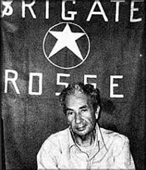
Waves of terrorism through gendered lens The leftist wave: focus on Italy
Women involvement in terrorism coincided with the Second wave of Feminism. This focused on issues of equality and called for the blurring of the personal and the political
Women drawn from educated middle class
Terror groups closely associated with class war in a context of sharp left-right political division post-second world war. Women hardly involved in right-wing terrorist groups

Slide 17
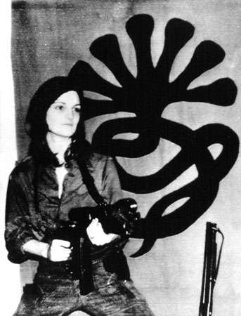
Waves of terrorism through gendered lens The leftist wave: focus on the USA
Women very active in left-wing revolutionary groups—Weather Underground, Black Liberation Army (BLA), Symbionese Liberation Army (SLA)
Women active in operational and leadership roles
Bernadine Dohrn, Cathy Wilkerson, Susan Stern, Kathy Boudin, Linda Evans and Judith Clark key founders of the Weather Underground
Assata Shakur key member of BLA. Still wanted*
Angela Atwood, Camilla Hall, Nancy Ling Perry, Emily Harris key founders of SLA

Slide 18
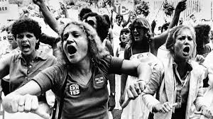
Waves of terrorism through gendered lens The leftist wave: focus on the USA
Terrorism mirrored Second Wave of Feminism
American women also strongly affected by the struggle for ‘black liberation’ and anti-Vietnam War
Most of the women involved in terrorism were middle-class, college-educated young women

Slide 19
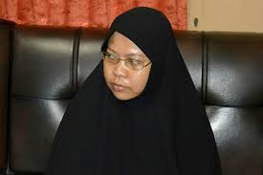
THE RELIGIOUS WAVE THROUGH GENDERED LENS

Slide 20
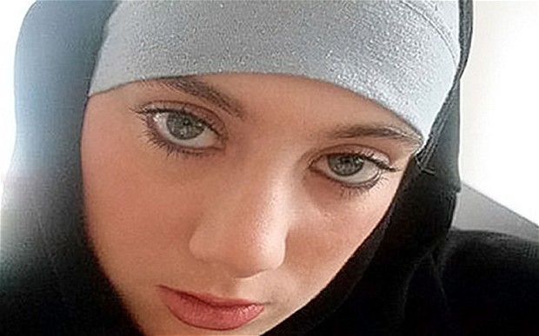
The religious wave
Female suicide bombers: ‘gender’ as a strategic advantage
What do women do? The case of ISIS at its peak
How are ISIS’s women portrayed by the media? The case of British newspapers

Slide 21
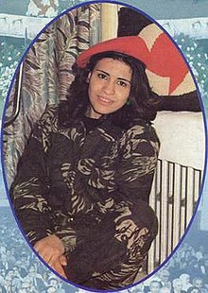
The religious wave female suicide bombers
Sana'a Mehaidli, a member of the Syrian Social Nationalist Party, first woman suicide bomber in 1985
Women comprised one third to one half of the elite Black Tigers of the Liberation Tigers of Tamil Eelam*
Chechenia ‘Black Widows’ also very active. About 42% of suicide attacks between 2002 and 2005*
Beginning in 2002 Palestinian women carried out a long series of suicide attacks against Israelis. Al-Qaeda and ISIS progressively green-lighted women attacks
Gender as a strategic advantage

Slide 22
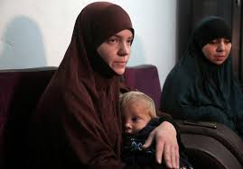
The religious wave what do women do? The case of isis at its peak
Women central to ISIS’s statebuilding project
All-female safe house in Islamic State-controlled Syria, the maqar, operated as matchmaking service and a jihad-style finishing school*
Main role as “jihadi brides” and “jihadi mothers”. But much more
Al-Khansaa Brigade to police morality
Key recruiters for Westerners brides and fighters
Skilled workers
Combat role from 2015 and call to global jihad soon after. ISIS-inspired female suicide bombers in Iraq and elsewhere

Slide 23
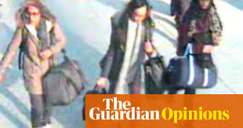
The religious wave How are isis’ women portrayed by the media: the case of British newspapers
Jihadi bride label
Assigned a (pre)determined gender role within the organisation. It acknowledged women’s agency only within the frame of marriage
Different to men labelled as ‘foreign fighters’ which acknowledged broader, heroic men’s agency
Only partly reflected the reality of women’s roles within ISIS

Slide 24
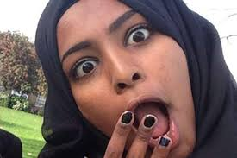
The religious wave How are isis’ women portrayed by the media: the case of British newspapers
The vulnerable, confused and naïve jihadists label
Depicted women as naïve subjects erased the political commitment that may have driven them to join ISIS
It constructed a terrorist that is not dangerous, violent or credible
Different from men viewed as very dangerous
In reality many ISIS’s women are very ideologically committed, often more than men

Slide 25
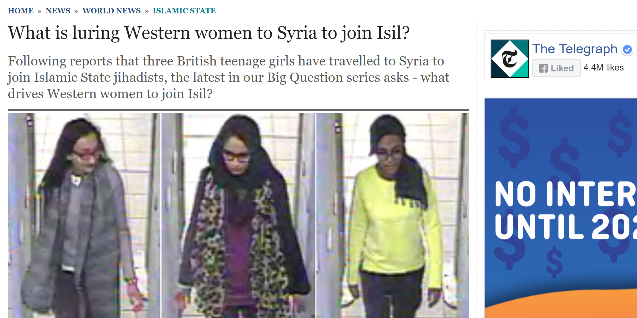
The religious wave How are isis’ women portrayed by the media: the case of British newspapers
Lured, groomed and enticed jihadists label
The passive voice neglected women’s agency and depicted them as victims of the men terrorists who, contrastingly, did exercise their agency
Women were infantilised
Women’s own words did not support this frame

Slide 26
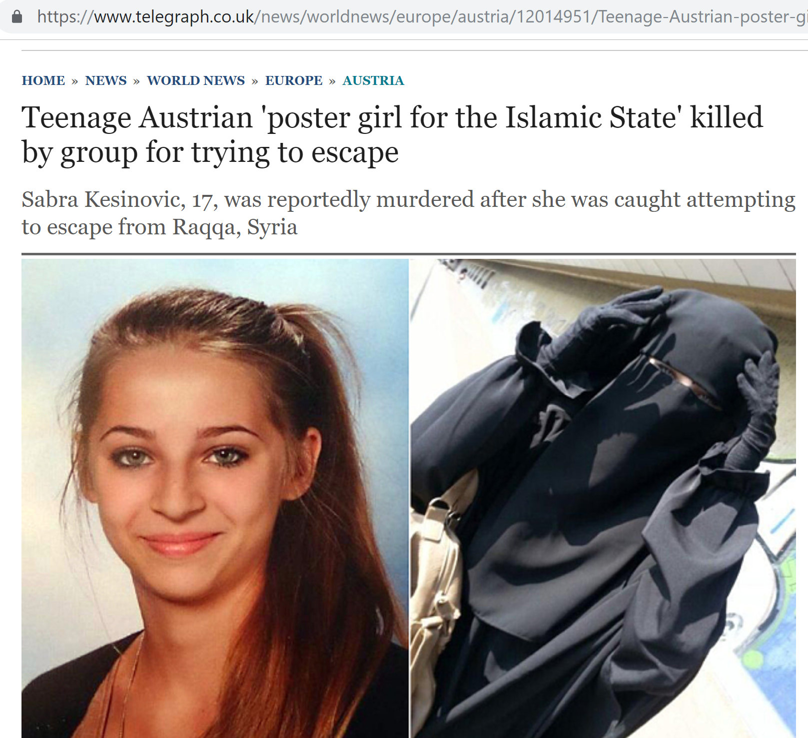
The religious wave How are isis’ women portrayed by the media: the case of British newspapers
Beauty label
Shifted the focus from these militants’ political claims or actions to their looks
Dramatized the difference between their appearance and their violent present
Different to men whose physical appearance is hardly ever noted

Slide 27
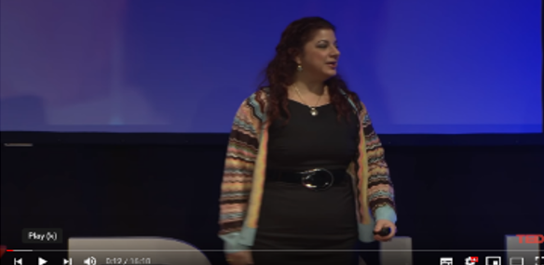
Mia Bloom - Seeing the New Face of Terrorism
Note to students:
Pay particular attention to ‘motivations’ (why women join terrorist groups).
Mia Bloom’s ‘Rs’ may be in your quiz

Slide 28
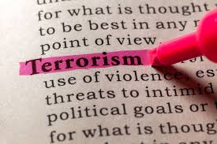
KEY points
Women have always been involved in terrorism and political violence. The level and type of involvement has changed across time and space
Women involvement in terrorism is shaped partially by ‘gender’ and other social identities. But gender expectations more often colour how perception of their involvement, rather than their real involvement
Gender sensitive analysis need to be context-specific, focus on facts and should be mindful of this perception risk

