Slide 1
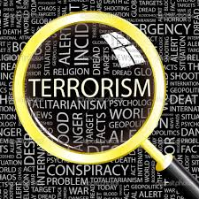
Terrorism
Dr Fabio Scarpello
Week 5
What are the organizational structures of terrorist groups?

Slide 2
Quiz
Students are required to take two quizzes, each consisting of twenty multiple-choice questions. Each correct answer counts for half a point. Each quiz is worth up to 10% of the overall grade for students. The content of the quiz will be based largely on the PowerPoint presentations of the lectures.
Quizzes will be available online via Canvas. Students are encouraged to bring a laptop or another electronic device to access the quiz. Some print copies will be made available for students unable to do so.

Slide 3
Quiz
Questions will be shuffled. No two students will have the same set of questions. Students can only have one attempt at each question.
Quizzes will be administered during the first ten minutes of the lecture in weeks seven (7) and twelve (12). To access the quiz students need a code that will be provided by Dr Scarpello on the day of the quiz. Students therefore need to attend the lecture on the day of the two quizzes. Students unable to do so must contact Dr Fabio Scarpello in advance to arrange alternative provisions. Students that fail to do so and do not attend the lecture will be unable to take the quiz and will be awarded a zero grade for the quiz.

Slide 4
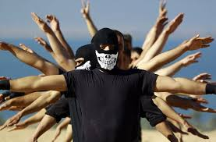
aims
Evaluate key organizational structures, and their respective strengths and weaknesses
Reflect on how organizational structures are fluid and may change according to the political context where groups operate

Slide 5
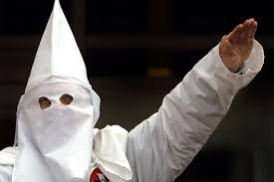
outline
Hierarchy-type structure
Network-type structures
Social Network Analysis
The case of Al-Qaeda
What structure-type presents the most threat?

Slide 6
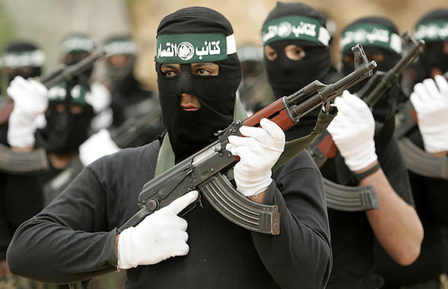
HIERARCHY-TYPE STRUCTURE

Slide 7
Hierarchy-type structure
Leadership
Active cadres
Active supporters

Slide 8
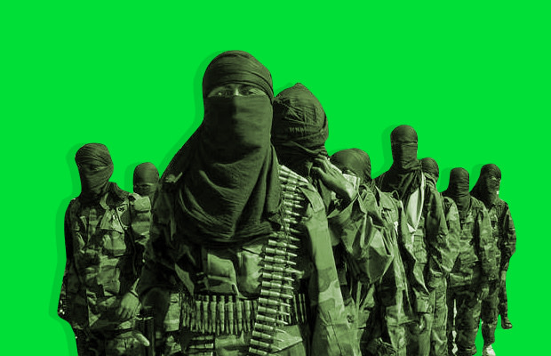
Hierarchy-type structure
Organisational structure resembles pyramid
Best suited for large groups operating in one territory and needing rules, reporting mechanisms and the ability to document dynamics, processes and demands
It provides clear leadership structure, objectives, and coordination channels
It is based on unilateral relationship between the agenda-setting leadership and subordinate units
It involves specialization of roles and functions with clear departmental boundaries

Slide 9
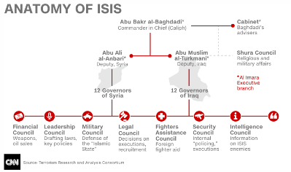
Hierarchy-type structure The case of ISIS in 2015

Slide 10
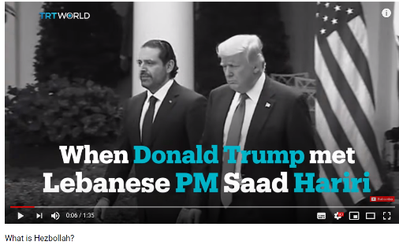
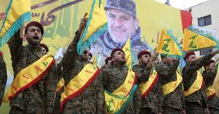
Hierarchy-type structure The case of Hezbollah
https://hezbollah.org/organizational-chart

Slide 11
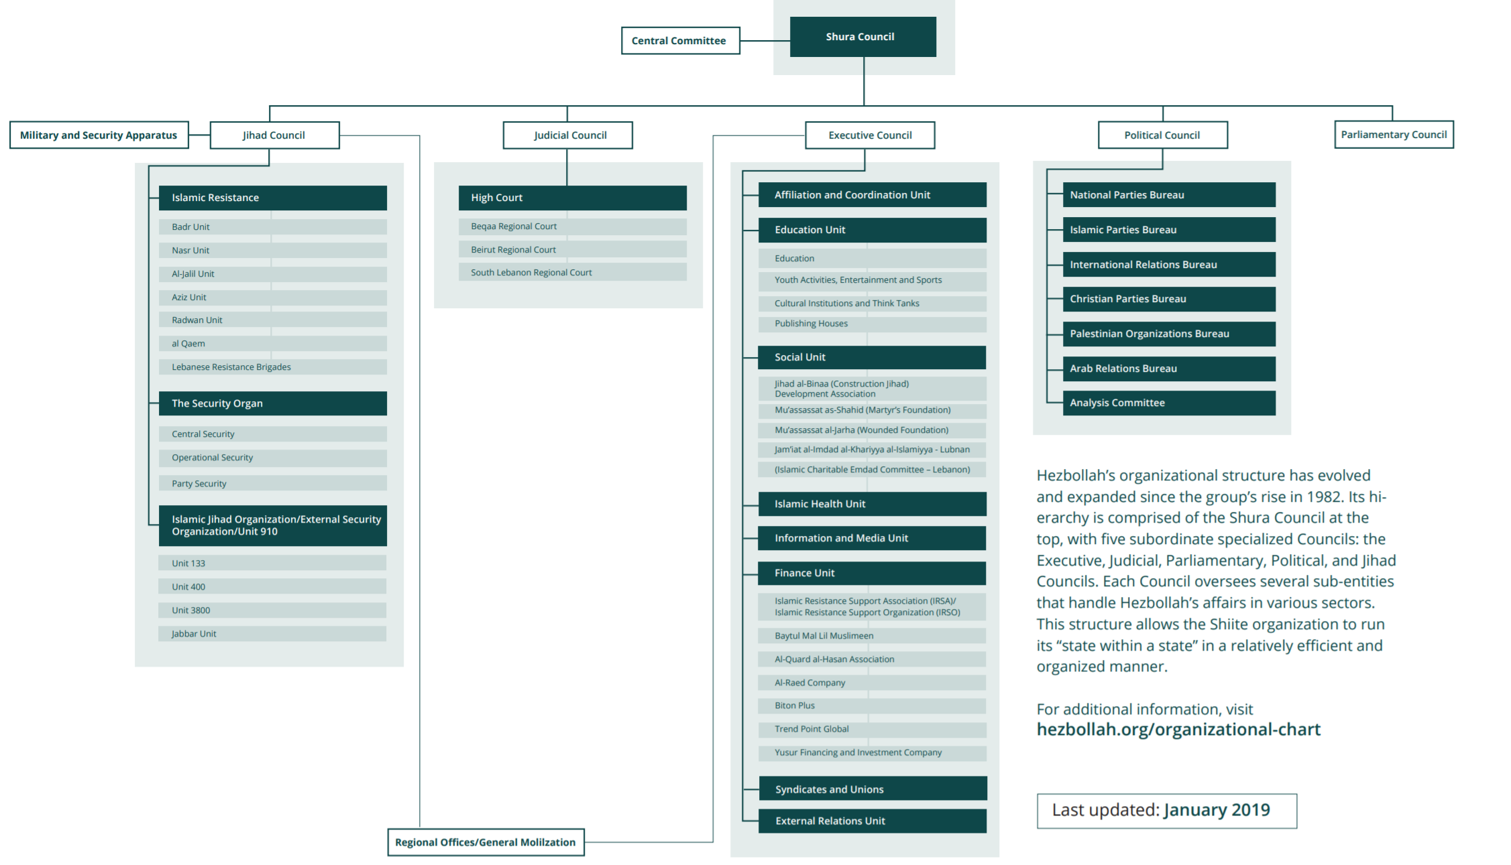
Hierarchy-type structure The case of Hezbollah

Slide 12
NETWORK-TYPE STRUCTURES

Slide 13
NETWORK-TYPE STRUCTURES
New Terrorism School, switch from hierarchy to network-type terrorist groups
One view, change partly due to post 9/11 strategies of Al Qaeda formulated by influential jihadist ideologues, such as Abu Musab al-Suri*
Another view, change partly due to counterterrorism since 9/11*
Consensus on the role of the Internet as a facilitator. The concept of Netwar has been influential (Arquilla and Ronfeldt 2001)*

Slide 14
NETWORK-TYPE STRUCTURES
Chain: people, goods, or information move along a line of separated contacts, and end-to-end communication travels through intermediate nodes
Hub and Spoke: actors tied to a central node/actor, and must go through that node to communicate and coordinate with each other*
All-Channels: multidirectional, rapid and efficient communication is required. Little hierarchy, no central control or functional differentiation among members*

Slide 15
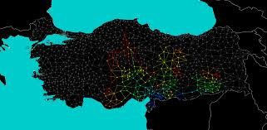
SOCIAL NETWORK ANALYSYS

Slide 16
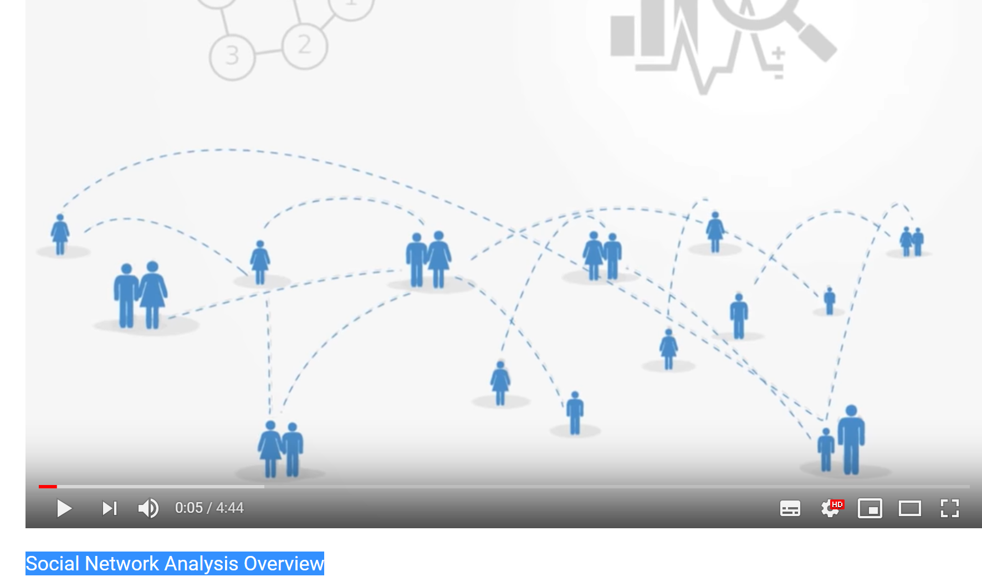
NETWORK-TYPE STRUCTURES Social network analysis*
SNA is about connecting the dots
SNA maps out and analyses the system of ties among the actors and how these relational patterns shape actors' activity, decision making, group dynamics, and group's collective action
In terrorism, key finding is that social ties precede the cause of the violence

Slide 17
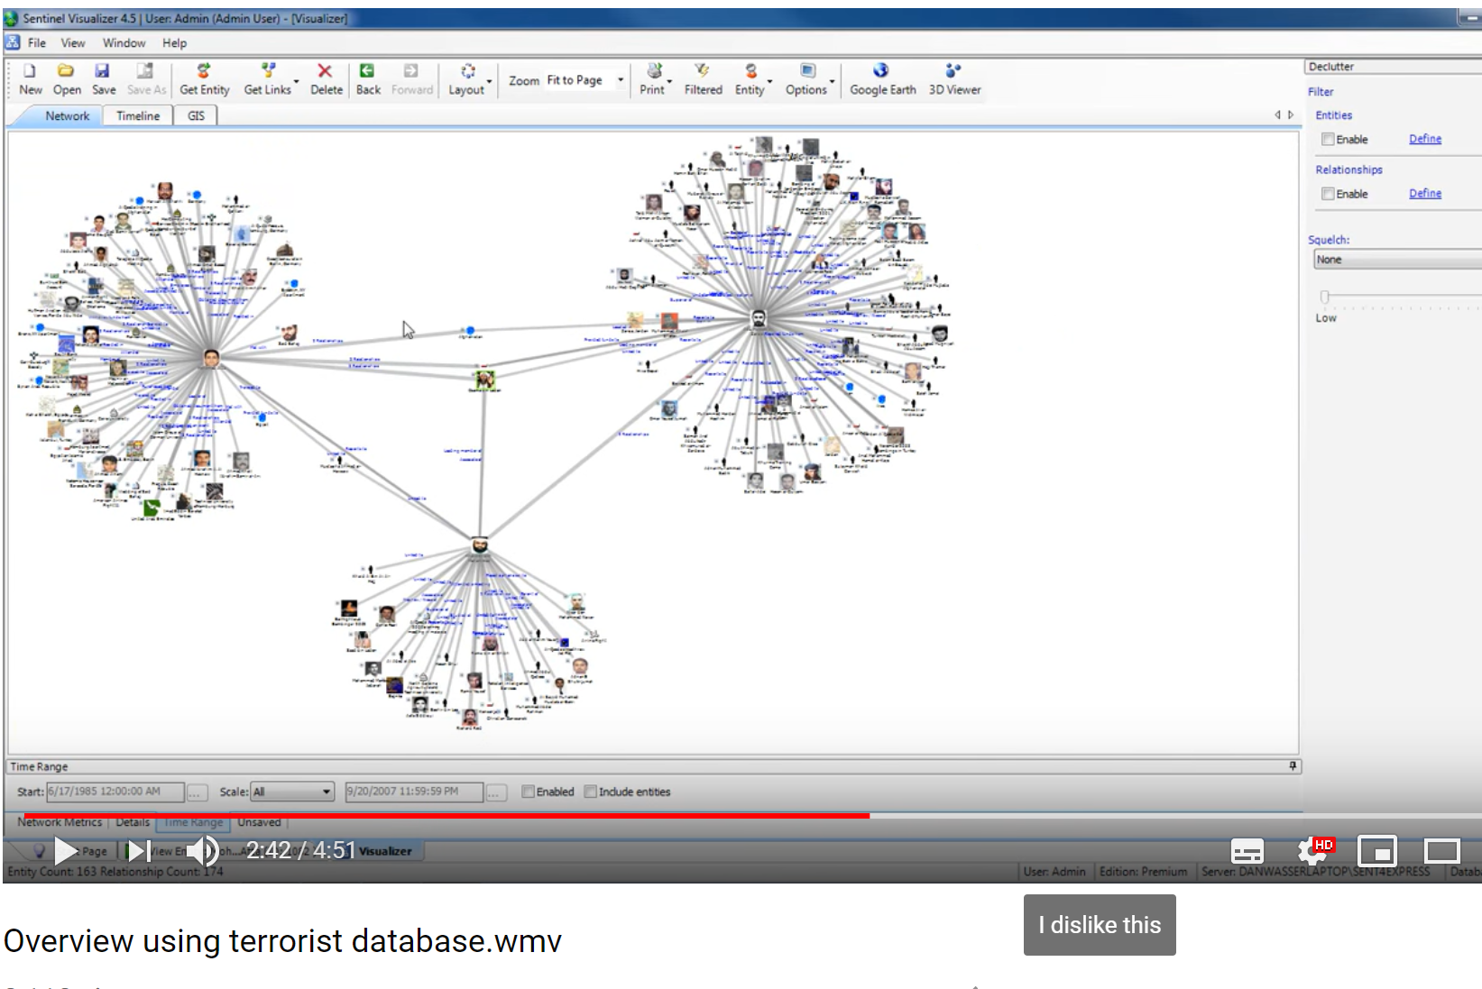
NETWORK-TYPE STRUCTURES Social network analysis
Usually applied to understand the network of suspects, or convicted terrorists*
Who is part of the cell?*
What sort of relationships should we focus on?*
Who is the hub within the cell?*
How is a cell linked to others?

Slide 18
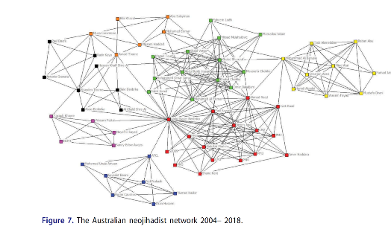
NETWORK-TYPE STRUCTURES Social network analysis: the case of Australia neo- jihadists network

Slide 19
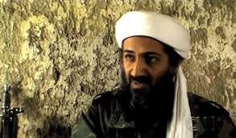
THE CASE OF AL-QAEDA

Slide 20
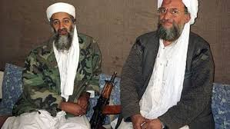
The CASE OF AL-QAEDA
Post-9/11 Al-Qaeda morphed in response to global political context
Al-Qaeda is now believed to operate based on a three-tier organisational structure:
First-tier, or core leadership
Second tier, or associate groups and key individuals
Third-tier, or the ideologically aligned, but operational independent individuals

Slide 21
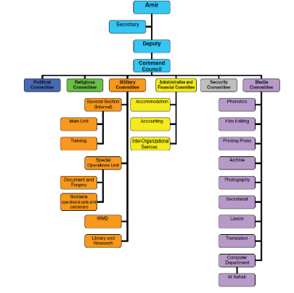
The CASE OF AL-QAEDA first tier: core leadership

Slide 22
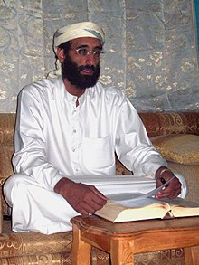
The CASE OF AL-QAEDA second tier: associated groups and key individuals
During the 1990s Al-Qaeda provided training, directions and finance to a number of groups. These remained independent and led localised struggles until US invasion of Afghanistan in 2001*
Since US invasion of Iraq in 2003, regional Al-Qaeda branches have been established. Targets more global*
Key clerics and ideological upstarts in Western countries also part of second tier. Anwar al-Awlaki key example*

Slide 23
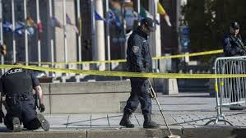
The CASE OF AL-QAEDA Third tier: ideologically aligned, but operational independent individuals
Most based in the West and usually labelled ‘lonewolves’ or ‘homegrown’ terrorists
Activity characterized by unsophisticated acts of violence
Responsible for a string of deadly attacks since 2003, especially in Europe

Slide 24
HIERARCHY OR NETWORK-TYPE GROUPS? WHERE IS THE MAIN THREAT COMING FROM?

Slide 25
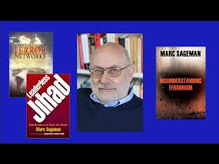
WHERE IS THE MAIN THREAT COMING FROM? The ‘network’ camp: strengths, weaknesses
Biggest threat unaffiliated individuals/cells motivated by Al Qaeda’s message of transnational jihad. These ‘bunch of guys’ can appear anywhere and conduct small scale attacks at any time
Their flexibility, anonymity, and motivation make them a formidable adversary for the security apparatus
But they have informal command structure lacking in centralization, limited resources, and no formal training

Slide 26
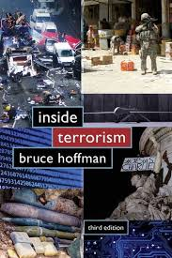
WHERE IS THE MAIN THREAT COMING FROM? The ‘hierarchy’ camp: strengths, weaknesses
Biggest threat stems from centralised organisations. These allow efficient operational planning and execution of coordinated, large scale attacks
Al-Qaeda still a major threat and continues to access relatively large resource pools from fundraising efforts in the Gulf region
But Al Qaeda target of relentless intelligence collection. Avoiding detection remains a primary operational of its ‘core’

Slide 27
Discussion questions
Is there a predominant organisational structure for contemporary terrorist groups?
Which organisational structure presents the highest level of threat?
How would you describe Al-Qaeda’s organisational structure?

Slide 28
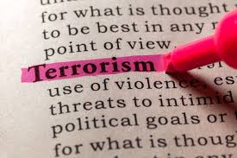
KEY points
The organisational structure of terrorist groups vary from hierarchal to networks. Each has strengths and weaknesses
Structures are not fixed. Groups morph according to the political and operational context. Groups often present elements of hierarchal and network structures
Social Network Analysis is useful to map and understand some of the dynamics that shape networks

Slide 29
references
Arquilla, John, and David Ronfeldt. 2001. Networks and Netwars the Future of Terror, Crime, and Militancy. Santa Monica, Calif.: Rand. https://www.rand.org/pubs/monograph_reports/MR1382.html. [Grah on network types]
Gunaratna, Rohan, and Aviv Oreg. 2010. “Al Qaeda’s Organizational Structure and Its Evolution.” Studies in Conflict & Terrorism 33 (12): 1043–78. [Graph of Al-Qaeda]
Kelly, Mitchel, and Anthea McCarthy-Jones. 2019. “Mapping Connections: A Dark Network Analysis of Neojihadism in Australia.” Terrorism and Political Violence, March, 1–23. [Graph of Australia Neojihadistas Network]
Ken, Miichi. 2016. “Looking at Links and Nodes: How Jihadists in Indonesia Survived.” Southeast Asian Studies 5 (1): 135–154. [Graph on Jemaah Islamiyah]
Thompson, Nick, and Atika Shubert. 2014. “The Anatomy of ISIS: How the ‘Islamic State’ Is Run, from Oil to Beheadings.” CNN, January 14, 2014. https://edition.cnn.com/2014/09/18/world/meast/isis-syria-iraq-hierarchy/index.html [Graph of ISIS]

