Slide 1
Terrorism
Dr Fabio Scarpello
Week 6
Lonewolf and homegrown terrorists: what is there to know?

Slide 2
aims
Assess the differences between lonewolf, homegrown and group-based terrorism
Reflect on the broader societal contexts that lead to LWs and HGTs
Think critically about radicalization theory and its policymaking implications

Slide 3
outline
Definitional and conceptual issues
Contextualisation of the threat
Root-causes and risk factors in comparative terms
Radicalisation theory
Radicalisation trajectories of lonewolf/homegrown terrorists
Case studies (time permitting)

Slide 4
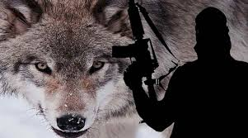
DEFINITIONAL AND CONCEPTUAL ISSUES

Slide 5
LONEWOLF TERRORISM definitional and conceptual issues
Based on broader definition of terrorism: (1) LWs operate individually; (2) do not belong to a terrorist group; (3) their actions are conceived and directed without direction from outside command or hierarch (Spaaij 2010)
Lonewolf crime is “ideologically driven violence, or attempted violence, perpetrated by an individual who plans and executes an attack in the absence of collaboration with other individuals or group” (Becker 2014)

Slide 6
LONEWOLF TERRORISM definitional and conceptual issues
Lonewolf must be placed within the broader context of the individual’s personal history, social relations, and political or religious struggles
A degree of external social influence is often present with outsiders on or off-line. Enablers are influential*
How alone are lonewolves? Various terms question this variable*

Slide 7
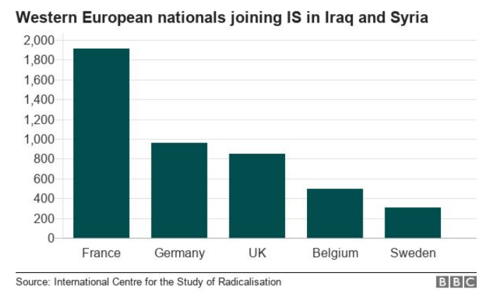
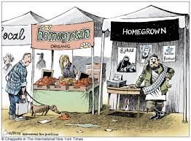
Homegrown TERRORISM definitional and conceptual issues
Threat first emerged due to decentralisation of Al-Qaeda and internationally-motivated, home-based terror*
Individuals born, raised and self-radicalised in the West. They act in small cells, on their own behalf and do not take orders from groups abroad (Crone and Harrow 2011)*
Following ISIS call to the Caliphate, some include so-called ‘Foreign Fighters' in HGTs

Slide 8
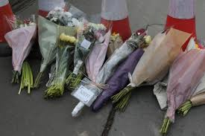
Contextualization of the threat

Slide 9
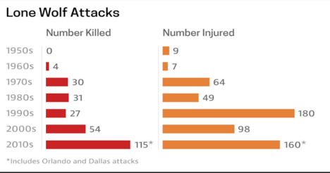
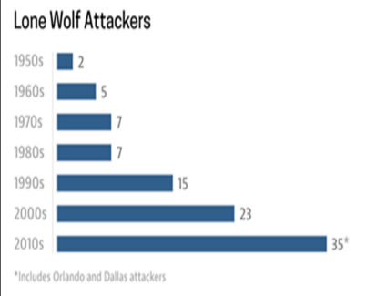
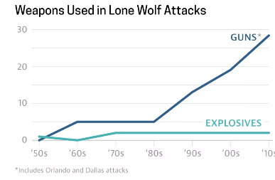
LONEWOLF TERRORISM Contextualization
Lonewolves active during anarchist wave and before. Bakunin’s 1870’s “propaganda of the deed’ influential*
Modern concept developed by right-wing extremists in the US. Beam 1983’s call for ‘leaderless resistance’ influential. Metzger published ‘Laws for the Lone Wolf’ in the 1990s*
Lonewolf violence in the US increased since the 1990s*
Pan-ideological. Lonewolves active elsewhere too

Slide 10
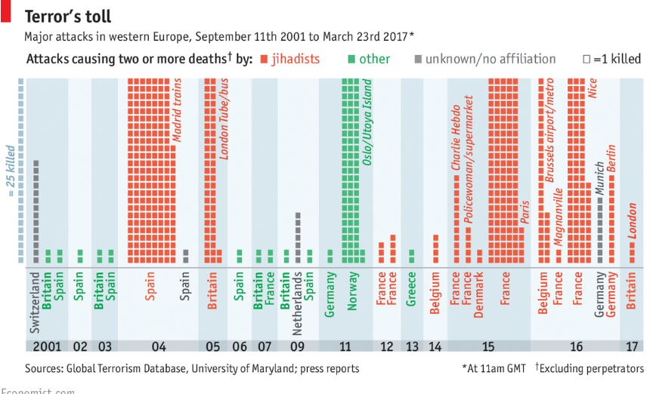
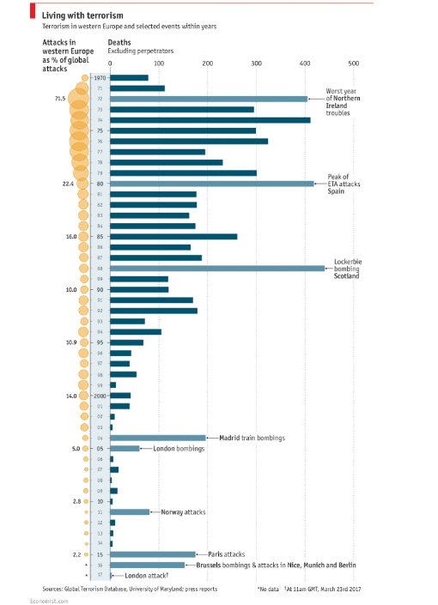
Homegrown TERRORISM Contextualization
Homegrown terrorism most prominent in Europe, where it has taken Islamic tints since 2001
‘Terrorism’ has a long history in Europe. Current period not particularly terrorism-prone

Slide 11
ROOT CAUSES AND RISK FACTORS IN COMPARATIVE TERMS

Slide 12
Group-based terrorism root-causes
Root-causes, group-based terrorism
Socioeconomic
Demographic
Urbanisation
Political and institutional
Political transformation and instability
Identity and cultural
Global political and economic
Evidence-based critiques
Inconclusive evidence but theory of relative deprivation highlights that people deprived of what they deem valuable in society—whether money, justice, status or privilege—may revert to violence to obtain these
Most terrorism in conflict-ridden/fragile countries and countries with intermediate level of political freedom. No substantial evidence for ‘cultural and identity’ factors root-cause, though these may channel socioeconomic and global political grievances

Slide 13
LONEWOLF TERRORISM root-causes*
Relative deprivation relevant. Most are unemployed, in low-paying jobs, rejected from institutions, clubs etc.*
Ideology relevant, though ‘constructed’
‘Cultural and identity’ relevant for LWs as vehicles to channel personal grievances*
Political factors (institutional, transformation and instability and global political economy) that play a role in group-based terrorism less relevant for lonewolves

Slide 14
group-based terrorism risk factors
Risk factors, group-based terrorism
Psychological characteristics
Social interactions, family and peer pressure
Revenge
Rape for women
Anomie
Evidence-based critiques
Psychological traits irrelevant. ‘Normality’ main trait
The role of family and peers important in why an individual may join a terrorist group
Revenge a clear motivation, especially for women. Rape very relevant for women
No conclusive evidence regarding anomie, but possible

Slide 15
LONEWOLF TERRORISM risk factors
Nexus between mental illness and lonewolf terrorism inconclusive. But evidence suggests more relevant that for group-based terrorism*
Lonewolves, to varying degrees, are loners with few friends and prefer to act alone. Family and peers do not play a relevant role

Slide 16
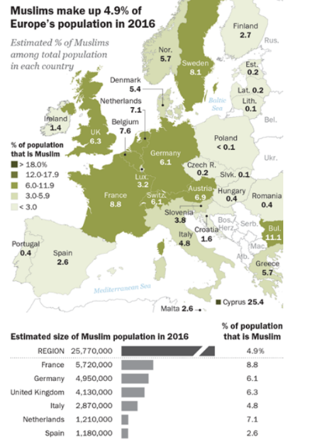
Homegrown TERRORISM root-causes
Lonewolves, root-causes
Relative deprivation relevant
Ideology relevant, though ‘constructed’ from several available
‘Cultural and identity’ often vehicles to channel personal grievances
Political factors, such as conflict, anomie, global political-economic order not much relevant
Homegrown, root-causes
Relative deprivation crucial. Most are poorly integrated second-third generation Muslims*
Global political economic issues key root-cause of group grievance. The plight of the Ummah
It is about perceived injustices, rather than Clash of Civilization

Slide 17
Homegrown TERRORISM risk factors
Lonewolves, risk factors
Mental illness fairly relevant
Lonewolves, to varying degrees, are loners with few friends and prefer to act alone. Family and peers do not play a relevant role
Homegrown, risk factors
Mental illness not a relevant risk factor
Social network, especially peers, key risk factor*
Many had a past in petty crimes*

Slide 18
RADICALISATION THEORY

Slide 19
Radicalisation theory
Terrorism rarely, if ever, is the result of a sudden impulse. It is a ‘process’
Main avenues for radicalisation: place of worship, internet/social media, prisons. Widespread view that extremists or ‘hate preachers’ may groom vulnerable individuals, whether in person or online*
The tipping point from radical into a terrorist (or violent extremist) is a catalyst*

Slide 20
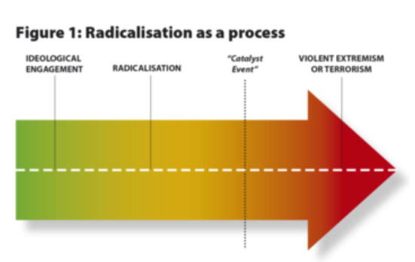
Radicalisation theory

Slide 21
Radicalisation theory Lonewolf terrorism
First phase. Individual may join groups, and be boastful with family and friends. No evidence of being ‘groomed/brainwashed’*
Second phase. Individual retrieves into solitude, usually rejects groups for various reasons
Third phase. Internet becomes central, and an unfiltered mirror that amplifies conjectures and ideas. No evidence of Internet as original source of radicalisation*
Forth phase. A few cross into violence. Not always a catalyst for taking action

Slide 22
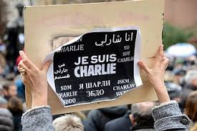
Radicalisation theory homegrown terrorism
Religion not driving force, but a channel to vent frustrations. No evidence of being ‘groomed/brainwashed’. Individuals seek alternative moral code
Ideology not a precondition for violence—violence a precondition for engaging with extremist ideology. It is more like a process of Islamising violence, rather than violent Islamic ideology

Slide 23
Radicalisation theory homegrown terrorism
First phase. Idealisation/indoctrination done individually, with peers or in prison. No evidence of Internet’s key role. New-found religious belief exhibited, but shallow in content
Second phase. Establishment of like-minded clique key phase in self-radicalisation. Members usually knew each-other before*
Third phase. Internet amplifies conjectures and key in seeking validation
Fourth phase. A few cross into violence. International events may be catalyst, tipping point

Slide 24
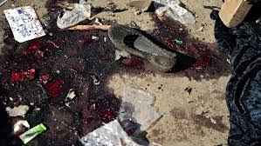
SOME CASE STUDIES

Slide 25
LONEWOLF TERRORISM the rise of The Rise of the Lonewolf in the US
Motivation
Root-causes
Risk factors
Radicalisation
Tactics
Level of threat

Slide 26
LONEWOLF TERRORISM Timothy McVeigh
On April 19, 1995 American Timothy McVeigh killed 168 people and injured hundreds with a truck bomb in Oklahoma City. Though McVeigh conceived of, planned and carried out the bombing, he did not act totally alone. Terry Nichols was convicted of conspiring with him, though his involvement was limited to helping mix the fertilizer and other bomb ingredients; McVeigh had threatened to harm him and his family if he did not help

Slide 27
LONEWOLF TERRORISM Anders Behring Breivik
On 22 July 2011, Norwegian Anders Behring Breivik killed 77 people in two consecutive attacks. First, he killed eight people with a car-bomb placed in the Norwegian government headquarters in Oslo. An hour later, he appeared at the summer camp of the Worker's Youth League, the youth organization of the Labour Party, at the island of Utøya. He shot for approximately 90 minutes, killing 69 people

Slide 28
LONEWOLF TERRORISM Brenton Tarrant
On 15 March 2019 Australian Brenton Tarrant killed 51 people and injured 50 more in two consecutive terrorist attacks at mosques in Christchurch, New Zealand. The attacks began at the Al Noor Mosque in the suburb of Riccarton at 1:40 pm and continued at the Linwood Islamic Centre at about 1:55 pm

Slide 29
LONEWOLF TERRORISM
Are they really lonewolves?
What were the root-causes and risk-factors that led them to terrorism?
What was their radicalisation trajectory like?
What are the communalities and differences in the profiles and radicalisation of the three cases?

Slide 30
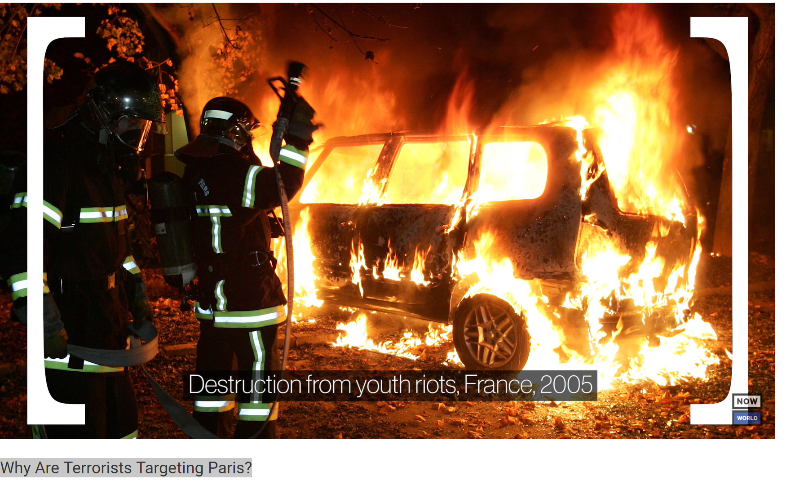
LONEWOLF TERRORISM Why Are Terrorists Targeting Paris?
Root-causes
Risk factors
Domestic and international relations
Level of threat

Slide 31
LONEWOLF TERRORISM Is Belgium A Terrorist Hotspot?
Root-causes
Risk factors
Domestic and international relations
Level of threat

Slide 32
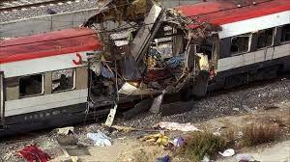
Homegrown TERRORISM 11 March 2004 Madrid train bombings
These were were nearly simultaneous, coordinated bombings against the Cercanías commuter train system of Madrid, Spain. The explosions killed 193 people and injured around 2,000. The bombings constituted the deadliest terrorist attack carried out in the history of Spain and the deadliest in Europe since the 1988 bombing of Pan Am Flight 103 over Lockerbie, Scotland

Slide 33
Homegrown TERRORISM 7 July 2005 London bombings
These were coordinated suicide attacks in London, carried out by four men. Fifty-two people were killed and more than 700 were injured. The members of the cell were: Mohammad Sidique Khan, Shehzad Tanweer, Germaine Lindsay, Hasib Hussain.

Slide 34
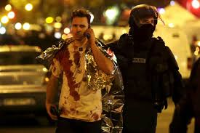
Homegrown TERRORISM 13 November 2015 Paris attacks
These were a series of co-ordinated terrorist attacks that killed 130 people and injured 413. The Islamic State of Iraq and the Levant (ISIL) claimed responsibility for the attacks, saying that it was retaliation for the French airstrikes on ISIL targets in Syria and Iraq. The attackers were shot or blew themselves up when police raided the theatre.

Slide 35
HOMEGROWN TERRORISM
What were the root-causes and risk-factors that led to the establishment of these cells?
What was the radicalisation trajectory of the members of these cells?
What are the communalities and differences in the profiles and radicalisation of the three cases?
What are the main differences in the root causes and risk factors between LWs and HMTs?
What are the key differences in the radicalisation trajectories between GBT, LWR and HGT?

Slide 36
Discussion questions
What is the difference between lonewolf and homegrown terrorists?
What root-cause or risk factors best explain who is more likely to become a lonewolf or a homegrown terrorist?
Mosque and the internet are the key places where individuals are radicalised. Discuss using examples

Slide 37
KEY points
LWT pan-ideological tactic, forged in the 19th century anarchism before being taken up, in particular by far-right extremists in the US
No reliable profile of LWTs. Relative deprivation relevant. LWTs present higher incidence of psychological problems
HGT taken up mostly by jihadis in Europe since 9/11
No reliable profile of HGTs. Relative deprivation relevant. Social network key
Radicalisation theory problematic and not supported by evidence in LWTs and HGTs trajectories. Yet influential in policy circles

Slide 38
References
BBC News. 2014. “NZ Approves New Anti-Terror Laws,” December 10, 2014, sec. Asia. https://www.bbc.com/news/world-asia-30407920. [Graph on Foreign Fighters]
Becker, Michael. 2014. “Explaining Lone Wolf Target Selection in the United States.” Studies in Conflict & Terrorism 37 (11): 959–78.
Crone, Manni, and Martin Harrow. 2011. “Homegrown Terrorism in the West.” Terrorism and Political Violence 23 (4): 521–36.
Hackett, Conrad. 2017. “5 Facts about the Muslim Population in Europe.” Pew Rersearch Centre, November 29, 2017. https://www.pewresearch.org/fact-tank/2017/11/29/5-facts-about-the-muslim-population-in-europe/.{Graph on Muslims in Europe]
Spaaij, Ramón. 2010. “The Enigma of Lone Wolf Terrorism: An Assessment.” Studies in Conflict & Terrorism 33 (9): 854–70.
The Economist. 2017. “Terrorist Atrocities in Western Europe,” March 23, 2017. https://www.economist.com/graphic-detail/2017/03/23/terrorist-atrocities-in-western-europe. [Graphs on homegrown terrorism]
Worth, katie. 2016. “Gunned Down: The Power of the NRA. Lone Wolf Attacks Are Becoming More Common — And More Deadly.” Frontline, July 14, 2016. https://www.pbs.org/wgbh/frontline/article/lone-wolf-attacks-are-becoming-more-common-and-more-deadly/. [Graphs on lonewolves]

