Slide 1
Access code for quiz:
TERRORISM346

Slide 2
Terrorism
Dr Fabio Scarpello
Week 7
What is the Global Salafi-Jihadist movement and how dangerous is it?

Slide 3
aims
Reflect on whether there is a causal link between Islam and terrorism
Analyse the differences between Islamic militants and the global Salafi-Jihadist movement (GSJM)
Reflect on the level of threat it poses to the West

Slide 4
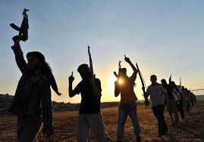
outline
What is a social movement
The GSJM’s key characteristics
The GSJM main actors and layers
The genesis of the GSJM
Why is the GSJM so difficult to end
The level of threat it poses to the West and beyond

Slide 5
SOCIAL MOVEMENT

Slide 6
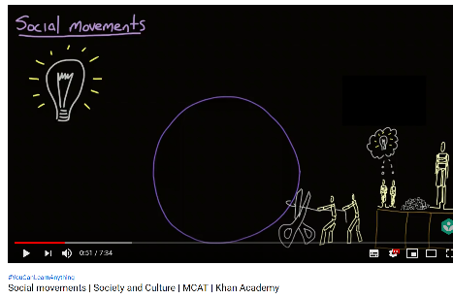
SOCIAL MOVEMENT
Large informal groupings of individuals or organizations that focus on specific political or social issues. They carry out, resist or undo social change
Movements are fluid with blurred boundaries They transcend organisations and individuals
Mobilised behind one overarching ideology, and more or less well defined goals
They benefit from strong leadership and resources
They implement various tactics and strategies to purse their political goals
Several theories explain how and why social movement emerge. One of them is the theory or relative deprivation

Slide 7
Key characteristics of
the Global Salafi-Jihadist movement
Notes:
Cold War had stabilised world order and displaced conflict into the Global South. Without that order, optimism. But, with Yugoslavia and Somalia, emerging idea was that conflict remained but had transformed.
And that with globalisation and mass circulation, need to manage poverty, environmental collapse, health etc internationally, as these do not respect state boundaries.

Slide 8
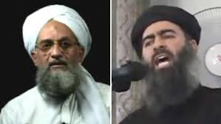
Key characteristics of the GSJM
Ideology
Political aim
Strategy
Leadership and resources

Slide 9
Key characteristics of GSJM ideology
Salafi jihadism
Salafism is a strand of Sunni Islam that advocates a return to the traditions of the Salafi, the first three generations of Muslims*
The Salafi movement is often divided into three sub-categories: purists, activists and jihadists
Salafi-jihadists advocate armed struggle to restore the early Islamic movement. It is the smallest subcategory of Salafism, constituting less than 1.0 percent of the world's 1.2 billion Muslims
Salafi-jihadists reject any engagement in politics and non-Salafi interpretations of Islam. Many Islamic militant groups are not part of the GSJM*

Slide 10
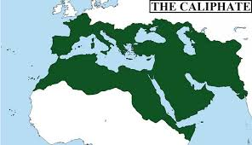
Key characteristics of GSJM Political aim
Its key political aim is the establishment of a supranational caliphate*
Salafi-jihadist groups may fight on local fronts, but as part of a global war
Only groups that share this transnational political aim are to be considered part of the GSJM

Slide 11
Key characteristics of GSJM strategy
The strategy to achieve this s a war of all Muslims against illegitimate, idolatrous Muslim rulers, i.e. violent jihad and no political engagement.
The West is targeted for its presence in Muslim countries and its support for illegitimate Muslim leaders
The strategic logic is that, unless the West is defeated or weakened, these Muslim rulers will be propped up and the caliphate cannot be established

Slide 12
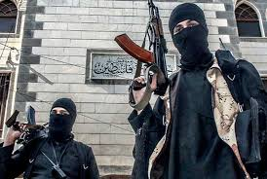
THE GLOBAL SALAFI-JIHADIST MOVEMENT

Slide 13
The global salafi-jihadist movement
Al-Qaeda and the Islamic State in Iraq and Syria (ISIS)
The networks of affiliates and adherents groups of Al-Qaeda and ISIS
Groups that have remained separate from Al-Qaeda and ISIS, subscribe to the Salafi-jihadist ideology, aims and strategy
Salafi-jihadist lonewolves and homegrown cells in the West

Slide 14
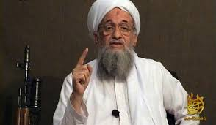
The global salafi-jihadist movement Al-Qaeda
Still very relevant. Changing and adapting
Focused on joining local insurgencies rather than usurp them
Reluctant to fight too many enemies at the same time
Focused on fighting near enemy governments, rather than far enemy governments like the United States
Attempted to leverage social media and other forums, though not as successfully as ISIS

Slide 15
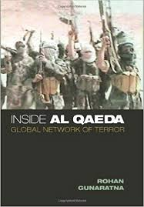
The global salafi-jihadist movement Al-Qaeda-affiliated organisations
Al Qaeda in the Islamic Maghreb (AQIM)
Al Qaeda in Yemen (AQY)
Al-Qaeda in the Arabian Peninsula (AQAP)
Al Qaeda Kurdish Battalions (AQKB)
Al Shabaab

Slide 16
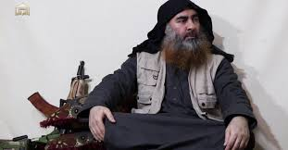
The global salafi-jihadist movement ISIS
Still very relevant despite loss of territory
ISIS’s organizational structure fairly decentralized. Local provinces/affiliated groups have autonomy to run daily operations
ISIS established a “virtual caliphate” across countries and continents via social media and encrypted communications
It has shifted from conventional war to guerrilla warfare and terrorism

Slide 17
The global salafi-jihadist movement ISIS-affiliated organisations
Ansar al-Islam
Islamic State Libya
Islamic State Sinai
Islamic State Khorasan
Islamic State West Africa
Islamic State Greater Sahara

Slide 18
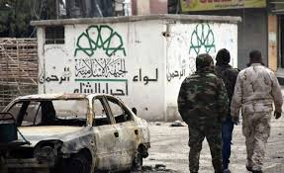
The global salafi-jihadist movement Non-affiliated organisations
Hay'at Tahrir al-Sham (Formerly Jabhat al-Nusra)
Tehreek-E-Taliban Pakistan (TTP)

Slide 19
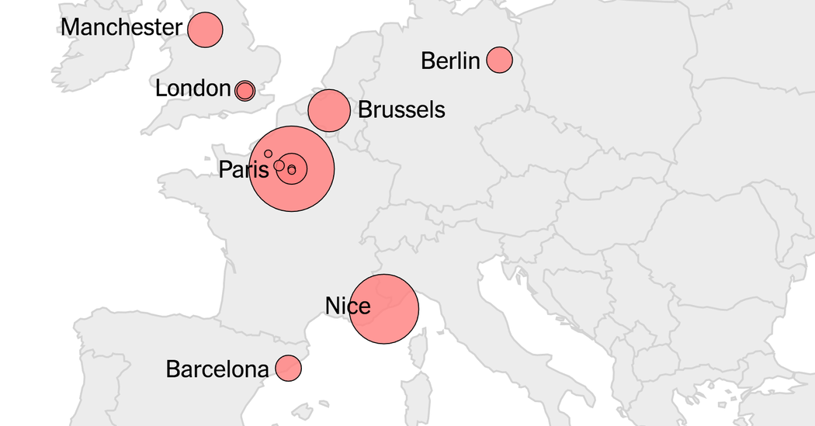
The global salafi-jihadist movement LONEWOLVES AND HOMEGROWN CELLS

Slide 20
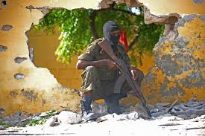
The global salafi-jihadist movement The case of Africa

Slide 21
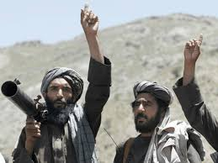
THE GENESIS OF THE GSJM

Slide 22
THE GENESIS OF THE GSJM
Post-Afghanistan local jihads in the early 1990 till mid-1990s
Al-Qaeda targets the Far Enemy from mi-1990s until 2001
US invasion of Iraq in 2003
The collapse and suppression of the Arab Spring from 2011

Slide 23
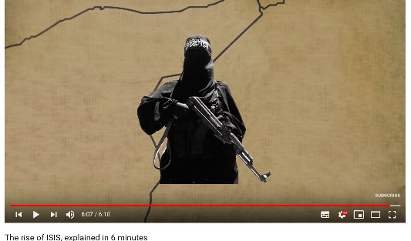
THE GENESIS OF THE GSJM

Slide 24
WHY IS THE GSJM SO DIFFICULT TO END

Slide 25
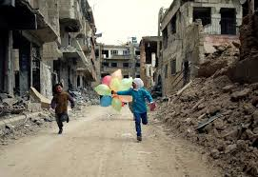
WHY IS THE GSJM SO DIFFICULT TO END
Violent political conflicts in the Middle East
Escalating geopolitical rivalries in the Middle East
Sunni-Shia sectarianism at historical high
Sunni Arabs’ profound sense of victimisation
Ongoing authoritarianism, post-Arab Spring
Weak states in Africa
Ideological space for Salafi-jihadists with the collapse ideologies that used to frame political activity against repression

Slide 26
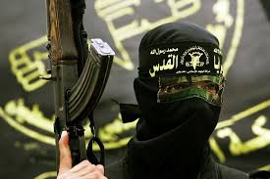
THE LEVEL OF THREAT

Slide 27
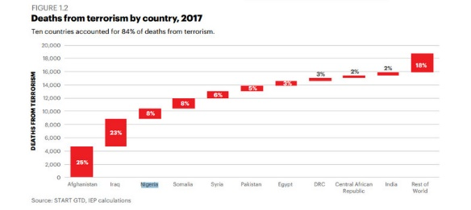
The level of threat worldwide
Deaths from terrorism have dropped since 2014. Deaths are now 44% below their peak in 2014 (Global Terrorism Index 2018)
Ten non-Western countries accounted for 82% of all deaths in 2017. This is an ongoing trend

Slide 28
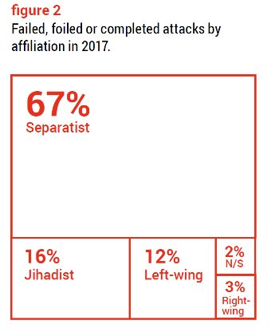
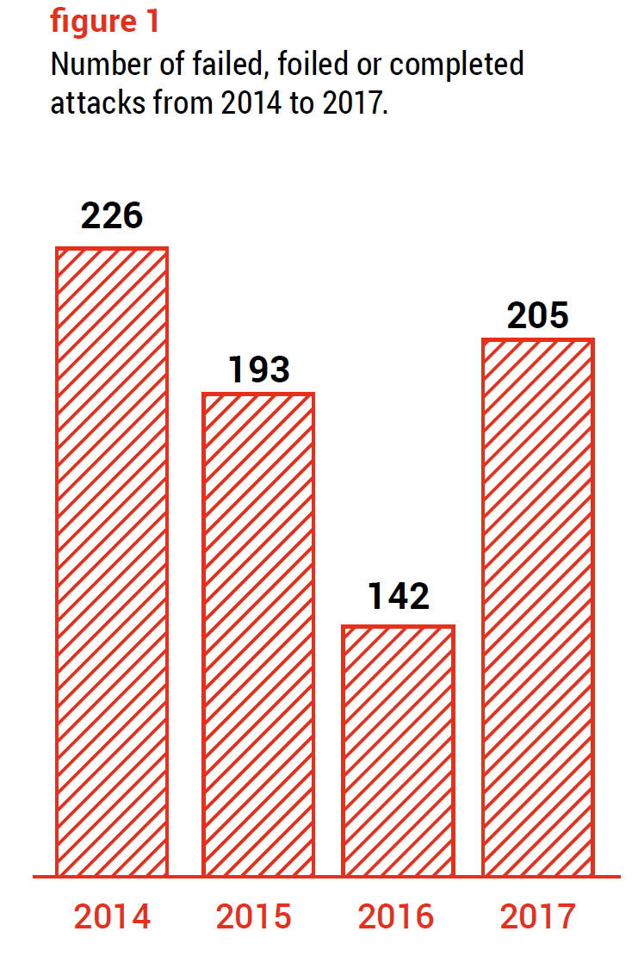
The level of threat in Europe
In 2017 a total of 205 foiled, failed and completed terrorist attacks were reported by nine EU Member States (EU Terrorism Situation & Trend Report 2018)
Only 16% of these were by jihadists

Slide 29
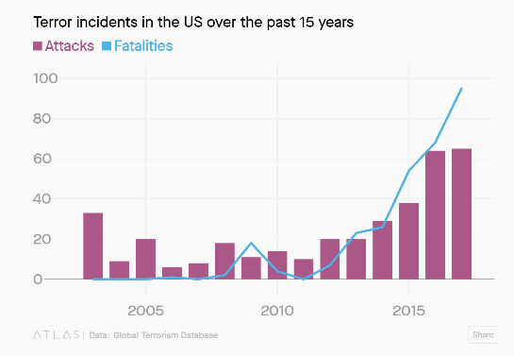
The level of threat in the USA
Spike in the number of attacks in the USA since 2015. In 2017 65 attacks were recorded
37 were tied to Far-Right motivations and 11 attacks were inspired by left-leaning ideologies
Only 7 ere linked to Islamic extremist (Romero 2018)

Slide 30
KEY points
The GSJM aims to establish a caliphate across the Middle East, parts of Asia and Africa. It is fragmented and presents deeps fissures. Yet, it is based on a shared ideology and strategies in support of its political aim
The Salafi-jihadist ideology is only embraced by about 1% of the Ummah
Al-Qaeda and ISIS are the leading groups of the GSJM. Each has affiliated groups operating rather autonomously. The GSJM includes unaffiliated groups and lonewolves and homegrown cells, the latter based mostly in Europe
The GSJM has deep roots, arching back to the anti-Soviet war in Afghanistan. The current phase is driven by the conflicts in the Middle East, geopolitical rivalries and the political space opened post-Arab Spring
The GSJM is a major threat for people in the Middle East and Africa. It is only a minor threat to Westerners

Slide 31
References
“Global Terrorism Index 2018.” 2018. Sydney: Institute for Economics & Peace. http://visionofhumanity.org/reports.
“EU Terrorism Situation & Trend Report 2018.” 2018. The Hague: Europol. https://www.europol.europa.eu/activities-services/main-reports/eu-terrorism-situation-and-trend-report.
Romero, Luiz. 2018. “US Terror Attacks Are Increasingly Motivated by Right-Wing Views.” Quartz, October 25, 2018. https://qz.com/1435885/data-shows-more-us-terror-attacks-by-right-wing-and-religious-extremists/.

