Slide 1
Terrorism
Dr Fabio Scarpello
Week 9
How terrorist groups raise their money?

Slide 2
aims
Reflect on the causal link between sources of finance and terrorist groups’ objectives, lethality and longevity
Reflect on the possible connection and nexus between crime and terrorism

Slide 3
outline
Risks and benefits of main sources of finance for terrorist groups
The role of Internet
The ten richest terrorist organisations in 2017
How the Far-Right gets its money in the USA

Slide 4
RISKS AND BENEFITS OF MAIN SOURCES OF FINANCE

Slide 5
Risks and benefits of main sources of finance 0 what do we mean by ‘funds for terrorism’?
“Assets of every kind, whether tangible or intangible, movable or immovable, however acquired, and legal documents or instruments in any form, including electronic or digital, evidencing title to, or interest in, such assets, including, but not limited to, bank credits, travellers checks, money orders, shares, securities, bonds, drafts, letters of credit”
International Convention for the Suppression of the Financing of Terrorism, 1999

Slide 6
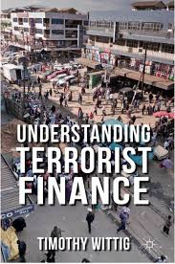
Risks and benefits of main sources of finance
Costs of terrorist attacks relatively low, but terrorist organizations require large budgets to function
Securing reliable sources of finance linked to terrorist groups’ longevity and sustained lethality
Main sources of finances include: popular support, legal activities, illegal activities and state support. Each comes with risks and benefits
Calculations include security of the flow; autonomy of the terrorist group and reputational cost

Slide 7
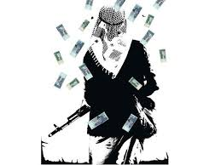
Risks and benefits of main sources of finance Popular support
Donations from individuals, private organisations or charities*
Support from sympathetic population or constituency. Typical of groups controlling territory. Diaspora plays an important role too*
Popular support provides easy and reliable funds, adds legitimacy to groups’ struggle but can affect their behaviour*

Slide 8
Risks and benefits of main sources of finance legal activities
The least important among ‘main’ sources of finance. No typical ‘legal activity’. Businesses depend on context and opportunities. Control of territory important*
Legal activities provide a safe and relatively steady flow of money, but may attract unwanted attention, require skilled workers and yield rather low comparable returns*

Slide 9
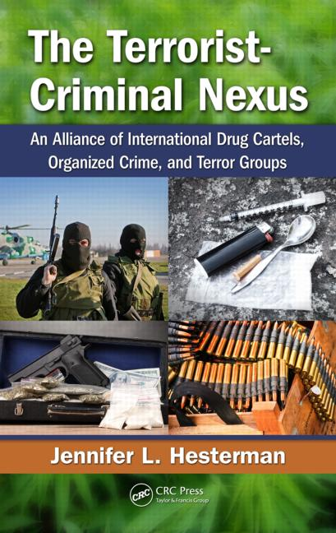
Risks and benefits of main sources of finance illegal activities and the crime-terror nexus
Illegal activities imply that terrorist groups get involved in criminal activities to finance their operations. There are many types of illegal activities*
Crime-terror nexus implies a mutually beneficial and ongoing collaboration between crime syndicates and terrorist groups*
Illegal activities and the ‘nexus’ provide huge streams of funds, but are unreliable and carry some reputational risk*

Slide 10
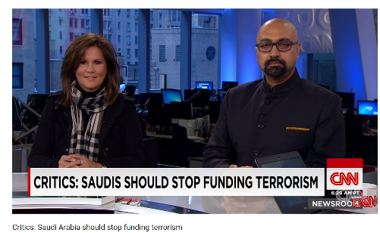
Risks and benefits of main sources of finance state-sponsored terrorism
State-sponsored terrorism decreased since the end of the Cold War.* Syria, Pakistan and Iran, among the main sponsors today
Saudi Arabia interesting and hotly debated case study*
State sponsorship brings huge steady funds, but it may affect groups’ autonomy. It also susceptible to policy changes

Slide 11
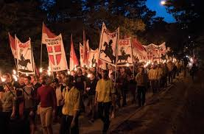
Internet and terrorism financing

Slide 12
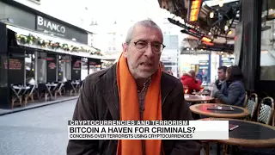
Internet and terrorism financing
Internet important, but not central, source of terrorism legal and illegal financing*
Crowdfunding quite widespread*
Cryptocurrencies a potential, though still very minor, source of finance*

Slide 13
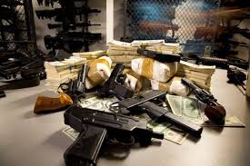
THE 5 RICHEST TERRORIST GROUPS IN 2017

Slide 14
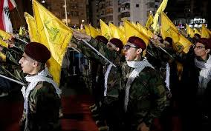
THE 5 richest terrorist organisations in 2017 1 - Hezbollah
Total annual Income – $1.1 billion
Main source of funds is Iran.* This has increased in the last years. This limits the group autonomy
Substantial capital from drug trading, especially heroin and cocaine
Steady flow from tax-like levies on local businesses in Hizbullah-dominated areas of Lebanon, and in particular the Bekaa Valley and southern Lebanon
Steady flow from diaspora and legal businesses

Slide 15
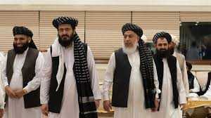
THE 5 richest terrorist organisations in 2017 2 - Taliban
Total annual Income – $ 800 million
Main source production and trade of drugs, mainly growing opium and manufacturing heroin*
Substantial funds also from pirate mining of natural resources within the regions under its control
The group is active in kidnapping
A further significant source of income comes from donations, mostly from wealthy Saudi sheikhs and philanthropists

Slide 16
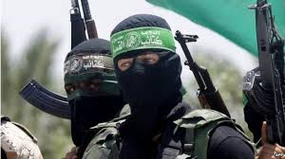
THE 5 richest terrorist organisations in 2017 3 - hamas
Total annual Income – $ 700 million
Main source of funds isn Iran*. Qatar also relevant
Sophisticated and elaborate tax network redirects capital flowing into Gaza as aid*
Steady flow from tax-like levies on local businesses in Hamas-dominated areas of Gaza
Legal businesses in real estate, security, banking and tourism
Steady flow from donations by individuals and charirties

Slide 17
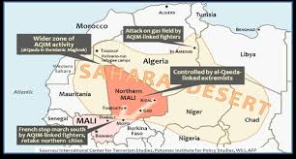
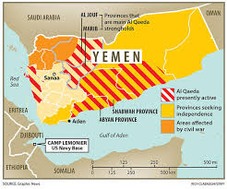
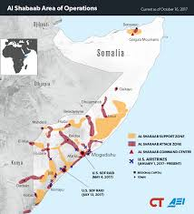
THE 5 richest terrorist organisations in 2017 4 – Al-Qaeda network
Total annual Income – $ 300 million
Al-Qaeda of the Islamic Maghreb, Al-Qaeda of the Arab Peninsula (AAP) and Al-Shabab active in illegal operations*
AAP controls the port of Mukalla in Yemen
Al-Shabab taxes inhabitants of the territories under its control

Slide 18
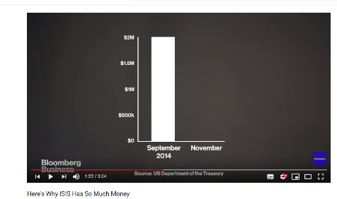
THE 5 richest terrorist organisations in 2017 5 – ISIS
Total annual Income – $ 200 million. Down from about 2-3 billion dollars in 2014
Since the loss of the caliphate, ISIS is likely to be supported by ransom payments, donations, and external aid to finance its guerrilla activities in Syria and Iraq. Sources yet to be ascertain

Slide 19
THE FAR-RIGHT’S SOURCES OF FINANCE IN THE USA

Slide 20
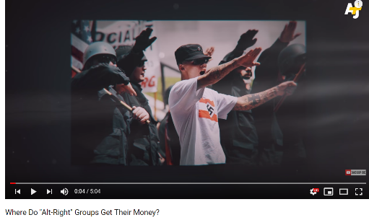
THE FAR-RIGHT’S SOURCES OF FINANCE IN THE USA
Philantropic donations
Crowdfunding
Membership fees
Merchandise
Event fees
Criminal activities
Self-funding for individuals

Slide 21
Conclusion
Terrorist attacks are cheap, but running a terrorist group is expensive. Funds are essential for groups
Terror groups gather funds from a combination of donations from supporters, legal and illegal sources, and state sponsors. Internet useful, but not central
Each source has pros and cons. State sponsors is financial bonanza, but limits groups’ autonomy. Illegal activities lucrative, but come with reputational risks. Legal activities bring little money but is a steady flow, while popular support adds legitimacy but may affect groups’ behaviour
Groups that control territory usually richer and last longer

Slide 22
References
“International Convention for the Suppression of the Financing of Terrorism.” Adopted by the General Assembly of the United Nations in resolution 54/109 of 9 December 1999. https://www.un.org/law/cod/finterr.htm.
Zehorai, Itai. n.d. “The Richest Terror Organizations in the World.” Forbes International. https://www.forbes.com/sites/forbesinternational/2018/01/24/the-richest-terror-organizations-in-the-world/.

