Slide 1
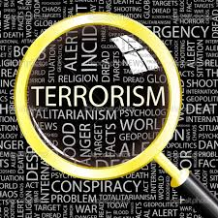
Terrorism
Dr Fabio Scarpello
Week 9
Is the web terrorists’ best friend?

Slide 2
aims
Reflect on how and why terrorists use the internet
Critically engage with the real or perceived threat posed by cyberterrorism

Slide 3
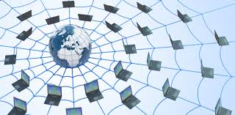
outline
Surface web, deep web and dark web
Why do terrorists use the Web/social media?
What is cyberterrorism and how ‘real’ a threat is it?

Slide 4
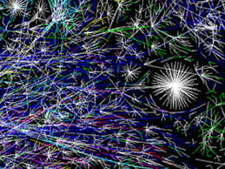
THE DIFFERENT LAYERS OF THE WEB

Slide 5
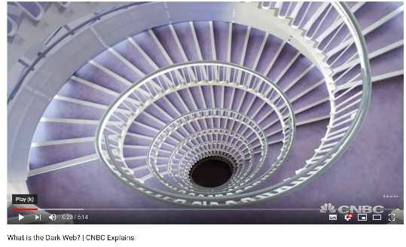
The different layers of the web
Surface Web accessible through conventional search engines. It is not the main informational content of the web
Deep Web accessed only through targeted queries; unable to be indexed by conventional search engines; protected by security mechanisms like login IDs, passwords, membership registrations, and codes. Hundreds of times larger than Surface Web*
Dark Web contains generally illegal and anti-social information. Accessible only through specialized browsers*

Slide 6
Why terrorists use the web/social media

Slide 7
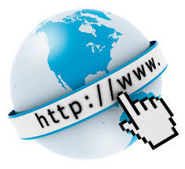
Why terrorists use the web/social media
Propaganda
Self-reporting and challenging mainstream media’s monopoly
Recruitment, radicalisation and incitement to violence
Data mining
Networking
Planning and coordinating
Financing

Slide 8
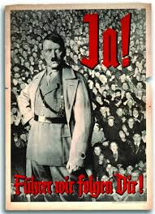
Why terrorists use the web/social media propaganda
Propaganda entails information that is not objective and is used primarily to influence an audience and further an agenda, often by presenting facts selectively to encourage a particular synthesis or perception, or using loaded language to produce an emotional rather than a rational response to the information that is presented
State-led propaganda has long history, especially during wartime. Nazi regime perfected it. Huge during Cold War
Internet allowed non-state actors to produce and disseminate propaganda material

Slide 9
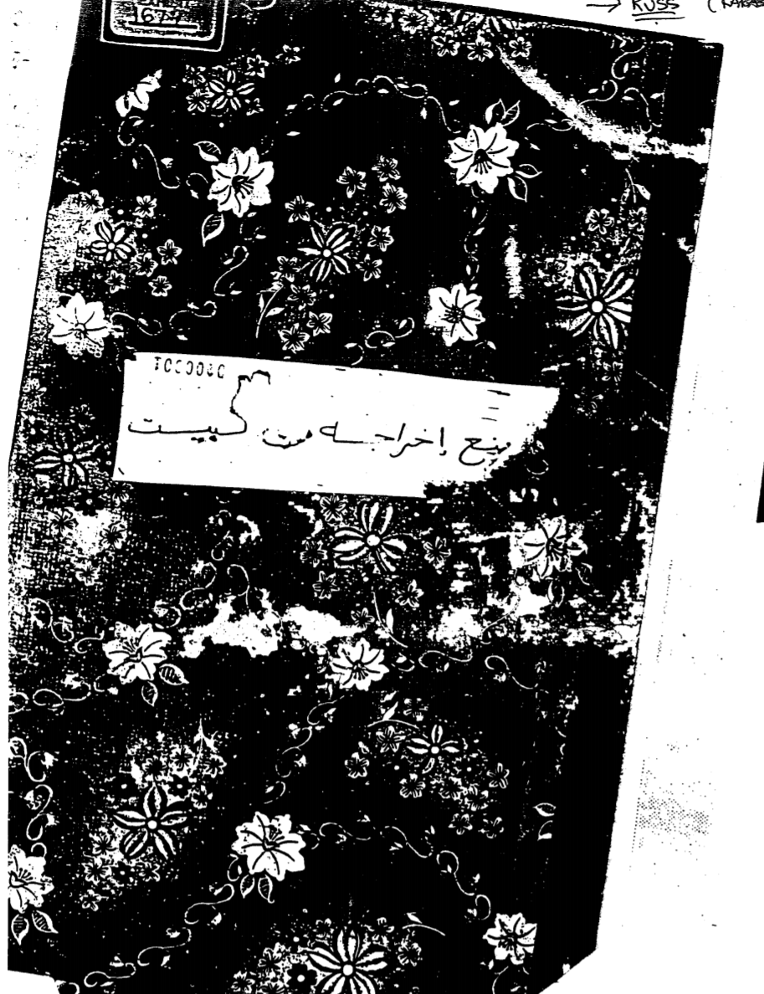
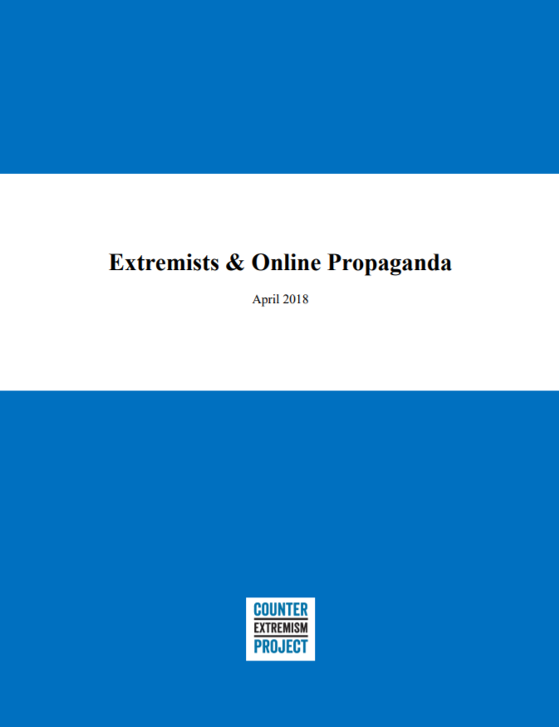
Why terrorists use the web/social media propaganda
Al-Qaeda’s ‘Military Studies in the Jihad against the Tyrants’ identified propaganda as a key strategy to pursue
ISIS has perfected the approach
Initial data seems to substantiate a link between online propaganda and terrorist acts

Slide 10
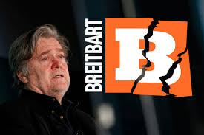
Why terrorists use the web/social media SELF-REPORTING AND challenging mainstream media
Internet enhances the ‘communicative’ element of terrorism as terrorists self-report their acts in a manner that sends a message to their enemies as well as their supporters
Internet allows terrorist [and radical movements] to construct their narrative of events, and challenge what was once the monopoly of information by the mainstream media
Breitbart is an example of a Far-Right media outlet often constructing an alternative narrative*

Slide 11
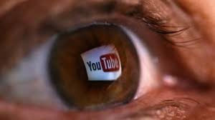
Why terrorists use the web/social media recruitment, radicalisation and incitement
Link between internet and recruitment and radicalisation weakly supported by evidence. But clear evidence of terrorist attempting to do so
Internet emerged as a key instrument in Al Qaeda’s effort to mobilize jihadist empathy since early 2000s*
Electronic jihad part of the Salafi-jihadis’ lexicon*
Internet key for Far-Right groups. YouTube’s “Rabbit Hole” particularly influential until recently

Slide 12
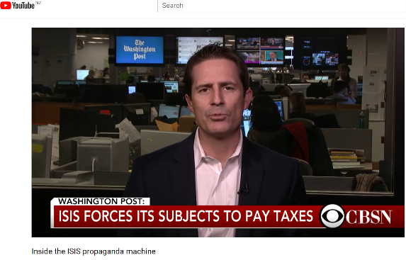
Why terrorists use the web/social media isis as a case study
ISIS developed a three-level media/propaganda machine. Internet key, though other media also exploited
Central level via al Hayat, al-Furqan, al-Itisam and Ajnad media units produces output on major events and for transnational audiences
Provincial level targets regional and local audiences with localised issues and events. Not always via digital channels
Support base amplifies official and unofficial ISIS’s communiques. This is a key level for ISIS

Slide 13
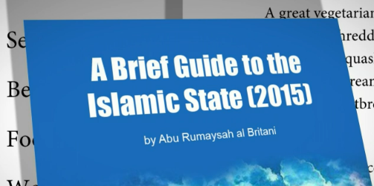
Why terrorists use the web/social media isis as a case study
Diversity crucial in maximising the relevance of ISIS’e media/propaganda campaign. Diversity entails different messages, different languages, and different cultural frames
Messages broadly followed two broad typologies: (1) horrific violence and (2) nirvana to be achieved under the Caliphate. Aimed at different audiences
ISIS strived to produce media packages that were language and cultural specific

Slide 14
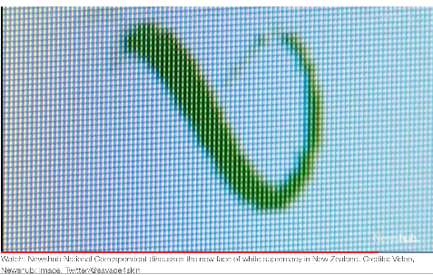
Why terrorists use the web/social media DATA MINING, networking, coordinatiNG
Surface, Deep and Dark Web have become a vast digital library useful especially for lonewolf and homegrown terrorists
Internet lets terrorists and terrorist groups communicate and coordinate their activities effectively
‘ProtonMail’, ‘Gab’, ‘4chan’ and ‘8chan’ increasingly influential especially for Far-Right groups

Slide 15
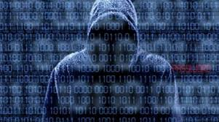
CYBERTERRORISM

Slide 16
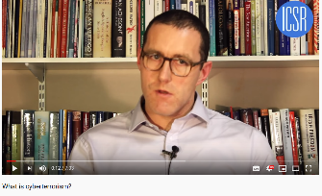
cyberterrorism
Many definitions, though they broadly follow the debate on ‘terrorism’
Cyber terrorists may have the same political, ideological and religious objectives as ‘traditional’ terrorists, but they behave and work differently
Cyberterrorism potentially attractive due to lower costs; prospect of anonymity; wider selection of available targets; the ability to conduct attacks remotely; and, the potential for multiple casualties
Experts divided on how ‘real’ a threat it is

Slide 17
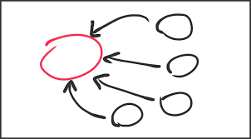
Conclusion
Terrorists use different layers of the web for different reasons
Surface web particularly relevant for propaganda, self-reporting and countering media-monopoly. Deep and Dark web sought for illegal activities, networking, planning, coordinating etc.
Non-mainstream social media platform growing in influence
Cyberterrorism still a possible, rather than real, threat

