Slide 1
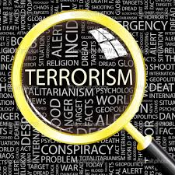
Terrorism
Dr Fabio Scarpello
Week 11
Can states be terrorists?

Slide 2
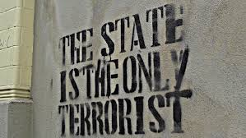
aims
Reflect on the political and policymaking implications of including states as possible perpetrators of terrorism
Critically think about how states may be involved in terrorism

Slide 3
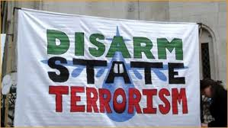
outline
Can states be terrorist? The debate
Domestic and international state terrorism
State terrorism during wartime
State-sponsored terroris

Slide 4
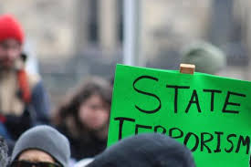
‘STATE TERRORISM’
THE DEBATE

Slide 5
‘state terrorism’ THE DEBATE
Definition and legal ‘right’ to use violence
Sceptics
A form of political violence practiced solely by non-state actors. Definitions are clear
The state has the legal right to use violence
Proponents
Definitions are convenient, biased and against scholarly/analytical principles
This right is highly circumscribed and needs to be kept in check

Slide 6
‘state terrorism’ THE DEBATE
The nature of the ‘chosen’ victims
Sceptics
State repressive violence different since victims are not randomly chosen. Terrorist engage in random acts of violence
Proponents
This is factually incorrect
Terrorism defined by the instrumental use of victims to send a message
States cannot eliminate all of their opponents. Victims are randomly chosen among these
States both eliminate opponents and send message

Slide 7
‘state terrorism’ THE DEBATE
The question of publicity
Sceptics
State agents do not seek publicity, unlike non-state terrorists
Proponents
This argument mistakes publicity for communication
State terrorism ‘communicates’ too

Slide 8
‘state terrorism’ THE DEBATE
Crimes committed by the state already covered
Sceptics
What called ‘state terrorism’ already circumscribed in international law under ‘repression’, ‘human rights abuse’ and ‘genocide’
Proponents
The same applies to non-state terrorism circumscribed in law under ‘crime’. They can be both
The argument neglects the political nature of terrorism. The label ‘terrorism’ underlines that
Acts of terror need to be analyzed with consistence, regardless of the actors involved

Slide 9
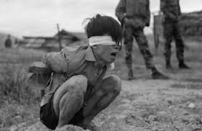
DOMESTIC AND INTERNATIONAL STATE TERRORISM

Slide 10
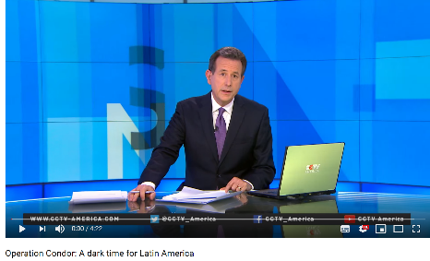
DOMESTIC state terrorism
Involves disappearances, illegal detention, torture and assassinations against a state’s own citizens
History of modern terrorism started with domestic state terrorism. Many contemporary examples of ‘state terrorism’ to spread fear and make political opposition impossible*
Can be carried out directly by state agents or indirectly by paramilitaries and vigilante groups*
The domestic-international state terrorism divide is at times blurred. ‘Operation Condor’ good example

Slide 11
International state terrorism
Involves targeted assassinations, kidnapping and bombings against targets in foreign countries
Can be direct or indirect
The motives can be the pursuit of domestic political objectives or foreign policy objectives.Foreign policy objectives may shift over time. ‘Operation Gladio’ good example
International state terrorism remains a prominent form of political violence*

Slide 12
International state terrorism The case of Israel
Mossad carried out at least 23 ‘targeted killings’ operations between 1972-2019
Most targets were Palestinians. The "Wrath of God“ lasted over twenty years
Israel justifies legality with the concept of “armed conflict, short of war”
Some argue targeted killings fulfil the criteria of acts of terror

Slide 13
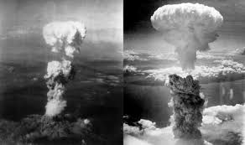
STATE TERRORISM DURING WAR

Slide 14
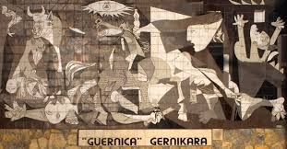
State terrorism during war
Aimed at destabilizing whole societies. It does not exclude war crimes
It includes acts of war that violate the Geneva Convention, such as torture and killing of disarmed enemy combatants, illegal targeting of civilians and disproportionate military response*
Terrorizing civilians has long been part of warfare. Many recent examples*

Slide 15
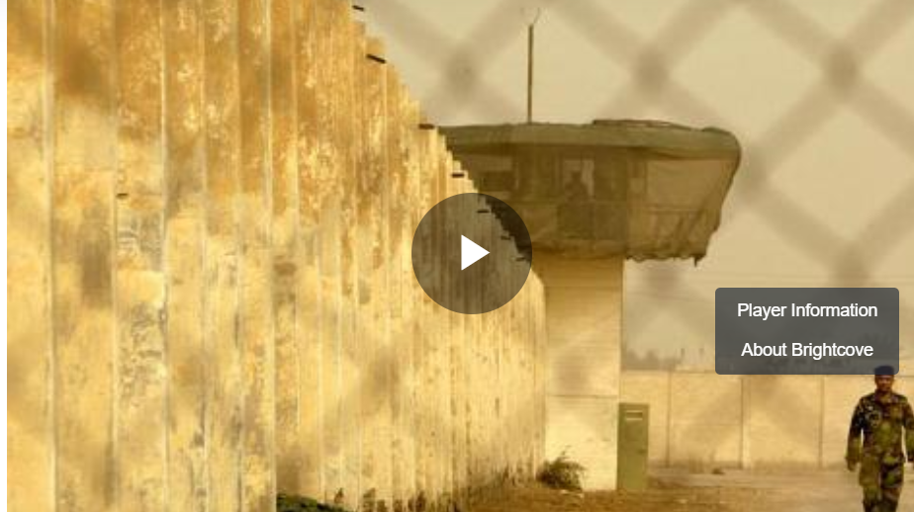
The case of the united states Torture, abductions and indefinite detention
US guilty of systematic torture of detainees suspected of terrorism (HRW 2011).* Abu Ghraib main example
Many ‘black sites’ in friendly countries. Guantanamo Bay still operative
Proponents argue measures necessary to counter al-Qaeda
Critics argue they amount to human rights abuse. Some content the policy fulfils criteria of state terrorism
Abu Ghraib: A justice denied (Al Jazeera)

Slide 16
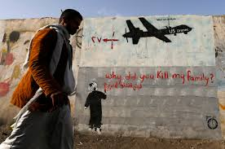
the case of the united states targeted killings and the drone program
Key policy post-9/11. Drone main component
Implemented in Afghanistan and Iraq wars and in counterterrorism efforts in Pakistan, Yemen, Somalia
Bipartisan approach. Bush started it, Obama and Trump escalated it*
Outcome partly secretive. Substantial civilian dead ascertained, though number contested*
Critics say psychological effects on civilians dire. Program fulfils criteria of state terrorism

Slide 17
STATE-SPONSORED TERRORISM

Slide 18
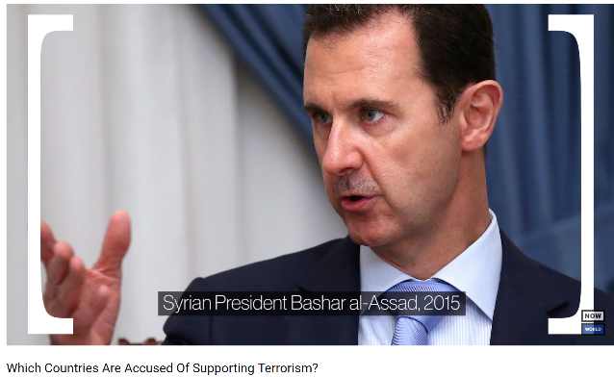
State-sponsored terrorism
It generally implies countries that train, fund and control domestic groups involved in terrorism in another country
US annual state sponsors of terrorism list
This logic of ‘sponsorship’ implies that if a country withdraws support, the terrorist group collapses. Hence political-economic pressure on sponsors
The list is seen as problematic, politicised and analytically limited*

Slide 19
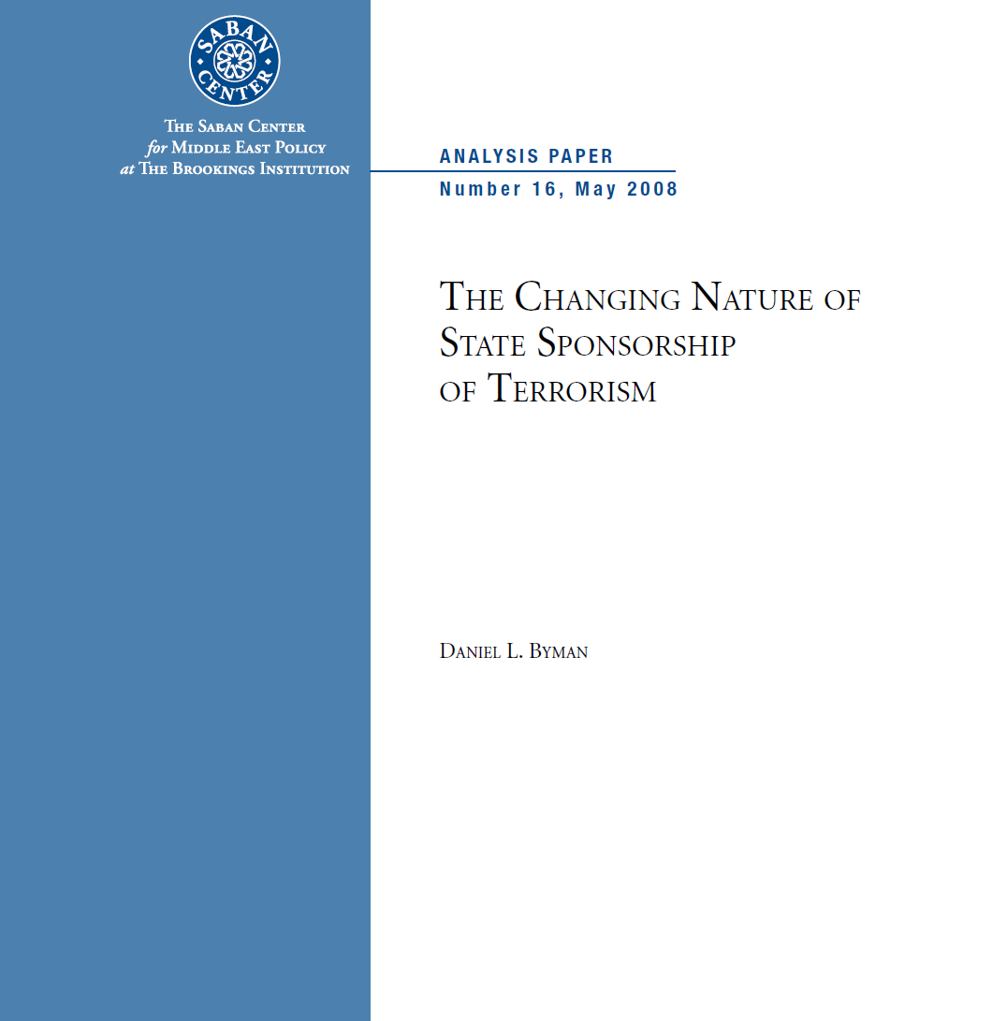
State-sponsored terrorism Byman’s framework
Active sponsorship
‘Control’, ‘Coordination’ and ‘Contact’
Passive sponsorship
‘Knowing toleration’, ‘Unconcern’ or ignorance’ and ‘Incapacity’
State variations
‘Government’, ‘Independent bureaucracies’ and ‘Key social actors’

Slide 20
State-sponsored terrorism the case of Pakistan
Government supports terrorist groups active in Kashmir and the Taliban in Afghanistan*
State-affiliated non-state actors, such as Jamiat Ulema-e-Islami of Fazlur Rehman (JUI-F) very active in supporting jihadism*
Inter-Services Intelligence (ISI) supports jihadi groups with relative autonomy*
Broad network of Islamic school bread extremism and anti-Western feelings*
Talibanisation of Pakistan increased anti-government jihadism. Islamabad unable to stop it

Slide 21
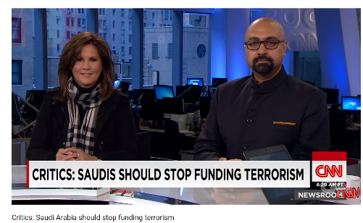
State-sponsored terrorism the case of Saudi Arabia
Since al-Qaeda’s May 2003 attacks in Riyadh, Saudi Arabia (SA) opposed al-Qaeda at home but tolerated its operations abroad. Saudi’s pro-al-Qaeda societal forces important factor in balancing act
SA still major fundraiser for global jihadism
SA still key source of jihadist fighters
Saudi clerics still source of of anti-Shia and anti-Western propaganda

Slide 22
Conclusion
The debate on whether states can be terrorists remain open with objections based on definitional issues, the state right to use violence, and the difference between how state and non-state terrorist commit violence and seek publicity
Proponents argue states have historically been the main perpetrator of terrorism whether against their own people or against other countries directly, indirectly or via various type of state-sponsoring
If ‘terrorism’ is seen as a non-normative, non-political analytical term, liberal democracies such as the United States, England, France etc. can be seen as perpetrators too

