Slide 1
Terrorism
Dr Fabio Scarpello
Week 12
Quiz, feedback, recap

Slide 2
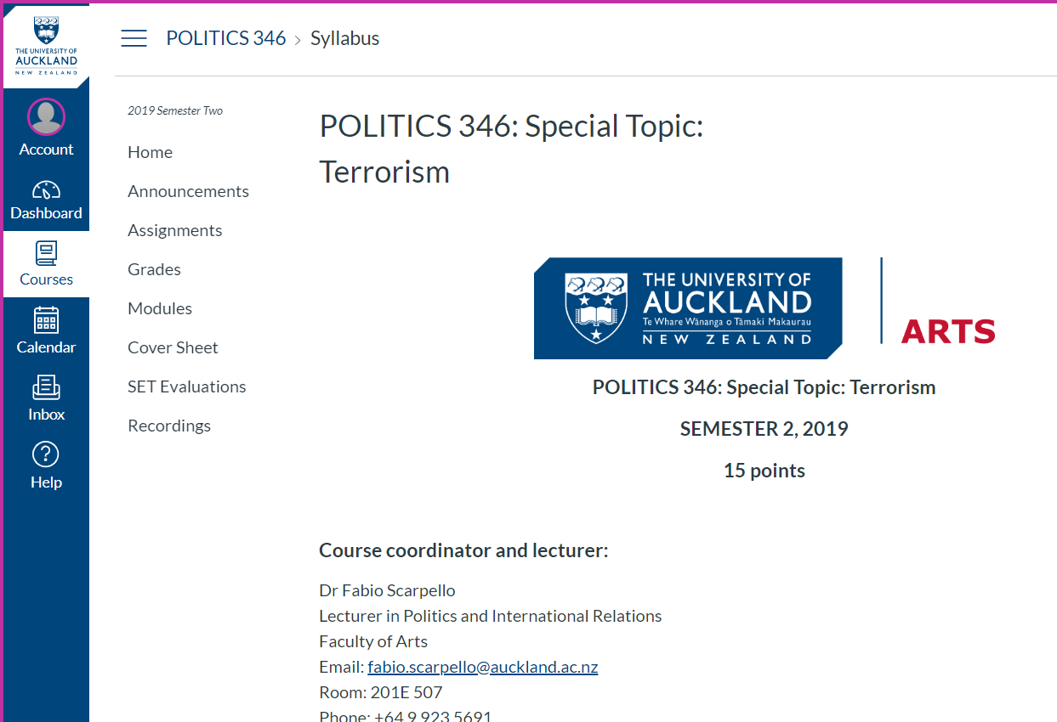

Slide 3
A social construct is something that exists not in objective reality, but as a result of human interaction. It exists because humans agree that it exists*
About the exam

Slide 4
Exam
Students must answer TWO essay questions from the list of five possible questions provided on the next page. All questions are worth equal marks.
Please allocate approximately 50 – 55 minutes per question. Your response to the question should be structured, coherent and written clearly in an essay format. Please ensure your essays are written in clear and easy to read handwriting.
Exam answers do not need to follow an academic referencing style, although students are encouraged to refer to scholars in the explanations.
Essay planning notes written on the exam paper are not assessed

Slide 5
Exam tips
Essay questions will NOT replicate the questions of the Positions Papers
Most essay questions focus on topics discussed since the Position Papers
Essay questions to assess your knowledge of what studied (literature, concepts, empirical facts etc.) analytical skills (implications of concepts, empirical facts etc.). Hence, knowledge and analysis over personal view
Showcase your knowledge. Use the correct terminology when possible. Refer to concepts and theories when possible even if not specifically related to the topic.
Criteria for assessment of exam: (1) how it answers the question (2) content and level of analysis , (2) structure and quality of writing

Slide 6
How to write a good essay
Analytical engagement
Structure
Content
Don’t just provide relevant information related to the question, but answer it!
Engage analytically with the literature/concepts etc.
Structure it properly

Slide 7
Answer the question
Make sure you understand the question before you begin
What are the instructive words in the question?
What does the question ask you to do?
Make sure you actually answer the question

Slide 8
analytical writing
Descriptive
Analytical
Only describes history, theory and events
e.g. a police report or testimony
Describes and evaluates history, theory and events
Academic work should always evaluate analytically and critically

Slide 9
Analytical writing
Analytical engagement
How do the various strand of the literature agree?
How do they differ?
How does this matter?
What are the implication of specific concepts/theories?
Why do they matter?

Slide 10
How to write a good essay structure (1)
Introduction
Main body
Conclusion
Say what you’re going to do, why and how!
Say that you’ve done and why you’ve done it!
Set out your problem and your argument
Do it!
Write clearly with subheadings
10 % of the WC
Make sure argument follows logically, i.e. are my points in the right order?
Restate your argument and why it matters with new words
Do not include a new concept/topic
Answer the question!
80% of WC
10 % of the WC
Then e.g. “this essay argues…”, “the first part…”, “the second part…”, “the third part…”, “the essay concludes that…”
Summarize but don’t be repetitive

Slide 11
How to write a good essay structure (2)
Always plan your essay before you begin. It’s possible you change your mind, then just change the plan.
Deal with one issue per paragraph and use 2-3 subheadings
Signpost to the reader: ‘Firstly’, ‘Having discussed…’, ‘before turning to’
Take the reader by the hand and show them what you want them to see.
Remember: We’re not in your head and we don’t know who we’re marking. Show, don’t tell! Examples are good!!!!!

Slide 12
A social construct is something that exists not in objective reality, but as a result of human interaction. It exists because humans agree that it exists*
Theoretical and analytical section

Slide 13
CONCEPTS social construct
Social construct. Something that exists not in objective reality, but as a result of human interaction. It exists because humans agree that it exists
Terrorism as a social construct. What constitutes terrorism and who is a terrorist is often a matter of subjective interpretations based on the social relations individuals are embedded within
Gender as a social construct. Gender is the assignment of masculine and feminine characteristics to bodies in cultural contexts

Slide 14
Other key CONCEPTS
Intersectionality. It refers to how one’s identities— such as race, gender, class, age, disability, and religion—interact, or “intersect”, and produce specific life experiences
Agenda setting. Editorial, top-down decisions about what media covers or does not cover. It is often ideological
Media framing. Journalist, bottom-up decision on how to cover a specific issue. It often ideological or strongly affected by the local understanding of terrorism

Slide 15
Theories of terrorism causation
Socioeconomic. Relative deprivation denotes tension between the ‘ought’ and the ‘is’ that dispose men to violence
Demographic. he youth bulge leads to political violence as the "third and fourth sons" find no prestigious positions in societies
Cultural and identity. Sectarian differences may lead to conflict between groups
Political. Political transformation may create the conditions for violence and, global political economy inequalities may lead to violence
Psychological. Terrorism linked to mental illness of life experiences
Sociological. Peer/family ties and revenge good indicators of who is likely to join terrorist groups

Slide 16
Other terrorism-related theories
Politics of labelling. Explains how uneven power relations bestow on some the power to label what terrorism is and who the terrorists are
Radicalization. Explains a process by which an individual or group comes to adopt increasingly
extreme political, social, or religious ideals and aspirations and may be triggered into violence
Social movement. Explains how large informal groupings of individuals or organizations that share an ideology and a broad political aim operate in order to carry out, resist or undo social change

Slide 17
Key Analytical terms/frameworks
Terrorism as an analytical term. It is politically motivated violence, or the threat of it, aimed at affecting an audience beyond the immediate victims
Byman’s state-sponsored terrorism framework. It analyses state-sponsor terrorism through the lens of active, passive and various form of state variations

Slide 18
A social construct is something that exists not in objective reality, but as a result of human interaction. It exists because humans agree that it exists*
Terrorism today

Slide 19
Main terrorist movements Threat to western way of life?
Salafi Jihadi
Salafi-jihadist ideology
Aims to establish a transnational caliphate
Primary and secondary strategy. Violence is the key
Led by Al-Qaeda and ISIS. It includes associated groups and homegrown terrorists
Major threat in Middle East and Africa. Relative low threat to West
Far-Right
Nativist ideology
Aims to establish nation-based ethnocracies
Strategies include political and societal engagement and violence
No leading organizations. Includes politicians, CSOs, intelligentsia, violent groups and lonewolf. Make-up changes from place to place’
Major threat to ‘Western way of life’

Slide 20
Terrorism-related current issues
Women role in terrorism. Not too different from men: politically motivated and ideological driven. Perception different due to gender stereotypes
Funding. Crucial for terrorist groups and accessed via public support, criminal activities, legal activities or state-sponsoring. Crime-terror nexus conceptually different than legal activities and potentially influential
Web and terrorists. Important for propaganda, recruitment, data mining, networking etc. Cyberterrorism potentially appealing for terrorists, but requires high level of skills. Experts divided on how ‘real’ a threat is
States and terrorism. Ongoing debate. Various forms of state terrorism (domestic, international and state sponsor) either directly or indirectly

Slide 21
A social construct is something that exists not in objective reality, but as a result of human interaction. It exists because humans agree that it exists*
Aims, objectives and learning outcomes

Slide 22
Aims and objectives
By the end of the course students will gain:
Broad knowledge of some of the main issue related to terrorism.
An understanding of what terrorism is, who is involved, why, how and in what way.
Broad knowledge of the role of women in terrorism.
Broad knowledge of the main terrorist groups and movements and how they operate.
An understanding of the threat posed to terrorism.

Slide 23
Learning outcomes
On successful completion of the course, students will have developed:
The ability to critically discuss several issues related to terrorism.
The ability to critically engage with the role of gender in terrorism studies.
A critical understanding of the various source of terrorist financing.
A critical understanding of the multilayered role of the internet for terrorists.

Slide 24
Q and A

