Slide 1
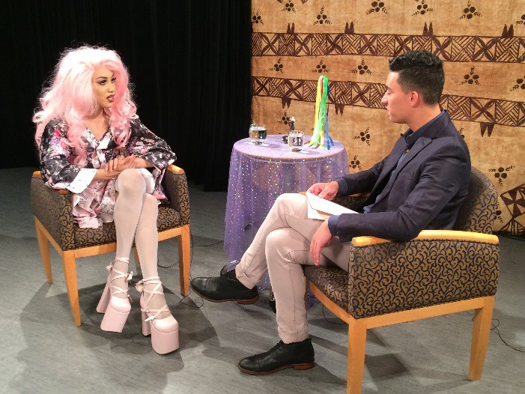
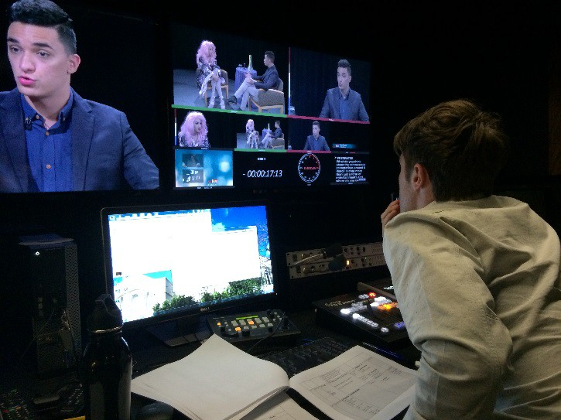
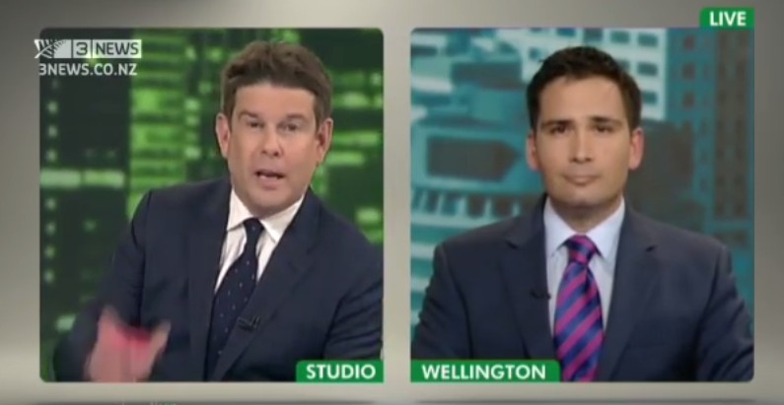
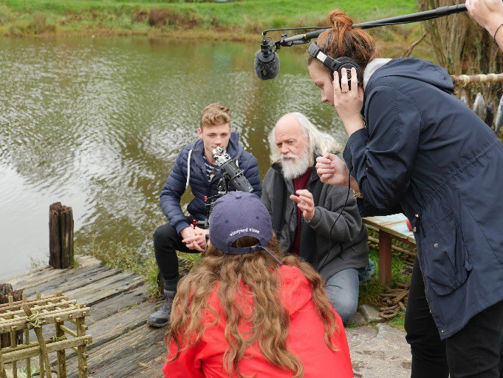
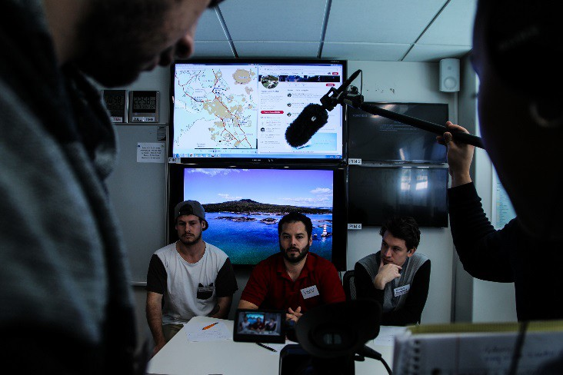
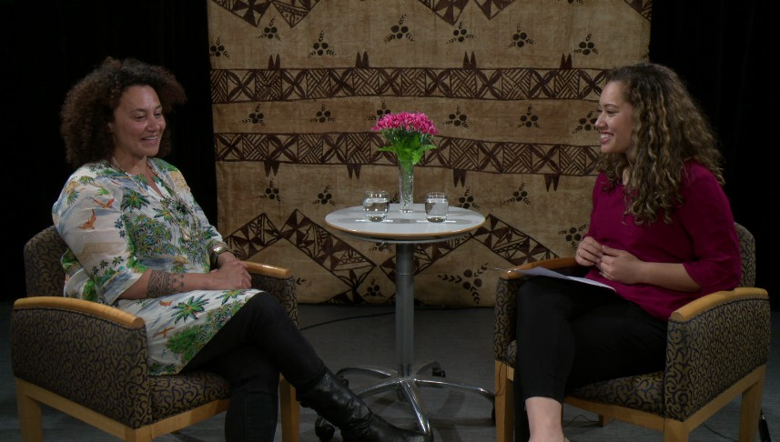
The Media Interview
& how to write a news story

Slide 2
The interview- lecture content
The importance of Sources for journalists How to approach people
Who do you approach Issues of verification
Balance Question lines
How to conduct interviews The Press Release
How to write an article coming out of a Press Release and an interview

Slide 3
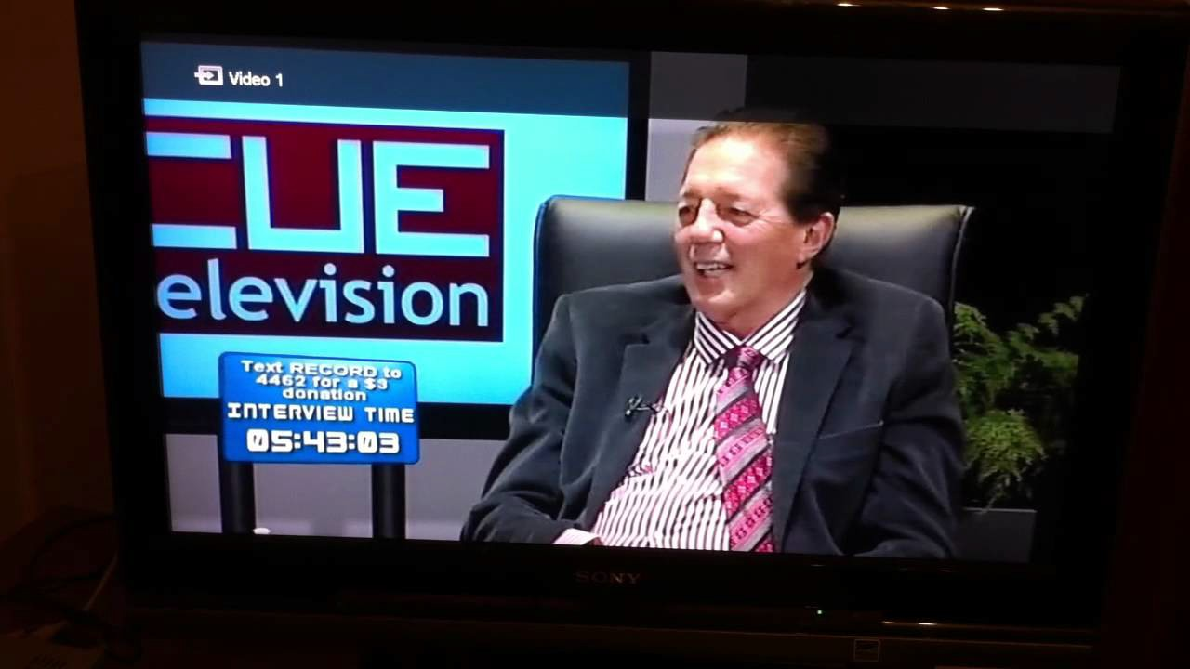
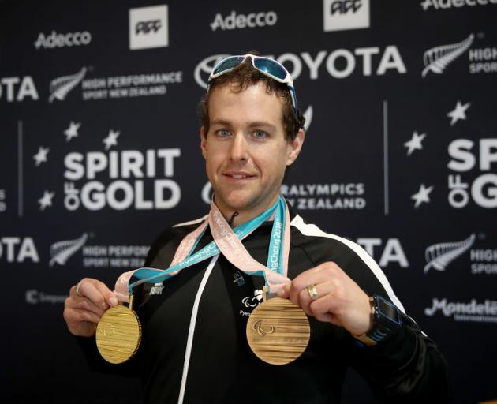
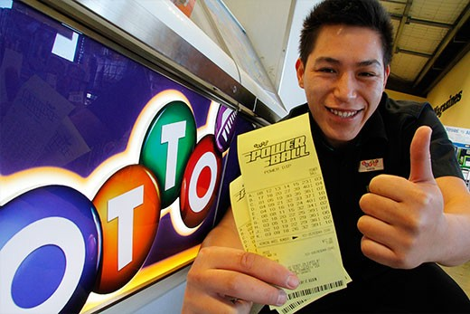
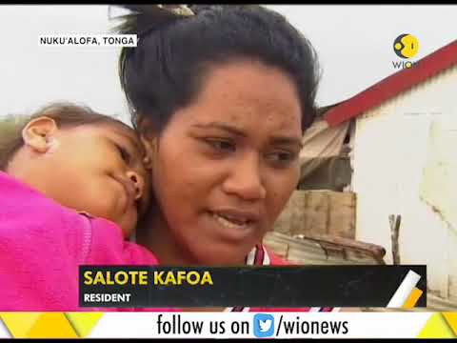
Sources
News comes from people because:
Of their job (official spokesperson or expert)
Of what they have accomplished
They are a witness to something important happening
Something important has happened to them
They know someone or something important
They are representative of a trend, idea, opinion, particular perspective
Give journalists tip-offs
  They provide journalists with quotes or soundbites for their story
Journalists have a CONTACTS LIST and do a ‘ring around’ to track down background and interviewees for a story, or sniff out a story.

Slide 4
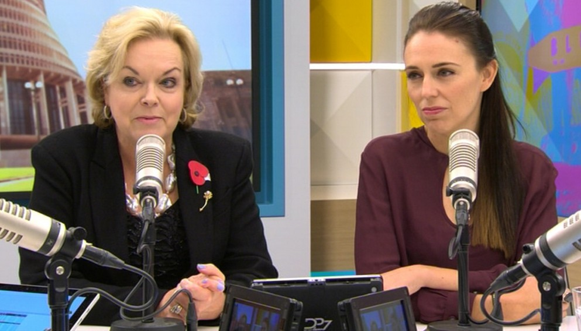
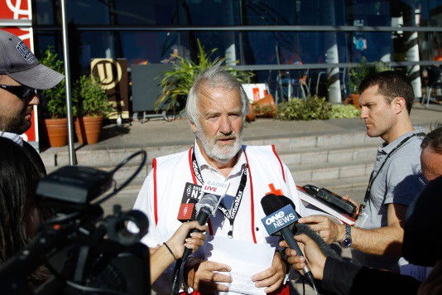
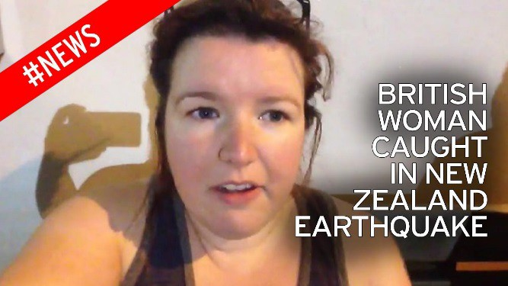
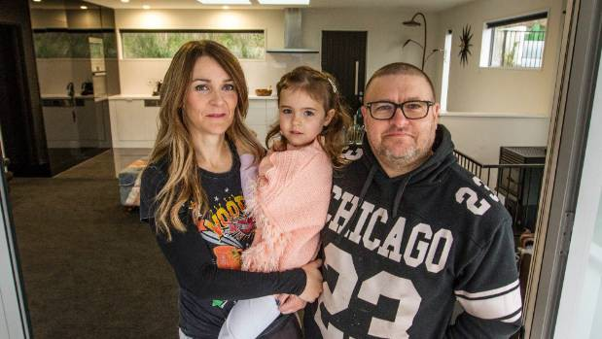
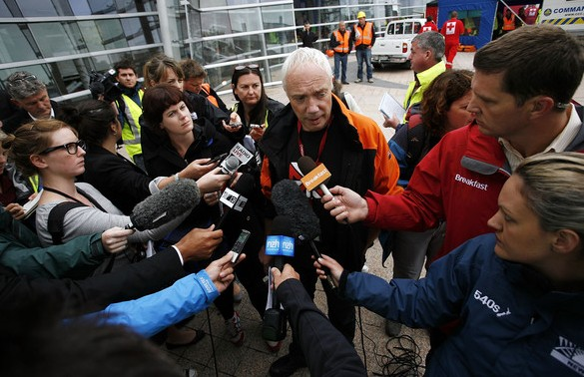
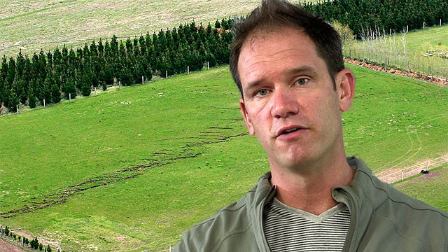
Sources (‘talent’)
Journalists adapt their interviewing style according to their source.
BUT must talk to everyone with respect and courtesy.
Main Source groups:
Politicians and CEOs
Experts
Celebrities/Sport Stars
The Innocents
Criminals
Children

Slide 5
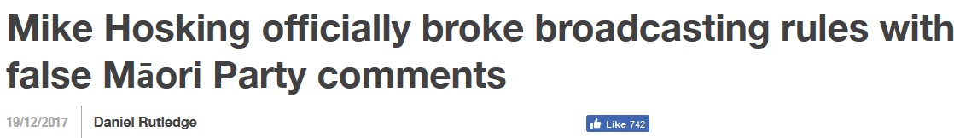
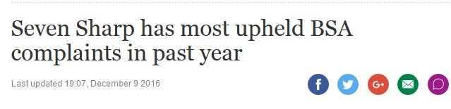
Balance
NZ Radio and TV Broadcasting Standards (BSA)
When discussing controversial issues of public importance in news, current affairs or factual
programmes, broadcasters should make reasonable efforts, or give reasonable opportunities, to present significant points of view either in the same programme or in other programmes within the
period of current interest.
Guidelines
4a No set formula can be advanced for the allocation of time to interested parties on controversial
issues of public importance. Significant viewpoints should be presented fairly in the context of
the programme. This can only be done by judging each case on its merits.
4b The assessment of whether a reasonable range of views had been presented take account of
some or all of the following:
• the programme introduction;
whether the programme approaches a topic from a particular perspective (e.g. authorial
•
documentaries, public access and advocacy programmes);
whether viewers could reasonably be expected to be aware of views expressed in other
coverage.
The purpose of this Practice Note is to provide guidance to complainants and broadcasters about the
way these standards have been interpreted by the BSA with respect to television programmes.

Slide 6

Day & Moss and NZME Radio Ltd - 2018-090 (2 April 2019)
Two complaints about Heather du Plessis-Allan’s use of the term ‘leeches’ to describe the Pacific Islands during Wellington
Mornings with Heather du Plessis-Allan were upheld, under both the good taste and decency and discrimination and denigration standards. The Authority recognised the important role talkback radio plays in fostering open discourse and debate in society. However, the Authority found Ms du Plessis-Allan’s comments went beyond what is acceptable in a talkback environment, considering the use of language that was inflammatory, devalued the reputation of Pasifika people within New Zealand and had the potential to cause widespread offence and distress.
Upheld: Good Taste and Decency, Discrimination and Denigration
Not Upheld: Children’s Interests, Law and Order, Balance, Accuracy, Fairness
Orders: Section 13(1)(a) broadcast statement; Section16(4) – $3,000 costs to the Crown
Chapple and Television New Zealand Ltd - 2018-064 (26 February 2019)
The Authority has not upheld a complaint that an episode of Sunday, which investigated gay conversion therapy in New Zealand, was unbalanced and inaccurate. The Authority found the existence of differing viewpoints was pointed to throughout the programme, with balancing comments provided by those featured and in final comments from the presenter. The broadcaster made reasonable efforts to ensure the accuracy of the programme, relying on authoritative medical opinion from health experts regarding current views on gay conversion therapy and the potential harm that could be caused by the practice. In making these findings, the Authority recognised the high public interest in this story and found that upholding the complaint would represent an unjustified and unreasonable limit on the broadcaster’s right to freedom of expression.
Not Upheld: Balance, Accuracy

Slide 7
Why interview?
“In journalism, quotes – or the lack of them- can make or break a story” (Paterno & Stein 2001)
1) They provide credible ‘from the source’ information and/or opinion 2)
3)
4)
5)
6)
7)
8)
9)
Hold public figures to account in a live situation – not through a press release spun by PR experts – function of
democracy
Seeing or hearing the interview subject allows the public to make their own judgements about who they are and what
they represent
Can give a story scope, depth, veracity, emotion, humour, colour
Generate information through a story-related party and not just the journalist Provide a range of quotes around which you can shape your story
Add personality and colour and credibility to your writing
Give credibility to the opinion of the ‘person in the street’ Ask questions the public would like to ask themselves
BBC journalism skills: Interview Techniques https://www.youtube.com/watch?v=dHUn6zSGEJ8
"An engaging interview is essentially a good conversation”. Peter Allen BBC

Slide 8
How to prepare
Try not to interview too early – be very clear in your own head why you need this interview and what
information you are going to generate out of it.
Make sure you clarify your story and your angle (how the story is framed)
Consider if you need to interview someone else who has an opposing view or different perspective.
Make sure you have done your background research not just on your topic but on the person you have selected to interview.
Never go into the interview without completing your background research – make sure it is up to date!
Organise your questions into logical sections of information to help give your interview structure

Slide 9
How to prepare cont.
Think about your location and evaluate for distractions and sound quality ie. cafes are usually very poor locations for an interview.
Ask if you can record the interview and make it clear when you start to
record and finish recording. (on the record and off the record – be clear if off record)
Stipulate the length of time for the interview – and stick to it if you can.
Do not rely on your memory or try to take full notes during the
interview – you often lose your connection with your subject if you are scribbling notes, just note the basic info and key points.
Explain the purpose of the interview – why them, what for, how is their material to be used, publication/privacy etc.
Confirm that you can contact them later with a few follow up questions
or clarifications by phone or email.

Slide 10
Starting the interview
Give them an overview of your story, angle and why you are interviewing them.
DON’T give them the questions ahead of time or you will get well rehearsed answers
Start recording
Introduce them at the start of the recording : “I am interviewing Jacinda Ardern, the Labour Prime Minister of New Zealand, on 28 March 2017”. You can check with them that you have got their title correct which is how you will reference them in your writing.
Make sure you label your recording at the time of the interview and double check you have the spelling and details correct.
Then, ask your first question which should be factual ie. confirming their title descriptor, confirming their role or position of authority or expertise.
Don’t ask them for their working history etc they may never stop talking.

Slide 11
Questions
There are only variations of six basic questions. Who? What? Where? When? Why? How?
Should be open ended “can you tell me about..” “one way of looking at this issue is …how would you respond to that perspective?..”
Avoid phrasing your question so it could convey your personal pre-determined point of view.
Shorter questions are better than longer – be concise
Ask questions one at a time – don’t lump a number of questions together
Use clear language – don’t over complicate your language. You can get a complex response from a simply phrased
question.
Ask the important question early in the interview – only ask the tough one first unless they are an official/media trained.
Don’t use more than 3 or 4 questions on one topic – start on a new tack, rephrase or come back to it later.
Thank them courteously at the end (even if you don’t really feel like it!)

Slide 12
During the interview
Maintain strong eye contact as much as you can
think about your body language and how you give feedback during and at the end of responses
Remain politically and emotionally neutral but engaged and interested
Give time for the subject’s response – sometimes pause – don’t leap in as soon as it appears they have finished talking.
Ask follow up questions to drill down to a deeper level or to craft a more succinct response (great to use for quotes in your work).
Check you are still recording a few times during the interview
Signal if you have finished one topic area and are starting on another. You can
ask if they have anything more to add before you change the topic focus for the next set of questions.
Take a few notes during interview (more relevant in a field interview – but not easy to do).

Slide 13
Do not lose control of the interview
Don’t let the subject become side-tracked into an area which is off topic for your research.
This may happen because of your poorly worded questions.
Or it may happen because you feel too embarrassed to interrupt.
It is totally acceptable to interrupt and bring the interview back on topic or clarify a particularly point.
Practice how to interrupt and redirect the discussion – use your body
language and phrases such as: “I am sorry to interrupt but could we just go back to your earlier point…”
In your briefing to your subject before the interview starts you can explain
that you may have to do this to keep the discussion within the parameters of your research topic.

Slide 14
After the interview
Check that they have nothing more to add or additional thoughts on some of the key points discussed before you turn off your recorder.
Check your recording to make sure it happened.
Double check your labelling and spelling of names and titles.
Write down any observations you may have had during the interview about what was said, how it was said, manner, tone etc.
Make sure the subject has your contacts as they may think of additional responses or want to retract or refine the way they expressed something.
Transcribe your interview as soon afterwards as possible. The longer you
leave it the harder it becomes. This is usually done on the run if you are a journalist.
  NEVER use a quote out of context – that is dishonest
    Don’t use ‘off the record’ quotes- that is dishonest

Slide 15
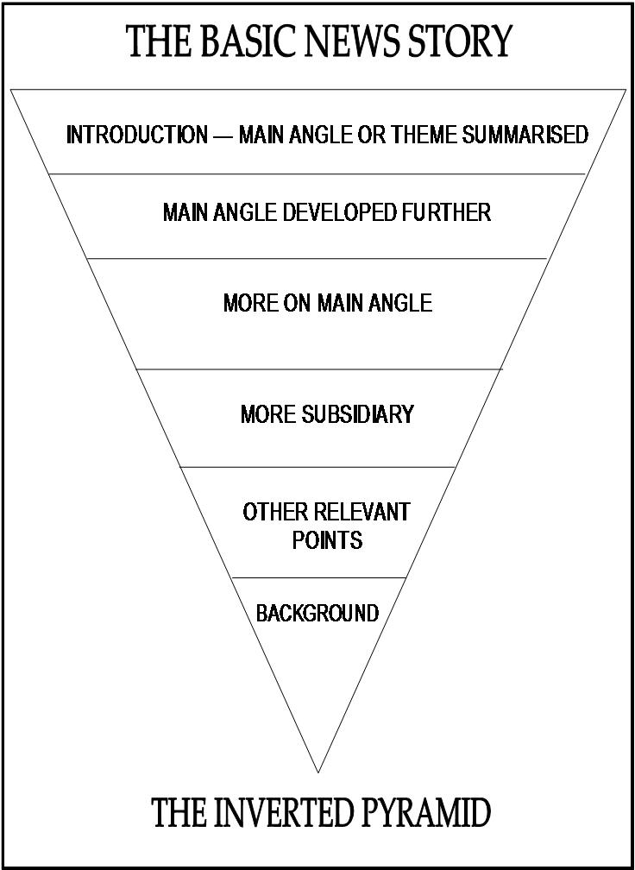
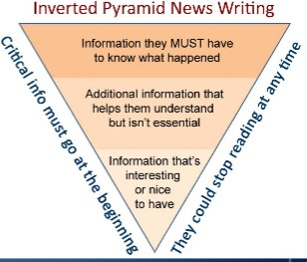
h

Slide 16
Write a short, catchy headline
Keep it short – 7-8 words max
Headlines need to be succinct, short and snappy.
Use vivid, simple and active language
The headline should provide a basic image of the content of the article.
Use present tense so it’s newsy.
(Can use future tense if that is relevant – just as catchy and effective)
Central Function: is to attract the reader

Slide 17
Use the inverted pyramid to structure a press article of 4-5 sentences
NEED TO HAVE:
What has happened?
Where did it happen?
When did it happen?
Who was involved?
How did it happen?
Why did it happen?
What does it mean?
This enables you to present the most important information first.
This formula means the article does not need to be edited but can be shortened by
cutting from the bottom paragraph upwards.

Slide 18
The Fog Index
(readability test for English writing)
The Gunning Fog Index is about sentence length. Based on an observation of the pattern of attention given by readers to printed material, it suggests that the longer a sentence, the thicker the fog which the reader has to get through to get to the message
8-10 word sentences are clear and easy to understand
10-15 word sentences are slightly less clear and easy to understand
15-25 word sentences can mean the fog is thickening
25+ can mean the sentence is impenetrable
Keep sentences short and concise. Break up longer sentences to maintain clarity.

Slide 19
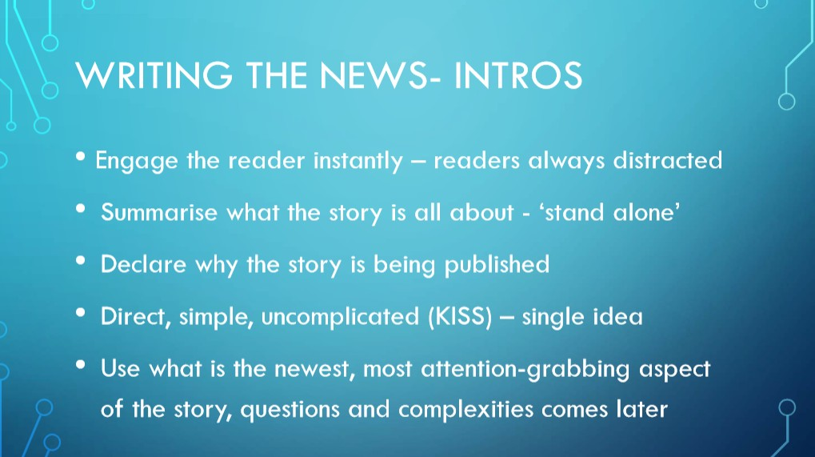

Slide 20
The Introduction
“This is the start of the story, the opening paragraph.
The traditional news introductory paragraph, still the dominant form, has two related purposes: to engage the reader instantly and to summarise what the story is all about.
The structure is known as the "inverted pyramid" and dates back to the days of hot metal when words on
their way on to paper passed through a stage of being slugs of lead. It was always easier and faster to cut a
story from the bottom, using a pair of tweezers.
News stories always have to be cut because reporters write them too long, and the (imperfect) theory was
that a well structured story could always be cut from the bottom so that in extremis (do not use - see later) if
the intro was the only paragraph left it still made sense.
The good intro depends on your judgment and decisiveness. It declares why the story is being published,
what is the newest, most interesting, most important, most significant, most attention-grabbing aspect of
the story.
It is not a summary of everything yet to come.
The best intro will contain a maximum of two or three facts, maybe only one. In a popular tabloid it will
consist of one sentence, probably no more than 25 words.
The worst intro will be uncertain of what the story is all about and will contain several ideas.
The best intro will demand that you read on.
The worst will make it likely that you will move on.”
https://gu.com/p/2x79n/sbl

Slide 21
Print News Stories
“News stories are about providing information, and there is nothing more
frustrating for the reader than finishing a story with unanswered questions still
hanging.
Journalism students are taught about the five Ws: who, what, when, where and
why. They are a useful tool to check you have covered all the bases, though not
all will always apply.
It is always difficult to detach yourself from your own prose when you read it
through, but try. Try to put yourself in the place of the reader coming cold to the
story, interested in it and asking the questions that will make it clear.
Have you dealt with them? The subeditor, or text editor, will soon tell you if you haven't.
There is always a problem over how much knowledge to assume, particularly
with a running story of which today's is another episode.
You cannot always start from the beginning for the benefit of reader recently
arrived from Mars, but you can include sufficient to ensure it is not meaningless.
It is a matter of judgement.”
https://gu.com/p/2x79n/sbl

Slide 22
Press Releases
Press releases are short, factual news stories written in the third person and given to the media to
encourage editors/journalists/broadcasters to feature the story in their publications and
programmes.
They can also be published on the originator’s website and in company magazines and newsletters.
In these instances, the style is often changed from the third to the first person.
Approximately 80% of newspaper news stories are generated by press releases
They should be crafted so they read the same way as a news story
The strategy is to get them published without being re-edited
(therefore give the journalists; facts, quotes from key
https://www.huffingtonpost.com/zach-cutler/press-release-tips_b_2120630.html

Slide 23
Writing a Press Release
Write a short, catchy headline.
Keep it short – 7-8 words max
Headlines need to be succinct, short and snappy.
Use vivid, simple and active language
The headline should provide a basic image of the content of the article.
Use present tense so it’s newsy.
(Can use future tense if that is relevant – just as catchy and effective)
Central Function: is to attract the reader

Slide 24
Don’ts for Media Releases
Don’t type your media release in capital letters.
Don’t type your media release in italics.
Don’t fail to proofread your release, (better still have it proofed by someone else).
Don’t use clichés.
Don’t use padding.
Don’t send it late.
Don’t send it to the wrong person.
Don’t use bold points to emphasise your point.
Don’t open quotation marks and forget to close them.

Slide 25
How to write a news story using a press release
Approach a press release the way you would approach food you’re about
to buy: examine it carefully to make sure it’s all there, and sniff it to make
sure it’s good. Be prepared to treat it as the starting point rather than simply a puzzle to reorganize—if time and price allow you that luxury
(Dearn 2014).
PR is usually written and reviewed by a team people.
Some of the facts in the release may be wrong or things have changed, or it is a narrow perspective on a topic/issue.
What information would your readers like to know, that is not in the Press
Release? Ask the politician those questions, which will be invaluable for writing your article.
These questions give you and information edge which means you are not just rehashing the press release in your own article.

Slide 26
What to look for in a Press Release
What is the key content/issue/political stance or opinion in the press release?
The heading and first paragraph should clearly indicate the central focus
Is there something in the press release that is:
newsworthy? Controversial?
Omits an opposing point of view or perspective? Warrants a follow up story?
Do the usual who, what , when, where, why checks:
Who authored the PR and what organisation does it represent?
What is the central issue, opinion, policy?
When did this event or piece of news take place?
Where is the event or news happening?
Why is this happening? Who is the target audience? What is the reasoning behind this event or news?

Slide 27
Key questions you could ask
(after you have carefully analysed the press release)
Clarification of any facts, figures which may be unclear, or clarify their source, relevancy, provenance, timing.
Are there counter facts/figures publically available which differ? Why could this be so?
Are there any glaring omissions or a subtle lack of full details available in the PR? What question could you ask which can politely reveal that lack of clarity, or confirm that no more information will be provided in that area.
Ask a question based on the central issue/argument coming out of the press release so you can get a direct quote from the spokesperson.

Slide 28
NEXT WEEK – NEWSWRITING EXERCISE
Newsmaker – David Seymour, ACT Party Leader and Epsom MP
Press release will be made available 24 hours before the press conference
David Seymour will conduct an online press conference via Zoom at 1 pm Monday May 11 – make sure you’re logged on to Zoom by 12.50 at the latest
Students will then ask him follow-up questions – submit via Zoom Q and A (text) first, then we’ll go to you in vision
You’ll then have 24 hours to write a 10-12 paragraph news story in a Word document and upload it to Canvas

Slide 29
NEXT WEEK – PRESS CONFERENCE
The press release will provide details on the ‘timely issue’ to be discussed at the press conference.
The presentation will last about 20 minutes and will provide more in-depth information about the ‘timely issue’.
Student question time: 10-15 mins – conducted as per media practice.
You can ask your questions based on the content of the press release and the Press Conference - submit these on the Q and A function in Zoom, and you'll then be called upon to put your question to David Seymour.

Slide 30
NEXT WEEK – PRESS CONFERENCE
Those who don’t ask questions should still listen carefully to assess whether newsworthy points are made and select information to add to your news article - take notes.
Your questions are based on the ‘timely issue’ outlined in the Press Release. However, as is journalistic practice, you can ask relevant questions outside the immediate issue discussed.
There is a chance too that the speaker will drop a 'bombshell' that could eclipse the timely issue that is discussed. For example, if there was a resignation pending, or an action about to take place, this could take the lead.

Slide 31
NEXT WEEK – PREPARATION
We don't know what the 'timely issue' will be, but in preparation, a journalist would do the following: a) familiarize themselves with what the portfolios are, and have been b) check what the former and present Government policies might be and any history of any relevant issues c) possibly gather in statistics (and their sources) if you are to shape questions on an issue.
A journalist would also revisit recent 'hot button' issues - for example. Although you can revisit older issues, make sure you do not ask a question that has been answered in the past. It is possible though you may discover an issue in the public interest that has never been satisfactorily been answered.

Slide 32
NEXT WEEK – WRITING THE NEWS ARTICLE
You are then required to write a news report (including a headline) following the inverted pyramid structure outlined in the lecture and reading for Week 7. We expect 200-250 words.
Write the report in a Word document, then upload it to Canvas in the same way as you did for the short essay.

Slide 33
NEXT WEEK – ASSESSMENT CRITERIA
Article written using the ‘inverted pyramid’ structure
Headline short, catchy and accurate
First sentence catchy, conveys story angle and can stand-alone
Angle clearly articulated
Article includes at least some if not all of the 5 x W’s and the H
Draws on information from Press Release and Press Conference and your research
Uses direct quotes
Uses clear concise sentence structure throughout
Factual information accurate, no spelling or grammar mistakes

